Slide 1


<Presenter’s Name>
GeoPose Summit
27 October 2025
GeoPose in other Standards

Slide 2
Rely on OGC’s Authoritative Geo Focus
GeoPose is a simple but precise way to locate and orient a space.
GeoPose is well-documented with easy conformance testing.
You can use it in your standard to avoid re-implementing the same concept.

Slide 3
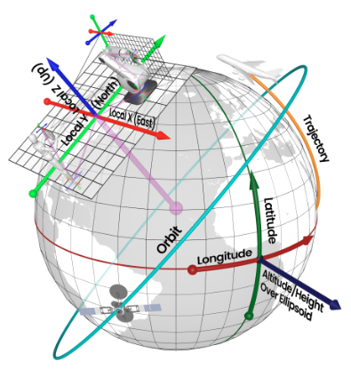
GeoPose in Other Standards
OGC GeoPose is built from modular components that can be used independently or combined to create complete representations of position and orientation.
This flexible design allows GeoPose to integrate seamlessly with other standards, making it a powerful tool for bridging systems and ensuring interoperability across diverse spatial applications.
By referencing GeoPose in a normative manner, other standards benefit from the well-defined framework of components.

Slide 4
Presenters
Alfred Tom, OMA3; [IWPS]
George Percivall, Spatial Web Foundation, percivall@ieee.org, On-site
  How the Spatial Web uses OGC GeoPose
  The Hyperspace Modeling Language (HSML) uses GeoPose to place and orient entities in spatial domains as required by the Spatial Web standard (IEEE Std 2874-2025)
Steve Smyth, OGC [Co-Chair GeoPose and CityGML SWGs], steve@opensiteplan.org, On-site.
  A Khronos glTF 2 Extension to GeoLocate, Orient, and Bound glTF Scenes
  Adding a small data object to a glTF scene enables collections of glTF Scenes to be merged in a single Eath reference frame.
Johannes Behr, Metaverse Standard Forum, 3D Web Interoperability Co-Chair, johannes.behr@threedy.io, REMOTE,
  A Web-of-Worlds API extension for exposing geographical poses in worlds and assets.
  A new schema for providing geoPose JSON data in OpenSpatialWorld and OpenSpatialAsset endpoints.

Slide 5
Questions/Comments/Suggestions?

Slide 6


THANK YOU
www.ogc.org
https://metaverse-standards.org/

