Slide 1
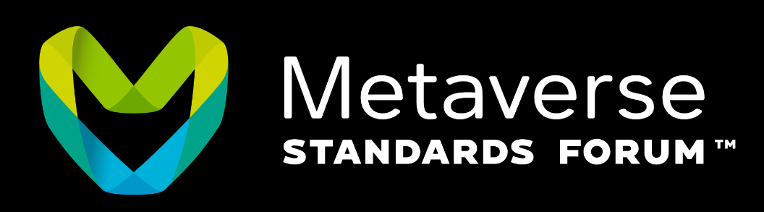
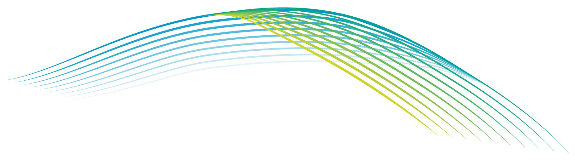
<Presenter’s Name>
GeoPose Summit
27 October 2025
Use Case: Point at the Sun, Here and Now

Slide 2
Example Packaging in an API
I am here now.
I want to stare at the sun.
I am blind but validated.

Slide 3
SolarPose
SolarPose is an early demo web service for solar GeoPose
The service provides sample GeoPoses of all types and includes a Swagger validator
SolarPose responds to HTTPS GET requests for examples of any of the JSON-encoded Standardization Targets, giving a single or sequence of GeoPoses for a specified latitude, longitude, and Unix time - default time "Now". It also responds to HTTPS POST requests to validate examples of any of the Standardization Targets. To see the OpenAPI/Swagger spec for the service, visit the SolarPose Swagger - OpenAPI UI.
The GeoPoses provided in the samples and in the validator are the pose of a camera or other body located at the anchor location of the GeoPose and oriented toward the current direction of the sun. Before applying the yaw, pitch, and roll angle rotations the camera is aligned with the axes of the outer reference frame. The first angle (yaw) is the rotation about the z axis: the horizontal direction of the Sun. The second angle (pitch) is the rotation about the (once rotated) y axis: the elevation of the Sun above the horizon. If the second angle is positive, then it is daytime. Otherwise it is night. The third angle (roll) is the rotation about the (twice rotated) z axis. It is always zero because the camera is (arbitrarily) kept horizontal with respect to the tangent plane. The samples in sequences are at successive times: now, 10 seconds in the future, and 20 seconds in the future.
This service can also be used to validate the specifications and instances in the JSON encodings in the GeoPose standard.

Slide 4
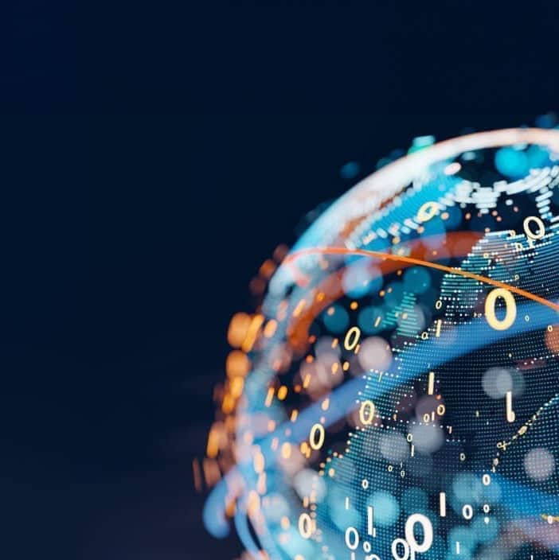

THANK YOU
www.ogc.org
https://metaverse-standards.org/

