Slide 1


Steve Smyth
GeoPose Summit
27 October 2025
Steve’s GeoPose Intro

Slide 2
Some Context
Where we are.
What comes next.
GeoPose links spatial content.

Slide 3
Before We Start
GeoPose arrived at OGC in 2021 with some design principles beyond simple computation-friendly representation:
The ability to attach to an Earth coordinate system compatible with mass market positioning and orientation sensors.
The ability to support local idiomatic approaches to defining a coordinate system tied to some maintaining organization and expressed in a formal but perhaps domain-specific manner. Much inspiration came from the NASA Spice system.
The desirability to have some expression in the serialized form that humans could read and interpret with their own brains.
A key use case was the integration of content from multiple sources in an application’s single reference frame. Some sources might be sensed elements of the physical world and others might be virtual, positioned with respect to the physical world. In short, Augmented Reality.
It’s a simple idea that gains value in enabling the interoperation of complex parts.

Slide 4
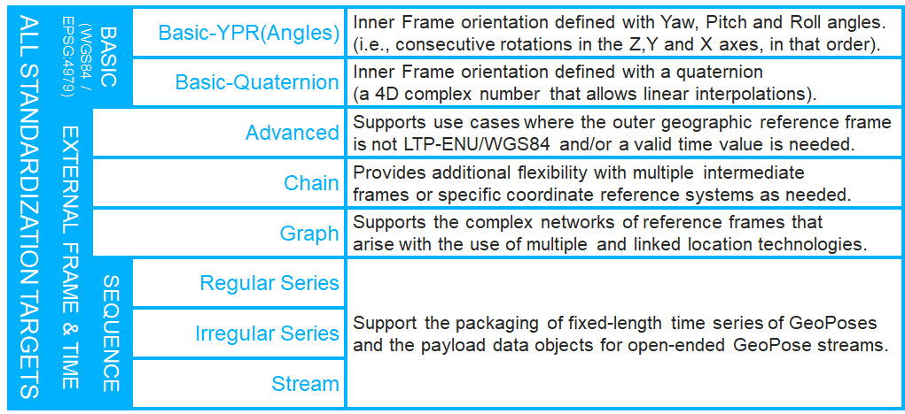
Where We Are
OGC GeoPose 1.0.

Slide 5
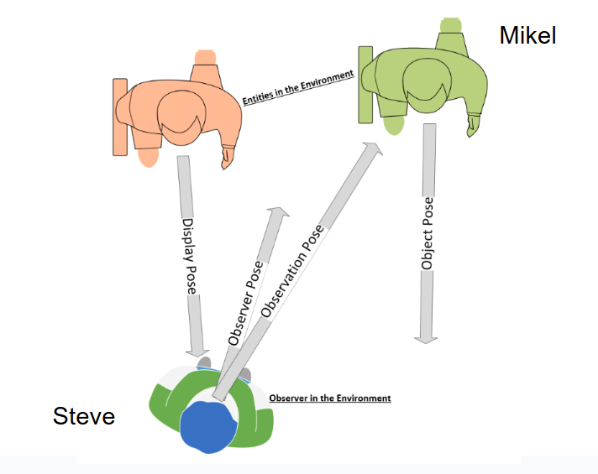
What Comes Next
GeoPose 1.x addresses:
Things we learned in OGC Testbeds 19 and 20.
Feedback from developers and other SDOs.
Adding back in some things that were out of scope in v 1.0.
Adding support for visual positioning, and more broadly, machine visual perception – imaging sensor to 3D content creation.

Slide 6
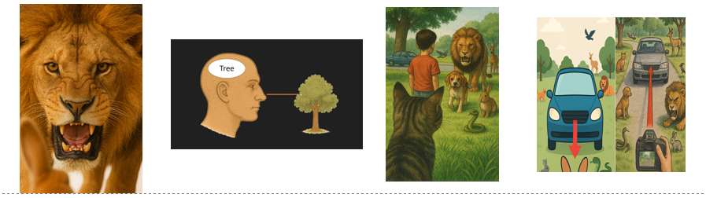
Three Things to Remember:
GeoPose is a standard way to reference elements of content in an interoperable spatial context.
It aligns with human visual perception and the concept of a georeferenced pose from computer graphics.
The data model has a solid theoretical basis as a frame transformation paired with an orienting rotation. These two elements may be modelled in many compatible domain-specific ways.

Slide 7


THANK YOU
www.ogc.org
https://metaverse-standards.org/

