Slide 1
Compare OWSContext and INSPIRE Download services based on Atom
86th OGC Technical Committee
Frascati, Italy
Joan Maso
24 September 2013
Copyright © 2013 Open Geospatial Consortium

Slide 2
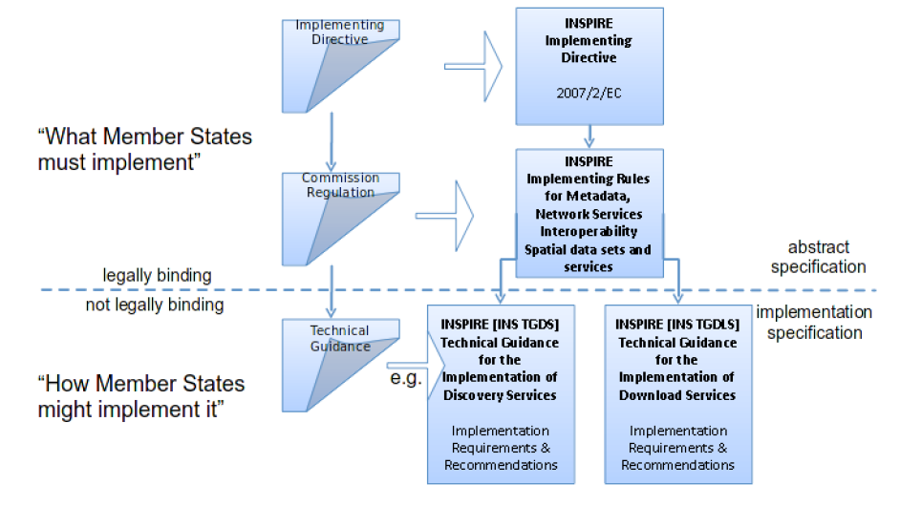
INSPIRE context
Atom Implementation of Pre-defined Dataset Download
Service
WFS and FE
Implementation of Pre-defined Dataset Download
Service
WFS and FE
implementation of Direct Access Download Service
Copyright © 2013 Open Geospatial Consortium

Slide 3
Atom Implementation of a Download service
Copyright © 2013 Open Geospatial Consortium

Slide 4
Atom Implementation of a Download service
Simple solution for people that are able to provide data as GIS files
Based on ATOM RSS feeds and GeoRSS.
  Top-level Download Service Feed that contains
    A link to an OpenSearch description document which provides operations metadata for the Download Service.
    Atom entries: one per pre-defined data set.
    Each of these Atom entries shall contain a link to another Atom Feed (a “Dataset Feed”)
  Dataset Feeds each one containing:
    A description of particular a pre-defined data set.
    Atom Entries with links to download the pre-defined dataset
      in different formats (e.g. in GML, ShapeFile etc)
      in different Coordinate Reference Systems.
      One link shall be provided for each format/CRS combination.
Feeds may be provided in multiple languages
Copyright © 2013 Open Geospatial Consortium

Slide 5
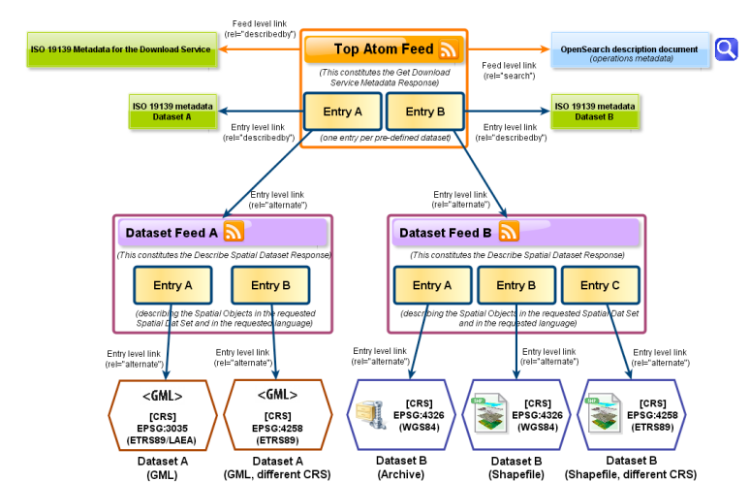

Two ATOM feed types
Download service feed
Copyright © 2013 Open Geospatial Consortium

Slide 6
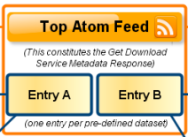
Download service feed
<feed xmlns=http://www.w3.org/2005/Atom
xmlns:georss="http://www.georss.org/georss"
xmlns:inspire_dls="http://inspire.ec.europa.eu/schemas/inspire_dls/1.0" xml:lang="en">
<title>XYZ Example INSPIRE Download Service</title>
<subtitle>INSPIRE Download Service of organisation XYZ providing Hydrography data</subtitle>
<!-- link to download service ISO 19139 metadata -->
<link href=http://xyz.org/metadata/iso19139_document.xml rel="describedby" type="application/vnd.iso.19139+xml"/>
<!-- link to Open Search definition file for this service-->
<link rel="search" href=http://xyz.org/search/opensearchdescription.xml type="application/opensearchdescription+xml"
title="Open Search Description for XYZ download service"/>
<!-- link to this feed in another language -->
<link href="http://xyz.org/download/de.xml" rel="alternate“ type="application/atom+xml" hreflang="de“ title="The download service information in German"/>
<!-- link to another representation of this feed (HTML) -->
<link href="http://xyz.org/download/index.html" rel="alternate“ type="text/html" hreflang="en“ title="An HTML version of this document"/>
<id>http://xyz.org/download/en.xml</id>
<rights>Copyright (c) 2012, XYZ; all rights reserved</rights>
<updated>2012-03-31T13:45:03Z</updated>
<author>
<name>John Doe</name>
<email>doe@xyz.org</email>
</author>
<!-- entry for a "Dataset Feed" for a pre-defined dataset -->
<entry>
…
Copyright © 2013 Open Geospatial Consortium

Slide 7
Download Service Feed entry
…
<entry>
<!-- title for "Dataset Entry" for pre-defined dataset -->
<title>Water network ABC Dataset Feed</title>
<inspire_dls:spatial_dataset_identifier_code>wn_id1</inspire_dls:spatial_dataset_identifier_code>
<inspire_dls:spatial_dataset_identifier_namespace>http://xyz.org/
</inspire_dls:spatial_dataset_identifier_namespace>
<link href=“http://xyz.org/metadata/abcISO19139.xml “ rel="describedby" type="application/vnd.iso.19139+xml"
<link rel="alternate“ href="http://xyz.org/data/waternetwork_feed.xml" type="application/atom+xml" hreflang="en" title="Feed containing the pre-defined waternetwork dataset (in one or more downloadable formats)"/>
<id>http://xyz.org/data/waternetwork_feed.xml</id>
<rights>Copyright (c) 2002-2011, XYZ; all rights reserved</rights>
<updated>2012-03-31T13:45:03Z</updated>
<summary>This is the entry for water network ABC Dataset</summary>
<!-- optional GeoRSS-Simple polygon outlining the bounding box of the pre-defined dataset described by the entry. Must be lat lon -->
<georss:polygon>47.202 5.755 55.183 5.755 55.183 15.253 55.183 5.755 47.202 5.755</georss:polygon>
<!-- CRSs in which the pre-defined Dataset is available -->
<category term="http://www.opengis.net/def/crs/EPSG/0/25832" label="ETRS89 / UTM zone 32N"/>
<category term="http://www.opengis.net/def/crs/EPSG/0/4258" label="ETRS89"/>
</entry>
</feed>
Link to Dataset Feed
Copyright © 2013 Open Geospatial Consortium

Slide 8
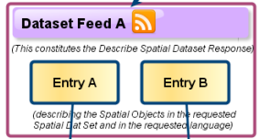
Dataset Feed A
<feed xmlns="http://www.w3.org/2005/Atom"
xmlns:georss="http://www.georss.org/georss" xml:lang="en">
<title>XYZ Example INSPIRE Dataset ABC Download</title>
<subtitle>INSPIRE Download Service, of organisation XYZ providing dataset ABC for the Hydrography theme</subtitle>
<!-- links to INSPIRE Spatial Object Type definitions for this pre-defined dataset -->
<link href="http://inspire-registry.jrc.ec.europa.eu/registers/FCD/items/105" rel="describedby“ type=”text/html”/>
<link href="http://inspire-registry.jrc.ec.europa.eu/registers/FCD/items/412" rel="describedby“ type=”text/html”/>
<!-- self-referencing link to this feed -->
<link href="http://xyz.org/data/abc/en.xml" rel="self“ type="application/atom+xml“ hreflang="en" title="This document"/>
<!-- link to this feed in another language -->
<link href="http://xyz.org/data/abc/de.xml" rel="alternate“ type="application/atom+xml" hreflang="de" title="This document in German"/>
<!—‘upward’ link to the corresponding download service feed -->
<link href="http://xyz.org/download/en.xml" rel="up“ type="application/atom+xml" hreflang="en" title="The parent service feed document"/>
<id>http://xyz.org/data/abc/waternetwork.xml</id>
<rights>Copyright (c) 2012, XYZ; all rights reserved</rights>
<updated>2012-03-31T13:45:03Z</updated>
<entry>
…
Copyright © 2013 Open Geospatial Consortium

Slide 9
Dataset Feed A (several variations)
…
<entry>
<title>Water network in CRS EPSG:25832 (GML)</title>
<link rel=”alternate“ href=“http://xyz.org/data/abc/waternetwork_25832.gml” type="application/gml+xml;version=3.2" hreflang="en" length=”34987” title="Water network dataset encoded as a GML 3.2 document in ETRS89 UTM zone 32N (http://www.opengis.net/def/crs/EPSG/0/25832)"/>
<id>http://xyz.org/data/abc/waternetwork_25832.gml</id>
<updated>2011-06-15T11:12:34Z</updated>
<category term="http://www.opengis.net/def/crs/EPSG/0/25832" label="ETRS89 / UTM zone 32N"/>
</entry>
<entry>
<title>Water network in CRS EPSG:25832 (ShapeFile)</title>
<link rel=”alternate“ href="http://xyz.org/data/abc/waternetwork_4285.zip" type="application/x-shapefile" hreflang="en" length=”89274” title="Water network dataset encoded as a ShapeFile in ETRS89 long/lat (http://www.opengis.net/def/crs/EPSG/0/4285)"/>
<id>http://xyz.org/data/abc/waternetwork_4258.zip</id>
<updated>2011-06-15T11:12:34Z</updated>
<category term="http://www.opengis.net/def/crs/EPSG/0/4285" label="ETRS89 / long lat"/>
</entry>
</feed>
Link to Data (CRS1-format1)
Link to Data (CRS2-format2)
Copyright © 2013 Open Geospatial Consortium

Slide 10
Fast introduction to OWS Context
Copyright © 2013 Open Geospatial Consortium

Slide 11
OWS Context
An OGC standard candidate that is at the end of the standardization process (hopefully a new OGC standard after a vote for adoption)
Based on the heritage of Web Map Context specification
12-080 OWS Context Conceptual Model
  Editors: Roger Brackin, Pedro Goncalves
12-084 OWS Context ATOM Encoding
  Editors: Roger Brackin, Pedro Goncalves
A OWS Context instance is a document with a list of
  A general description
  A list of resources (data access, data process, data discovery…); and for each:
    List of links to services to get them:
      Request to layers / featuretypes / coverages / observations… (WxS)
      Optional Inline responses
    Data
      KML, GML, GMLCOV (GeoTIFF, JPEG2000)…
      In line or references to external files.
    Styles
      SLD
Copyright © 2013 Open Geospatial Consortium

Slide 12
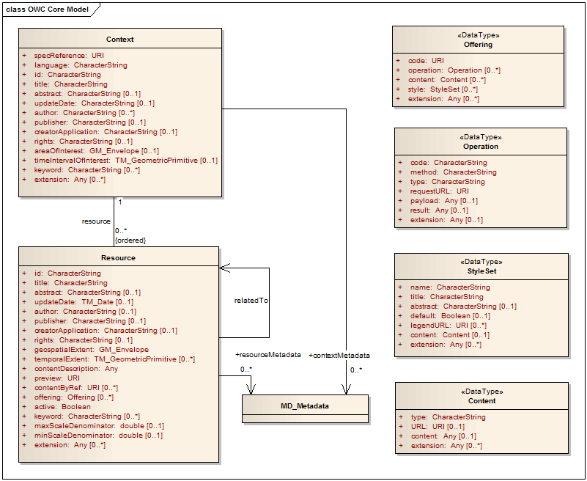
Conceptual model
Inline
content
General
description
for the
set
Service
link
Style
Resources
Copyright © 2012 Open Geospatial Consortium

Slide 13
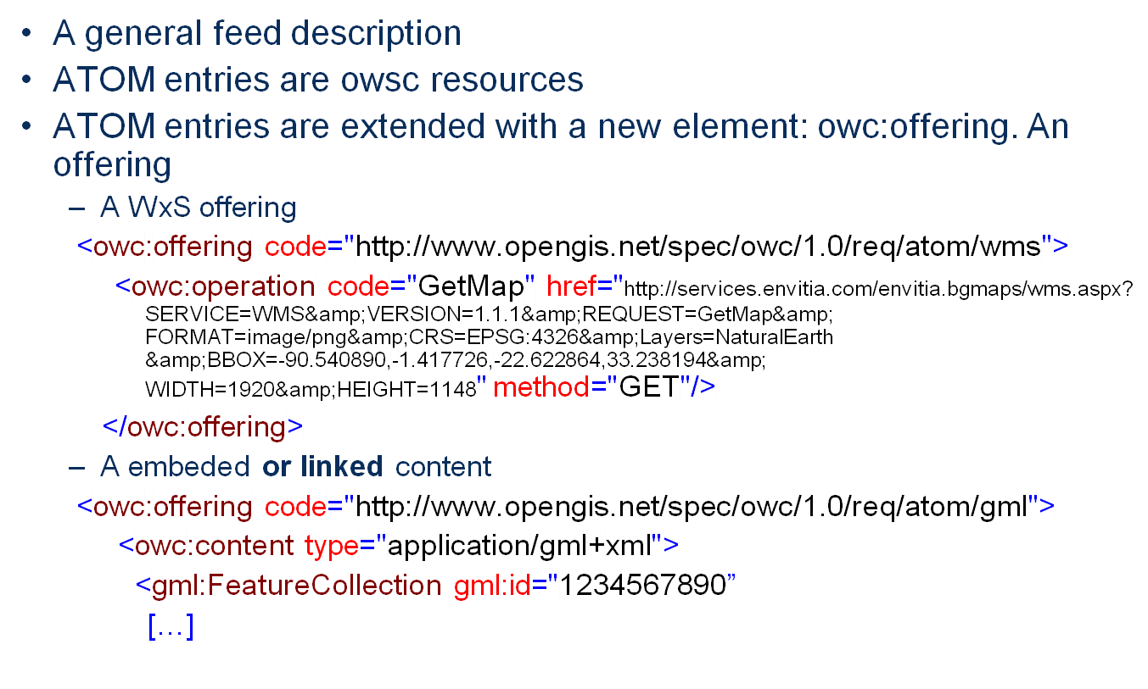
OWS Content implemented in ATOM
Copyright © 2013 Open Geospatial Consortium

Slide 14
OWS-Contextualized INSPIRE download service ATOM feed
Copyright © 2013 Open Geospatial Consortium

Slide 15
OWS-Contextualized download service feed
<feed xmlns="http://www.w3.org/2005/Atom" xmlns:dc="http://purl.org/dc/elements/1.1/" xmlns:georss="http://www.georss.org/georss" xmlns:gml="http://www.opengis.net/gml" xmlns:owc="http://www.opengis.net/owc/1.0" xmlns:xsi="http://www.w3.org/2001/XMLSchema-instance" xmlns:inspire_dls="http://inspire.ec.europa.eu/schemas/inspire_dls/1.0" xml:lang="en">
<atom:link rel="profile“ href=“http://www.opengis.net/spec/owc-atom/1.0/req/core” title="This file is compliant with version 1.0 of OGC Context"/>
<id>http://xyz.org/download/en.xml</id>
<title>XYZ Example INSPIRE Download Service</title>
<subtitle type="text">
INSPIRE Download Service of organisation XYZ providing Hydrography data
</subtitle>
<rights>Copyright (c) 2012, XYZ; all rights reserved</rights>
<updated>2012-03-31T13:45:03Z</updated>
<author>
<name>John Doe</name>
<email>doe@xyz.org</email>
</author>
<updated>2012-11-04T17:26:23Z</updated>
<!-- In OWS context we do not have global offering but we could have it in the future -->
<link href="http://xyz.org/metadata/iso19139_document.xml" rel="describedby" type="application/vnd.iso.19139+xml"/>
<link rel="search" href="http://xyz.org/search/opensearchdescription.xml" type="application/opensearchdescription+xml"
title="Open Search Description for XYZ download service"/>
<entry>
...
Tentative approach
Copyright © 2013 Open Geospatial Consortium

Slide 16
OWS-Contextualized download service feed entry
...
<entry>
<id>ftp://ftp.remotesensing.org/pub/geotiff/samples/gdal_eg/cea.txt</id>
<title>Water network ABC Dataset Feed</title>
<inspire_dls:spatial_dataset_identifier_code>wn_id1</inspire_dls:spatial_dataset_identifier_code>
<inspire_dls:spatial_dataset_identifier_namespace>http://xyz.org/</inspire_dls:spatial_dataset_identifier_namespace>
<id>http://xyz.org/data/waternetwork_feed.xml</id>
<rights>Copyright (c) 2002-2011, XYZ; all rights reserved</rights>
<updated>2012-03-31T13:45:03Z</updated>
<summary>This is the entry for water network ABC Dataset</summary>
<!-- optional GeoRSS-Simple polygon outlining the bounding box of the pre-defined dataset described by the entry. Must be lat lon -->
<dc:publisher>JRC</dc:publisher>
<content type="text">WMS SatCat March 2011</content>
<!-- CRSs in which the pre-defined Dataset is available -->
<category term="http://www.opengis.net/def/crs/EPSG/0/25832" label="ETRS89 / UTM zone 32N"/>
<category term="http://www.opengis.net/def/crs/EPSG/0/4258" label="ETRS89"/>
<owc:offering code="http://www.opengis.net/spec/owc-atom/1.0/req/atom/gml>
<owc:content type="application/gml+xml;version=3.2" href="http://xyz.org/data/abc/waternetwork_25832.gml" inspire_dls:crs="http://www.opengis.net/def/crs/EPSG/0/25832" inspire_dls:title="Water network dataset encoded as a GML 3.2 document in ETRS89 UTM zone 32N (http://www.opengis.net/def/crs/EPSG/0/25832)"/>
</owc:offering>
<owc:offering code="http://www.opengis.net/spec/owc-atom/1.0/req/atom/shp>
<owc:content type="application/x-shapefile" href="http://xyz.org/data/abc/waternetwork_25832.zip" inspire_dls:crs="http://www.opengis.net/def/crs/EPSG/0/25832" inspire_dls:title="Water network dataset encoded as a ShapeFile in ETRS89 UTM zone 32N (http://www.opengis.net/def/crs/EPSG/0/25832)"/>
<owc:content type="application/x-shapefile" href="http://xyz.org/data/abc/waternetwork_4258.zip" inspire_dls:crs="http://www.opengis.net/def/crs/EPSG/0/4258" inspire_dls:title="Water network dataset encoded as a ShapeFile in long/lat (http://www.opengis.net/def/crs/EPSG/0/4258)"/>
</owc:offering>
<owc:offering code="http://www.opengis.net/spec/owc-atom/1.0/req/atom/wms>
<owc:operation method="GET" code="GetCapabilities" href="http://xyz.org/service/wfs?SERVICE=WFS&amp;VERSION=1.0.0&amp;REQUEST=GetCapabilities" type="text/xml"/>
<owc:operation method="GET" code="GetFeature" href="http://xyz.org/service/wfs?SERVICE=WFS&amp;VERSION=1.1.0&amp;REQUEST=GetFeature&amp;OUTPUTFORMAT=text/xml;%20subtype=gml/3.2.1BBOX=-90,-180,90,180&amp;TYPENAME=tds:waternetwork"/>
</owc:offering>
</entry>
</feed>
Tentative approach
Copyright © 2013 Open Geospatial Consortium

Slide 17
Conclusions
There are similarities between INSPIRE download services in ATOM and OWS Context in ATOM enconding
From OWS Context point of view, INSPIRE DS ATOM is a particular use case
  Instead of using 2 atom files
    one is enough
    ows:offering “array” is a container for the 2nd INSPIRE atom (dataset feed)
    We need to extend ows:offering to include CRS (and title)
    Multilanguage can be also an issue that need to be fixed.
    We are not using link “enclosure” in both approaches
INSPIRE gain the capability to advertise not just files but also services that are able to provide de same data
OWS Context will discuss this further and come with a concrete recommendation (probably in the form of an OGC discussion paper).
Is this something that we want to study further in this forum or in INSPIRE?
Copyright © 2013 Open Geospatial Consortium

