Slide 1
OGC API Coverages
OGC API Hackathon 2019
London, United Kingdom
20 June 2019
Copyright © 2019 Open Geospatial Consortium

Slide 2
OGC API Coverages - Intro
Establishes how to access coverages as defined by the Coverage Implementation Schema (CIS) 1.1 through OpenAPI
Current scope
Only gridded coverages are addressed, not MultiPoint/Curve/Surface/SolidCoverages.
Only GeneralGridCoverage is addressed, other coverage types will follow later.
Only coverage extraction functionality is considered, not general processing
Subsetting is considered in the query component only for now.
Copyright © 2019 Open Geospatial Consortium

Slide 3
OGC API Coverages - Paths
From Common
Path = /
Path = /api
Path = /conformance
Path = /collections/
Path = /collections/{collectionId}
Path = /collections/{collectionId}/coverages
Returns list of coverages in the collection. Supports bbox parameter.
Path = /collections/{collectionId}/coverages/{coverageID}
Returns the coverage itself. Typically as an image file.
Path = /collections/{collectionId}/coverages/{coverageID}/domainset
Returns a description of the domain set of the coverage
Path = /collections/{collectionId}/coverages/{coverageID}/rangetype
Returns a description of the range type of the coverage
Path = /collections/{collectionId}/coverages/{coverageID}/metadata
Returns additional metadata about a coverage.
Copyright © 2019 Open Geospatial Consortium

Slide 4
OGC API Coverages - Issues
Issue 21: Tree structure vs features API
features and coverages in same service?
Issue 19: Identifier syntax for OAPI Common
any restrictions (cf. NCNAME)
Issue 15: What extensions should API Coverages have?
CRS transformation extension - part of common?
Guidance for extensions & application profiles
https://github.com/opengeospatial/ogc_api_coverages/projects/1
Copyright © 2019 Open Geospatial Consortium

Slide 5
OGC API Coverages - Issues
HTML representation
Issue 13: HTML not optimal for findabilty/discovery
Issue 14: Coverage representation in HTML
Hypermedia As The Engine Of Application State (HATEOAS) https://en.wikipedia.org/wiki/HATEOAS
Issue 9: Make use of HTTP headers
Multiple formats in one request (multipart/related; JSON + GeoTIFF)
Guidance from common (#28)
https://github.com/opengeospatial/ogc_api_coverages/projects/1
Copyright © 2019 Open Geospatial Consortium

Slide 6
OGC API Coverages - Issues
Issue 8: Coverage collections
Hierarchies, nesting, member of more than one set, and not member of any set
Unique IDs needed?
OpenAPI Common - CRS: representation of same coverage in different CRS
Issue 5: How to model resource (sub) selection based on the coverage model
Guidance for using conformance classes from common
https://github.com/opengeospatial/ogc_api_coverages/projects/1
Copyright © 2019 Open Geospatial Consortium

Slide 7
Points of Contact:
Chuck Heazel
cmheazel@heazeltech.com
Peter Baumann
baumann@rsdaman.com
Stephan Meißl
stephan.meissl@eox.at
Copyright © 2019 Open Geospatial Consortium

Slide 8
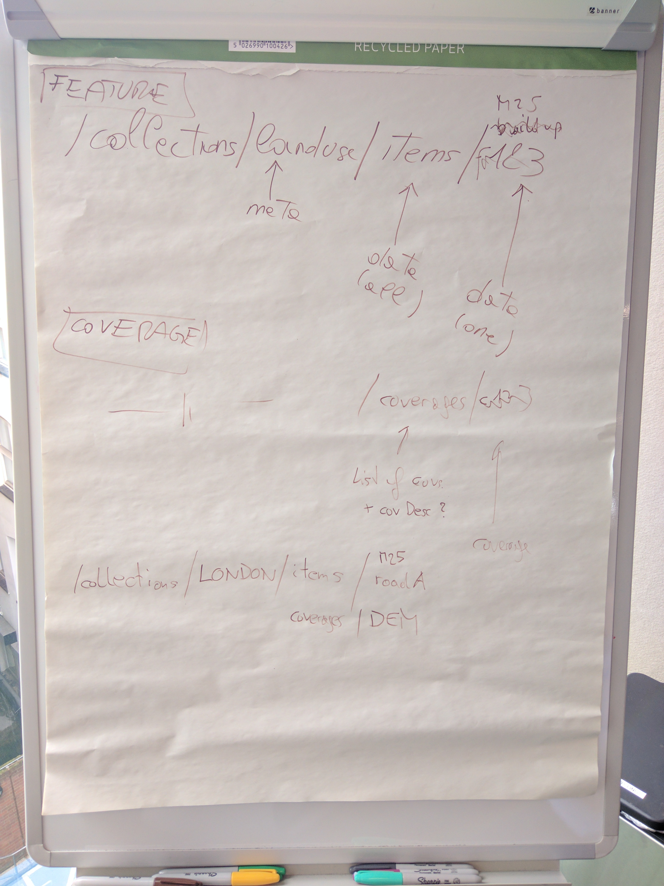
/collections/{id}/items URL & response
/collections/landuse/items/ - common and features
/collections/landuse/coverages/ - even valid?
Does common have guidance on these URLs and what they shall return?
E.g. /items gives features themselves. Should /coverages also return coverages or is covDesc fine?

Slide 9
Root paths
Resource specific collections, hierarchies, etc.
What about
/hierarchies
/mosaics
Allowed by common???
https://github.com/opengeospatial/OGC-API-Hackathon-2019/issues/8
Version
Where to report service version
https://github.com/opengeospatial/oapi_common/issues/29

