Slide 1


OGC API-Common Joan Masó
Pre-event Webinar for the OGC API September Sprint

Slide 2
Background
The OGC API Standards form a modular framework for building Web APIs.
API-Common should be the foundation upon which APIs are built.
Therefore, an API-Common “standard” is required
to bring harmonization to OGC API standards.
to allow for multiple APIs to work together
Yet API-Common cannot be standardized until it has been validated through implementation by other standards.

Slide 3
OCP API architecture
OGC API Features v1
GeoData
Inspired
(collections)
Common Core
(
)
Dataset
OGC API Tiles
OGC API Coverages
OGC API Maps
OGC API Processes
OGC API Features v2

Slide 4
OGC API Common
GET
/ (landing page)
Provides the conformance and API description pages
/conformance
List of conformance classes supported by the implementation
/api
The API definition. Currently only in OpenAPI 3.0
/collections
The list of geospatial data in the API
/collections/{collectionId}
A geospatial data [description]
/collections/{collectionId}/{resource}
items, coverage, tiles, map
GET
GET
GET
GET
GET

Slide 5
Parts
Features Part 1
[Other} Part 1, 2...
items
resources
Common Part 2
Collections/{id}
/, conf, api
/, conf, api
Common Part 1
/, conf, api

Slide 6

Parts
Features Part 1
[Other} Part 1, 2...
items
Collections/{id}/{other}
Common Part 2
Collections/{id}
/, conf, api
/, conf, api
Common Part 1
/, conf, api

Slide 7
Parts
Features Part 4
POST
PUT
Simple Transactions
DELETE
Features Part 1
[Other} Part 1, 2...
GET
GET
items
GET
Collections/{id}/{other}
Common Part 2
Collections/{id}
/, conf, api
/, conf, api
Common Part 1
/, conf, api
GET

Slide 8
OGC API – Common and beyond
Resource | Path | HTTP Method | Resource Description
Landing Page | / | GET | Basic information about this API and the starting point for hypermedia navigation
API Definition | /api | GET | An OpenAPI document for this API
Conformance Classes | /conformance | GET | A list of URLs, one for each implemented Conformance Class
Collections Metadata | /collections | GET | Information about the collections on this API. Includes partial description of each collection.
Collection Information | /collections/{collectionid} | GET | The full description of a single collection.
Collection | /collections/{collectionid}/items | GET | The collection itself.
information
about the API
named collections
the collection contents

Slide 9
Plans for the next months
Get Part 1 done and out for vote before the end of the year
How to describe your API (paths, conformances and discovery in the landing page)
OpenAPI definition requirements class (in the core document) need to be more elaborated
Examples in the Swagger hub
Update the user guide
This contains many non normative aspects. E.g.:
Many recommendations on how to do your API
How to create an API combining several standards
How to combine conformance classes etc.
This is going to satisfy OGC API Processes
but the others need also part 2.
Agreeing on part 2 is difficult due to the number for inputs from many other SWGs

Slide 10
Resources:
https://github.com/opengeospatial/oapi_common/
Part 1:
https://github.com/opengeospatial/oapi_common/tree/master/core
https://github.com/opengeospatial/oapi_common/blob/master/19-072.pdf
Materials
https://github.com/opengeospatial/oapi_common/tree/master/users_guide
https://github.com/opengeospatial/oapi_common/blob/master/20-071.pdf
OpenAPI Domains
https://app.swaggerhub.com/domains/UAB-CREAF/ogc-api-common/1.0.0
...

Slide 11
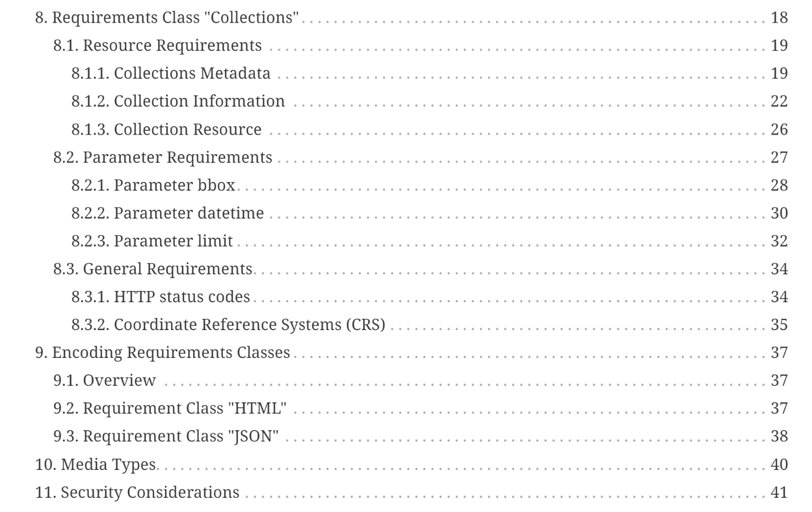
Status
Specific folder for Part 2
https://github.com/opengeospatial/oapi_common/tree/master/collections
Compiled document in the root
https://github.com/opengeospatial/oapi_common/blob/master/20-024.pdf

Slide 12

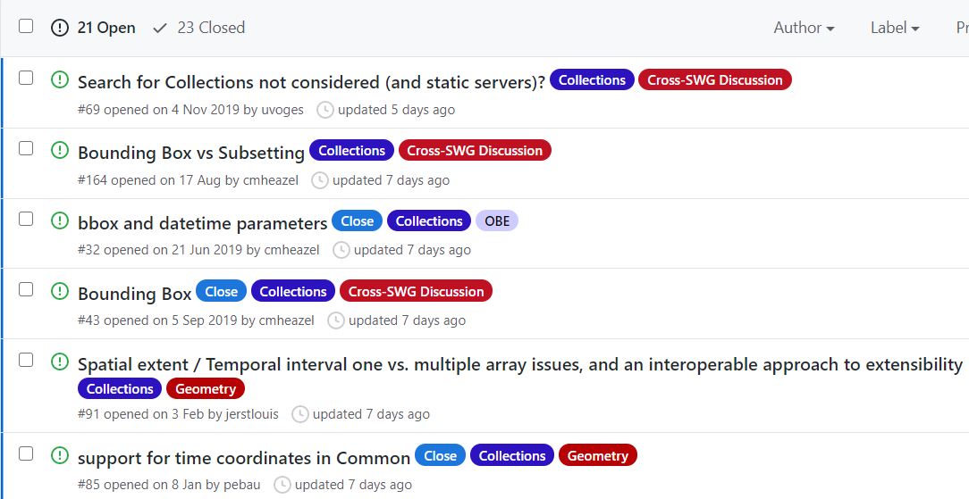
Status
There is a label for collections in the GitHub
https://github.com/opengeospatial/oapi_common/issues?q=is%3Aissue+is%3Aopen+label%3ACollections

Slide 13

Let's make some progress!! Joan.Maso@uab.cat

