Slide 1
Big Data in Byte-sized Chunks
EDR API Pre-Hackathon Webinar 2020-11-04
Chris Little, Technology Fellow, Met Office
Chair OGC EDR API Standard WG
Chair OGC Meteorology & Oceanography Domain WG
Member OGC Architecture Board, W3C Spatial Data on the Web WG
© Crown copyright Met Office

Slide 2
Contents
Background
Problem
What to do about it?
Summary
Questions & Answers
© Crown copyright Met Office

Slide 3
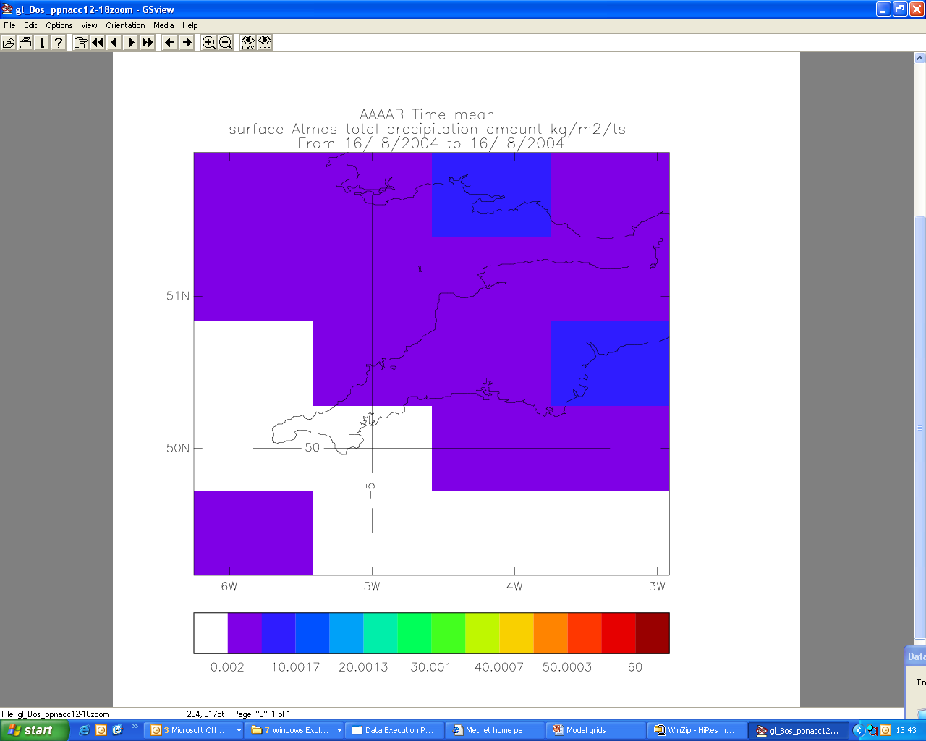
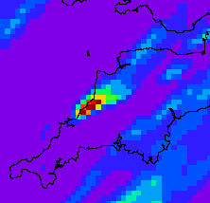
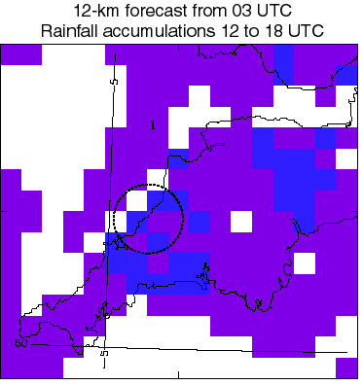
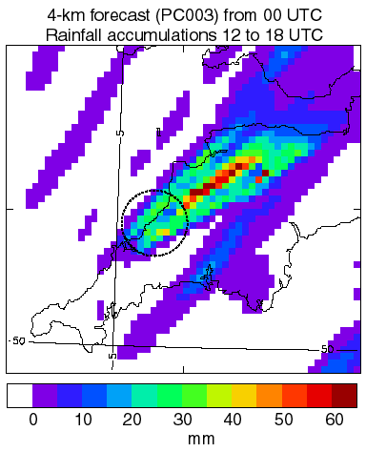
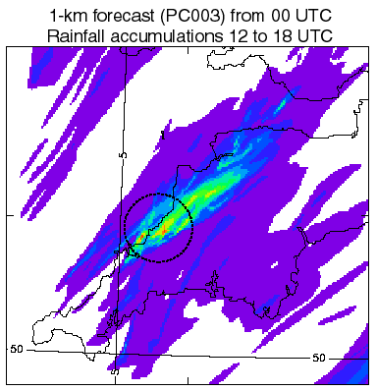
Influence of grid length on forecasts
Forecast rainfall accumulations for 1200-1800UTC 16/8/2004
5km radar actual
60km forecast from 00UTC
12km forecast from 00UTC
4km forecast from 00UTC
1km forecast from 00UTC
© Crown copyright Met Office
Notes:
This slide illustrates the enormous step forward that convective scale (~1Km) forecasting offers.
The radar actual shows a very small scale rainfall maximum of ~100 sq km, exceeding 60mm.
Only the 4km and 1.5km models are able to capture this feature. The 4km has it in the wrong place, because it misrepresents the scale of the convection. The 1.5km has the feature correctly represented.
***Experiments have shown that with adequate resolution this was actually a highly predictable event – probably 12 hours warning could have been given – given the air mass characteristics and the wind direction, the event and its location were strongly constrained by the local topography

Slide 4
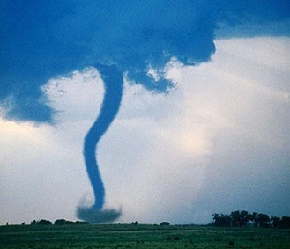
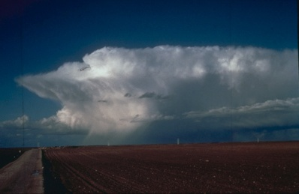
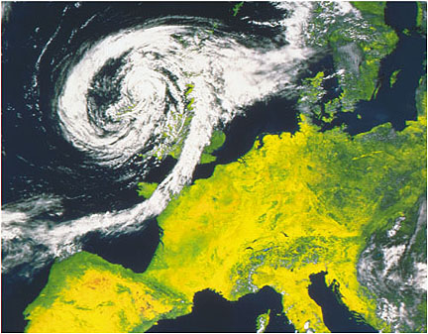
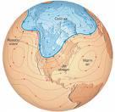
Scales and Predictability
increasing scale
increasing lifetime
increasing predictability
resolution needed
Tornado
1km
10 minutes
30 minutes
200m
Thunderstorm
10 km
1 hour
3 hours
2 km
Front
100 km
12 hours
36 hours
20 km
Planetary Wave
10000 km
3 days
9 days
2000 km
…but if we know what the planetary wave characteristics will be in 9 days, we can give an accurate probabilistic tornado forecast
© Crown copyright Met Office
Notes:
Disturbances in the atmosphere typically grow as non-linear instabilities until they reach equilibrium. The growth & decay timescale is therefore also a measure of the rate at which uncertainty will grow.
The large scale depressions of the mid-latitude storm belt have a lifetime of several days and predictability of one to two weeks.
Precipitation features such as fronts and organised convective systems have shorter timescales of up to a day and are predictable for several days.
A thunderstorm has a lifetime of about an hour and may be predictable for up to 6 hours.
If the development of the smaller feature is governed by a larger one of by the fixed surface conditions, it may have longer predictability in a statistical sense.

Slide 5
Quantifying uncertainty with ensembles
Deterministic Forecast
Initial Condition Uncertainty
Forecast uncertainty
X
CHAOS
Analysis
Climatology
time
© Crown copyright Met Office
Notes:
For forecasting beyond two or three days ahead, there is still significant uncertainty in the result. However, research has shown that the uncertainty varies, and that we can predict it. So we actually run many slightly different forecasts and then use the differences in the results to estimate how significant the uncertainties are.
UK Met Office policy is to use deterministic language up to three day ahead, and probablistic terminology beyond three days. E.g. “It will rain on day three. Later, days four and five, there is a strong chance of widespread rain.”

Slide 6
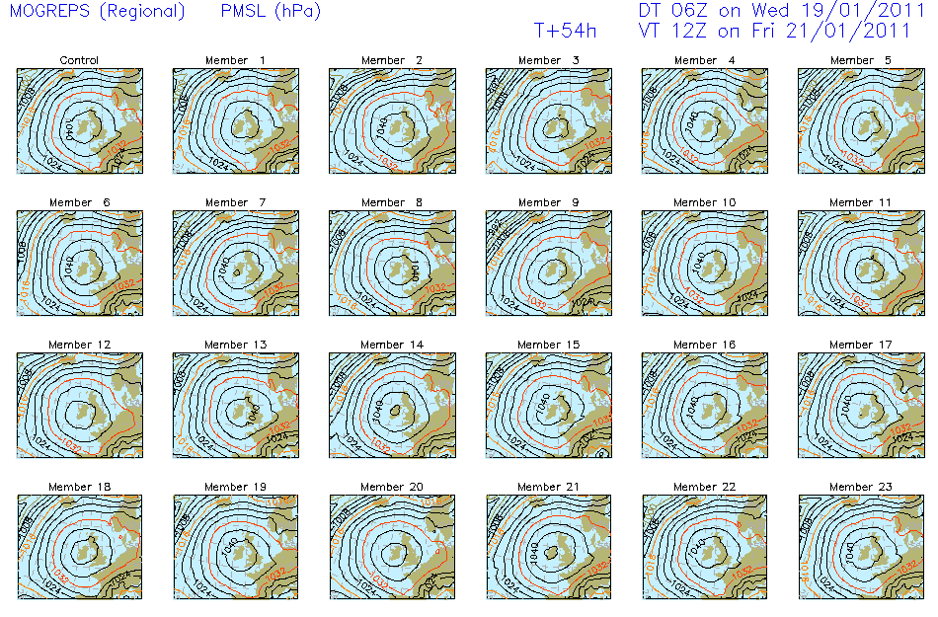
© Crown copyright Met Office
Notes:
Ensemble of 23 four day forecasts
Plans for enesmble resolutions:
Strategic: same res as ‘deterministic’ best control run
Global 2015 33Km, 70L, 2TB -> 2017 20Km, 100L, 20TB/2.5TB
UK 2014 2Km, 70L, 2TB -> 2017 2Km, 65L, 15TB/7TB ??

Slide 7
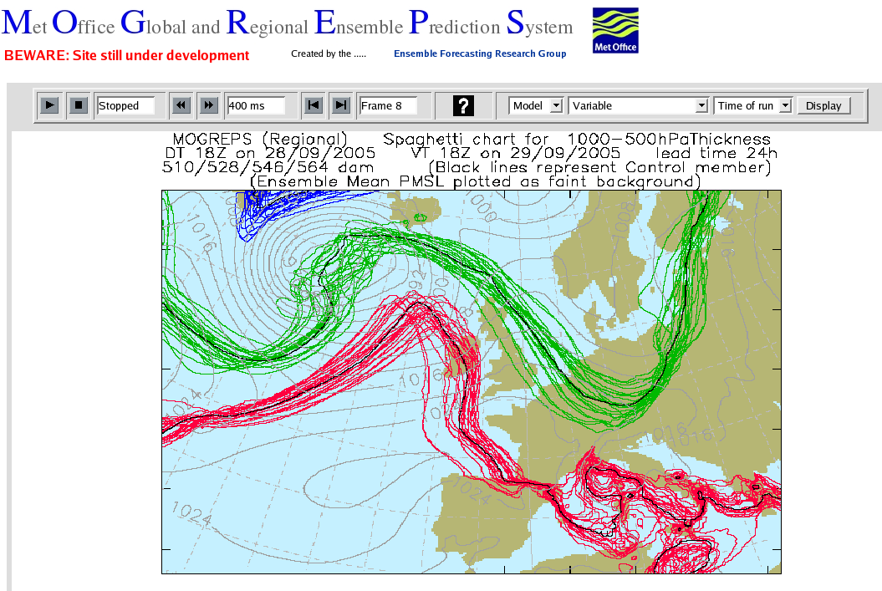
Ensemble of many forecasts
© Crown copyright Met Office
Notes:
Contours indicating atmospheric temperature from an ensemble of many simultaneous, slightly different forecasts, all ‘equally likely’.
We can be confident of forecasting temperature change over Ireland or the North Sea. There is uncertainty in what happens in the Mediterranean.

Slide 8
Problem !
© Crown copyright Met Office

Slide 9
Maps & Layers ‘broken’
2D Maps and Layers long established
3D or 4D data breaks ‘Layers’ paradigm
  Suppose data have 10 levels x 10 times: =>
  100 layers – choose from a menu?
But
  100 levels x 100 times x 100 parameters x 100 ensembles: =>
  100 000 000 layers?
© Crown copyright Met Office

Slide 10
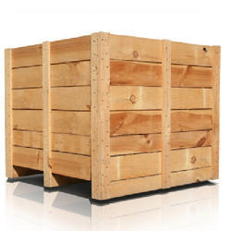
Copyright © 2017 Open Geospatial Consortium
Notes:
NetCDF, GRIB, BUFR, GF3, FITS, BAM, Shapefiles, etc will not go away
Contents currently on INSIDE of lid.
~10km grid= 2560 x 1920 x70 levels x 100 timesteps x ~100 ensembles = 3x10**12 = 3 trillion points
= 15trillion values per forecast
= 60 PB = 5PB/hour = 5000TB = 85TB/min = 85000GB = 1500GB/sec

Slide 11
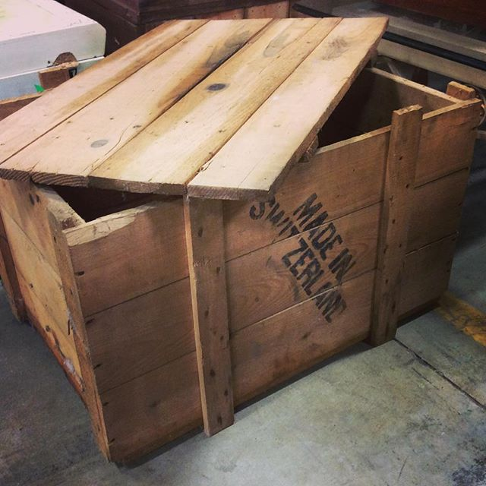
Copyright © 2017 Open Geospatial Consortium
Notes:
What’s in the box?
More boxes?
Neat racking?
A big mess on a long bit of string?

Slide 12

Copyright © 2017 Open Geospatial Consortium
Notes:
Copy List of contents of crate to its own container

Slide 13
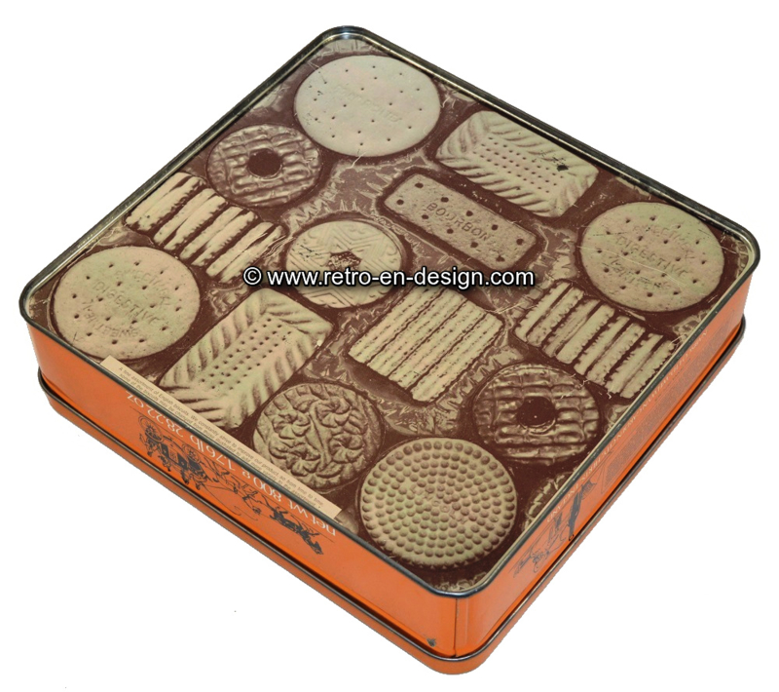
Copyright © 2017 Open Geospatial Consortium
Notes:
ISO 19115 slots. Filling the tin is a good short term strategy, but not open ended.
No query metadata slots.
No data structure metadata slots.

Slide 14
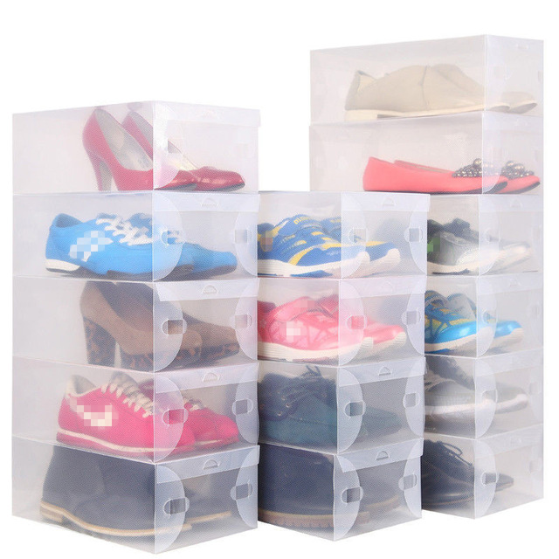
Copyright © 2017 Open Geospatial Consortium
Notes:
Transfer format for data not same as crate – JSON/CSV/XML more transparent, smaller, ligherweight, HTTP resolvable

Slide 15
What to do about it ?
© Crown copyright Met Office
Notes:
Get just the data that an end user wants

Slide 16
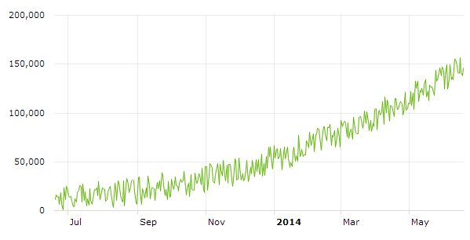
Points:-
Domain Types:-
  Single Point:
  Collection of Points:
  Time-series at a Point:
  Time Series of a collection of Points:
Point
Point Collection
Time Series at a Point
© Crown copyright Met Office

Slide 17
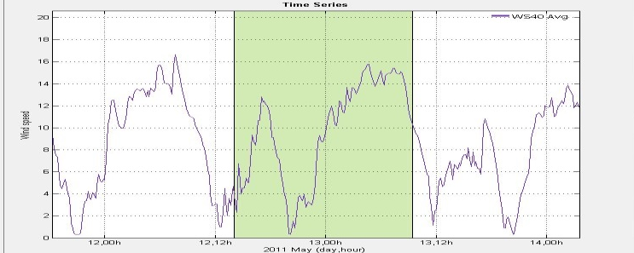


Profiles-
Domain Types-
  Single Profile
  Collection of Profiles
  Time-series of a Profile
  Time Series of a collection of Profiles
Profile
Profile Collection
Time Series of a Profile
© Crown copyright Met Office

Slide 18
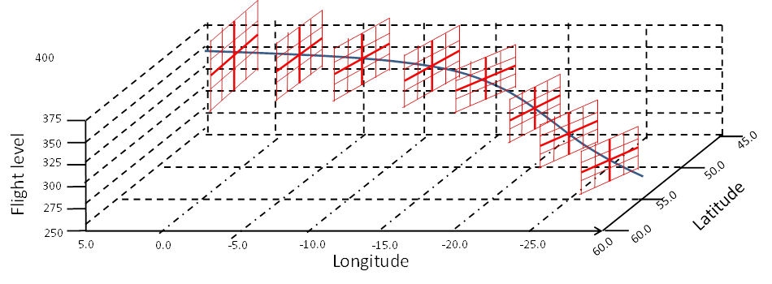
More Domain Types.
  Domain Types
    Cross sections / ‘Curtains’
    Trajectories
    Corridors
Cross Section
Trajectory
Corridor
© Crown copyright Met Office

Slide 19
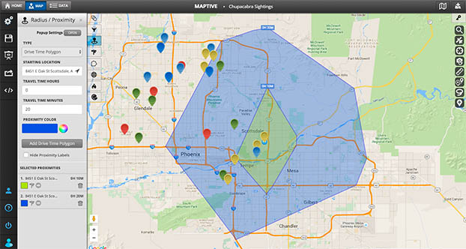
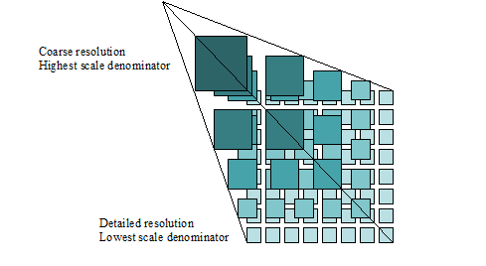
More familiar domain types
Domain Types
  Polygons
  Tiles
© Crown copyright Met Office

Slide 20

Grids
Domain Type
  GRID Trimming
  GRID Re-sizing and sampling
  GRID Layers (Slicing)
  GRID Time series
Trimming
Slicing
Slicing
Re-sizing and sampling
© Crown copyright Met Office

Slide 21
Weather on the Web (WotW) Hackathon Washington 2018-12
Demonstrated initial WotW capability, gridded data focus
Completed OpenAPI demo endpoint (Canadian CMEP)
  Successfully conducted test against generic WFS 3.0 client library (OWSLib - https://github.com/geopython/OWSLib)
  Recommendations to align closer to WFS 3.0 patterns in GitHub: https://github.com/OGCMetOceanDWG/MetOceanAPI-Workshop/blob/master/api-review-comments.md
© Crown copyright Met Office

Slide 22
WotW Hackathon continued
Completed initial cut at WotW API conformance classes:
  Core: Use simple feature spec (point, line string, polygon)
  Spatial: Required for start/stop/interval, enumeration, elevation
  Weather Params: Use WFS3 as basis for query parameters. Create filter
  Temporal: define time range/units using MetOcean spec, GRIB2, netCDF
  Measurements: Define specific observations to return
  Interpolation: Define how to map observations to return locations
      Specify interpolation method per axis/axes, use well-known methods
      Specify default as nearest-neighbour.
      Work on other interpolation methods with vendors
  Return: Inform JSON, CovJSON, XML, GRIB, netCDF
  Vendor Extras: Out of scope
© Crown copyright Met Office

Slide 23
WotW Hackathon continued
Completed initial support of WotW API geometry query types
  Point, Point Timeseries, Polygon, Profile, Corridor, Trajectory
Next steps
  Adoption of MetOcean Profile as OGC standard (Done)
  Better alignment of MetOcean API with WFS3 patterns (Done)
  Agree conformance with WFS3 geometry classes (OBE)
  Assess vendor implementations of MetOcean Profile (OBE)
  Work towards plugfest (Done)
  Establish formal Standards WG (Done)
© Crown copyright Met Office

Slide 24
More OGC API hackathons:
London Geovation June 2019 https://www.opengeospatial.org/projects/initiatives/oapihackathon19
  OGC API – Features
  OGC API – Common
  OGC API – WotW
  OGC API – Maps
  OGC API - Tiles
ESIP, Bethesda, MD, Jan 2020 https://2020esipwintermeeting.sched.com/event/Vabd/esip-and-ogc-api-coverage-analytics-sprint-day-1
  OGC API – Coverages, grids, analytics, …
© Crown copyright Met Office

Slide 25
Environmental Data Retrieval API Standard WG
Early Proof of Concept Hackathon Washington 2018
WotW API renamed EDR API – hydrology, defence, space,…
  Github https://github.com/opengeospatial/Environmental-Data-Retrieval-API
  Mailing list EDR-API.SWG@lists.opengeospatial.org
Charter established 25 Nov 2019
1st Hackathon 18-20 Mar 2020
Released for Public Comment 28 Aug 2020
Public Comments finished 28 Sep 2020
2nd Hackathon 9-10 Nov 2020
© Crown copyright Met Office

Slide 26
EDR API SWG Charter Members
Name | Organization
Chris Little | UK Met Office
Steve Olson | US National Weather Service
Frédéric Guillaud | Météo-France
Dave Blodgett | US Geological Survey
Tom Kralidis | Meteorological Service of Canada
Roope Tervo | Finnish Meteorological Institute
Bruce Bannerman | Individual
Chris Lynnes | NASA
Ethan Davis | UCAR
Cristiano Lopes | ESA
Iain Burnell | DSTL
Keith Ryden | ESRI
Copyright © 2019 Open Geospatial Consortium
Notes:
12 charter members: 5 Met Services, 1 Met org, 1 meteorologist, 5 others

Slide 27
EDR API SWG Plan
Initial Deliverables by Dec 2020: APIs
retrieve data values at a specified point location altitude and time (x,y,z,t)
retrieve a time series of values at a specified location and height (x,y,z), whether elevation or altitude with a specific vertical CRS
retrieve a vertical profile of values at a specified location and time (x,y,t)
retrieve an array of values across a rectangular area (tile)
retrieve a set of values across a polygonal area (optional z or t extents)
retrieve a series of values along a specified trajectory, whether 2, 3, or 4 dimensions
retrieve a set of values within a 'corridor', a trajectory with a surrounding buffer region along its length

Slide 28
Summary
© Crown copyright Met Office

Slide 29
Summary - Forecasting
Big Data getting bigger despite electricity costs
Forecasts need supercomputers, not ‘clouds’
Meteorological forecasts too big & volatile to move
  Global enterprise involving all 193 countries.
“Moving data costs, calculations are free”
  Move apps to the data, but how?
    Merging authoritative & unreliable info
    Need federated security architecture
  Defining ‘Convenience APIs’
    Get just the data needed for the application
    Use scalable Web architectural style ‘RESTful’
    Cache retrieved API data with URI for re-use
© Crown copyright Met Office

Slide 30
Summary - Organisations
About 20 institutions have Global 24/7 operational capability
Another 70 WMO Members have regional F/C capability
  WMO members moving towards an all-hazards approach in their infrastructure
  WMO is adopting external ICT standards, such as OGC, OASIS and ISO, as well as their own.
  WMO Info System 2.0 for public and private: clouds, REST, APIs
  Aviation (ICAO, CAA/FAA) moving in same direction
OGC is “the only game in town” for geospatial interoperability
  Traditional 2D maps & layers, true 3/4D now appearing
W3C is for cross-domain Web standards & semantics
  Data, Spatial Data (& Statistical Data) on the Web Best Practices
© Crown copyright Met Office

Slide 31
Summary - Data
Cross-domain information becoming the norm, but
Domain specific (big) data formats here to stay:
  (NetCDF, HDF, GRIB, BUFR, FITS, BAM, VCF, GF3, …)
  Binary, efficient, optimised
  Established eco-systems of access software & tools
  Established domain expertise, controlled vocabularies
Generic data formats have no traction, but
Web friendly transfer formats for browsers and apps
  (CSV, JSON, XML)
  More verbose – small amounts OK
© Crown copyright Met Office
Notes:
Big Crates, Transparent shoe boxes

Slide 32
Summary - Metadata
Metadata should be cross-domain for discovery
  Metadata fixed format/containers a good start
  Only for discovery, not usage and management
  Metadata is open-ended, not in containers/catalogues/portals
Controlled Vocabularies -> Taxonomies -> Ontologies
Semantic Web / Web 2.0: standards action in W3C
Highly scalable
Highly flexible
Resolvable registries of controlled vocabularies happening
Conceptual models can be stored as ontologies
Ontologies allow valid machine reasoning
Semantic formats too verbose for data but metadata OK
Copyright © 2017 Open Geospatial Consortium
Notes:
Use Case: big complex scientific archives

Slide 33
Questions and answers
© Crown copyright Met Office
Notes:
A few following slides stored here just in case they come in handy for answering questions
My question: are oceanographic organisations willing or prepared to take part?

Slide 34

© Crown copyright Met Office

