Slide 1
Second Environmental Linked Features Interoperability Experiment
David Blodgett
116th OGC Member Meeting
Virtual | 17 September 2020

Slide 2
Overview
Objective: … "what is the expected network behavior and resource model when resolving a Web identifier for a non-information resource?“
Outcomes:
Four core SELFIE functionalities. Identification, landing, structured data, data.
Content model rather than resource model.
URI-14 -> URL-14 -> URL-200
Issues:
Landing content type and landing resource considerations.
Dealing with “in-band” vs “out of bad” resources in linked data.
Availability and consistent use of suitable domain concepts.

Slide 3
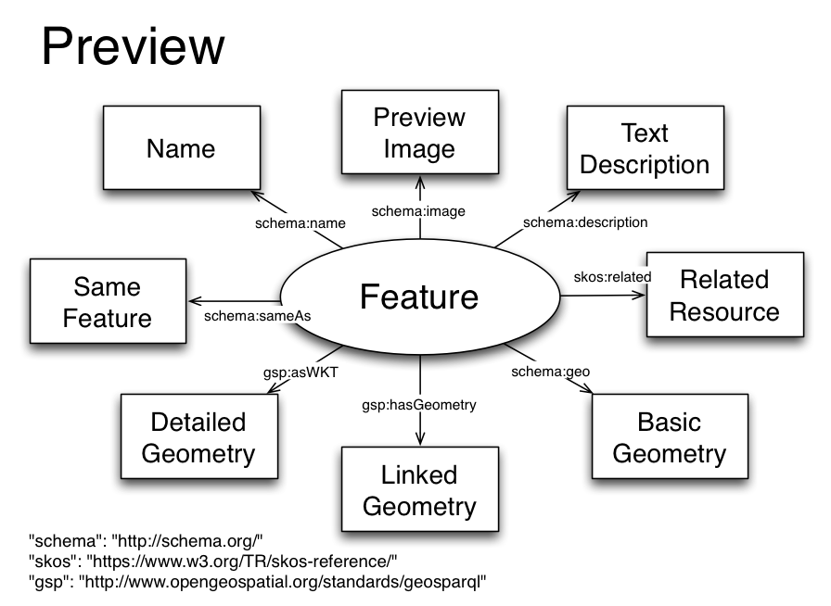
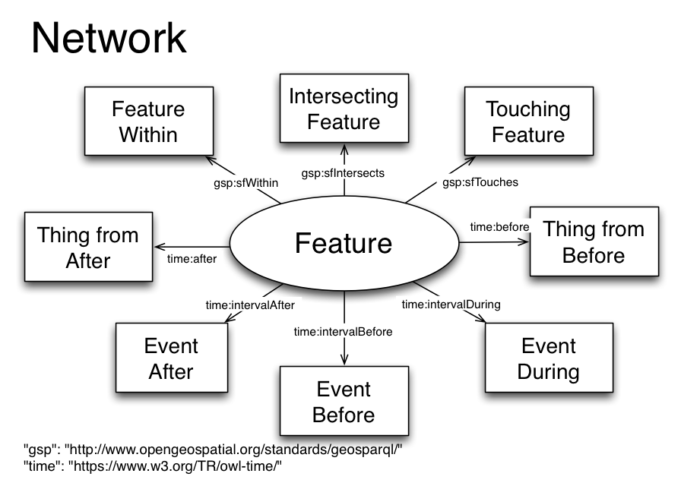
Background -- ELFIE
Functional linked data graph views… preview, network.

Slide 4
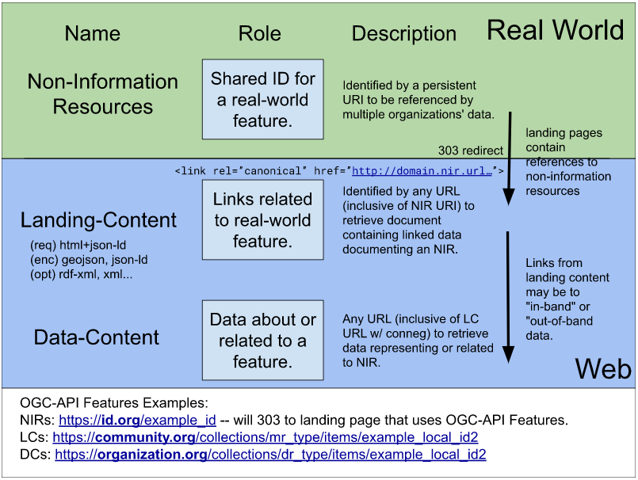
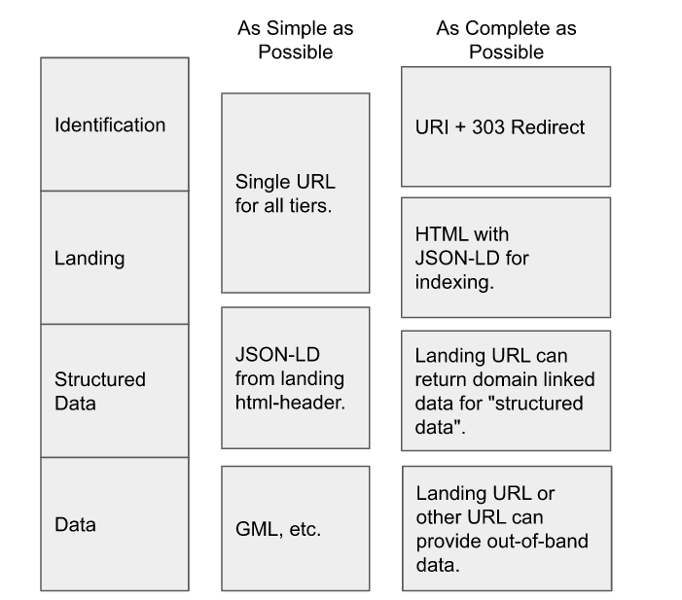
Functions and Content Model
As a Web user, I want to find all the information available for an environmental feature, so I can find what I’m looking for and retrieve it.
“resource model” vs “content model”
the four SELFIE “functions”
https://github.com/opengeospatial/SELFIE

Slide 5
SELFIE scope limitations
Did not evaluate content negotiation by profile.
Limited example data available “by profile”
Did not find solution for “type of representation”
e.g. Non-information resource -> association X -> information resource.
https://schema.org/subjectOf
“A CreativeWork or Event about this Thing.”
Need more work … “in the context of multiple representations of the same feature where each representation is of a different type.”

Slide 6
Summary and next steps…
URI-14 – URL-14 – URL-200 is a sound architecture.
URI-14 – URI-14 associations work well.
URI-14 – URL-200 associations need more work.
Separating conceptual and technical communication is hard.
“Landing content” (URL-14) presents challenges.
“The decision was made to move forward pragmatically — treating the URL-14 resource as a convenience resource who’s only job is to provide information about a URI-14 and, therefore, not a resource that would ever be the subject of linked data.”

Slide 7
Motion:
The GeoSemantics DWG recommends that the OGC Technical Committee approve release of [OGC 20-067] Second Environmental Linked Features Experiment
Pending any final edits and review by OGC staff
Motion: Nic Car
Second: Chris Little
Discussion: None
NOTUC: No

