Slide 1
<Presentation template>
113th OGC Technical Committee
Toulouse, France
<Name of presenter>
<xx> November 2019

Slide 2
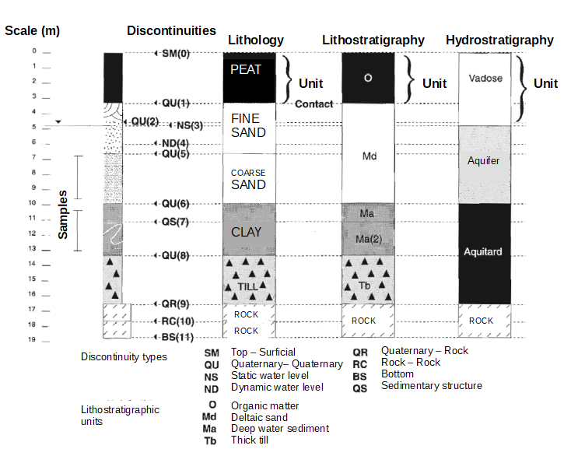
NRCan example
Borehole with many features located along its path and multiple interpretations
Samples
Contacts or any other boundaries
Units

Slide 3

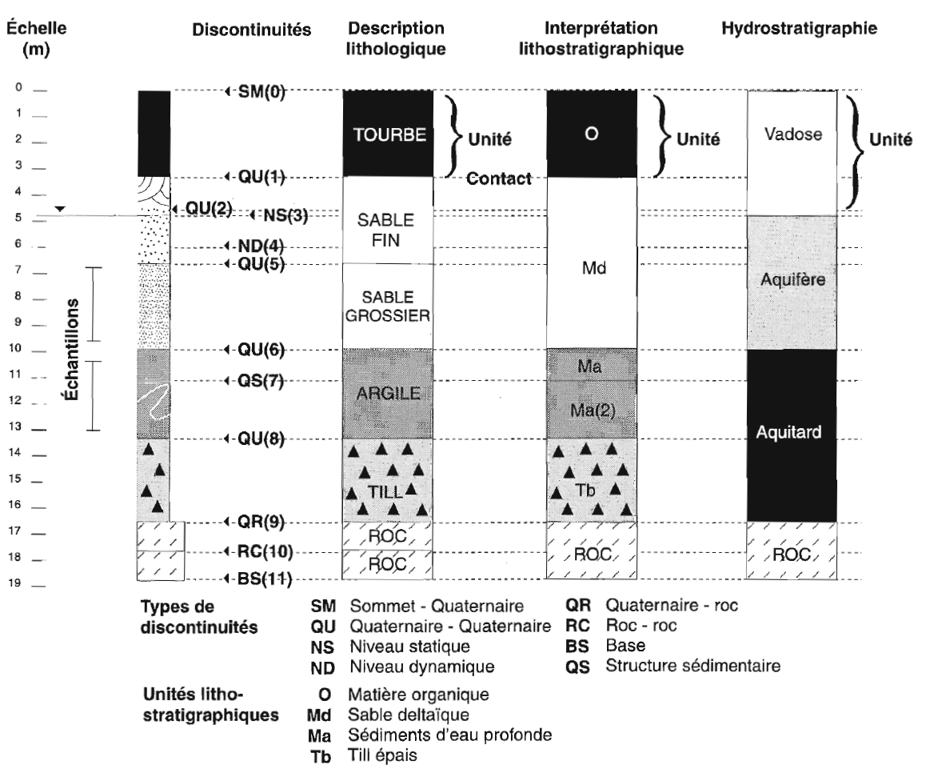

Mapping
Units delimited by boudaries
(BoreholeEvents delimited by other BoreholeEvents)
Sample interval unconstrained by natural boundaries
(Version originale française.. Nous sommes en France après tout)

Slide 4
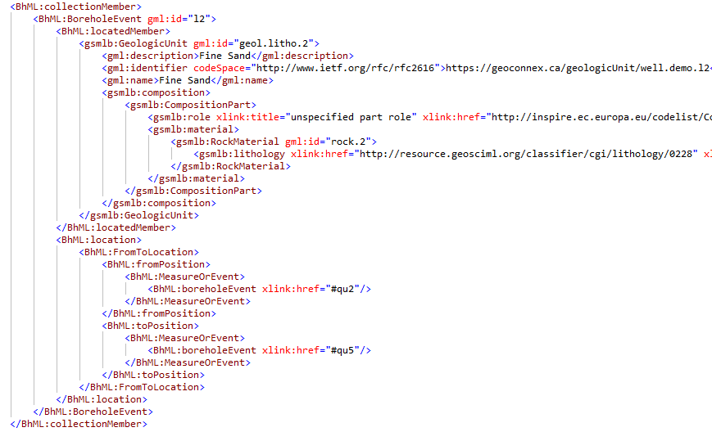
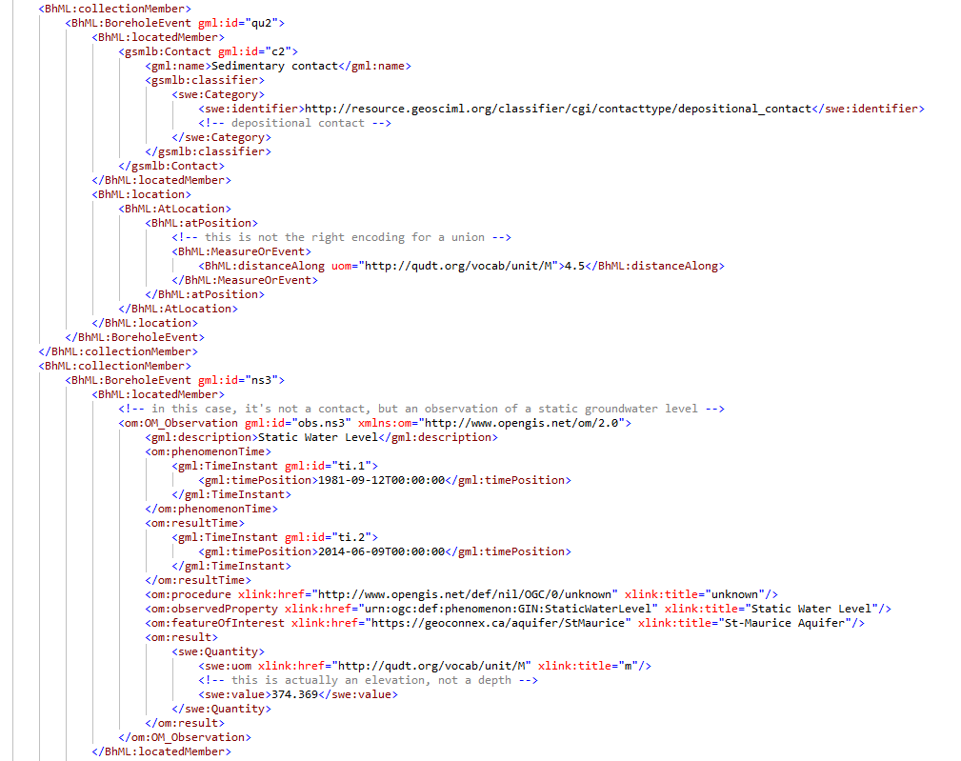
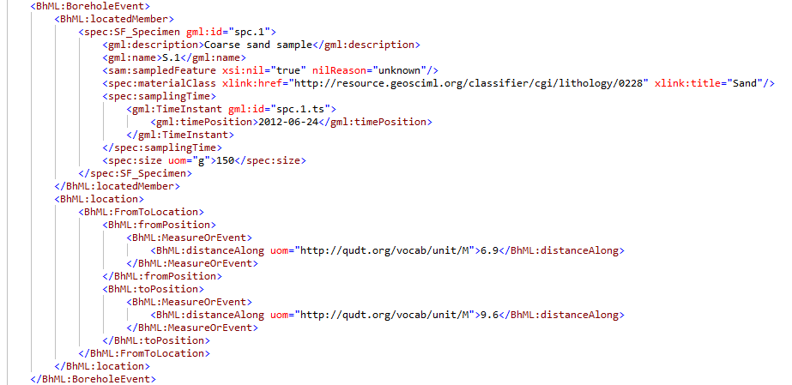
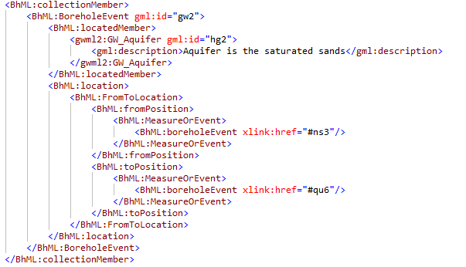
GML XML encoding
GeoSciML contact
GeoSciML Geologic Unit
O&M Observation
(static groundwater level)
O&M SF_Specimen
GWML2 Aquifer

