Slide 1
Joana Simoes 25/04/2025
OGC
Open Standards Code Sprint
#Day 1 – Kickoff

Slide 2
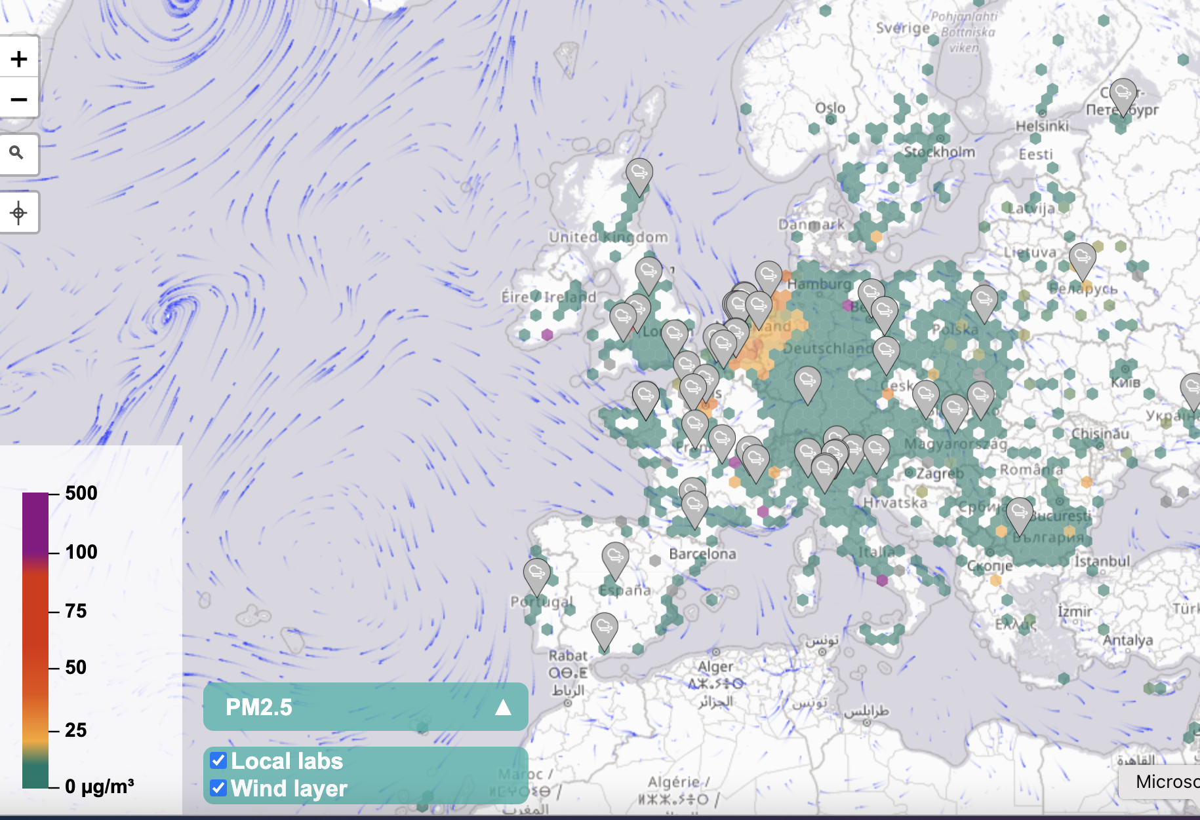
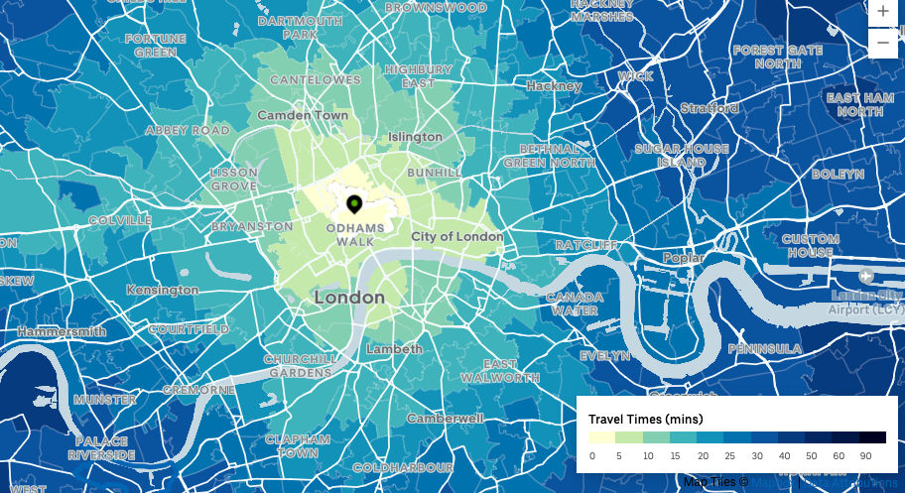
Motivation
Current values of sensors measuring air quality. Source: https://maps.sensor.community/#2/0.0/0.0
Travel times across London. Source: https://movement.uber.com/

Slide 3
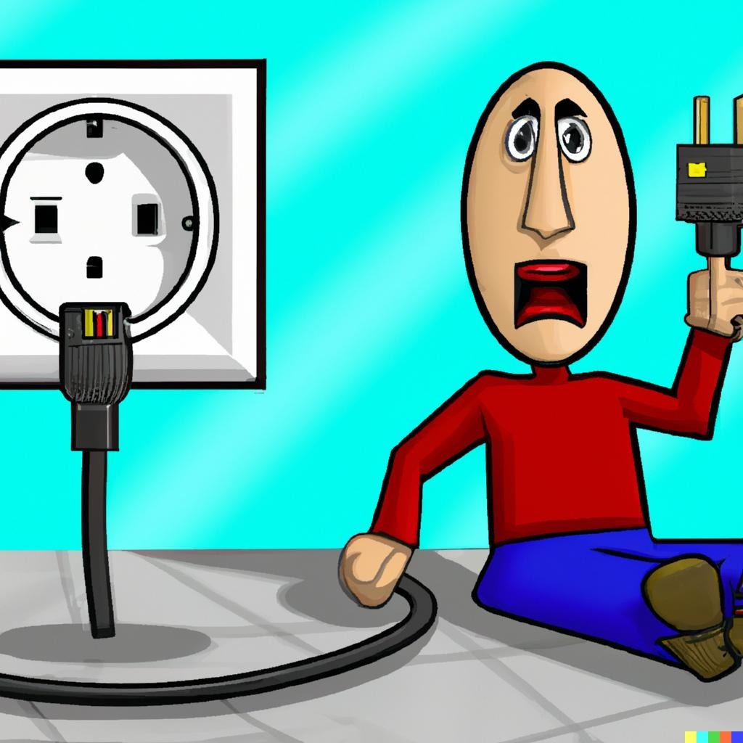
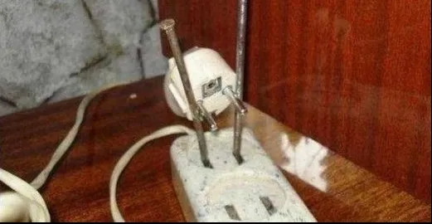
The lack of interoperability can lead to less optimal solutions…

Slide 4
What is OGC?
Our Vision
Building the future of location with community and technology for the good of society.
Our Mission
Make location Information Findable, Accessible, Interoperable and Reusable (FAIR)
Our Approach
A proven collaborative and agile process combining consensus-based standards, innovation project and partnership building.

Slide 5

Some advantages of adopting Standards
Server side: enable a wide range of clients to consume services (e.g.: no need to create custom clients).
Client side: being able to consume services from a wide range of servers (e.g.: add support to more sources with minimal coding).
More data access, less coding.

Slide 6
OGC Code Sprints
Support the development of the standards.
Support the development of implementations of the standards.
Create awareness about the standards.
Standards Working Group Meetings
GitHub activity
Code Sprint

Slide 7
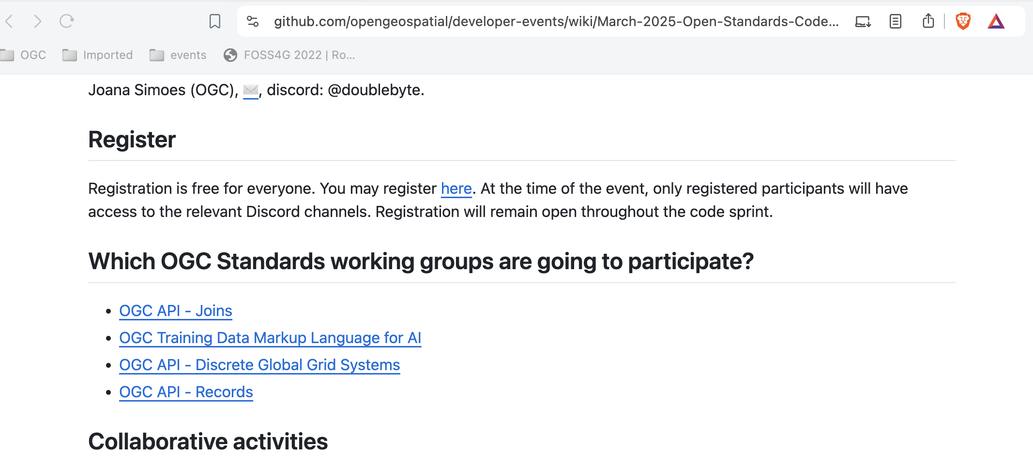
Open to All OGC standards
Standards Working Groups that have registered for this code sprint:

Slide 8
Thank You to our hosts!

Slide 9
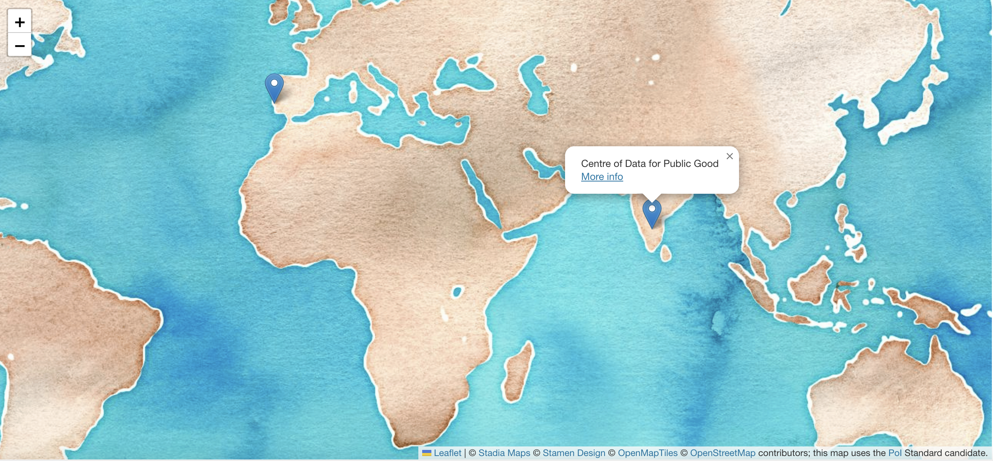
Local Nodes
👉🏽 https://developer.ogc.org/sprints/nodes/
🇵🇹 Arts & Nerds
🇨🇮 Centre of Data for Public Good
🔌 Powered by POI Standard Candidate

Slide 10
Arts & Nerds – Logistic information
Coffee shops and restaurants.
Wifi.
Fire exit.
Pastries.
Toilets on the upper floor.

Slide 11
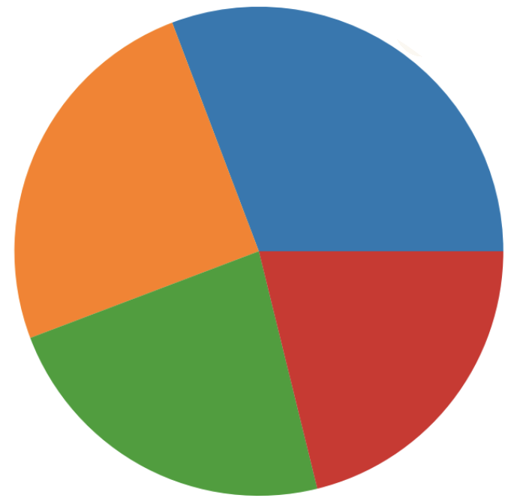
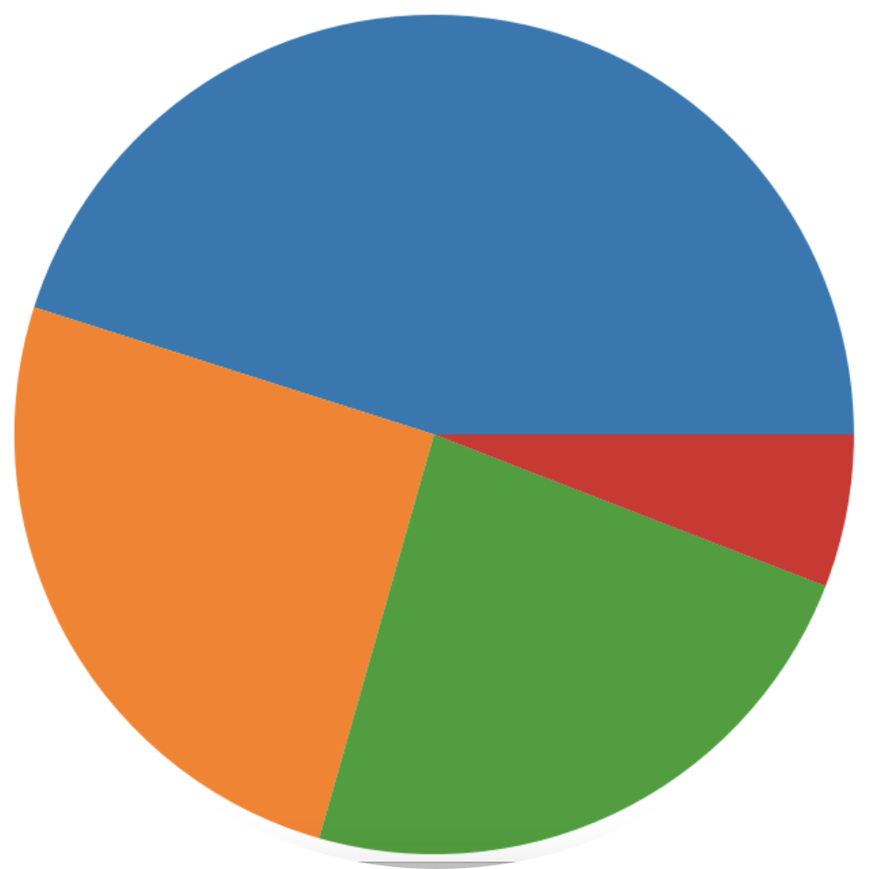
Who are the participants of the sprint?
“Coding is not my day to day job, but I often hack on things to solve key problems”.
No experience with any of the APIs!
I am fluent in a variety of programming languages and have shipped production systems with thousands of users.
Have created a server implementation
Have created a client implementation
I have several years of professional software development experience and write code almost every day.
I am comfortable with code, and can copy and paste pieces or script things together.
Have used APIs and web services based on one or more OGC APIs.
Data from: 20/04/2025
Notes:
India 28 United States 9 Portugal 4 Canada 3 United Kingdom 2 – TOTAL 74

Slide 12
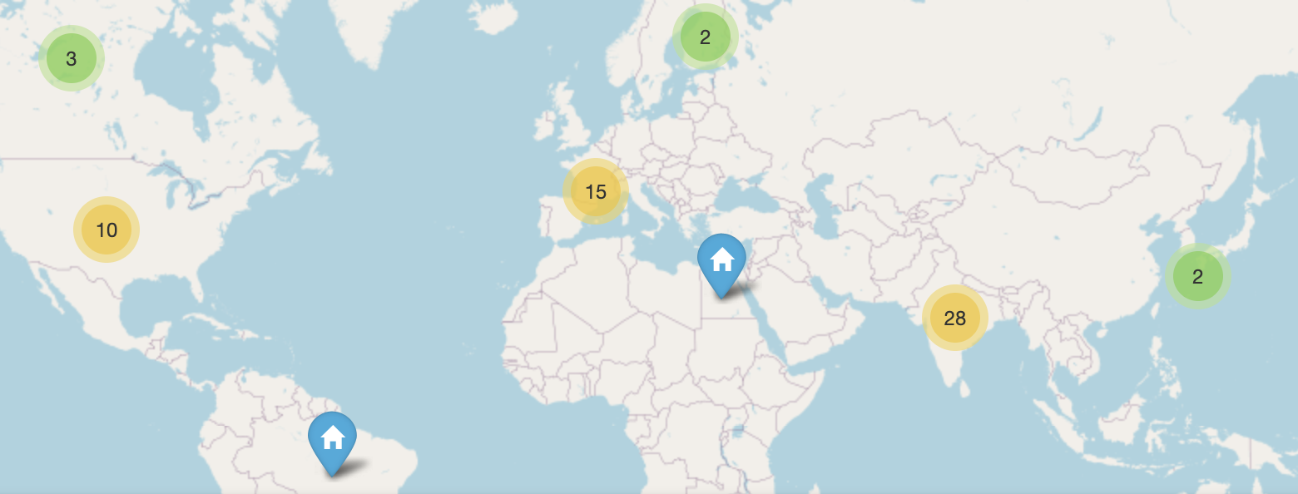
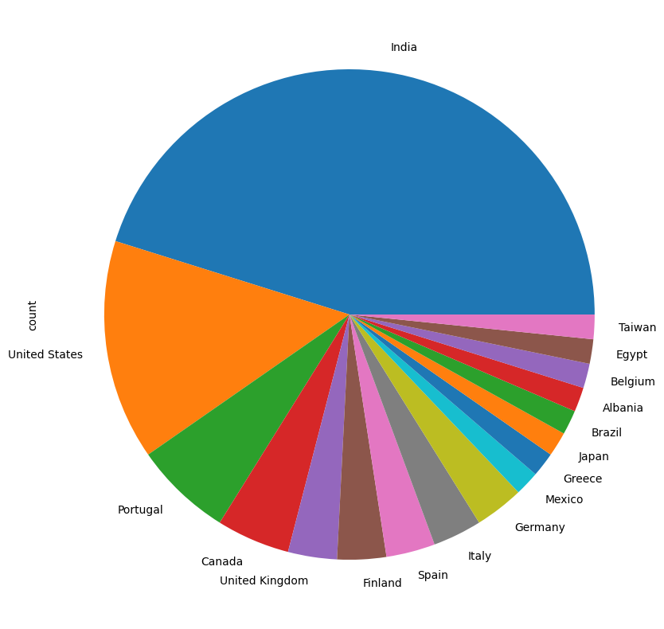
Where do they come from?
Data from: 20/04/2025
Notes:
India 28 United States 9 Portugal 4 Canada 3 United Kingdom 2 – TOTAL 62

Slide 13
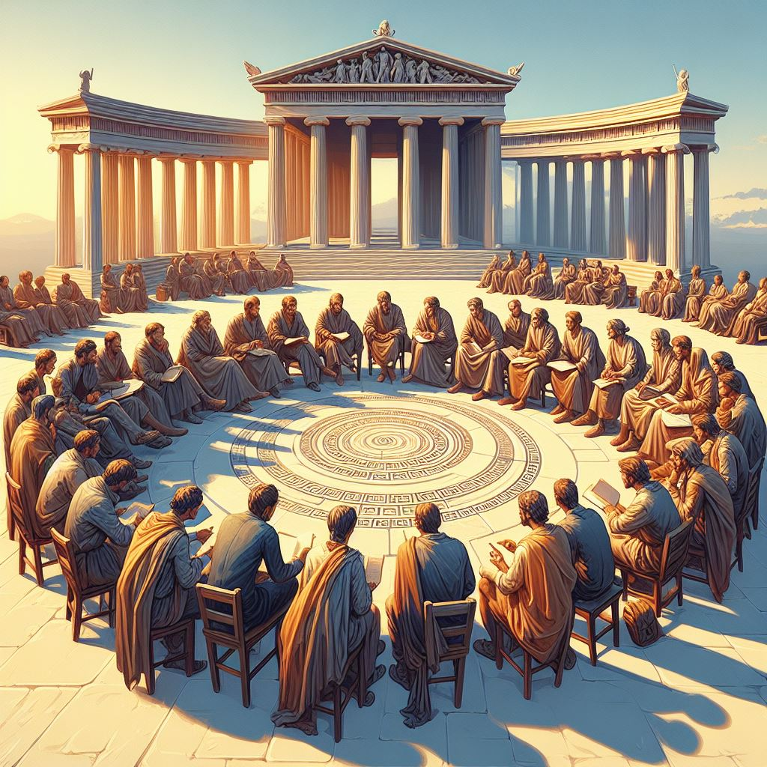
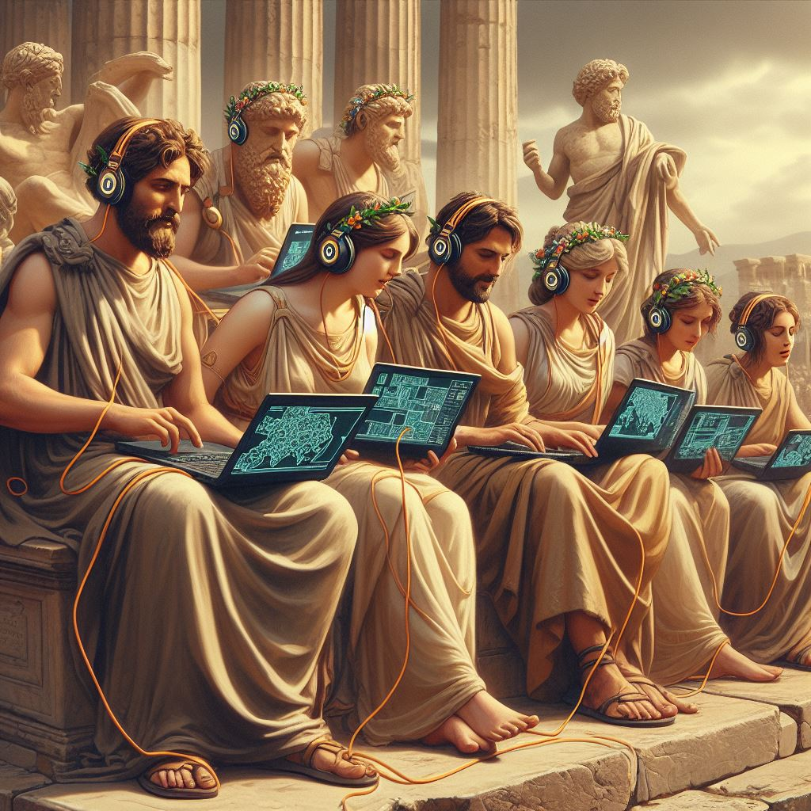

What happens during the code sprints?
Discussions
Independent Work
Mentor Stream

Slide 14

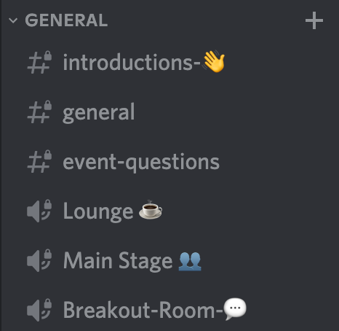
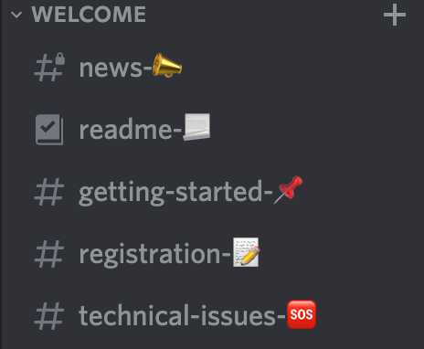
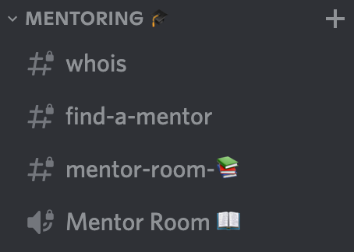
OGC Events Discord Server
Meta channels: check-in and general info
Main track: Kick-off, standups and demos
Mentor stream: tutorials, 1:1 mentoring
Matrix bridge: https://matrix.to/#/%23ogc:matrix.org

Slide 15

Tutorials – Onboarding Day
Mentor Stream Onboarding
@Mentor Room: 10:10 - 10:30 UTC

Slide 16
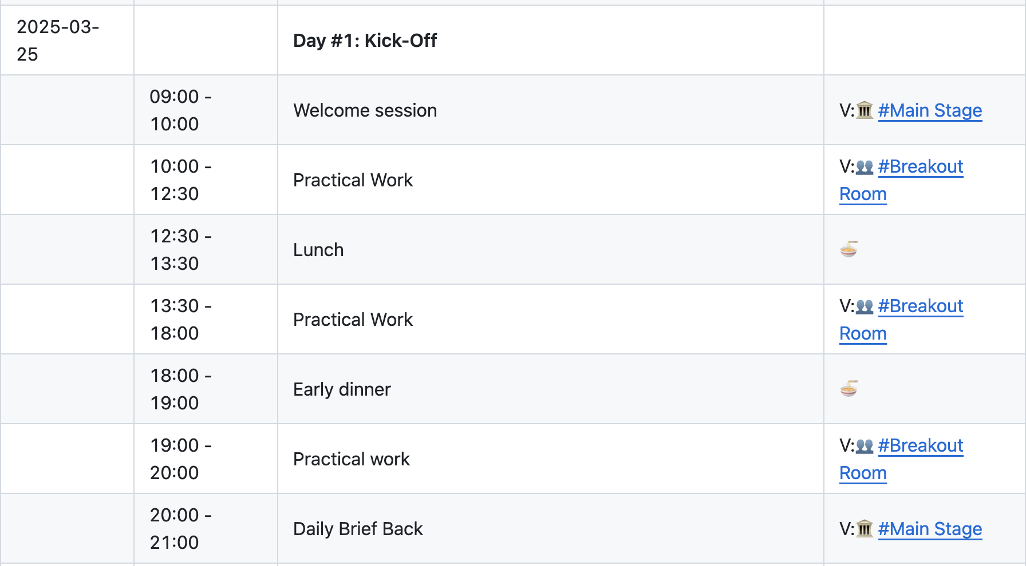
Day #1 - Tuesday, the 25th of March 2025
Location on Discord

Slide 17
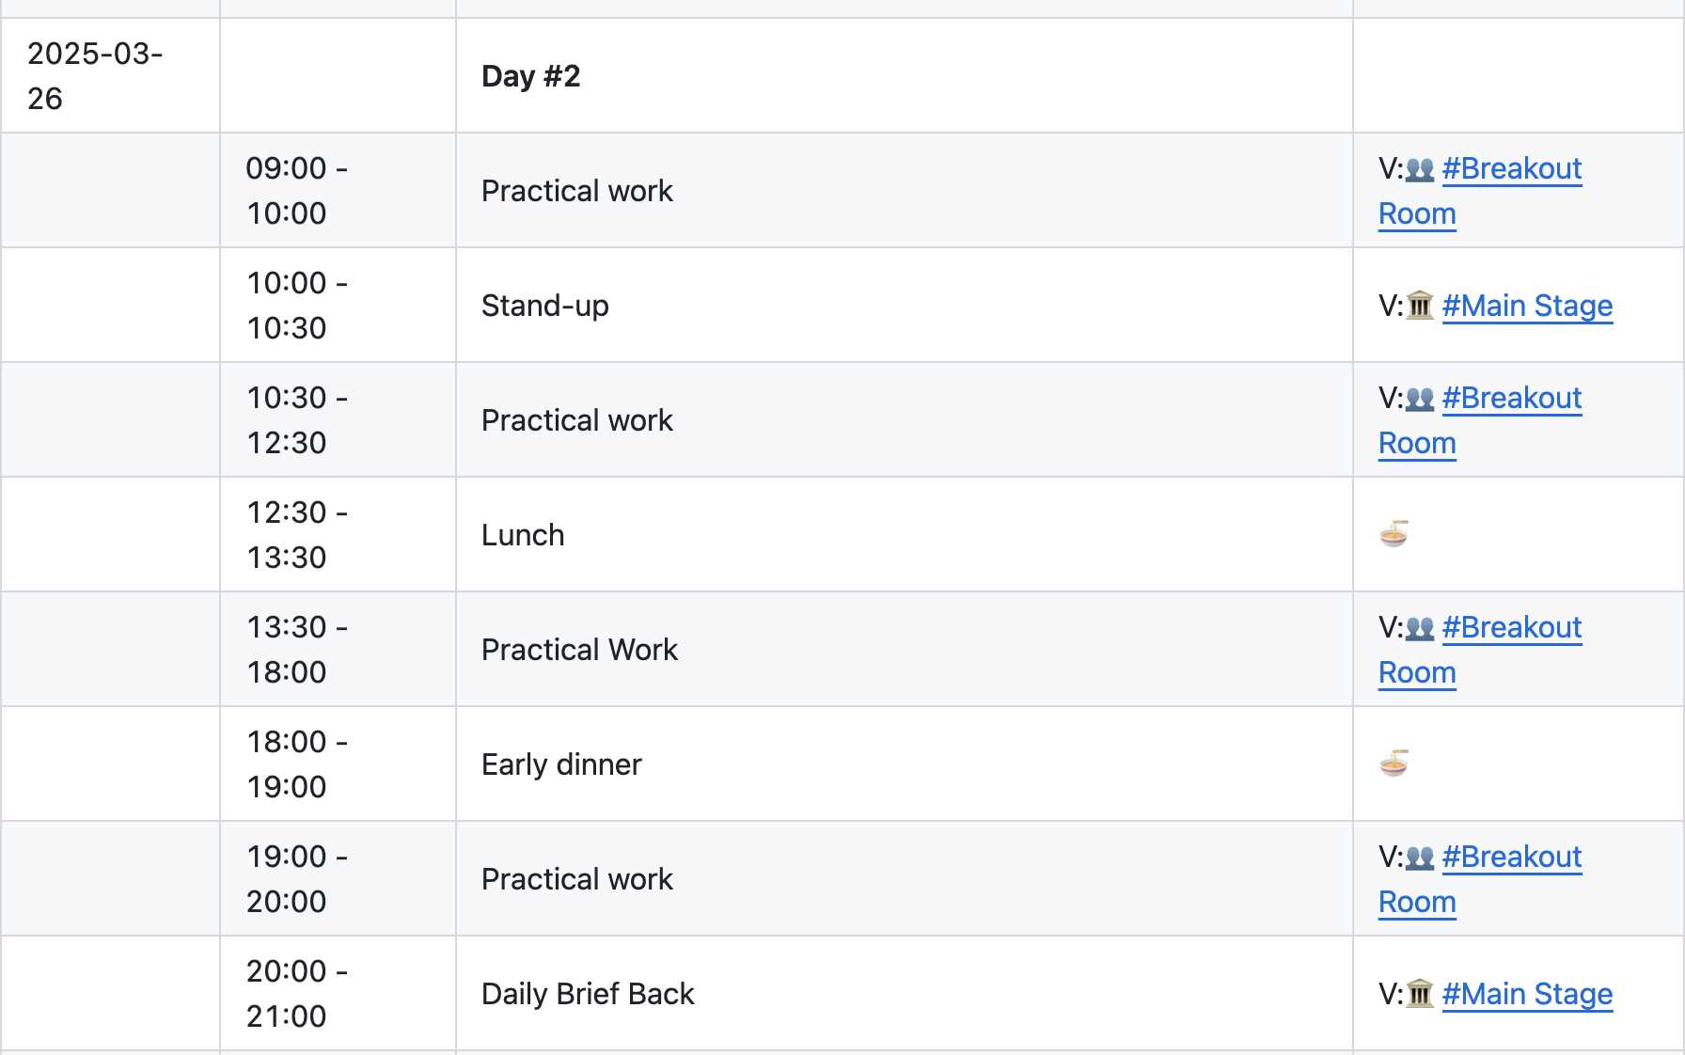
Day #2 - Wednesday, the 26th of March 2025

Slide 18
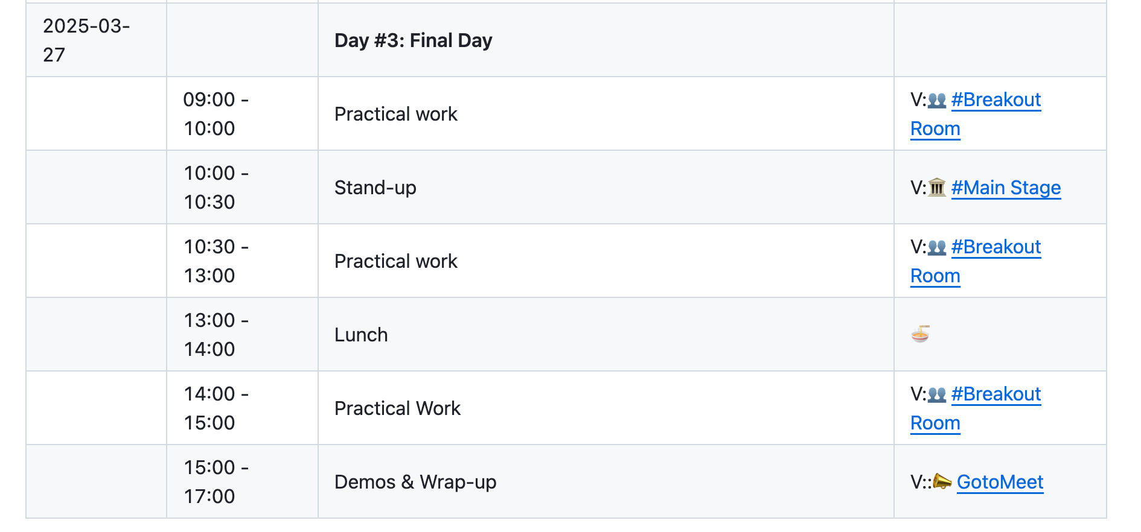
Day #3 - Thursday, the 27th of March 2025

Slide 19
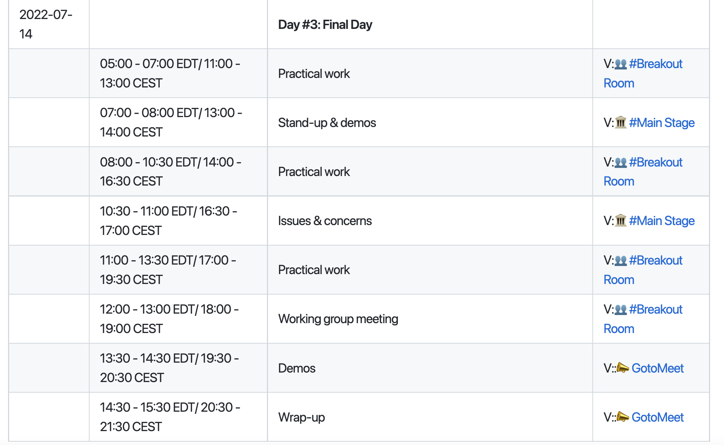
Feel Free to add more items to the schedule
👈🏼 Example from a previous schedule
👉 https://github.com/opengeospatial/developer-events/wiki/March-2025-Open-Standards-Code-Sprint#schedule

Slide 20
Missed a session?
Slides will be uploaded to GitHub.
There will be a video recording of the demo session.
There will be audio recordings for all the other sessions at the #Main Stage.

Slide 21

More Information
GitHub repo:
https://github.com/opengeospatial/developer-events/
Folder 👉🏽 2025/Open-Standards-Code-Sprint
Wiki page:
https://github.com/opengeospatial/developer-events/wiki/July-2024-Open-Standards-Code-Sprint
Developer website:
https://developer.ogc.org
Hashtags: #CODESPRINT25 #OGCAPI

Slide 22
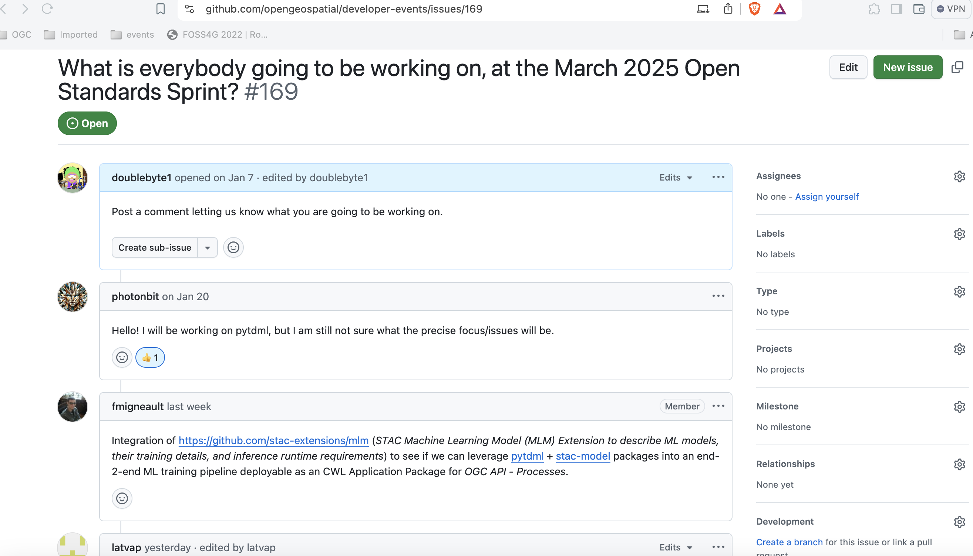
#169
Share what you will be working during the sprint

Slide 23

THANK YOU
Let’s get started!
www.ogc.org

