Slide 1
Dr Gobe Hobona (OGC) 22 January 2026
Sprint Goals for participating OGC working groups

Slide 2
Introduction to OGC
Our Vision
Building the future of location with community and technology for the good of society.
Our Mission
Make location Information Findable, Accessible, Interoperable and Reusable (FAIR)
Our Approach
A proven collaborative and agile process combining consensus-based standards, innovation project and partnership building.

Slide 3
Innovation
Call for Sponsors
DWG discussion
Create public call
SWG formation
Identify
Project
Standards development
Select best members
Innovation
Standards
Development
Interest gathering
DWG/SWG Presentation
Execute
Project
Deliver Results
Formulation of enhancements
DWG = Domain Working Group
SWG = Standards Working Group

Slide 4
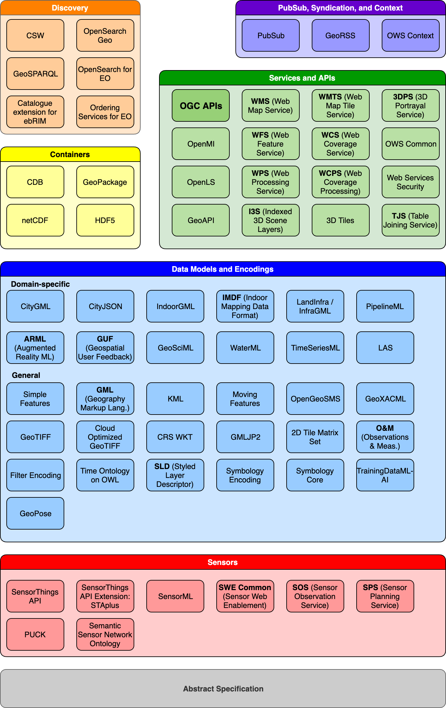
OGC Standards at a glance
COG
MUDDI

Slide 5
Overview of OGC Testbed-21
The testbed is composed of the following threads:
Data Quality for Integrity, Provenance, and Trust (DQ4IPT)
GEOINT Imagery Media for Intelligence, Surveillance, and Reconnaissance for OGC Testbed-21 (GIMI-T21)
Conformance Testing Tool Development (CTTG)

Slide 6
Which OGC Standards will feature in the code sprint
OGC API - Records
OGC API - PubSub
Coverage Implementation Schema (CIS)
Web Coverage Processing Service (WCPS)
Training Data Markup Language for
Artificial Intelligence

Slide 7
Sprint Goals for OGC Working Groups
Develop prototype implementations
Test the prototype implementations
Identify opportunities for further innovation
Provide feedback to the Editors, Working Groups, and OGC Testbed participants about what worked and what did not

Slide 8

THANK YOU
www.ogc.org

