Slide 1

Datum: 9 Oktober 2025
Use case: Webbased Spatial Join
Maarten Vermeij

Slide 2
Web-based Spatial Join Challenges

Slide 3

Real-World Question
Give an overview of buildings with green roofs in the city.
Indicate which buildings have green roofs,
How large the green roof area of each building is
Aggragate values
Track changes over time (does the number and area increase/decrease change over time)

Slide 4
Real-World Solution
Dataset 1: Green Roofs (~10.000)
Automated detection of “groene daken” “green roofs”
results in a dataset with polygons indicating positive detection
Dataset 2: Buildings (Rotterdam ~300.000, Netherlands ~10.000.000
-Rotterdam ~300.000 polygons

Slide 5
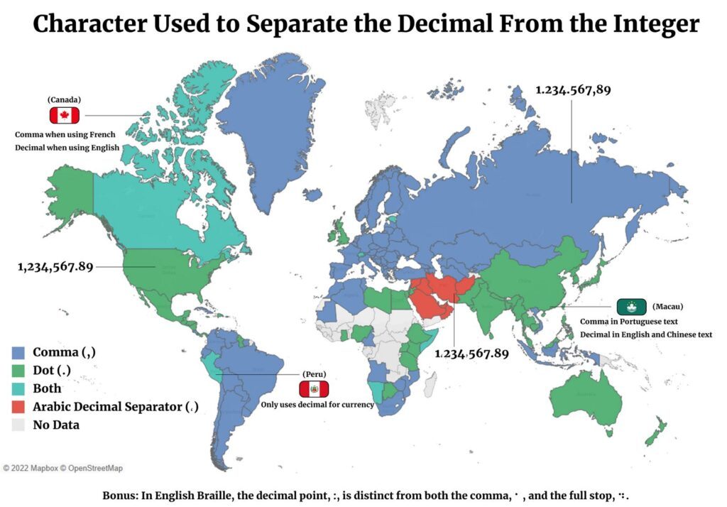

Slide 6
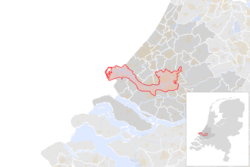
~300.000 buildings
~10.000.000 buildings

Slide 7
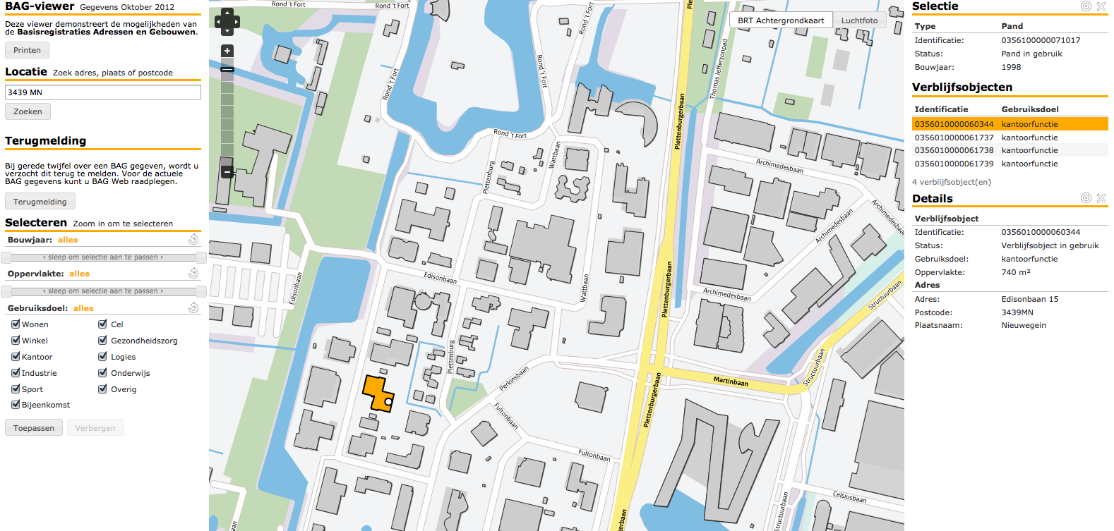

Slide 8


Slide 9
Let’s join
Dataset 1:
10.000 records
Dataset 2:
300.000 records

Slide 10



Let’s join
Dataset 1:
10.000 records
Dataset 2:
300.000 records

Slide 11

Let’s join
Dataset 1:
10.000 records
Dataset 2:
300.000 records

Slide 12


Let’s join
Dataset 1:
10.000 records
Dataset 2:
300.000 records
WFS / API Features
WFS / API Features

Slide 13

Let’s join
Dataset 1:
10.000 records
Dataset 2:
300.000 records
WFS / API Features
WFS / API Features
WFS / API Features

Slide 14

Let’s join
Dataset 1:
10.000 records
Dataset 2:
10.000.000 records
WFS / API Features
WFS / API Features
WFS / API Features
PDOK: “You are requesting more than 50.000 records. Please consider using the download”

Slide 15
What is the best way to spatially join to datasets over webservices?
Given that:
We promote service oriented architectures
We promote federated data architectures
What are usable solutions/patterns for spatially joining datasets using webservices?
What are practical limits when applying webservices?
Are downloads avoidable? If so, how do we present these consistenly in relation with the webservices?
If downloads are still necessary, how do we nudge users to webservices when these are “better”?

