Slide 1
Clemens Portele | interactive instruments Panagiotis (Peter) A. Vretanos | CubeWerx Inc. 09-OCT-2025
OGC Features and Geometries JSON (JSON-FG)

Slide 2
About JSON-FG
Intentional limitations exist in GeoJSON
Restricted to WGS 84 (longitude/latitude) as Coordinate Reference System
Points, line strings and polygons – no support for 3D, non-linear interpolation or measures
Supports spatial, but not time
No feature type concept, no information about the schema
JSON-FG specifies GeoJSON extensions to address these constraints
Avoid edge cases, focus on capabilities that are useful for many spatial experts
Specify as a superset of GeoJSON: Valid JSON-FG is also valid GeoJSON
Extensions:
Additional JSON members in feature collections, features and geometries
Additional geometry types
JSON Schema is used to formally specify the JSON-FG syntax

Slide 3
Requirements class overview
Mandatory extensions (Core):
Coordinate Reference Systems other than WGS 84
The ability to encode temporal characteristics of a feature
A statement to which JSON-FG conformance classes a JSON-FG feature collection, feature, or geometry conforms to
Optional extensions specified in additional requirements classes:
Support for polyhedra as geometry types
Support for prisms (extruded geometries) as geometry types
Support for circular arcs, compound curves, and curve polygons as geometry types
Support for measure values in coordinates
The ability to declare the type and the schema of a feature

Slide 4
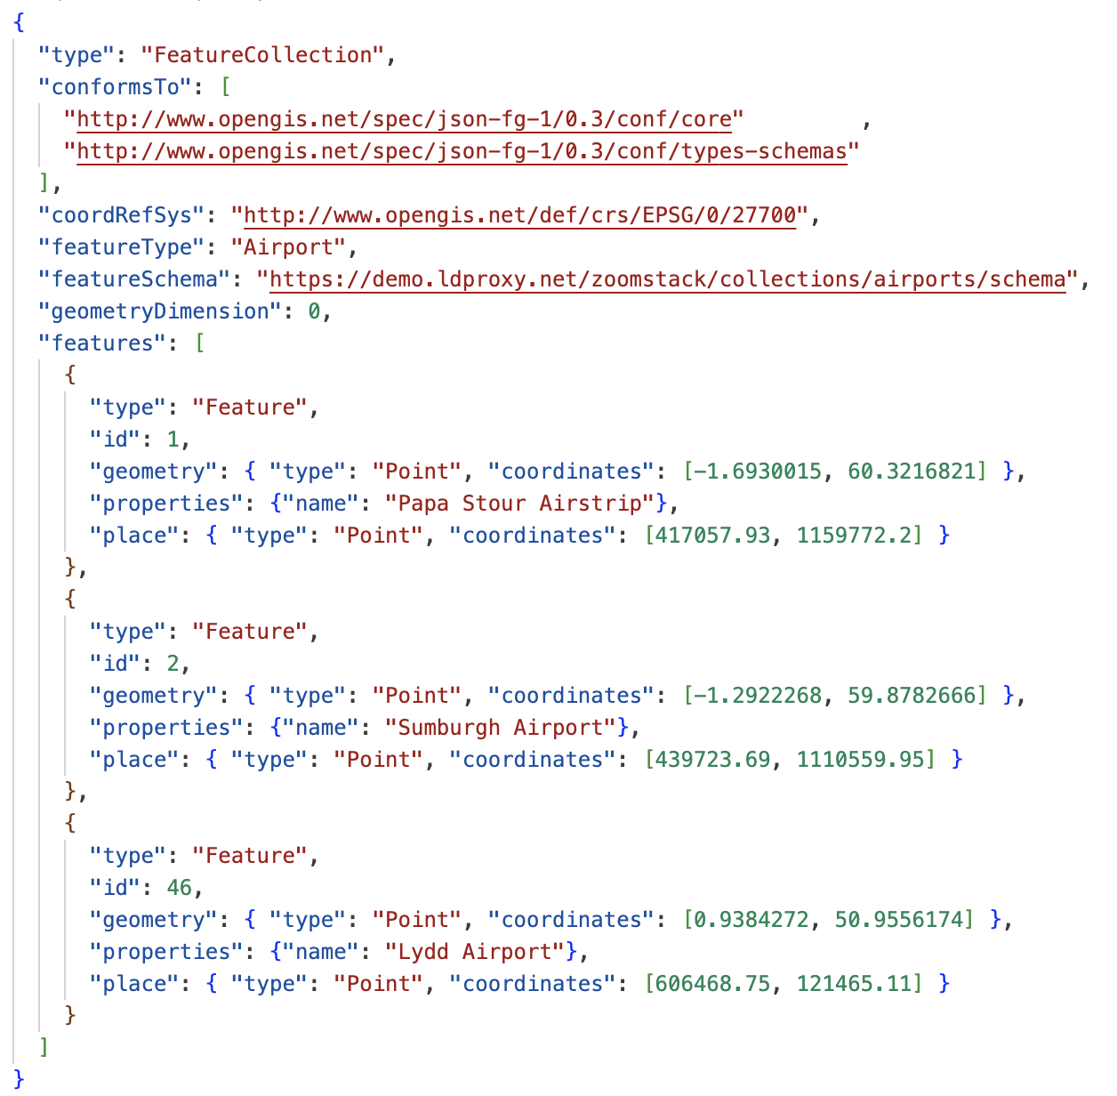
An example - three airports in the UK
“conformsTo”:
declaration of the supported conformance classes
“place”:
a primary feature geometry that is not a Simple Feature geometry or not in WGS 84 longitude/latitude
“coordRefSys”:
Coordinate reference system of the geometry in “place”
“geometry” (from GeoJSON):
a primary feature geometry that is a Simple Feature geometry and in WGS 84 longitude/latitude (optional, if “place” is provided)
“geometryDimension”:
hint about the geometry types used (0 = points)
“featureType”, “featureSchema”:
Information about the type of a feature and the logical schema of the features of that type

Slide 5
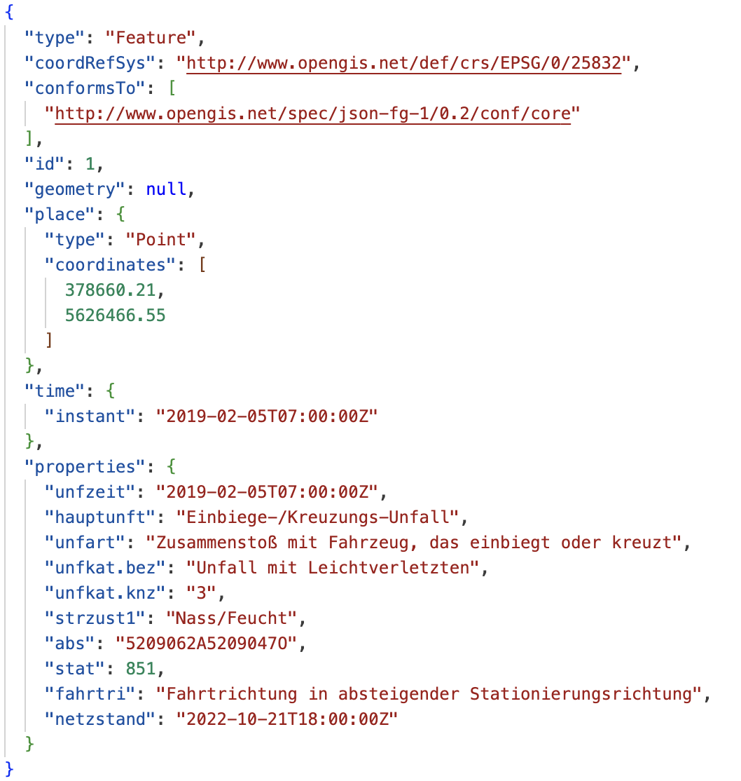
Another example – a road accident in Germany
“time”:
a primary temporal information

Slide 6
Technical changes since the Public Comment Period
Improvements
Use “application/geo+json” as the media type, do not register a JSON-FG media type
Supports GeoJSON clients that access JSON-FG documents over HTTP
Specification of three GeoJSON profiles
Geometries are also first class JSON-FG objects, not just features and feature collections
Allows, for example, reuse of the geometries in future versions of CQL2-JSON
Updated JSON Schemas to test more requirements through JSON Schema validation
New capabilities
Added support for circular arcs – plus curves and surfaces with arcs
Added support for measure (M) coordinates
Removed from scope
The permission to use non-Euclidean metrics, in particular ellipsoidal metrics
This would break GeoJSON, which requires Euclidean metrics for GeoJSON geometry types
GeodesicString has been added as an example of a geometry extension
Support for CURIEs
CURIEs add overhead to parsers, but are not an advantage to writers

Slide 7
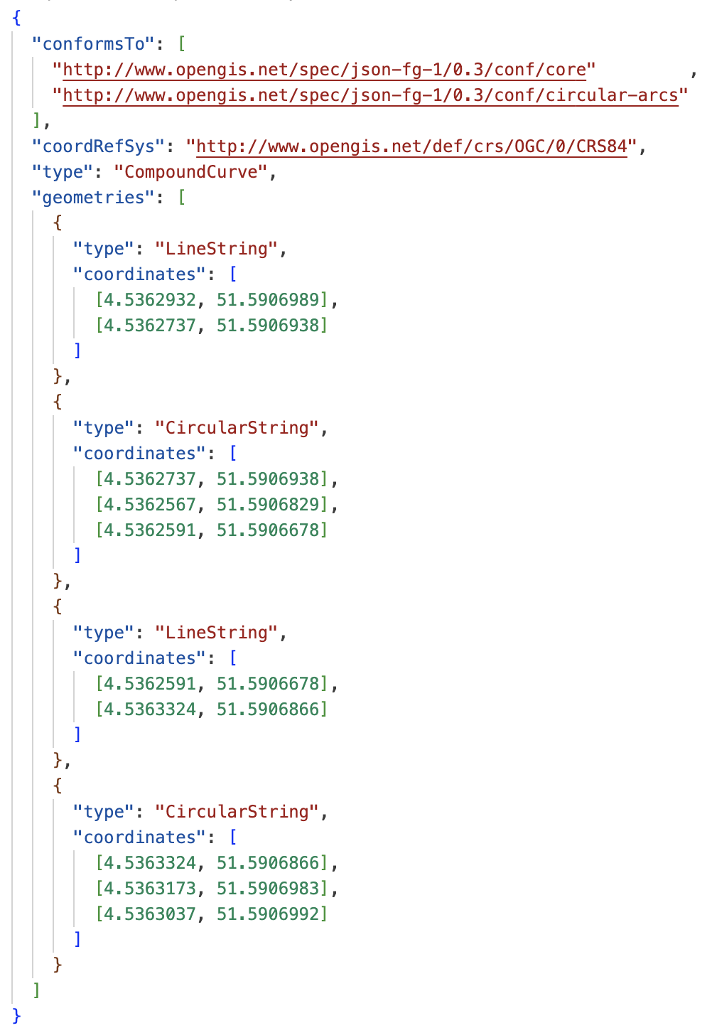
Circular arcs
New geometry types CircularString, CompoundCurve, CurvePolygon, MultiCurve, MultiSurface
JSON representation based on WKT of the geometry types with the same name from SQL/MM
Following the same conventions as GeoJSON – the use of “coordinate” arrays, a “type” member and a “geometries” array for collections of geometries
Widely implemented in spatial databases
Multiple requests for support

Slide 8
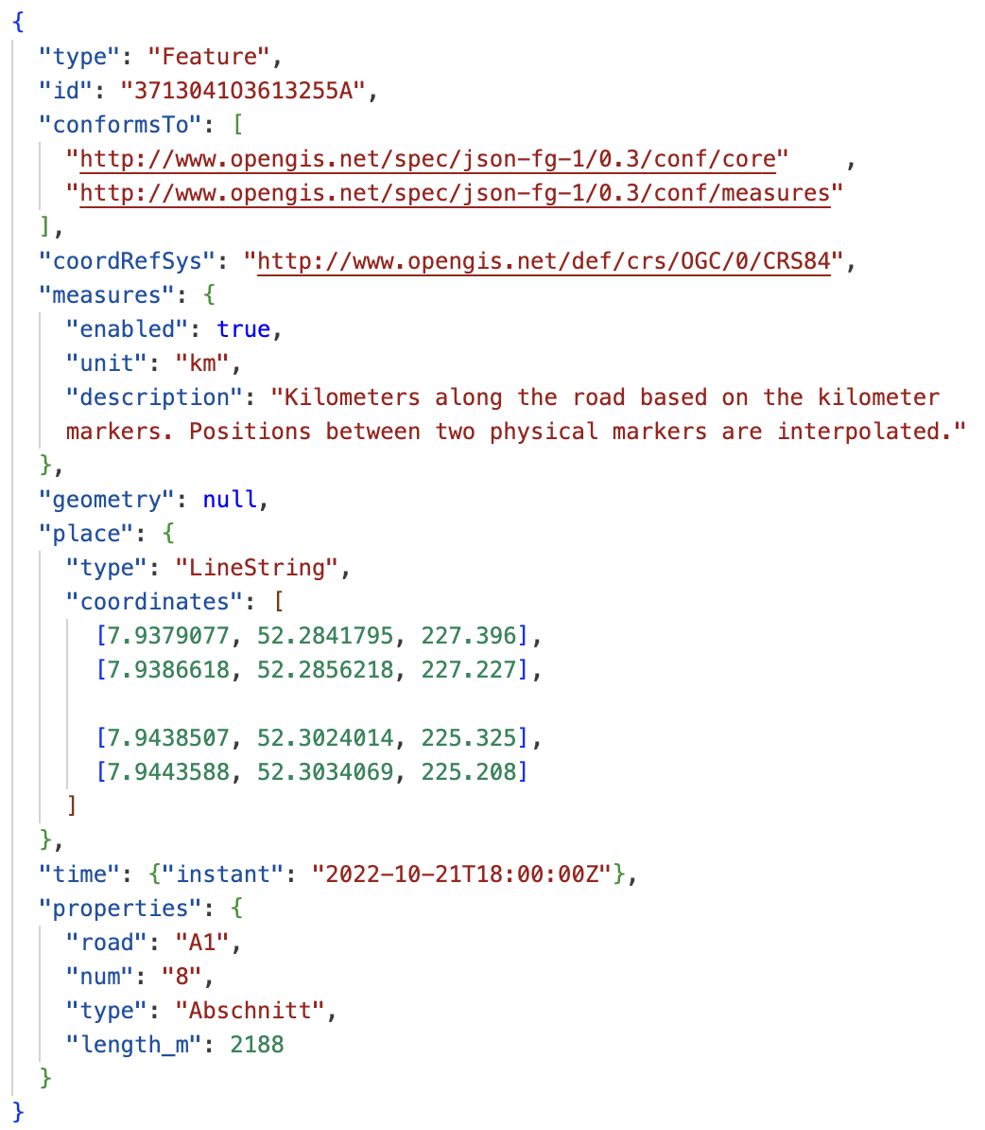
Measure (M) coordinates
GeoJSON supports more than three coordinates in a position, but discourages non-spatial coordinates
Multiple requests for support
M coordinates are supported in WKT and widely supported in spatial databases
“measures”
Used to declare the use of M coordinates in geometries
The meaning of the X/Y or X/Y/Z coordinates is declared through the “coordRefSys” member
“unit” and “description” provide metadata (optional)
Only in “place”, not in “geometry”

Slide 9
GeoJSON profiles
A GeoJSON document should use the “application/geo+json” media type
A profile specifies “additional semantics (constraints, conventions, extensions) that are associated with a resource representation, in addition to those defined by the media type” [RFC 6906]
JSON-FG specifies three profiles for use in Web APIs such as those implementing OGC API Features
RFC 7946 ("rfc7946"): GeoJSON as specified in RFC 7946
JSON-FG ("jsonfg"): JSON-FG as specified in this Standard
JSON-FG with improved support for GeoJSON readers ("jsonfg-plus"): JSON-FG with a geometry in the "geometry" member
Profiles are requested via a ”profile” query parameter (one or more profiles)
Example: ...&profile=jsonfg-plus,rel-as-uri

Slide 10
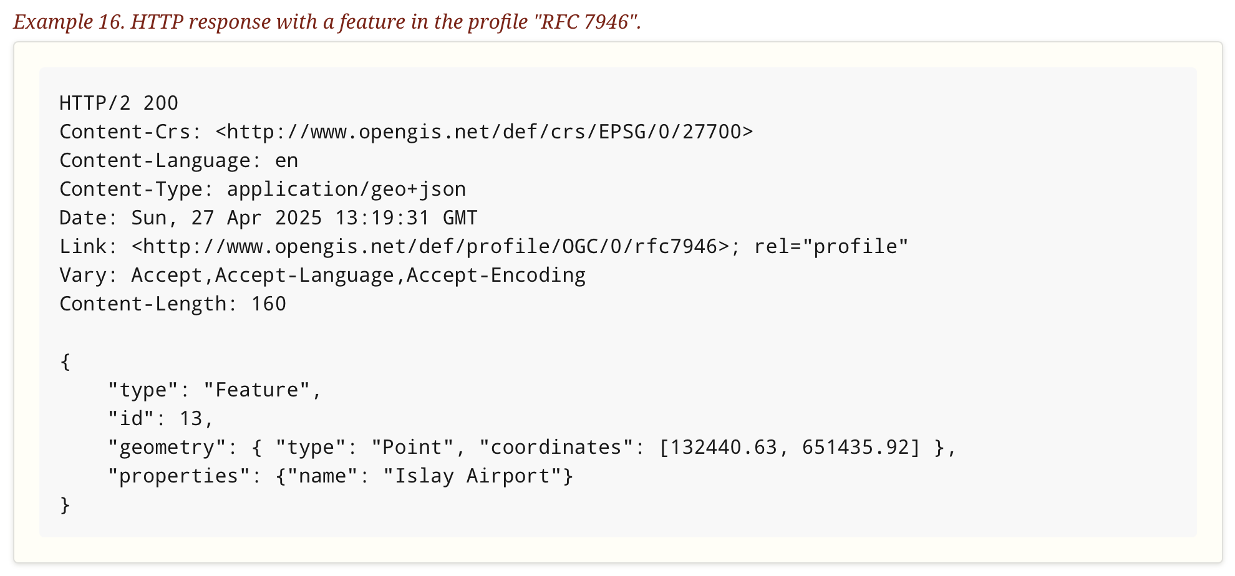
HTTP-Response with Profile “rfc7946”

Slide 11
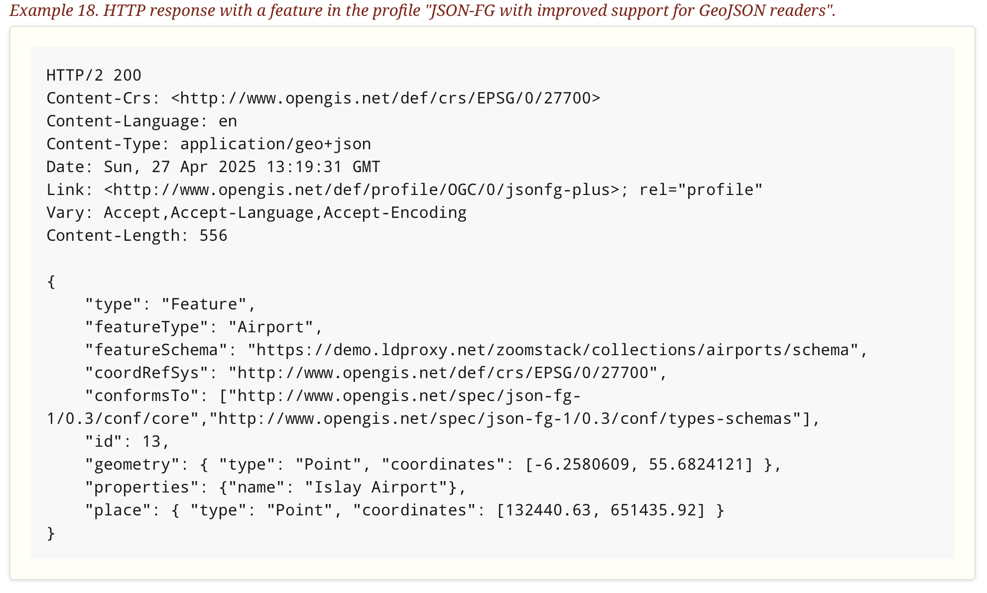
HTTP-Response with Profile ”jsonfg-plus”

Slide 12
Implementations
Multiple implementations of the previous draft (v0.2)
Servers/APIs
Map clients
Converters (including GDAL)
Validators (including the OGC Checker by Geonovum)
Tested and used in multiple code sprints
Changes since v0.2 that may affect current implementations (ignoring new capabilities):
Use of “application/geo+json” as the media type, use of GeoJSON profiles
Removal of CURIEs
New version → new Conformance Class URIs
At least two implementations will be upgraded, including support for the new capabilities, in parallel to the approval process

Slide 13
Sprint goals
Outreach
Make people in the “geo” space aware of this standard
All the nice things about GeoJSON with added “spice” to handle more advanced use cases
Test the new things we added
Circular arcs
Measure coordinates
Profile support

Slide 14
Dependency on OGC API – Features – Part 5: Schemas
Schemas referenced by a “featureSchema” member are logical schemas that conform to OGC API – Features – Part 5: Schemas
Part 5 is currently still a draft
Close to finalization, should be submitted to the TC in a few weeks
Delay JSON-FG publication until the vote of Part 5 has passed?

Slide 15

THANK YOU
www.ogc.org

