Slide 1
Benjamin Pross (52-north) Panagiotis (Peter) A. Vretanos (CubeWerx) 09-OCT-2025
OGC
Introduction to the OGC API – Processes Standards

Slide 2
Agenda
Introduction to OGC API – Processes – Part 1: Core
Introduction to OGC API – Processes – Part 2: Deploy, Replace, Undeploy
Code sprint goals

Slide 3
OGC API – Processes – Part 1: Core (ready for OAB review around upcoming OGC TC)

Slide 4
Requirements classes
Core
How to get a list of available processes and the description of a process
How to execute a process (sync or async)
Get job status info and get results for async execution
Collections
Collection input
Support local OGC collection as process input
Various OGC data access methods can be used (e.g. Feat, Cov., etc.)
Filtering is done by the input source API.
Remote collection
Same a collection input but accessing a remote API
Collection output
Support redirection to collection output for a single output
Local filtering
Support local filtering of data if the input source server does not support it

Slide 5
Requirements classes
OGC process description
Get the description of a process (inputs, outputs, etc.) using the OGC process description vocabulary
JSON
Support for JSON-encoded responses
HTML
Support for HTML-encoded responses
OpenAPI 3.0
Support for OpenAPI 3.0
OpenAPI 3.1
Support for OpenAPI 3.1
Job list
Get list of jobs with filtering

Slide 6
Requirements classes
Callback
Support for job notifications (rather than polling)
Dismiss
Cancel and executing job or remove a completed job
KVP-encoded execute
Support GET method on /processes/{processID}/execution endpoint
Process input parameters are passed as query parameters
Profile query parameter
Support for the “profile” query parameter to allow clients to request profiles of media types

Slide 7
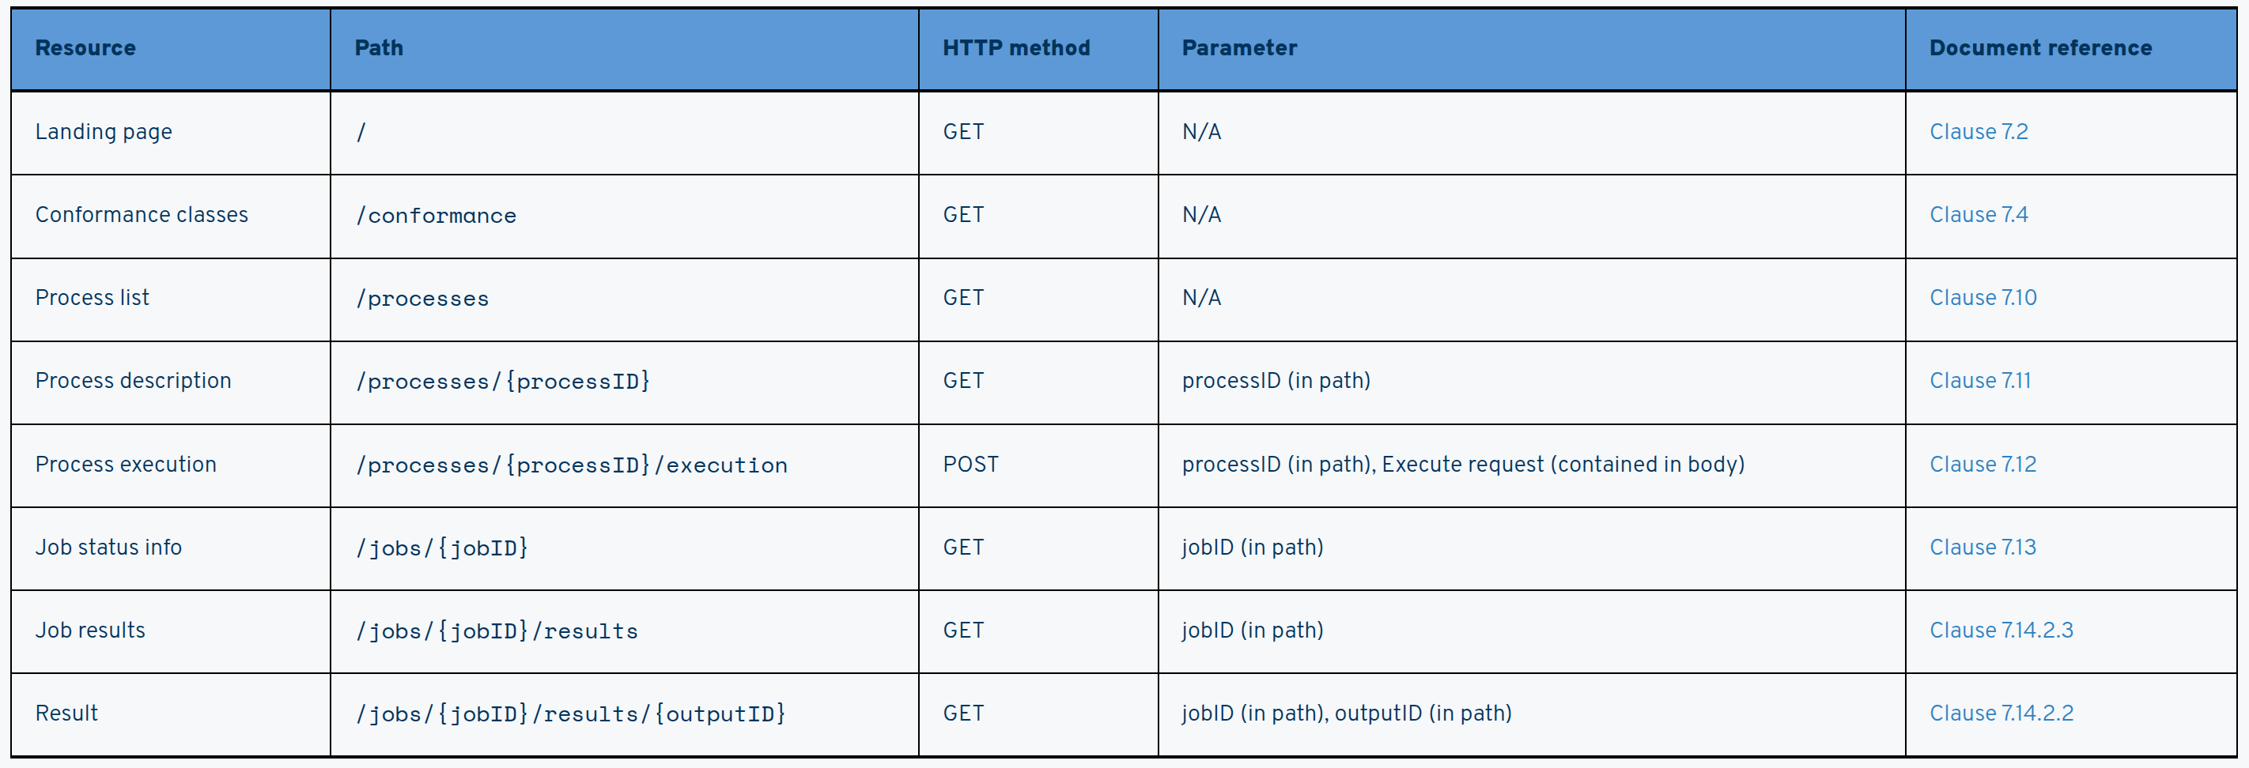
Processes API

Slide 8
OGC API – Processes – Part 2: Deploy, Replace, Undeploy (ready of OAB review around upcoming OGC TC)

Slide 9
Requirements classes
Deploy, Replace, Undeploy
Uses POST, PUT, DELETE to dynamically add, replace or delete processes from an OAProc deployment
Body of POST or PUT is a formal description of a process
Only processes marked as “mutable” can be modified
Based on “OGC API – Features – Part 4: Create, Replace, Update and Delete”
OGC Application Package
A JSON-encoded description of a process
Can be used as the body of a POST or PUT operation
An application package contains a process description using the OGC Process Description vocabulary from Part 1
An application package also contains details about the “execution unit”
The execution unit is the thing the OAProc server executes when the process is invoked
Details of the execution unit can be specified in-line or by reference

Slide 10
Requirements classes
Docker
An extended execution unit description specifically for Docker containers
Provides details such as the reference to the image, the type of deployment (local, remote, hcp, cloud) and as well as resource requirements to run the container (# of cpus, mem requirements, temp storage requirements, etc.)
Common Workflow Language
Based on the Common Workflow Language standard
CWL can be used as an execution unit in a OGC Application Package
CWL can, on its own, be used as the process description for deployment

Slide 11
Sprint goals
Sanity check for changes in version 2.0 of Part 1: Core
Focus execution due to major update to the execute mechanism (e.g. support for collection input and output).
Exercise Part 2: Deploy, Replace, Undeploy
New standard so want to test as much of it as possible
Clients are always a problem so we propose to focus on testing servers using cURL.
Possibly also use python-based client and TEST Engine-based tests.

Slide 12

THANK YOU
2300, Wilson Blvd. Suite 700-1026, Arlington, VA 22201, USA
www.ogc.org

