Slide 1

OGC-API-Joins
Codesprint Rotterdam
Panu Muhli, Pekka Latvala Pieter Bresters

Slide 2
Why is data integration needed ?
Growing need to integrate statistical and other tabular information with geographic features for more effective analysis and interpretation.
OGC-API-Joins is based on a basic principle: keep data at its source and only join when needed.
Census districts and blocks, municipalities, postal codes, telephone area codes, ecoregions and regular measurement points are all examples of geographic features that one could link tabular data to.
Geographic identifier provides the link for merging tabular data to geographic features

Slide 3
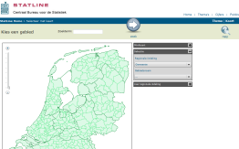
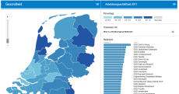
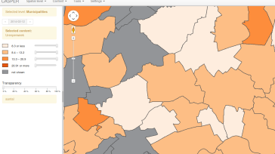
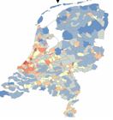
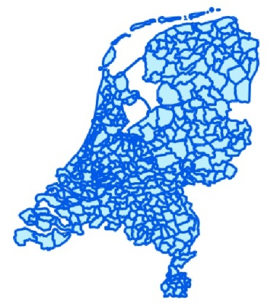
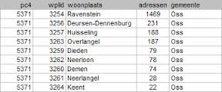

Data integration by OGC API - Joins
applications
Feature collection
Tabular data
Key-fields
OGC API - Joins

Slide 4
OGC API – Joins overview
Initiative from Finnish Geospatial Research Institute FGI and National Land Survey of Finland, based on existing Table Joining Standard.
Online Joining of tabular data to geospatial data
Tabular data (CSV-supported) by uploading or by provided URL
Geospatial data can be provided using OGC-API-features collection or with an externally hosted or uploaded geospatial file (GeoJSON)
Joining process is executed through common key values available in both datasets (for example municipality codes or names).
The draft standard uses definitions from OGC API – Common.

Slide 5

Status of the standard
The standaard is still a draft: https://docs.ogc.org/DRAFTS/22-026.html
You can contribute via: https://github.com/opengeospatial/ogcapi-joins/issues

Slide 6
How to get involved
Become OGC-member
Standards Working Group (SWG) teleconferences held every 2 weeks on Tuesdays at 09:00am US Eastern Time.
Sign the Observer Agreement and participate in the SWG teleconferences, https://portal.ogc.org/index.php?m=public&orderby=default&tab=7

Slide 7
Sprint goals OGC-API-Joins
Promoting and getting familiar with the standard
introduction to the OGC API Joins and demonstrate server and client implementations and Sample pitch on Youtube.
Oct 20th, 16:15-17:00 UTC+2
by Pekka Latvala (Finnish Geospatial Research Institute)
Creation of a demo implementation in Pygeoapi based on
Statistical units from Statistics Netherlands
CSV-files
Getting feedback as input to the consulation
from the development of the implementation
From all the attendees of the code sprint

Slide 8
Thank you for the attention!
Pieter Bresters
p.bresters@geonovum.nl
00 31 (0)33 4604100

