Slide 1
Sam Bolling, Riverside Research
OGC Connected Systems API SWG
Participation Plans for OGC Code Sprint 26
Co-Chairs:
Alex Robin, GeoRobotix
Glenn Laughlin, Pelagis
09 October 2025, 0700 EDT

Slide 2
Agenda
Sprint Goals
OS4CSAPI Initiative (Quad Format)
Repositories of Interest
Project Board
Quads for Repositories of Interest
Useful Links
OGC Code Sprint 26 Planning

Slide 3
Sprint Goals
Confirm that the OAS definitions work as intended and can be used to autogenerate useful code without issues
Confirm that a generic API – Features client (such as QGIS) can connect to a CSAPI server as expected without issues
Arrive at three or more stable, independent open-source implementations of CSAPI
Additional Goals to Refine:
Conformance Test development for API – Connected Systems Parts 1 and 2 (and encodings?)
Prototyping and testing OGC API – Connected Systems with OGC Pub/Sub using Web Video Map Tracks (WebVMT) as a use case
OGC Code Sprint 26 Planning

Slide 4
OS4CSAPI Initiative
POC, Description, & Links:
POC – Sam Bolling, sbolling@riversideresearch.org
A pilot effort to identify, engage, and assist open-source projects of interest with implementation of the OGC CSAPI v1.0 standard
Work Plan:
Draft actionable goals per project
Draft actionable work items per project
Prioritize Projects, Goals, and Work Items
Assign Resources to Tasks
Execute Plan
Report Results
Discuss Future Work and Way Forward
Accomplishments & Status:
Identified and engaged seven open-source repositories of interest
GitHub Project Board created, updated, organized, and issues linked
Camp-To-Camp - Fork, Implementation Plan, and Issues created
52 North – issues created and labeled for the sprint
OWS Lib – issues created for the sprint
Challenges & Risks:
Developer Resources available
Alignment of Developer Resources to Tasks
Time and Opportunity to Work on Tasks
OGC Code Sprint 26 Planning

Slide 5
Repositories of Interest
Project | Description | Open | Client/Server | Language | Response? | Engaged? | CSAPI P1 | CSAPI P2
Open Sensor Hub | Java-based middleware for building better Sensor Webs and the Internet of Things | Yes | Server | Java | No | Yes
52 North CSAPI PyGeoAPI | Proof of Concept of OGC Connected Systems API based on pygeoapi | Yes | Server | Python | Yes | Yes
Botts Innovation CSAPI | Connected Systems API for Java | Yes | Server | Java | No | Yes
GeoServer | GeoServer is an open-source software server written in Java that allows users to share and edit geospatial data. Designed for interoperability, it publishes data from any major spatial data source using open standards. | Yes | Server | Java |  | No
HAKUNAPI | OGC API Features Java server | Yes | Server | Java |  | Yes | Planned | Not Planned
MERLIN (Server) | MERLIN is a reference implementation of standards of interest from the National MASINT Standards Baseline | No | Server | Java | Yes | Yes | Planned | Planned
QGIS (Plugin) | QGIS is a free, open source, cross platform (lin/win/mac) geographical information system (GIS) | Yes | Client | C++, Python | Yes | Yes
OWSLib | OWSLib is a Python package for client programming with Open Geospatial Consortium (OGC) web service (hence OWS) interface standards, and their related content models. | Yes | Client | Python | Yes | Yes
Camp to Camp | A TypeScript library for interacting with geospatial services | Yes | Client | TypeScript | Yes | Yes
MERLIN (Client) | MERLIN is a reference implementation of standards of interest from the National MASINT Standards Baseline | No | Client | TypeScript | Yes | Yes | Planned | Planned
OGC Code Sprint 26 Planning

Slide 6
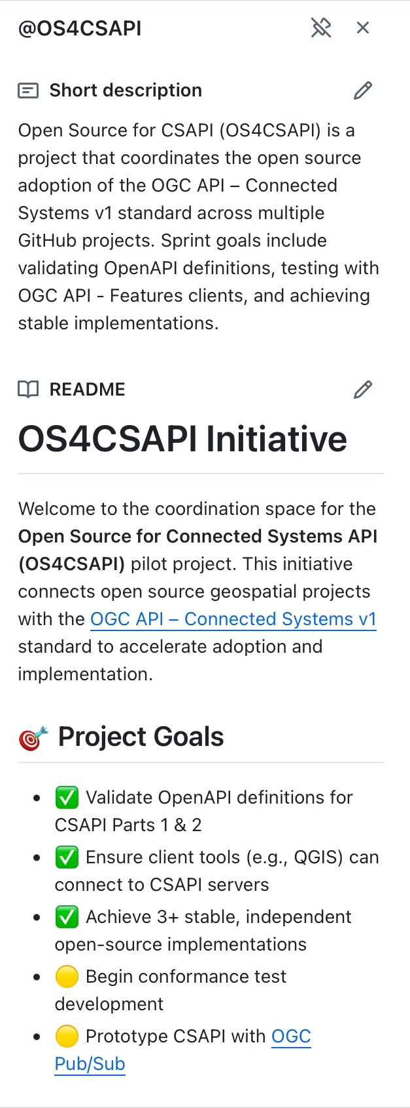
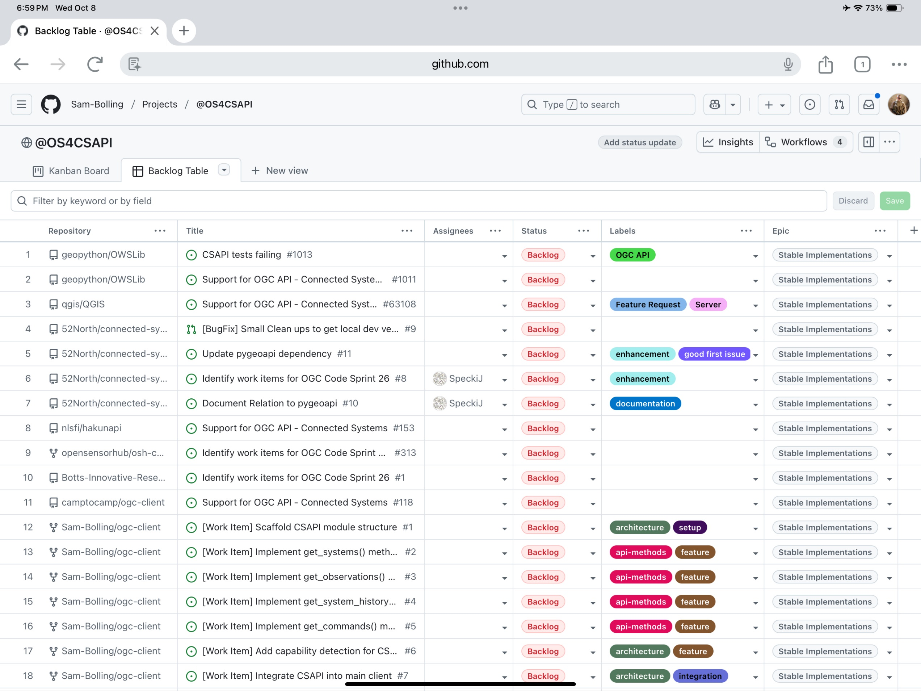
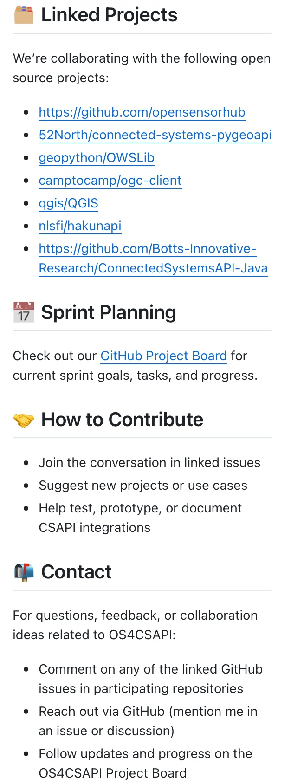
OS4CSAPI GitHub Project Board
OGC Code Sprint 26 Planning

Slide 7

OS4CSAPI Initiative – 52 North CSAPI PyGeoAPI
POC, Description, & Links:
POCs - [Organizational] Simon Jirka (jirka@52North.org), [Technical] Jan Speckamp (j.speckamp@52North.org), [Technical] Christian Autermann (c.autermann@52North.org)
52°North is developing a Server Implementation of the OGC CSAPI Standard in python. Core feature is the seamless integration with the pygeoapi Project, allowing for co-hosting CSAPI with other OGC API Family standards. Currently the project is in alpha-phase, the first production-ready release is planned for Q2 2026.
https://github.com/52North/connected-systems-pygeoapi
Sprint Goal – contribute to the addition of an OGC CSAPI v1.0 implementation to this project
Work Plan:
Identify which Sprint Idea is worked on during the sprint
Develop+Publish (Long-Term) Roadmap
Add non-technical documentation
Showcase how to use the standard to store data from client-view
Sprint Ideas:
Test Specification Conformance
Develop suite of integration-data for Part 1 and 2
Structure test data in a way to be reusable by official ETS
Implement Integration with Generic Features Clients (QGIS + OWSLib)
Currently not working out-of-the-box
Document Best-Practice for Backend Developers
Demonstrator for integration with pygeoapi
"pygeoapi" is part of the Repo name, but no documentation on the actual integration
Setup Demo highlighting cohosting of CSAPI data with other OGC API Family Specifications
Prototype CSAPI Part 3: Pub/Sub
Create base for easily testing out ideas during specification development
Learning from Part 1 and 2
Accomplishments & Status:
Project Engaged and Responded
https://github.com/52North/connected-systems-pygeoapi/issues/8
Project Maintainer provided metadata and additional support
Project Maintainer drafted initial, high-level goals and work plan
Challenges & Risks:
Support from 52°North limited by restricted resources
OGC Code Sprint 26 Planning

Slide 8

OS4CSAPI Initiative – Camp to Camp
POC, Description, & Links:
POC - TBD
The camp-to-camp OGC-Client is a TypeScript library for interacting with geospatial services. It implements several OGC standards and will help you interact with them in a user-friendly and consistent way.
camptocamp/ogc-client: A TypeScript library for interacting with geospatial services
Sprint Goal – contribute to the addition of an OGC CSAPI v1.0 implementation to this project
Work Plan:
Draft actionable goals
Draft actionable work items
Prioritize Goals and Work Items
Assign Resources to Tasks
Execute Plan
Report Results
Discuss Future Work and Way Forward
Accomplishments & Status:
Project Engaged and Responded
Project forked, implementation plan created, work items created
Forked Project with plan and work items:
Sam-Bolling/ogc-client: Fork of camptocamp/ogc-client to implement OGC API Connected Systems support (CSAPI), including modular client, tests, and documentation.
Upstream Repository issue:
Support for OGC API - Connected Systems · Issue #118 · camptocamp/ogc-client
Challenges & Risks:
Developer Resources available
OGC Code Sprint 26 Planning

Slide 9
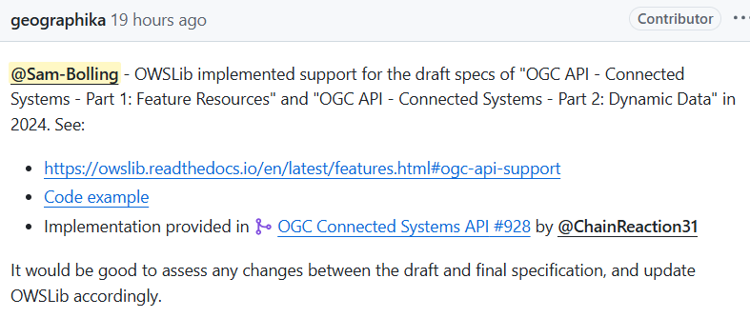
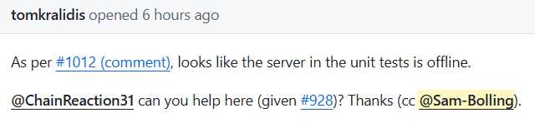
OS4CSAPI Initiative – OWSLib
POC, Description, & Links:
POC - TBD
OWSLib is a Python package for client programming with Open Geospatial Consortium (OGC) web service (hence OWS) interface standards, and their related content models.
https://github.com/geopython/OWSLib
Sprint Goals:
Assess any changes between the draft and final specification, and update OWSLib accordingly
Fix issues causing CSAPI unit tests to fail
Work Plan:
Draft actionable goals
Draft actionable work items
Prioritize Goals and Work Items
Assign Resources to Tasks
Execute Plan
Report Results
Discuss Future Work and Way Forward
Accomplishments & Status:
Project Engaged and Responded
Support for OGC API - Connected Systems · Issue #1011 · geopython/OWSLib
CSAPI tests failing · Issue #1013 · geopython/OWSLib
OGC Connected Systems API by ChainReaction31 · Pull Request #928 · geopython/OWSLib
Challenges & Risks:
Developer Resources available
OGC Code Sprint 26 Planning

Slide 10

OS4CSAPI Initiative – QGIS
POC, Description, & Links:
POC - TBD
QGIS is a free, open source, cross platform (lin/win/mac) geographical information system (GIS)
qgis/QGIS: QGIS is a free, open source, cross platform (lin/win/mac) geographical information system (GIS)
Sprint Goal – contribute to the addition of an OGC CSAPI v1.0 implementation to this project
Work Plan:
Draft actionable goals
Draft actionable work items
Prioritize Goals and Work Items
Assign Resources to Tasks
Execute Plan
Report Results
Discuss Future Work and Way Forward
Accomplishments & Status:
Project Engaged and Responded
Support for OGC API - Connected Systems · Issue #63108 · qgis/QGIS
Challenges & Risks:
Developer Resources available
OGC Code Sprint 26 Planning

Slide 11

OS4CSAPI Initiative – HAKUNAPI
POC, Description, & Links:
POC - TBD
HAKUNAPI is an OGC API Features Java server
nlsfi/hakunapi: OGC API Features Java server
Sprint Goal – contribute to the addition of an OGC CSAPI v1.0 implementation to this project
Work Plan:
Draft actionable goals
Draft actionable work items
Prioritize Goals and Work Items
Assign Resources to Tasks
Execute Plan
Report Results
Discuss Future Work and Way Forward
Accomplishments & Status:
Project Engaged and Responded
Support for OGC API - Connected Systems · Issue #153 · nlsfi/hakunapi
Challenges & Risks:
Developer Resources available
OGC Code Sprint 26 Planning

Slide 12
Attendance Planning and Useful Links
SWG Member | 26 Code Sprint
Mr. Jim Antonisse
Mr. Dave Archer | Virtual
Mr. Sam Bolling | Virtual
Dr. Mike Botts | Tentative In-Person / Virtual
Mr. Drew Botts | Tentative In-Person / Virtual
Mr. Glenn Laughlin | Virtual
Mr. Eric LoMonaco | Virtual
Mr. Tom Kralidis | Tentative In-Person
Mr. Alex Robin | Tentative In-Person / Virtual
Mr. Rob Smith
Mr. Jan Speckamp | In-Person
Dr. Chris Tucker | Tentative In-Person / Virtual
Links:
Open Standards Code Sprint
October 2025 Open Standards Code Sprint · opengeospatial/developer-events Wiki
What is everybody going to be working on, at the October 2025 Open Standards Sprint? · Issue #173 · opengeospatial/developer-events
OGC Events Discord server
Backlog Table · @OS4CSAPI
OGC Code Sprint 26 Planning

Slide 13

Thank You!
sbolling@riversideresearch.org
OGC Events Discord server
www.ogc.org

Slide 14
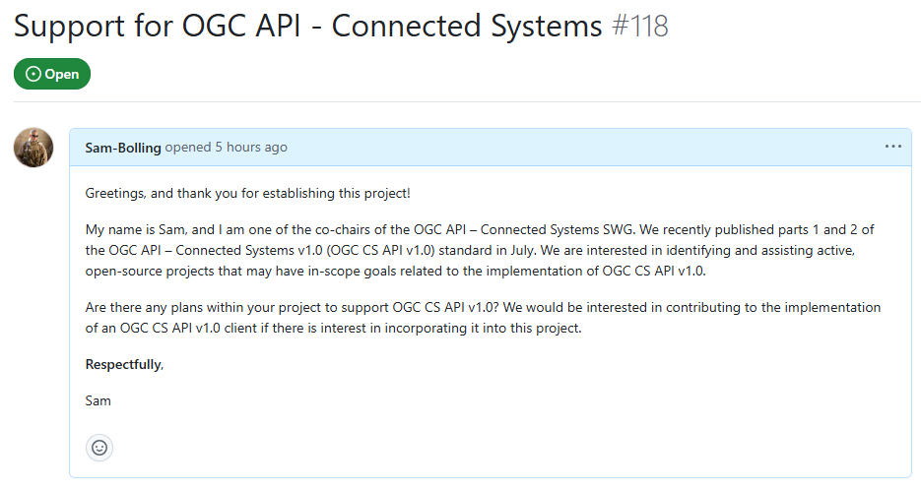
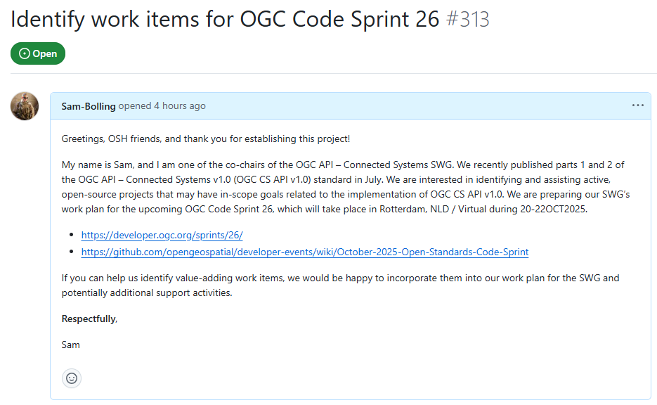
OS4CSAPI Initiative (Working Title)
GENERAL OGC PROJECT ENGAGEMENTS
CSAPI SPECIFIC PROJECT ENGAGEMENTS
OWS Lib – Issue #1011
QGIS – Issue #63108
Camp-To-Camp – Issue #118
GeoServer – TBD
HAKUNAPI – TBD
Open Sensor Hub (OSH) – Issue #313
52 North connected-systems-pygeoapi – Issue #8
Botts Innovation ConnectedSystemsAPI-Java – Issue #1
OGC Code Sprint 26 Planning

Slide 15
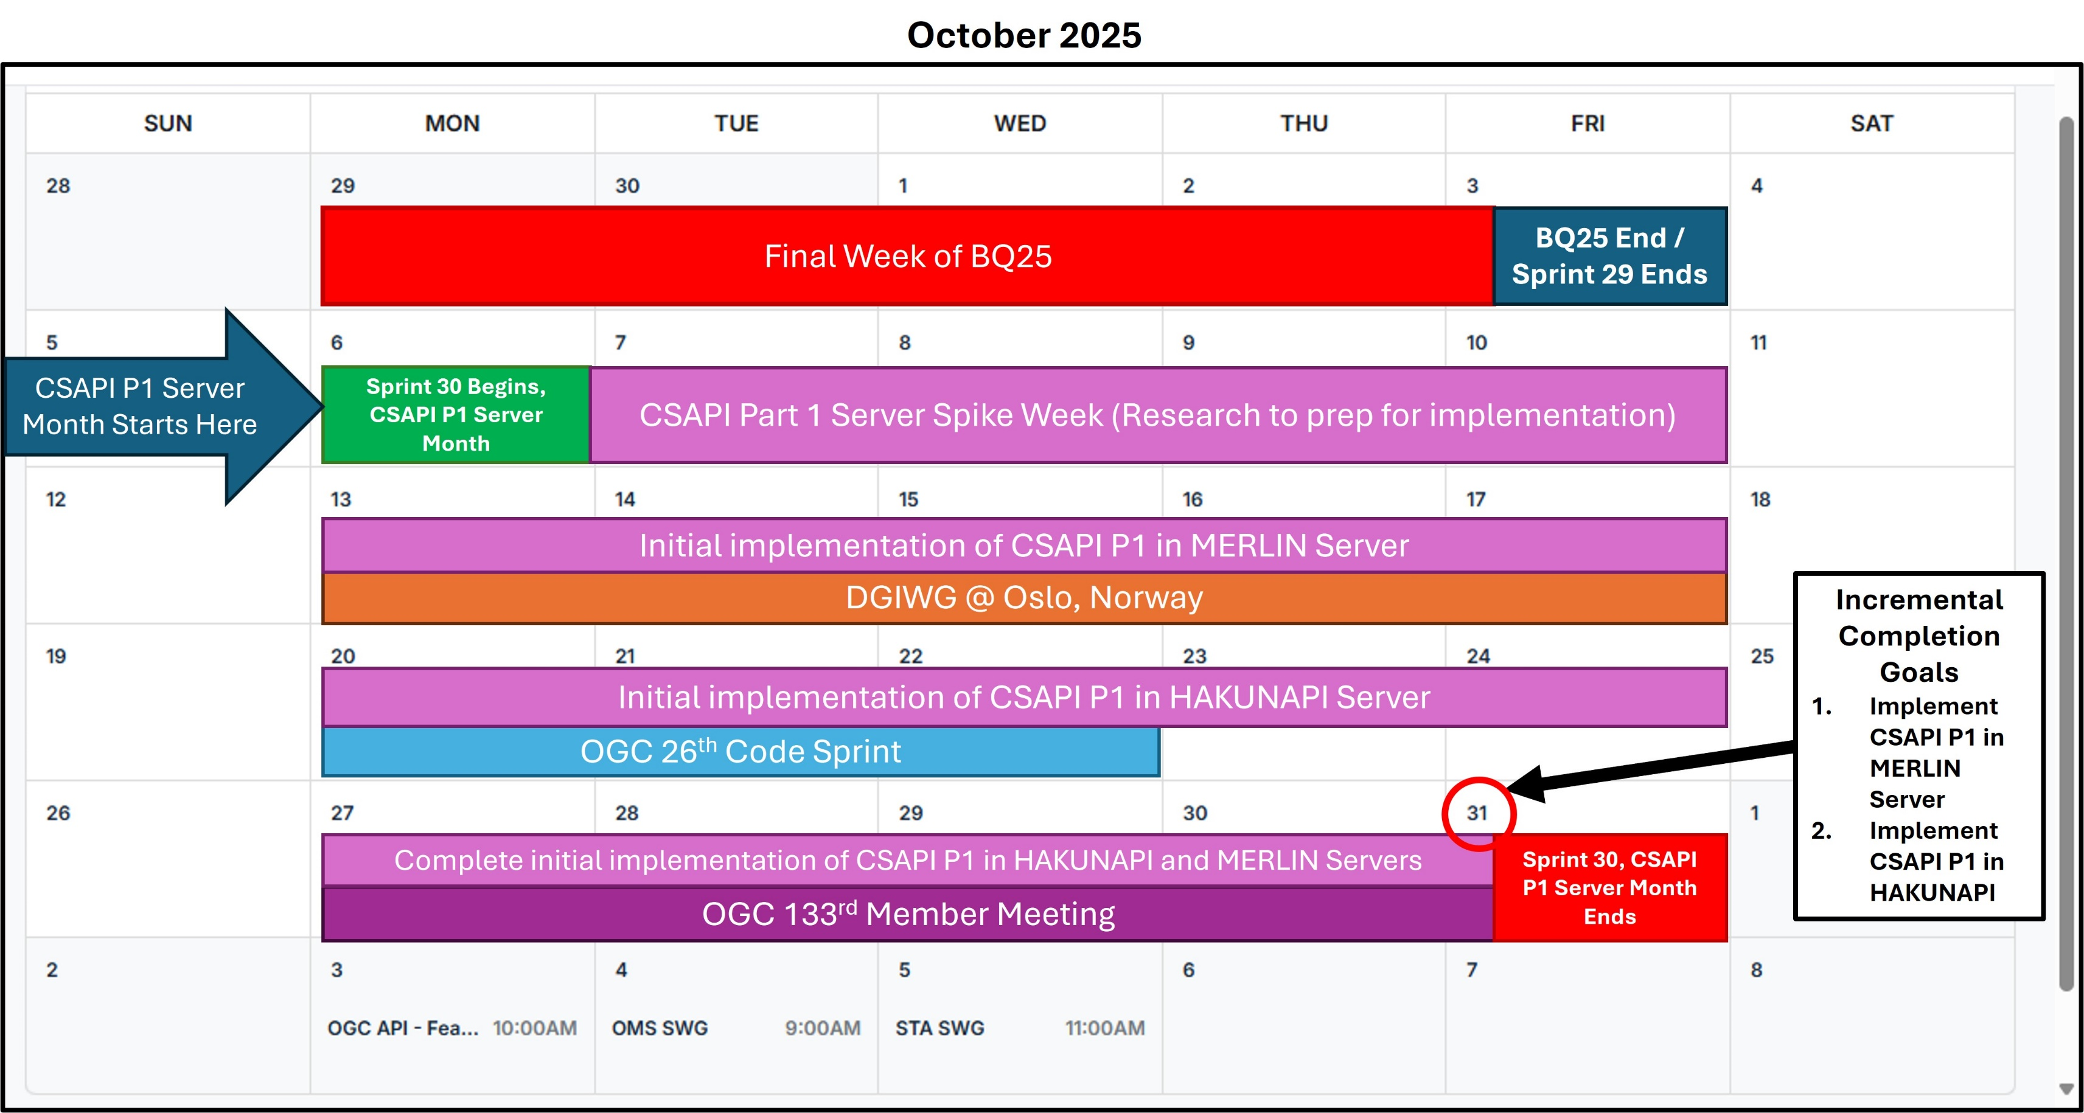
OS4CSAPI Initiative: A notional October Schedule

Slide 16
Useful Links
API – Connected Systems SWG Space on OGC Agora – General (Connected Systems SWG) | Agora
API – Connected Systems SWG Events on OGC Agora – Events (Connected Systems SWG) | Agora
OGC API – Connected Systems Public Page - OGC API - Connected Systems
OGC API – Connected Systems Public Overview Page – OGC API - Connected Systems – Overview (may need updating)
OGC API – Connected Systems Standard v1 Announcement Page - OGC Publishes API for Connected Systems v1.0
OGC API – Connected Systems Standard Public Page - OGC API – Connected Systems
OGC SensorML Standard Public Page – Sensor Model Language (SensorML) Standard | OGC Publications
OGC SWE Common Standard Public Page – Sensor Web Enablement Common (SWE Common) Standard | OGC
OGC API – Connected Systems Github – opengeospatial/ogcapi-connected-systems: Public Repository for the Connected Systems SWG
What Else?
OGC Code Sprint 26 Planning

