Slide 1
Joan Maso (OGC) 27 January 2026
HEIF-GIMI-Introduction

Slide 2
HEIF-GIMI is one of the activities in Testbed-21
The testbed is composed of the following threads:
Data Quality for Integrity, Provenance, and Trust (DQ4IPT)
GEOINT Imagery Media for Intelligence, Surveillance, and Reconnaissance for OGC Testbed-21 (GIMI-T21)
Conformance Testing Tool Development (CTTG)

Slide 3
Introduction
High Efficiency Image File Format (HEIF) is a modern digital container format designed for storing and compressing images, image sequences and movies more efficiently than traditional formats like JPEG. Developed by the Moving Picture Experts Group (MPEG) and finalized in 2015, HEIF is part of the MPEG-H media suite.
Key Features:
Efficient Compression: HEIF files, particularly those using the HEVC (H.265) codec (known as HEIC), can store images at about half the size of equivalent quality JPEG files.
Versatility: HEIF can store individual images, image sequences, audio, video, and timed text streams.
Non-destructive Editing: The format supports image derivations, allowing for non-destructive edits such as cropping, rotation, and overlays.
Metadata Support: HEIF can store various types of metadata.
131st OGC MEMBER MEETING, ROME, ITALY

Slide 4
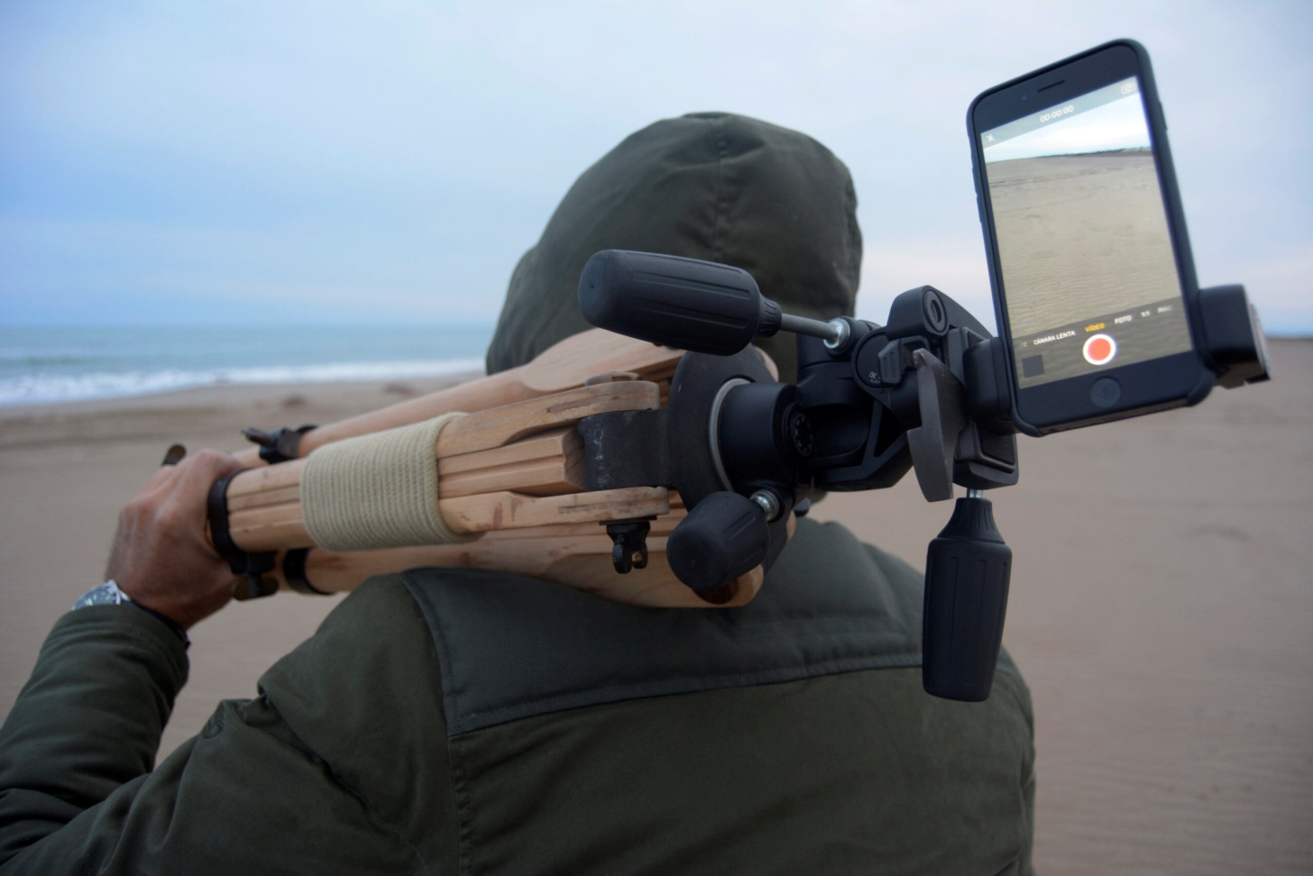
Why we are doing this
Formats such as TIFF and JPEG were designed decades ago and present limitations:
They are not efficient for the (high) resolutions of the current cameras
They do not support multiple related images in a single file
They do not easily incorporate metadata
Need to add a georeference to the HEIF format to make GIMI usable for geospatial
Need to develop more implementations in geospatial applications and web browsers
131st OGC MEMBER MEETING, ROME, ITALY

Slide 5
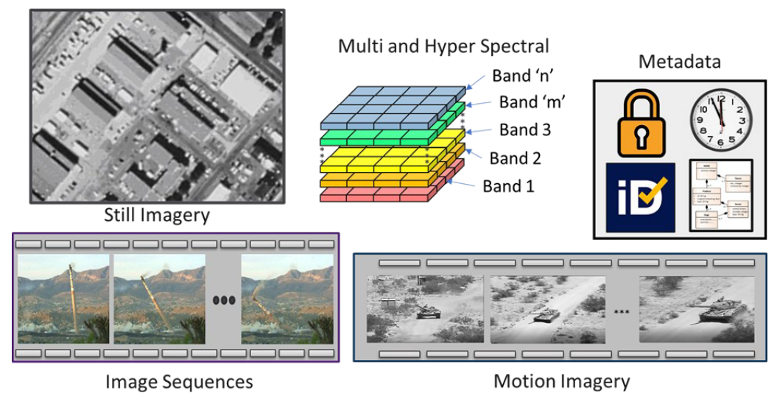
Overview:ISOBMFF+HEIF+GIMI
GIMI (Geospatial-Intelligence Imagery Media for ISR)
Geospatial Intelligence profile: Metadata, and audio. Inclusion of International Atomic Time (TAI) nanosecond formatted timestamps, information security markings of a dataset, and content identification
Uncompressed
ISO 23001-17
HEIC/HEVC
AVC
JPEG2000
GeoHEIF (Geospatially enabled HEIF)
Georeference information +
semantics of dimensions and the cell properties
HEIF (High Efficiency Image File Format)
a container file format designed for MPEG, for storing multimedia files that compresses images files while maintaining high quality
MP4
3GP
ISOBMFF (ISO Base Media File Format )
versatile container format designed for storing time-based audio-visual media

Slide 6
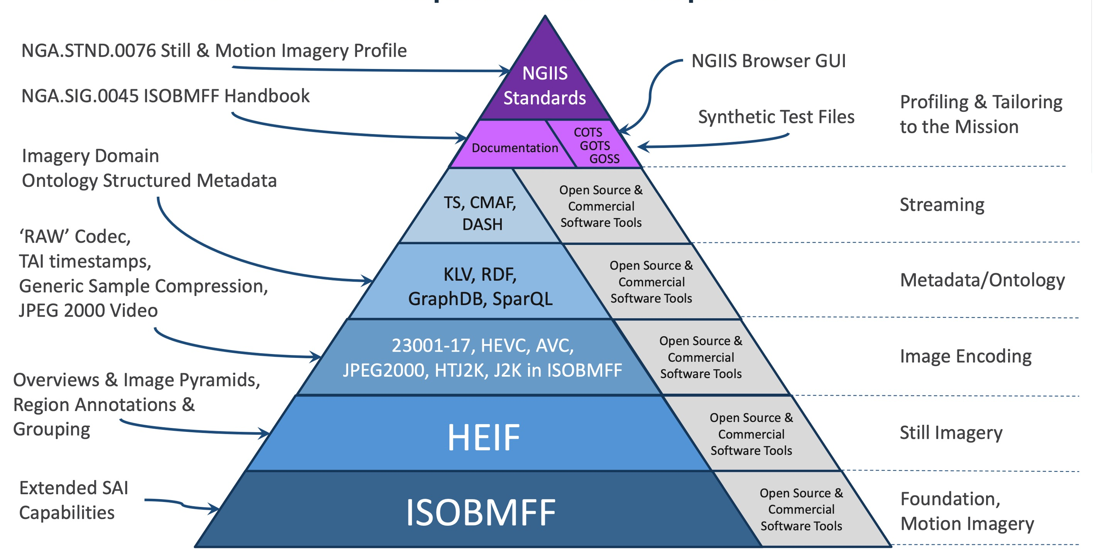
NGIIS tools & Capabilities (in Development)
Testbed 20 | Kickoff

Slide 7
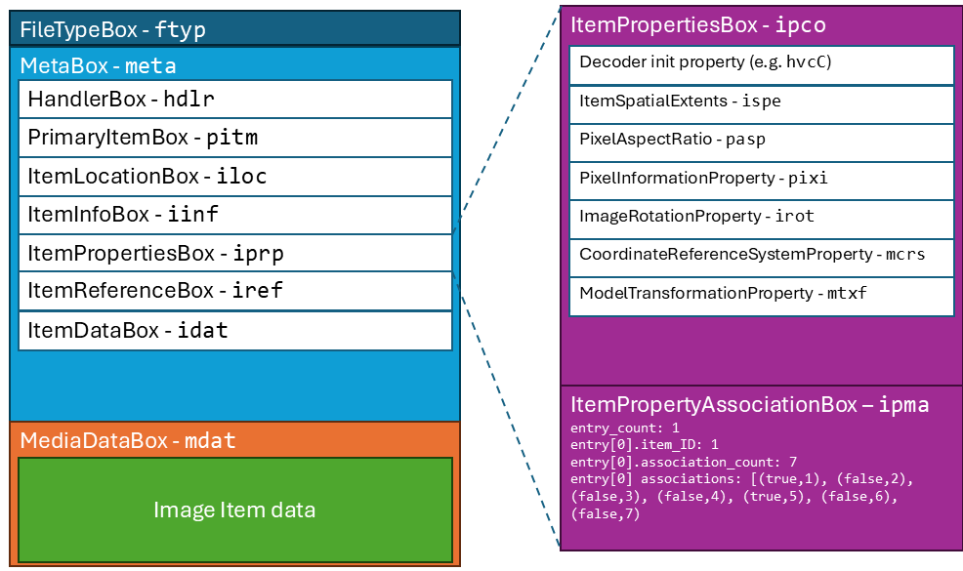
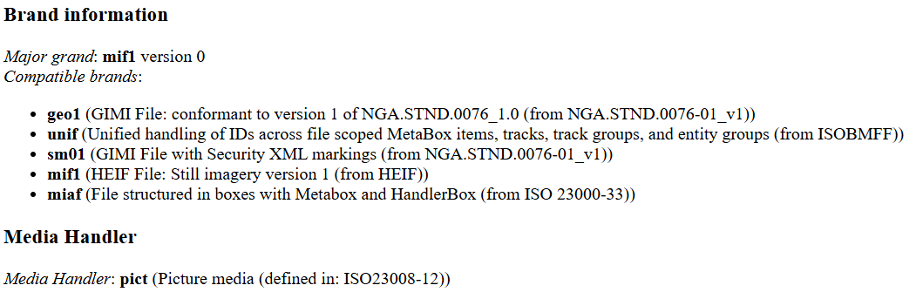
Basic Structure in “boxes” and what happens in static images
The basic structure is a sequence of boxes.
Each box structure starts with the same header structure: size a box identifier (4 character code (4cc)) and content according to the requirements of that box.
The boxes can be nested
In still imagery there are 3 main boxes:
FileTypeBox (ftyp): Brand information
MetaBox (meta): The image metadata
MediaDataBox (mdat): The image
For image data, the MetaBox (meta) provides the required information
the HeaderBox: type of file

Slide 8
Starting by the Metabox (but the actual content is in the MediaDataBox)
For image data, the MetaBox (meta) provides the items in the file. The nested box includes:
the ItemInfoBox, list of items that are present,
the ItemPropertiesBox, which provides descriptive and transformative properties of the items.
ItemPropertyContainerBox (ipco)
ItemPropertyAssociationBox (ipma).
the ItemLocationBox, offsets of the encoded data of the items in the MediaDataBox,

Slide 9
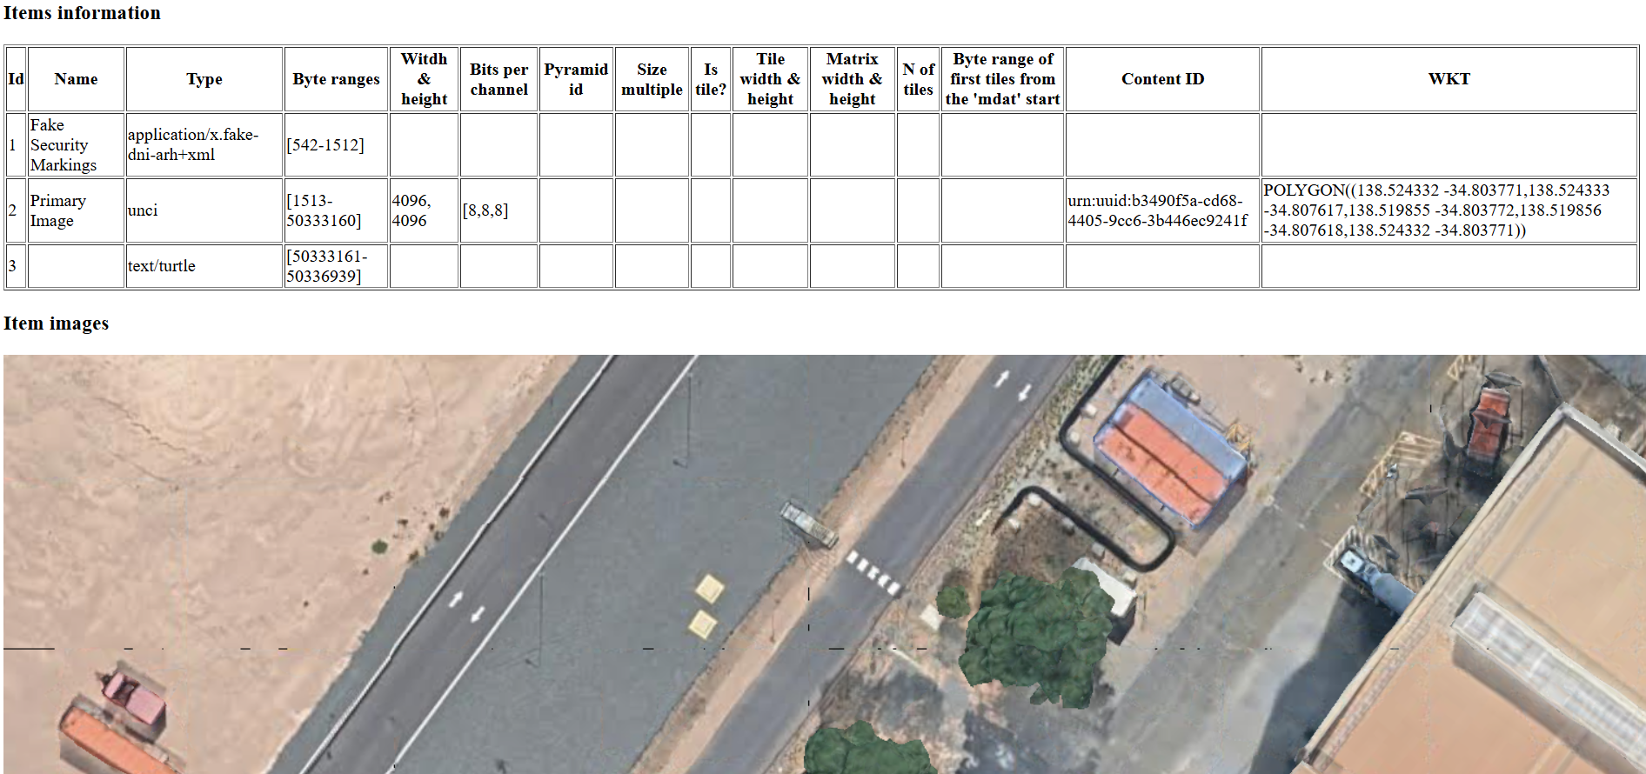
Single image example
tb21-single-image-uncompressed-internal-rdf.heif

Slide 10
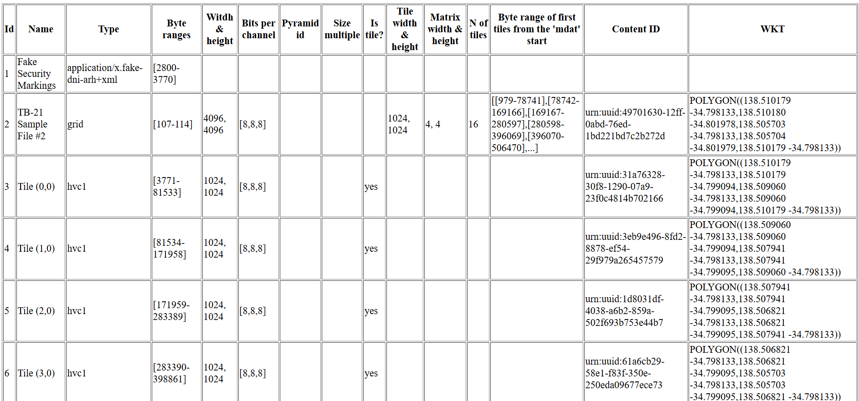
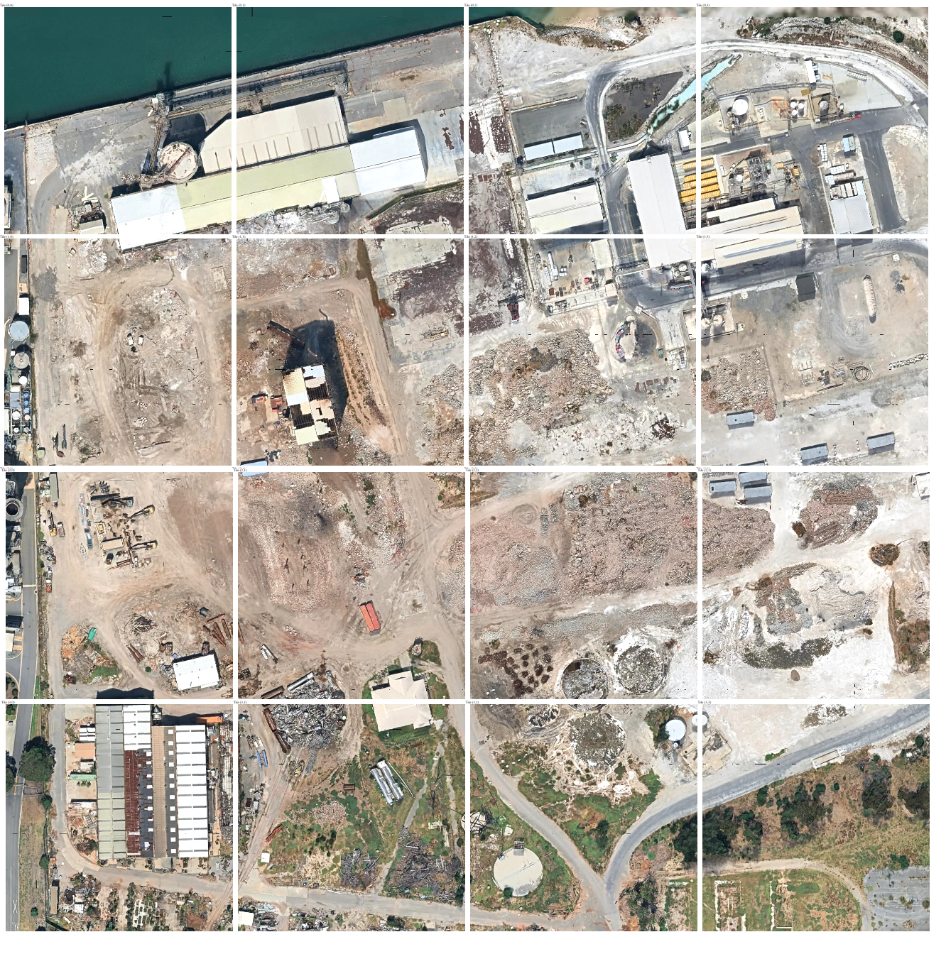
Grid image example

Slide 11
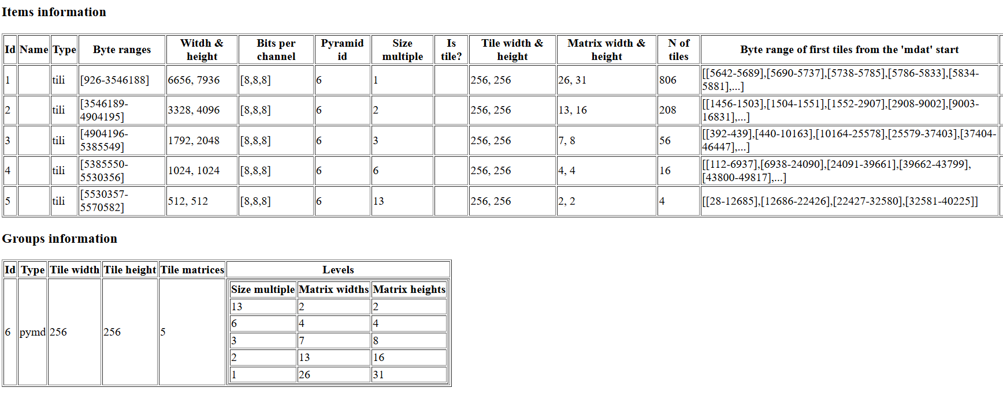
Tili section with pyramid.

Slide 12
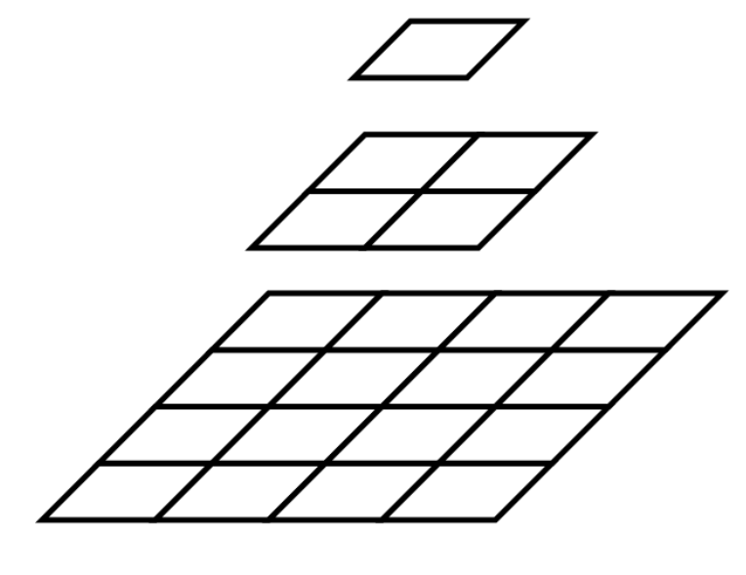
Pyramid combining HEIF stategies
unci
grid
tili

Slide 13
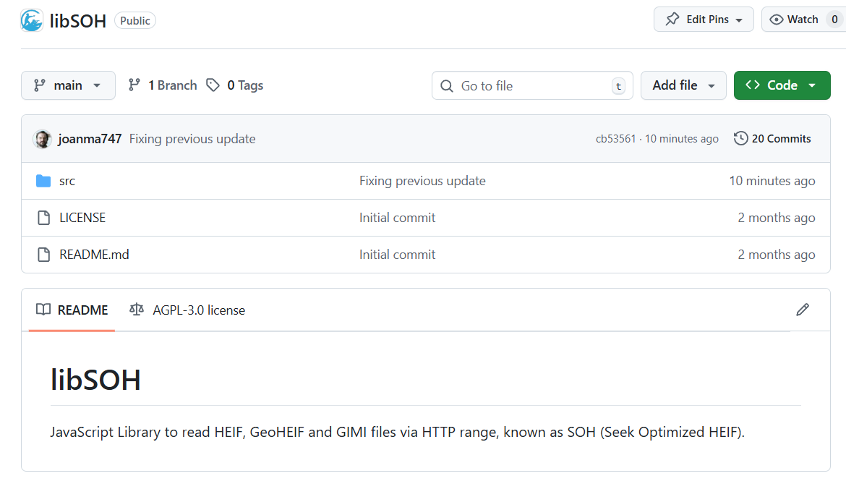
Javascript library designed for Seek Optimized HEIF in browsers
Based on the h265 libraries (hvc)

Slide 14
Overview:ISOBMFF+HEIF+GIMI
GIMI (Geospatial-Intelligence Imagery Media for ISR)
Geospatial Intelligence profile: Metadata, and audio. Inclusion of International Atomic Time (TAI) nanosecond formatted timestamps, information security markings of a dataset, and content identification
Uncompressed
ISO 23001-17
HEIC/HEVC
AVC
JPEG2000
GeoHEIF (Geospatially enabled HEIF)
Georeference information +
semantics of dimensions and the cell properties
HEIF (High Efficiency Image File Format)
a container file format designed for MPEG, for storing multimedia files that compresses images files while maintaining high quality
MP4
3GP
ISOBMFF (ISO Base Media File Format )
versatile container format designed for storing time-based audio-visual media

Slide 15




GIMI Files – High Level Overview
GIMI builds on ISO standards
Video files are MP4 files (video, timed metadata, and audio tracks)
Still imagery files are HEIF files (image and single instance metadata items)
Four elements of content are required in a GIMI file
Brand: identifies MP4 & HEIF files as meeting the requirements of
NGA.STND.0076 (GIMI). The GIMI brand is ‘geo1’
Security: carries ODNI defined ISM.XML security markings
Content IDs: uniquely identifies each piece of media content (globally)
Timestamps: nano-precision TAI timestamps, with timing metadata
‘geo1’
GIMI file

Slide 16
GIMI Supports the Containment of GEOINT Imagery & Ontology Structured Metadata
NGA.STND.0076 (GIMI) File
Content IDs and TAI timestamps link information together
Common to all GIMI Files
Media Content Options
RDF Triple Store Sidecar File
(External to GIMI file)
Still Image(s)
Branding
Container for Ontology Structured Metadata
Image Sequence(s)
ISM.XML Security Markings
Application Metadata
Motion Imagery Track(s)
Content ID
Content IDs
Application Metadata
TAI Timestamp
TAI Timestamps
Audio

Slide 17
Metadata content in GIMI files
ISOBMFF provides the foundational metadata structures which includes methods for storing and associating metadata to ISOBMFF/HEIF media:
item properties for still images,
and various boxes which carry media support information, such as color boxes.
GIMI defines three primary categories of metadata:
GIMI-Essential,
Security,
and Application Metadata.
GIMI-Essential Metadata stores and associates TAI Timestamps and Content IDs to media.
Security Metadata stores and associate’s security markings to media by linking Content IDs to embedded security markings.
Application metadata stores and associates GEOINT metadata with the media using the Imagery Domain Ontology

Slide 18
Structure of the contributions of GIMI to HEIF
Imagery Domain Ontology
@prefix cco: <http://www.ontologyrepository.com/CommonCoreOntologies/> .
@prefix geosparql: <http://www.opengis.net/ont/geosparql#> .
@prefix imh: <http://ontology.mil/foundry/IMH_> .
@prefix obi: <http://purl.obolibrary.org/obo/OBI_> .
@prefix rdf: <http://www.w3.org/1999/02/22-rdf-syntax-ns#> .
@prefix rdfs: <http://www.w3.org/2000/01/rdf-schema#> .
@prefix xsd: <http://www.w3.org/2001/XMLSchema#> .
# The Content ID in the GIMI File
<urn:uuid:1958d874-1203-4aed-a0df-f8ad2acfc7bb> a imh:0000078 ;
rdfs:label "The Main Image" .
# TAI Timestamp
<urn:uuid:25c7117c-0778-4c12-be28-14e52d6c8494> a imh:0001416 ;
obi:0002135 "1635120000000000000"^^xsd:long ;
rdf:label "October 25, 2009 TAI Timestamp" .
# Raster Bounds Correspondence Group - Links the Image to its Geospatial Extent
<urn:uuid:fa72c5b2-1ebf-473b-8379-879ac110dca3> a imh:0001634,
"geosparql:geometry" ;
rdfs:label ":raster-bounds-correspondence-group of urn:uuid:1958d874-1203-4aed-a0df-f8ad2acfc7bb" ;
imh:0001161 <urn:uuid:25c7117c-0778-4c12-be28-14e52d6c8494> ;
imh:0001678 <urn:uuid:12d1a10c-1ffc-4945-a9b0-5e1106115dca>,
<urn:uuid:a93ea7bc-476e-44a2-b4a7-f78db829be99>,
<urn:uuid:ae3973f5-7635-4483-bcaa-d254687915f0>,
<urn:uuid:de2dfc8a-ff6e-4a77-8698-c33b260b5feb> ;
cco:is_about <urn:uuid:1958d874-1203-4aed-a0df-f8ad2acfc7bb> ;
geosparql:asWKT "POLYGON((-0.6073920048867456 2.417257774840304, -0.6074591250137896 2.4172577770596337, -0.6074591246647237 2.4171796502905774, -0.6073920048867456 2.417179652156712, -0.6073920048867456 2.417257774840304))"^^geosparql:wktLiteral .
GIMI-Essential
TAI Timestamps
Content IDs
GIMI
Security
security markings
organizing
Temporally on a timeline
Collection of elements;
Application Metadata
structure
Sequential
KLV
Single-Article
Turtle
Single Instance
Single-SIMA
Embedded in file
storing
sidecar file
both

Slide 19


GIMI-Essential Metadata
Mandatory
Provides universally recognized attributes about the media content within a GIMI file.
There are two types:
Content Identification (Content ID’s):
Enables identification for each piece of content within a GIMI file.
Supports the linkage of ontology structured metadata with media content it describes.
High precision timing information:
Is the combination of a media timestamp and clock details.
Each media timestamp is a count of nanoseconds since the TAI epoch.
Associating Content IDs and timing information to GIMI content enables global search and discovery and provides external files and systems an ability to reference (or “point to”) content within a GIMI file.
Reference-able content is primary-media-content and includes Still Image items, image sequence and Motion Imagery tracks, Motion Imagery frames, groups of image items and/or tracks, image components, and user defined regions of interest.

Slide 20
Imagery Domain Ontology
The IDO provides a rich set of ontologically structured information geared toward providing descriptive information and context about GIMI imagery media content.
The initial IDO effort is focused on "Collection" and the parameters associated with sensor systems and the entities within a scene.
The IDO is part of a wider Government wide effort aimed at aligning data management and achieving cohesive understanding across different domains.

Slide 21
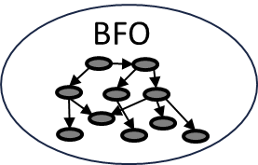
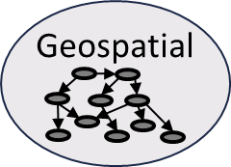
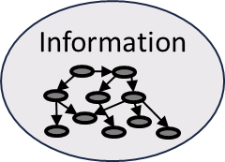
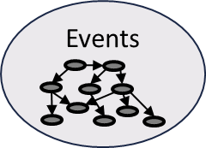
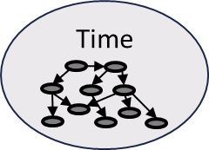
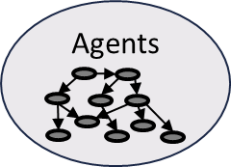

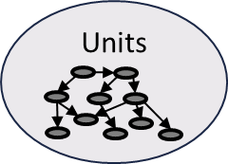



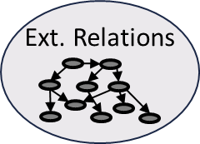
The Common Core Ontologies
Geospatial - Sites, spatial regions, and other entities, typically located near the Earth's surface, and the relations between them.
Information Entities - Generic types of information as well as the relationships between information and other entities.
Events - Processual entities, especially those performed by agents, occurring within multiple domains.
Time - Temporal regions and the relations holding between them.
Agents - Agents, especially persons and organizations, and their roles.
Qualities - Attributes of entities, especially qualities, realizable entities, and process profiles.
Units of Measure - Standard measurement units measuring various attributes of entities.
Currency - Currencies countries issue and use.
Facilities - Buildings and campuses serving some specific purpose and common to multiple domains.
Artifacts - Artifacts common to multiple domains, along with their models, specifications, and functions.
Extended Relations - Relations holding between entities at the level of the mid-level Common Core Ontologies.
https://github.com/CommonCoreOntology/CommonCoreOntologies

Slide 22
Imagery Domain Ontologies as Building Blocks
BFO
Basic Formal Ontology
(Top-Level)
Common Core Ontologies (Mid-Level)
Imagery Domain Ontologies
(includes utilization of other shared ontologies)
Process Characteristics
Time
Uncertainty
Functions
Illumination Sources
Energy
Atmosphere
Optics
Noise
Sensor Models
Platforms
Military Equipment
Terrestrial Features
Cameras
Radiometry
Coordinates
Imagery

Slide 23
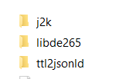

Javascript library designed for Seek Optimized HEIF in browsers
Turtle interpretation:

Slide 24
GeoHEIF SWG

Slide 25
Innovation
Call for Sponsors
DWG discussion
Create public call
SWG formation
Identify
Project
Select best members
Standards development
GeoHEIF standard
Testbed 21
GeoHEIF.SWG
Interest gathering
DWG/SWG Presentation
Execute
Project
Deliver Results
Formulation of enhancements
D203 Baseline OGC Testbed-21 Specification for GIMI
D214 Cloud-based GIMI/IDO player/viewer
D206 Advancement of the GIMI Standard Report
DWG = Domain Working Group
SWG = Standards Working Group

Slide 26
Scope
In scope:
How to georeference HEIF/GIMI images
How to organize HEIF/GIMI internal images in a data cube
Add meaning of dimensions and values
Add metadata
Add annotations (very relevant for AI)
Image sequences ?
Out of scope
Video
OGC APIs for GeoHEIF
Available at: https://github.com/opengeospatial/geotiff/tree/master/GeoHEIF_charter

Slide 27
What the charter says?
Considers two work items
A general way to specify the georeference information, datacube and other metadata
A way to embed or accompany the HEIF/GIMI file (or both)
Collaboration with other SWGs with a similar problem: GeoTIFF, GMLJP2…
Work under the MetaCat DWG
Other collaborations: OGC API Coverages, Coverages DWG, GeoDataCube SWG
We had a document Testbed 20 (OGC 24-038: GEOINT Imagery Media for ISR (GIMI) Specification Report) using the standards template that was close to the solution needed here BUT:
Testbed 21 proposes a completely different approach that we should also consider
Back to the drawing board. ☹

Slide 28

Call for Supporters of this Charter
Some people supports this proposal and are committed to the Charter and projected meeting schedule.
Do you want to be added to the charter as supporters?
The charter members have voting rights beginning the day the SWG is officially formed.
You can email us or respond to the Agora topic:
https://agora.ogc.org/c/overivew-technical-committee/geoheif-ad-hoc-meeting-to-vote-the-charter

Slide 29
Starting activities in the OGC MM in Phyladelphia

Slide 30

THANK YOU
www.ogc.org

