Slide 1

Australian Groundwater
data projects
Paul Sheahan
25 June 2012

Slide 2

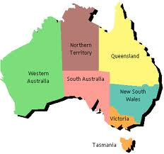
Visualising Victoria’s Groundwater project
Australian Bureau of Meteorology
  National Groundwater Information System
  Water Act – Regulations data transfer

Slide 3













Visualising Victoria’s Groundwater project
Lead by the University of Ballarat

Slide 4
Visualising Victoria’s Groundwater project
“An interoperative web-GIS that federates groundwater data from disparate sources to assist water managers make the correct choices for the sustainable use of a precious resource”
Access to federated Victorian groundwater data sets
Tools that provide (on-the-fly):
  Groundwater bore details
  Water-level graphs
  Chemistry graphs
  Depth to watertable
  Cross sections of aquifers
  Three-dimensional models of groundwater systems

Slide 5
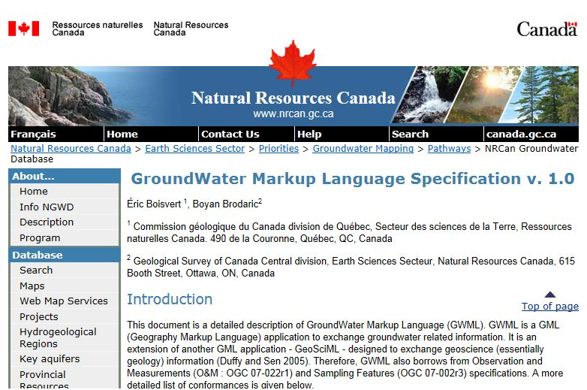
Visualising Victoria’s Groundwater project
Interoperability is based on the Open Geospatial Consortium (OGC) standards for Geography Markup Language (GML), specifically GroundwaterML
Notes:
Our timeline is that we are getting all the data on the web at the moment and will launch the VVG site in mid-July. At this stage we are not using GWML as it does not give us the opportunity to share all the available data (e.g. mineral springs, chemistry, etc.). Our intention is to implement GWML as soon as we can (and we have some GWML services working at the moment), but feel that it's more important to get all the available data on-line in the first instance.

Slide 6
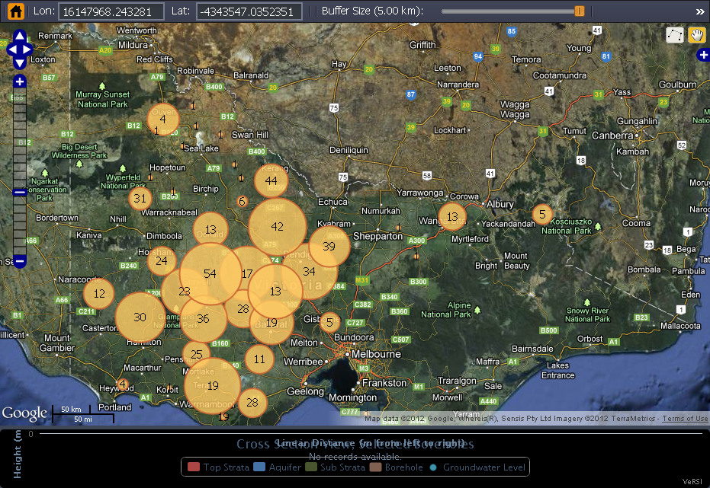
Visualising Victoria’s Groundwater project
SISS demonstrator http://siss.versi.edu.au:8080/vvg/

Slide 7
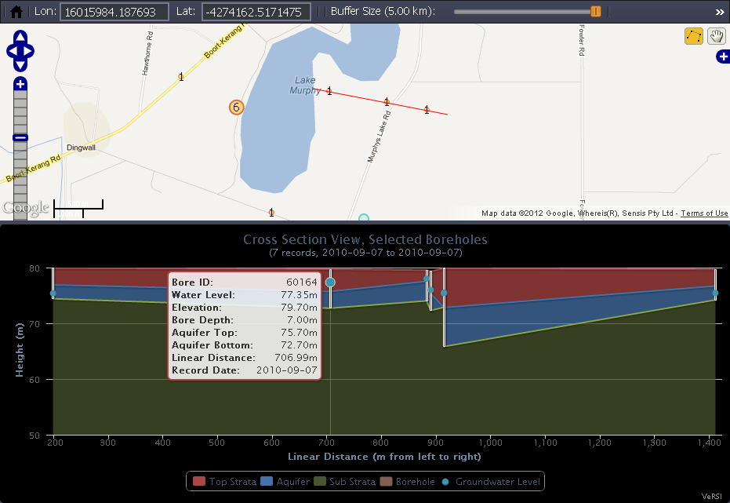
Visualising Victoria’s Groundwater project

Slide 8
Visualising Victoria’s Groundwater project
Australian Bureau of Meteorology
  National Groundwater Information System
  Water Act – Regulations data transfer

Slide 9
Australian National Groundwater Information System
National Aquifer Framework
  Is a national hydrogeological unit classification - an approach to grouping geological units and HGUs into “aquifers”.
  Developed through consultation with Jurisdictional groundwater managers
  Is intended to be updated and improved in subsequent releases/versions

Slide 10
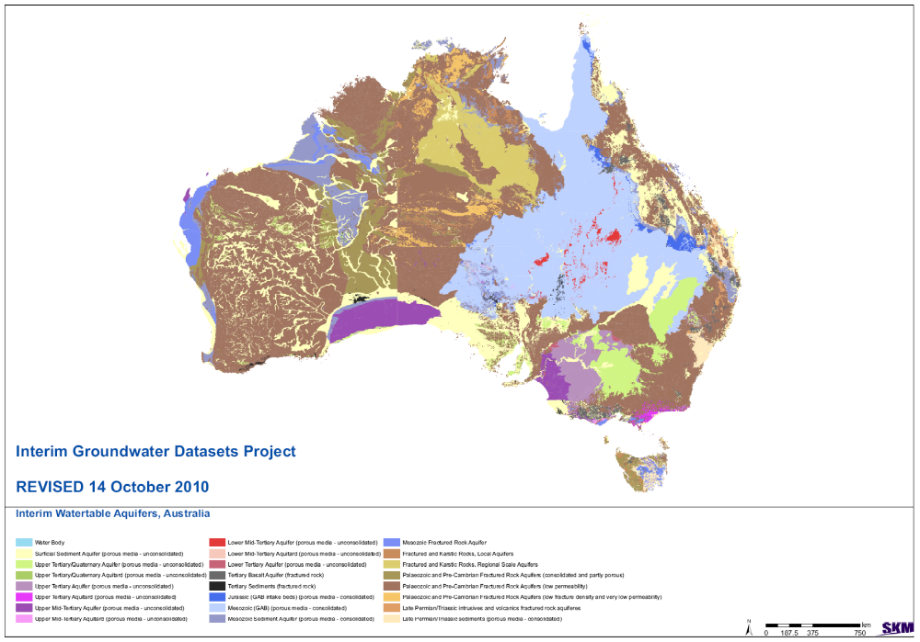

Slide 11
Jurisdictions use different hydrogeological classifications:
Rail gauges all over again?

Slide 12
Australian National Groundwater Information System
Provides national standardised data for:
  Bore reference / location
  Bore construction e.g. screen depth range
  Hydrogeological stratigraphy at bore hole
  Aquifers
Provides the data that are the essential context for interpreting groundwater levels
Facilitates the sharing of data between jurisdictions
Will allow three dimensional analysis of aquifer volumes
=> national definition of groundwater resource units
Compatible with ArcHydro for Groundwater
Suitable for use with Aquaveo tools

Slide 13
Australian National Groundwater Information System
CoreFeature dataset
  NGIS_Bore
    NGIS_BoreholeLog
    NGIS_ConstructionLog
    NGIS_LithologyLog
  NGIS_BoreLine
    NGIS_HydrogeologicUnit
  NGIS_ConstructionLine
  NGIS_ManagementZone
HydroStratigraphy Dataset
  NGIS_GeoVolumes
    NGIS_GeoRasters

Slide 14
Visualising Victoria’s Groundwater project
Australian Bureau of Meteorology
  National Groundwater Information System
  Water Act – Regulations data transfer

Slide 15
Water Act – Regulations data transfer
Water Act 2008
Category number | Description of category information
1 | Surface water resource information
2 | Ground water resource information
3 | Information on major and minor water storages
4 | Meteorological information
5 | Water use information
6 | Information about rights, allocations and trades in relation to water
7 | Information about urban water management
8 | Information about water restrictions
9 | Water quality information
10 | Descriptive and reference information about water information in other categories
2a | Ground water level of a bore, expressed in metres relative to specified datum, and the time of the observation
2b | Ground water pressure of a bore, expressed in kilopascals, the aquifer layer and depth at which the pressure is measured, and the time of the observation

Slide 16
Water Act – Regulations data transfer
Water Data Transfer Format
WIRADA : BOM and CSIRO
  OGC Observations and Measurements (O&M) model (Cox, 2007a & b)
  ISO General Feature Model, ISO 19109 (ISO/TC-211, 2005)
Observation features
Time series measurements and metadata

Slide 17
Water Data Transfer Format
- Groundwater
SamplingGroup
  A collection of sampling points, a Bore.
BorePipeSamplingInterval
  A ground water sampling point. One or many pipes in a bore.
  Details on screened interval location
featureMember (Bore)
  Bore details including depth.
procedureMember - Ground Water Level
  Datum, Temperature compensation for observed pressures
observationMember - Time Series
  Level time series
  Pressure time series

Slide 18
Surface water / Groundwater interaction has not been addressed
NGIS
Lithology
Hydro Stratigraphy
Bore construction
WDTF
Observation data
Bore Depth
Screened interval

Slide 19
Coal Seam Gas Project
Publication of data
  NGIS Bore data
  Time series data
Project areas
  Namoi
  Queensland

Slide 20
Thank you…
Paul Sheahan
+61 2 6232 3530
Email p.sheahan@bom.gov.au

