Slide 1
Groundwater Markup Language
Eric Boisvert, Boyan Brodaric, François Létourneau

Slide 2


GIN architecture
Applications
GIN Advanced:
3D, analysis
GIN Basic:
2D, download
GML GWML WaterML
WMS, WFS, SOS
Data Pipeline
Mediator
Standard web services
Standard themes, layers, vocabularies
GML
WMS, WFS, SOS
GWML
GML-BC
GML-AB
GML-SK
GML-ON
GWML
GML
Data
NRCan
BC
AB
SK
ON
USGS
…
Notes:
Context, why we need GWML

Slide 3
Domain specific standards
Groundwater Markup Language (GWML) provides a standard representation for groundwater related data.
Based / Derived from other international standards
  Geography Markup Languages
  Observations and Measurements
  ISO-19115 Metadata
  GeoSciML (Geoscience Markup Language)
Notes:
Now, what do we exchange over the internet

Slide 4
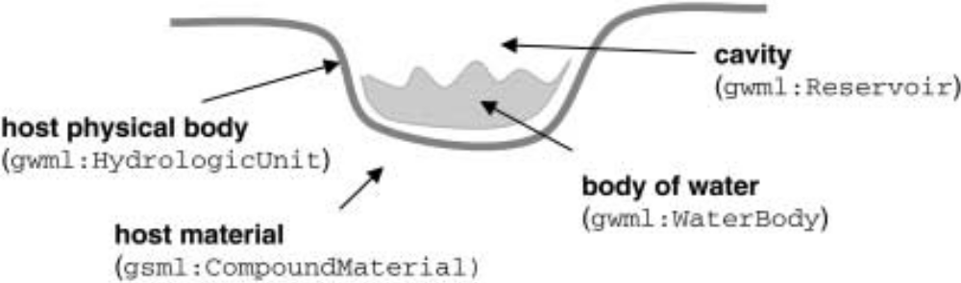
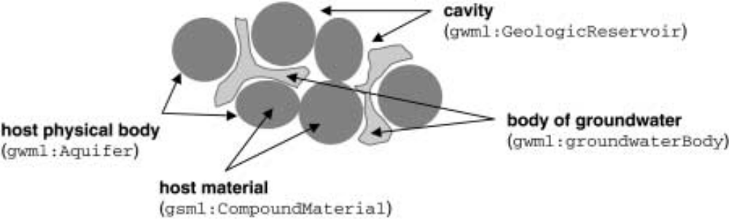
Conceptual model
Notes:
To be honest, the conceptual model was reverse engineered from various design cycles. Rock properties are already adressed by GeoSciML

Slide 5
Overview
GeologicUnit
Reservoir
GeologicFeatureRelation
relationship=aquiferHost
hostedReservoir
waterContainer
HydrogeologicUnit
containedWater
hostUnit
waterContent
WaterBody
sampledFeature
SF_SamplingFeature
WaterWell
relatedObservation
O&M
(WaterML 2.0)

Slide 6
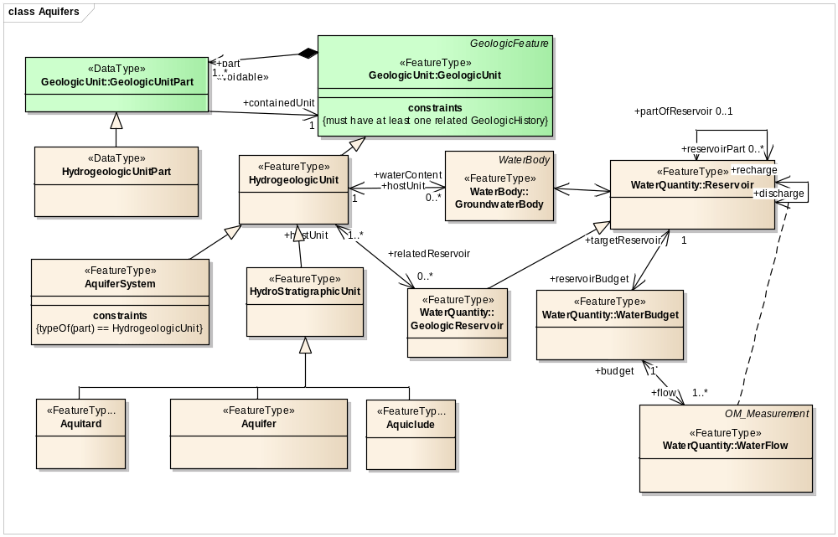
HydrogeologicUnit

Slide 7
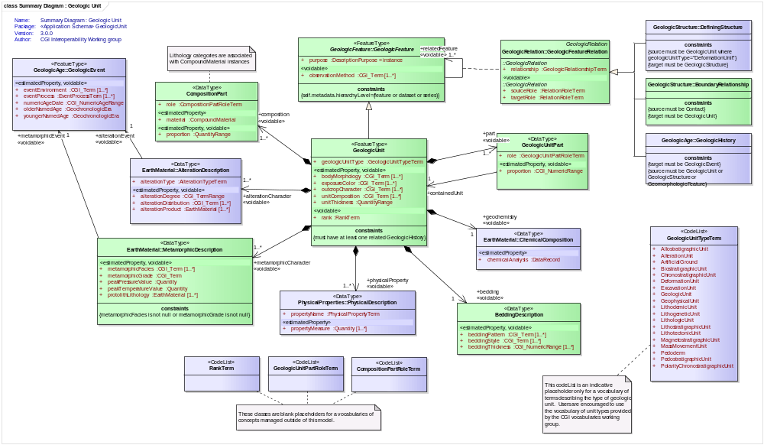
«CodeList»
GeologicUnitTypeTerm
+
AllostratigraphicUnit
+
AlterationUnit
+
ArtificialGround
+
BiostratigraphicUnit
+
ChronostratigraphicUnit
+
DeformationUnit
+
ExcavationUnit
+
GeologicUnit
+
GeophysicalUnit
+
LithodemicUnit
+
LithogeneticUnit
+
LithologicUnit
+
LithostratigraphicUnit
+
LithotectonicUnit
+
MagnetostratigraphicUnit
+
MassMovementUnit
+
Pedoderm
+
PedostratigraphicUnit
+
PolarityChronostratigraphicUnit

Slide 8
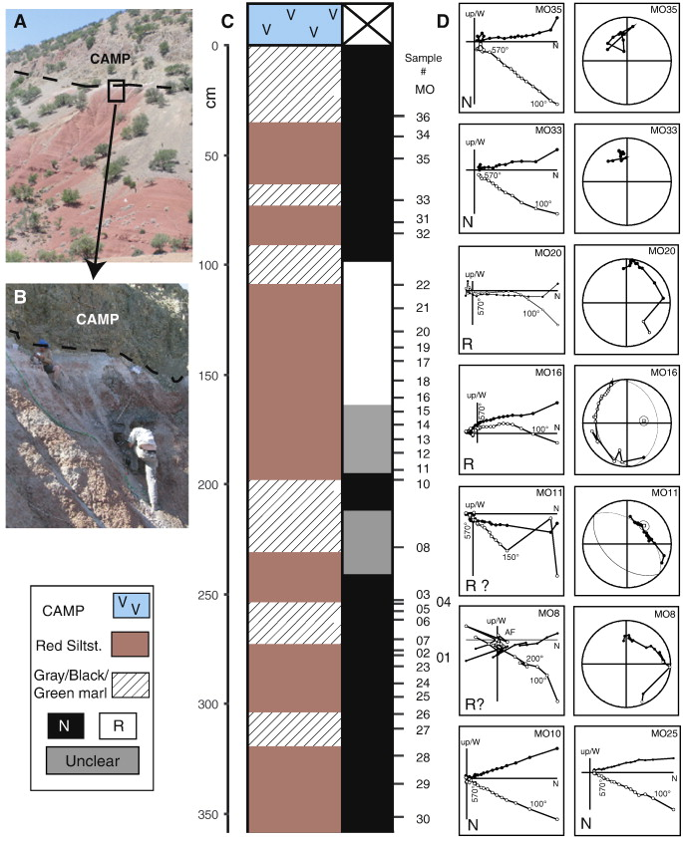
Magnetostratigraphic unit
Overview of the magnetostratigraphic section in the Argana basin, Morocco
A new chronology for the end-Triassic mass extinction
M.H.L. Deenena, , , M. Ruhlb, N.R. Bonisb, W. Krijgsmana,
W.M. Kuerschnerb, M. Reitsmaa, c, M.J. van Bergenc
Earth and Planetary Science Letters
Volume 291, Issues 1–4, 1 March 2010, Pages 113–125

Slide 9
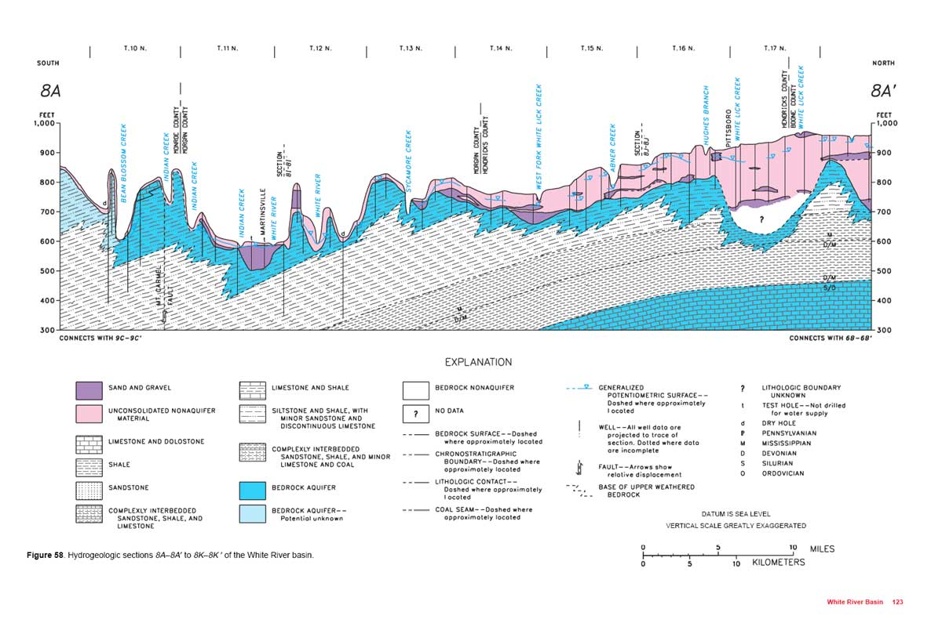
Hydrostratigraphic units
3 geologic unit types.
Lithostratigraphic
Chronostratigraphic
Hydrostratigraphic
Same package of rock
http://www.iupui.edu/~g107cwt/08_water_and_air/water%20resource/03.html
Notes:
They often geometrically coincide, it’s not the point. Their boundaries are based on different concepts. I obviously chose those exemples because it drives the point.

Slide 10
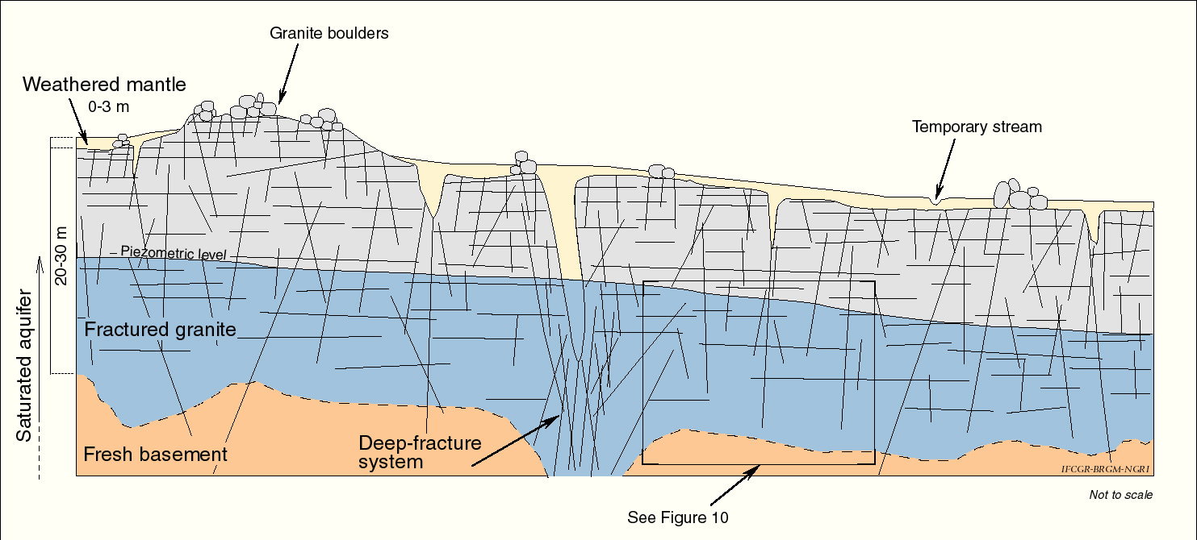
Fractured aquifer
http://jcmarechal.unblog.fr/category/pumping-tests-in-fractured-aquifer/

Slide 11
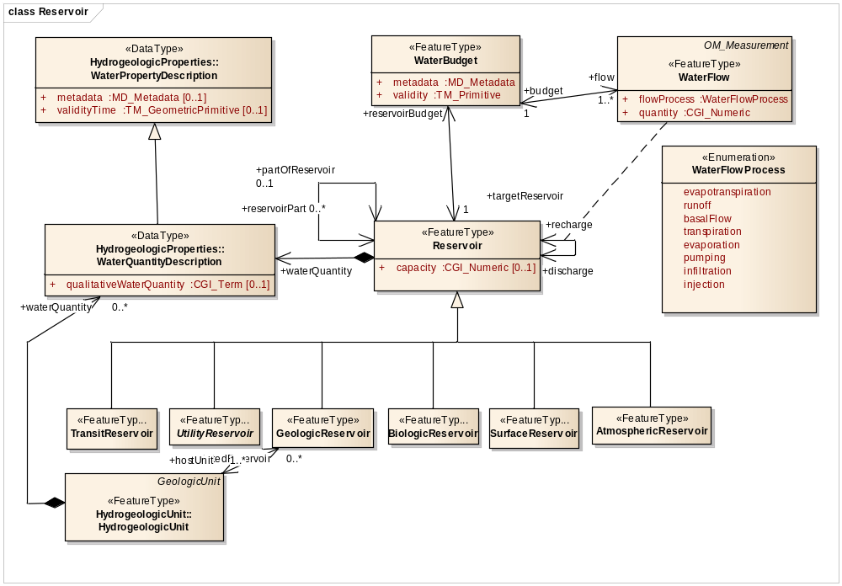
Budget

Slide 12
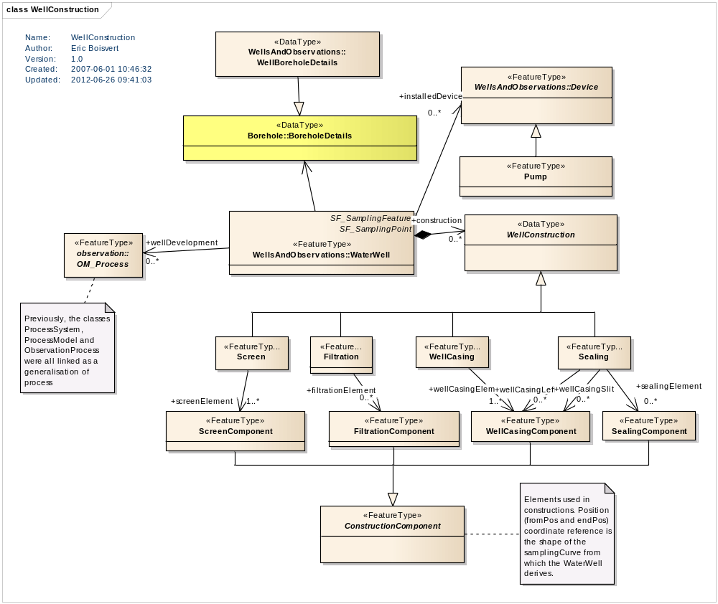
Extensive WaterWell model

Slide 13
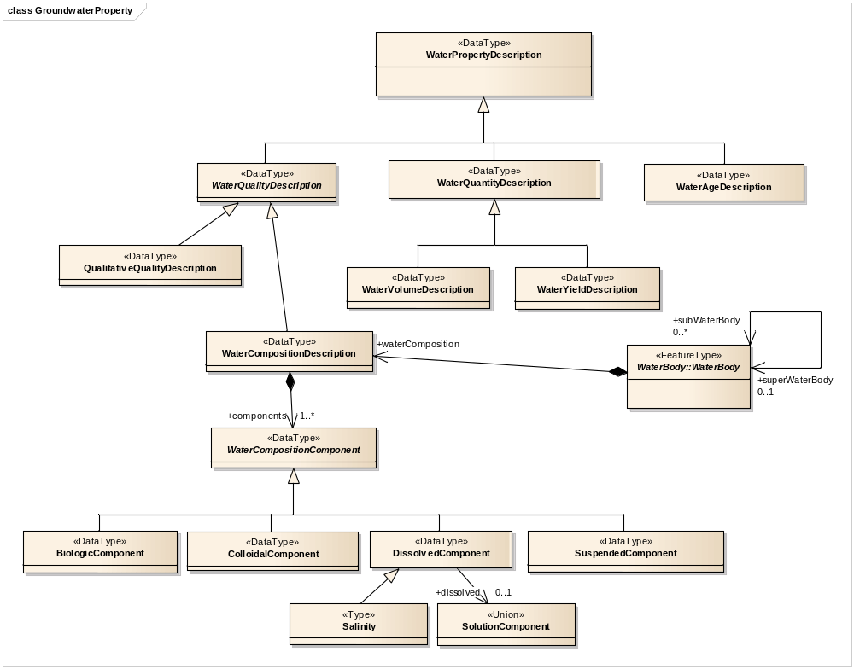
Water Composition

Slide 14
Notes
GWML 1.1
  Still based on GeoSciML 2.0 (pre-final)
  « GWML 2.0 » is so far GWML 1.1 rewired to GeoSciML 3.0 (so, there are no real « 2.0 »)
  GWML needs repackaging and modularisation needs to be rethought

Slide 15
Model review
Tested for the last few years in GIN
Tested in GWIE in 2010 (US and Canada)
Reviewed/commented by several other groups
  University of Ballarat (Victoria)
  USGS
  Université de Liège (Piotr Wojda)
  Romania
Generated a series of CR

Slide 16
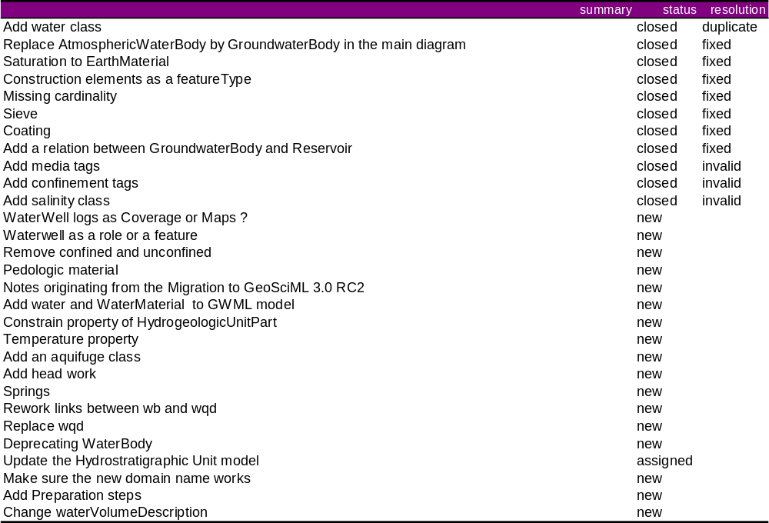
Several change proposals

Slide 17
Issues
Values / Coverage / Observations
  Real life is mixture
  <<estimatedProperty>>

Slide 18
International model
We Should
  Scope
  Design with extension in mind

Slide 19
GIN - RIES
http://ngwd-bdnes.cits.nrcan.gc.ca/service/gin/wfs/gw_mn?REQUEST=GetFeature&INFO_FORMAT=text/html&FID=mn.ww.39602
http://ngwd-bdnes.cits.nrcan.gc.ca/service/gin/wfs/gin?REQUEST=GetFeature&INFO_FORMAT=xml&FID=ngwd.key.mf.92

