Slide 1
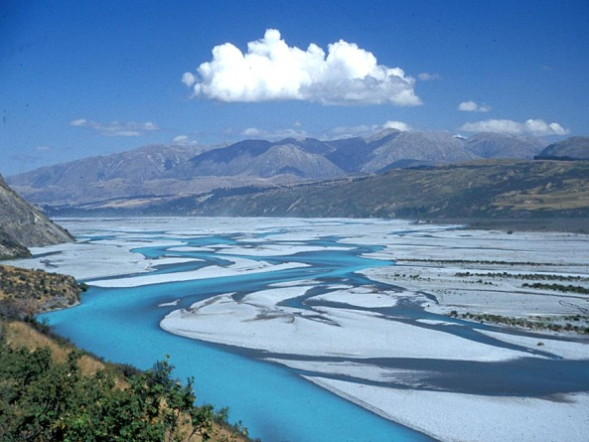
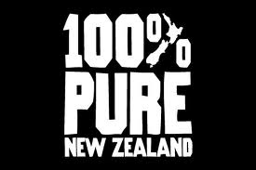
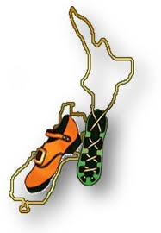
Initiatives in
Interoperability in New Zealand
Compiled for OGC Hydro DWG
Arlington, March 2014
By Jochen Schmidt, NIWA, New Zealand
On behalf of many NZ institutions with
no guarantee of comprehensiveness
Copyright © 2012 Open Geospatial Consortium

Slide 2

Environmental Data:
The New Zealand situation
NZ: Heterogeneous environment in terms of legislation, governance, management (freedom!). NZGO encourages use of standards and national SDI but with no “teeth” (sticks or dollars).
Diversity of information system across the country.
BIG PUSH since ~4 years to make information better accessible (particular freshwater).
Lots of ducks are running around (portals build, statements made, etc.).
Since about ~2 years more engagement with OGC etc. through various organizations – seems ducks getting in a row!
Copyright © 2012 Open Geospatial Consortium

Slide 3
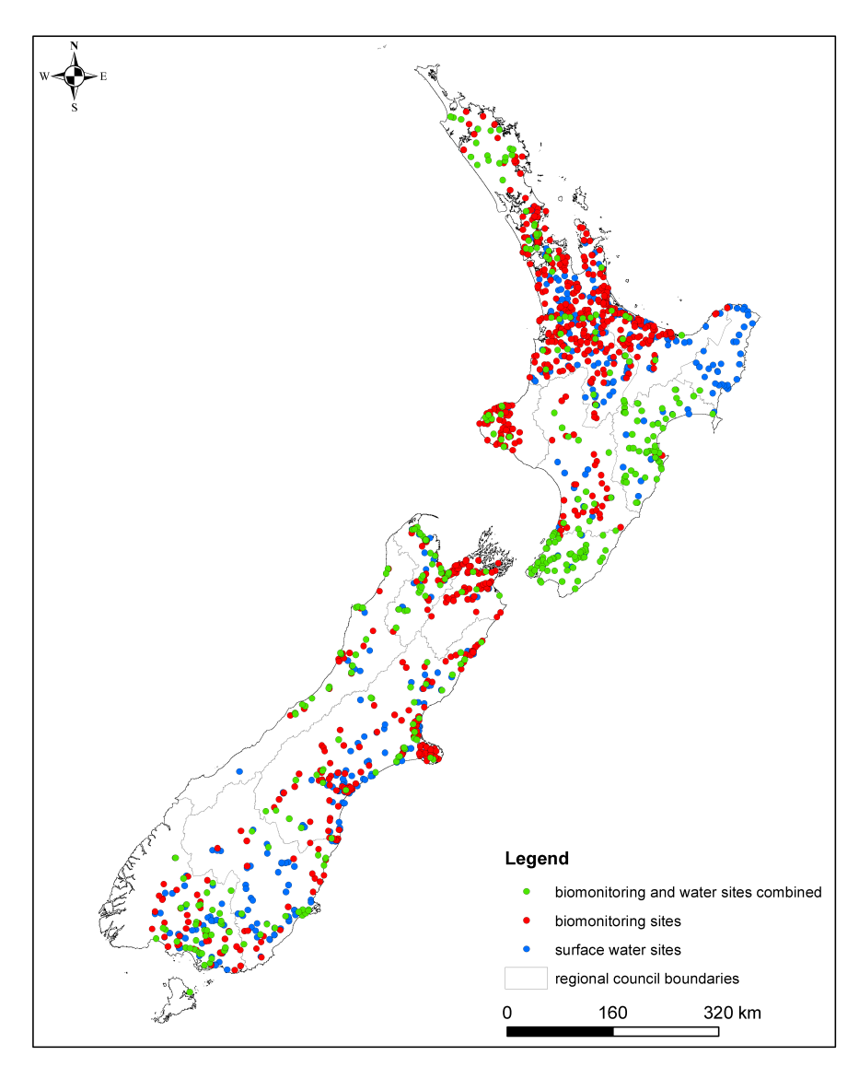
New Zealand environmental monitoring is diverse
Variety of stakeholders – Regional Councils, Energy Companies, NIWA.
Variable in space, varying densities, e.g. Auckland very well sampled whereas Alpine areas (where most of water / energy is coming from) under sampled.
Done for varying objectives and therefore to varying standards using varying technologies (sensors, telemetry, etc.).

Slide 4
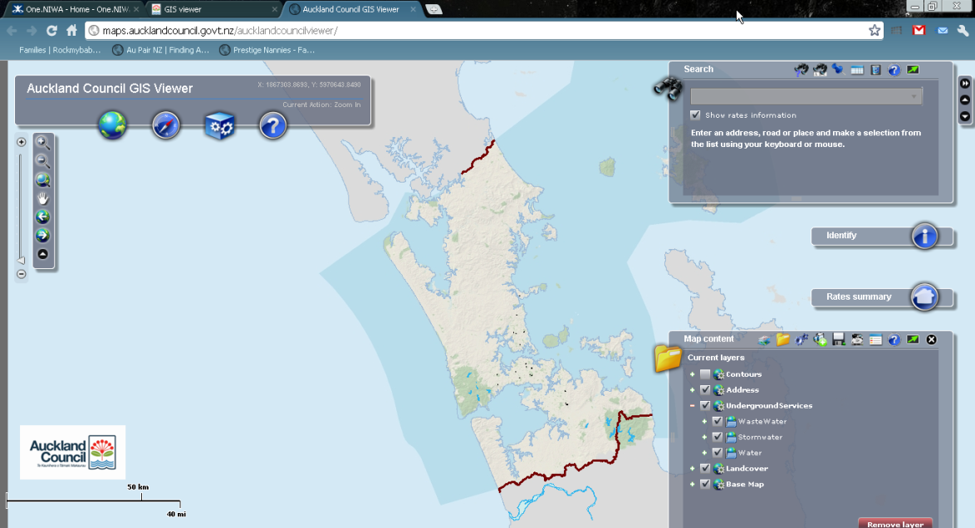
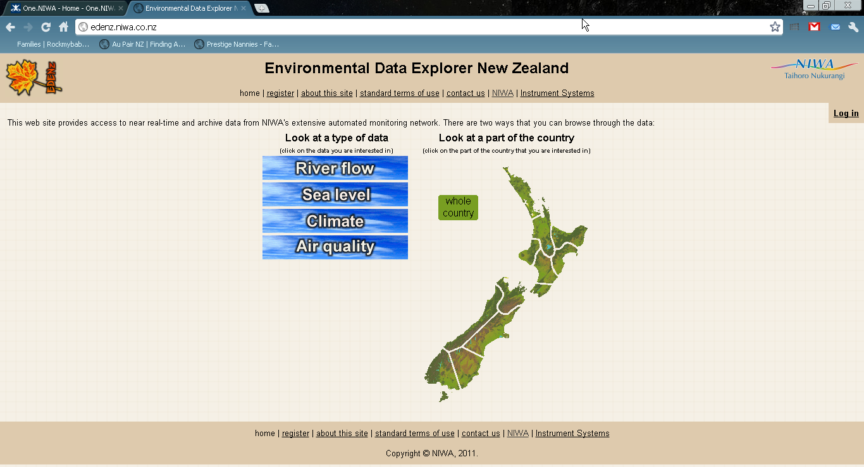
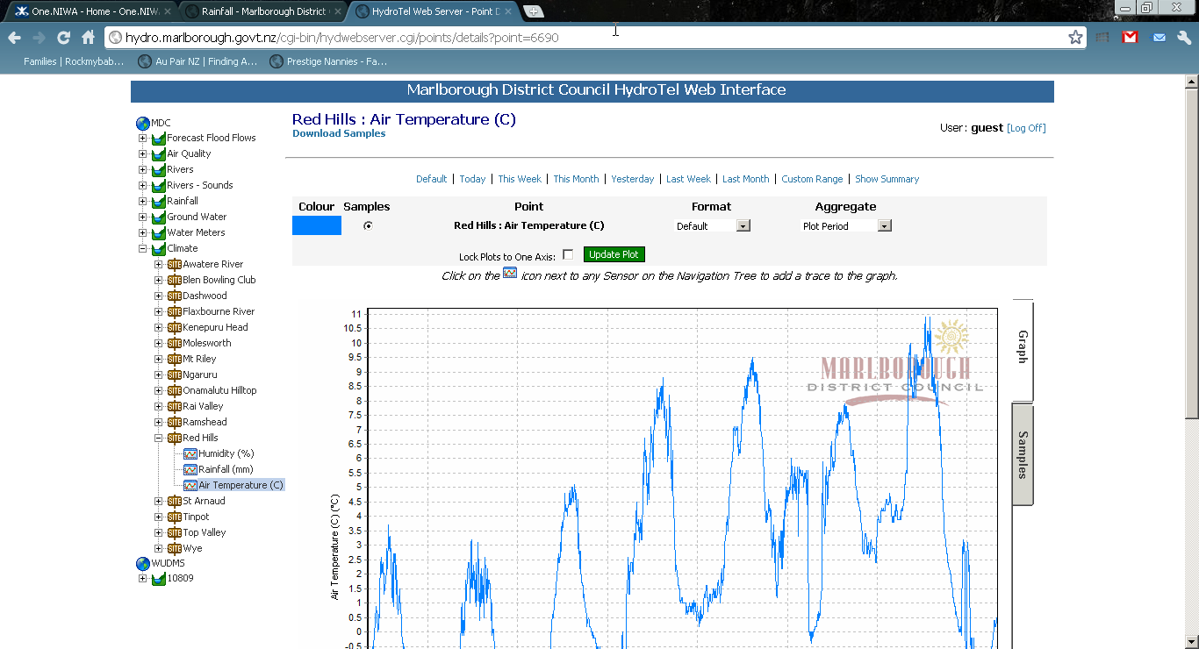
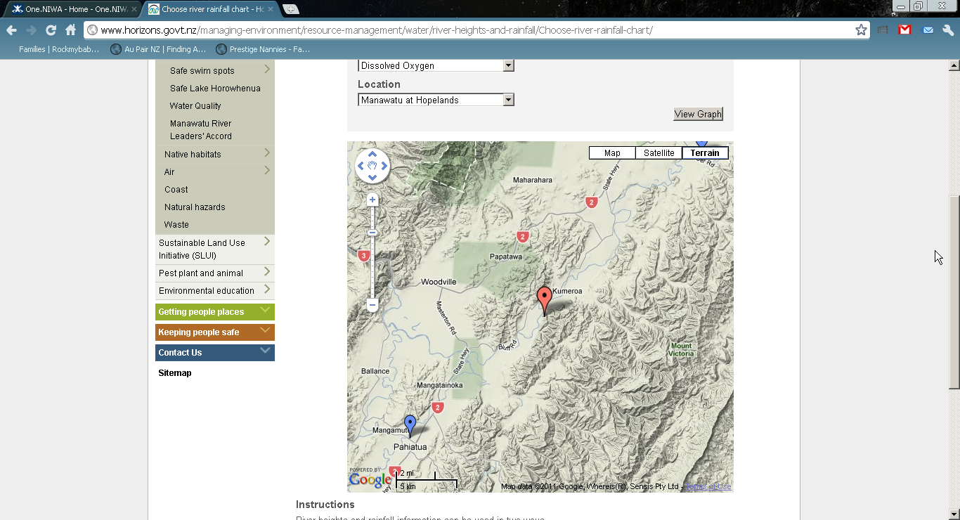
Different Organisations – Different networks – Different databases – different delivery systems

Slide 5
NZ environmental monitoring situation
Vision: consistent NZ Monitoring and Reporting
How is data made shareable?
  procedures/standards
  IP / legal
How is data documented?
  procedures/standards
How is data collected?
  procedures/standards
What is important?
  for different objectives?
  “filtering” necessary?
?
NZ environmental monitoring – situation
Different agencies
Different projects
Different objectives
Different monitoring networks
Different standards
Notes:
In almost all GEO benefit areas New Zealand situation is that monitoring is carried out:
by Different agencies
for Different projects
for Different objectives
by Different monitoring networks
to Different standards
This makes data sharing difficult because of:
Varying IP / legal issues
Documentation issues (no standard)
Data Standard Issues (collected to differing standards, not comparable)
Observations not homogenized according to objective

Slide 6

Consistent National Environmental Monitoring and Reporting
Issues:
Different agencies
Different projects
Different objectives
Different monitoring networks
Different standards
Challenges:
National consistency in monitoring and data exchange
Mandate?
Resources?
Agreement???

Slide 7
The (NZ) challenge
Develop an agreed federated information infrastructure which allows easy sharing of environmental information based on community standards.

Slide 8
NZ Interoperability initiatives
NZ Geospatial Strategy – NZ Geospatial Office + others.
NZ SDI Cookbook – NZ Geospatial Office.
BOI / Oceans & Coasts Portal – NIWA/LINZ
Government “Open Data” => Catalogues
  geodata.govt.nz, data.govt.nz, ei.niwa.co.nz, lris.scinfo.org.nz
Various Data Cataloguing exercises across the sector.
NZ deployment station catalogue (WFS) – NIWA.
IMOS-NIWA collaboration – NZ marine data through THREDDS/CSW/SOS.
Groundwater interoperability SMART – GNS, Hilltop
Regional Council SOS – Waikato, Kisters, Hilltop
CSIRO SISS / SOS workshops in Wellington – NIWA, NZGO, LCR, GNS
NIWA experiments with SOS – MapServer, Kisters, CSIRO
Biodiversity Interoperability – NIWA, LCR, Regional Councils

Slide 9

Example NZ projects for data access through OGC standards
Copyright © 2012 Open Geospatial Consortium

Slide 10
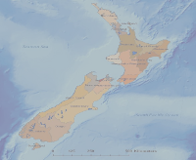


GNS SMART Project
www.smart-project.info
Aquifer characterisation,
groundwater volume,
hydraulic properties,
water age,
and more.
Data published
in groundwater portal
as SOS / WaterML
(National Groundwater
Monitoring Program)
CSW
SMART- GeoPortal Software
Registry Service
Discovery Service
View
Download
Transformation
Internet
multiple data
sources, local repository+ other OGC services)
Spatial Data
Web Site / Maps
Data
Sources
CSW
WMS/WFS/WCS
SOS

Slide 11
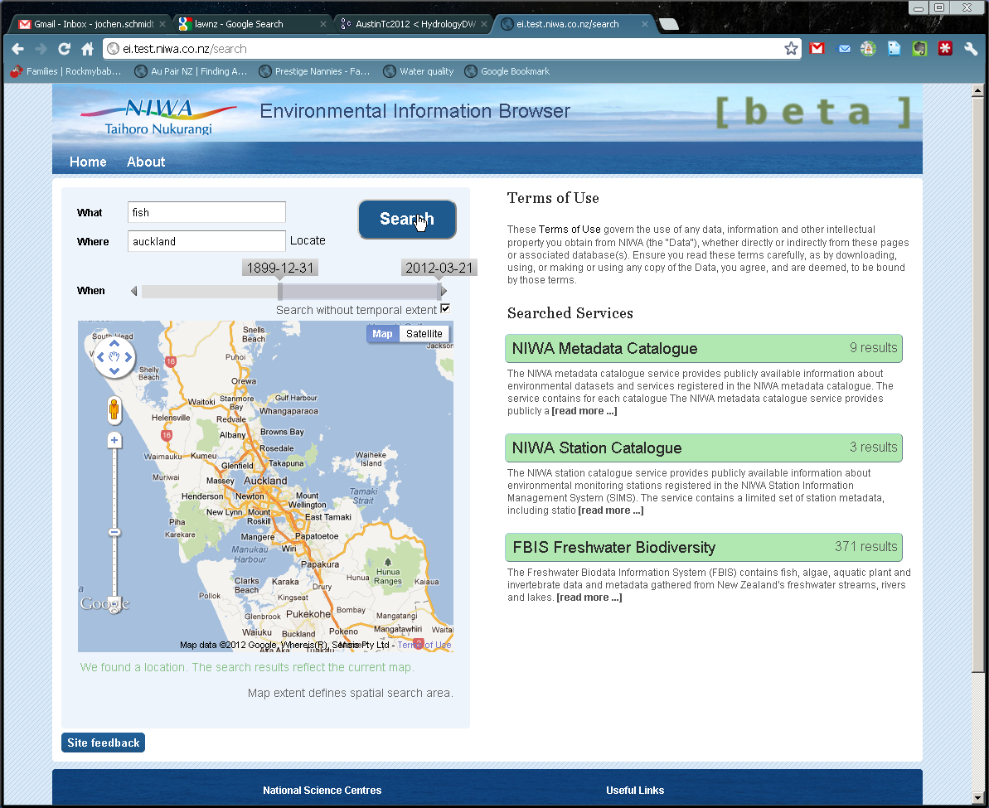
NIWA Environmental Information Browser
http://ei.niwa.co.nz
NIWA climate, freshwater, marine and more data provided through OGC services (CSW, WFS, WMS, SOS).
Geospatial, temporal, contextual discovery and selection.
Information visualisation components.
Report & download options.
Copyright © 2012 Open Geospatial Consortium

Slide 12
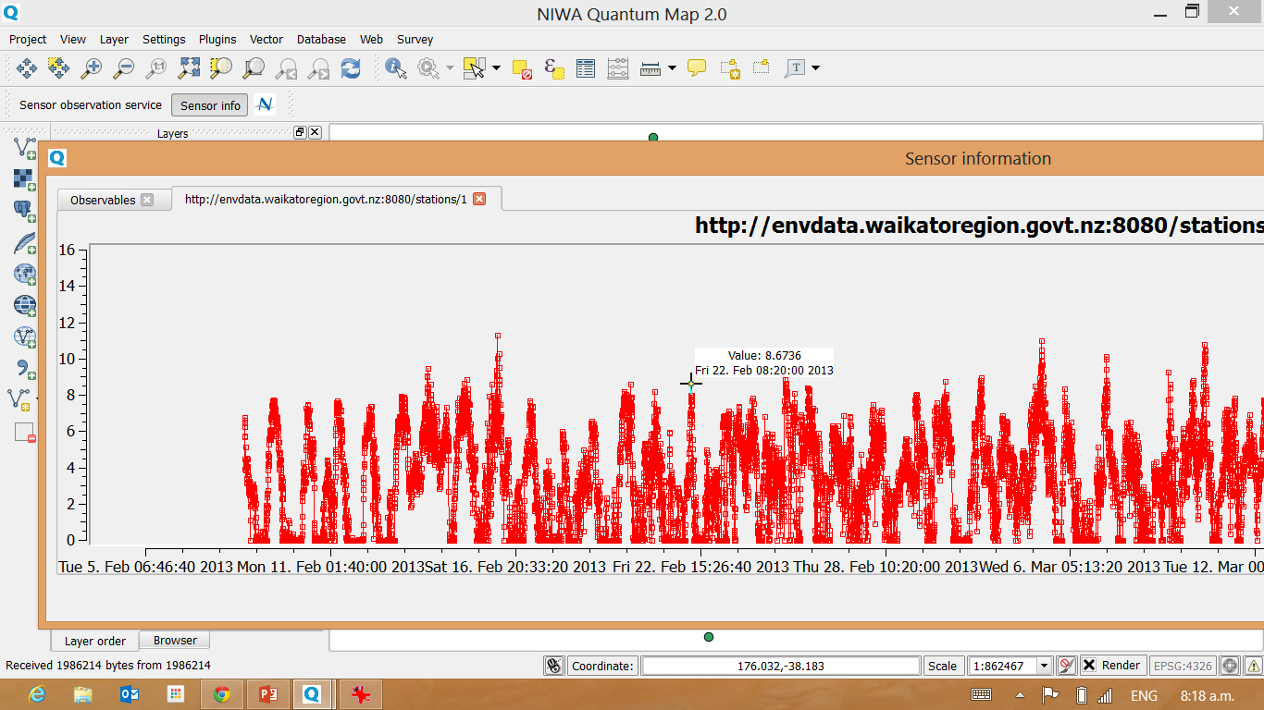
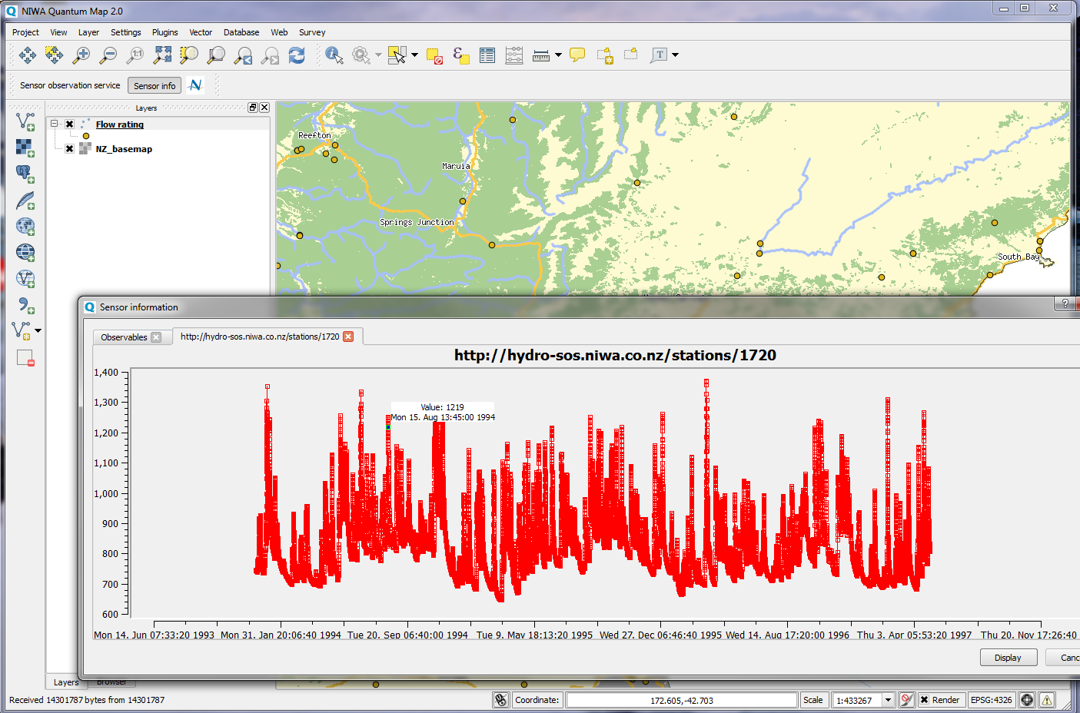
NIWA QuantumGIS
Waikato Regional Council River Flow Data
NIWA River Flow Data

Slide 13
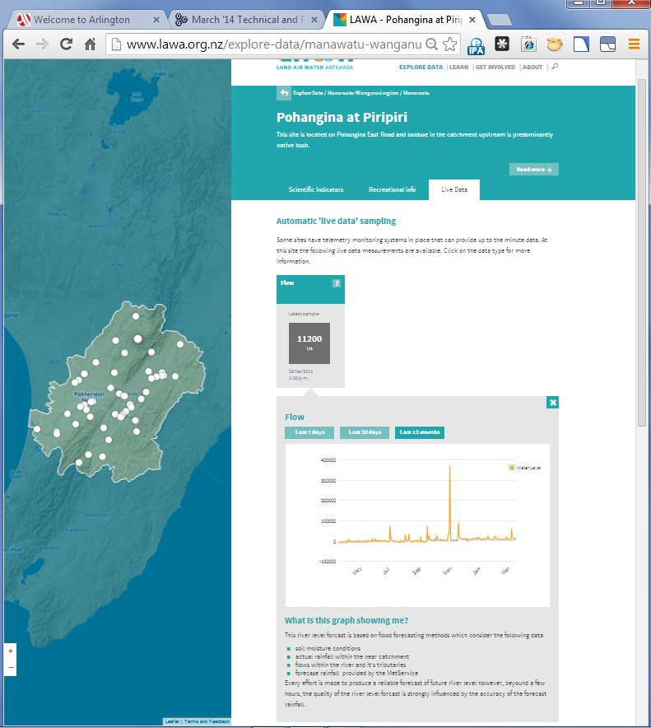
LAWA – New Zealand Regional Council
Land-Air-Water Data Federation
www.landandwater.co.nz
& www.lawa.co.nz
Includes all NZ Local Authority data
OGC services used to federate the data
One-stop-shop to freshwater information in NZ
  states & trends
Copyright © 2012 Open Geospatial Consortium

Slide 14
Landcare Research – OS infrastructure stack
http://lris.scinfo.org.nz,
  catalogue & clip-zip-ship
  LCDB: DQF
Browser & Services stack
  http://ourenvironment.scinfo.org.nz
  http://smap.landcareresearch.co.nz
  SCAR Antarctic Environments Portal
  Possum population model scenario viewer
Services – faq & examples
  http://maps.scinfo.org.nz
Irrigation control; real-time field sensors
HPC pipelines & datacubes;
  elastic spatio-temporal modelling
CSW
  DQF
WMS
  ? WMS-V
WFS
  SoilML
  Land Cover
O&M/UncertML
DGGS/O&M
Copyright © 2012 Open Geospatial Consortium

Slide 15
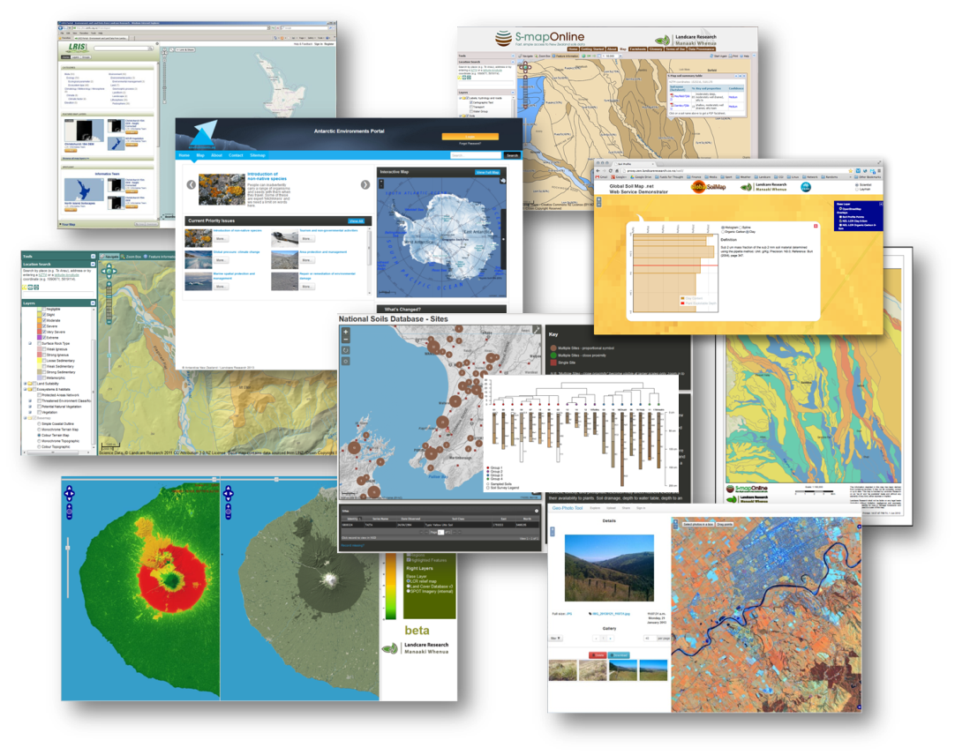
Landcare Research – OS infrastructure stack
Copyright © 2012 Open Geospatial Consortium

Slide 16

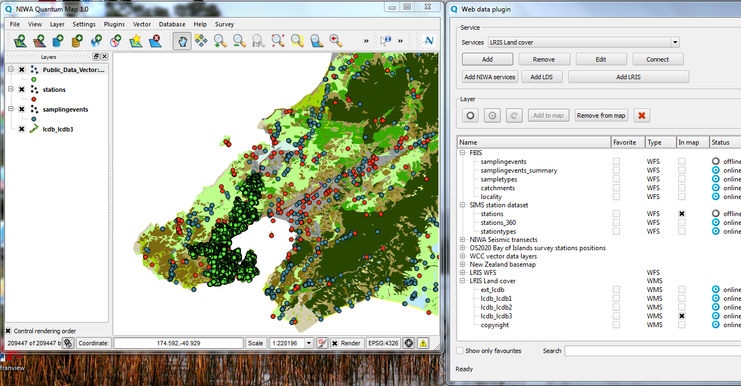
Interoperability in action
Delivered through OGC standards in real time:
LCDB3 from Landcare Research
City Assets from Councils
Observation points from NIWA
Notes:
Example of Interoperability
Sampling locations from NIWA
Station locations from NIWA
Land Cover Database from Landcare Research
Water Assets from Wellington Council
All delivered through standard (OGC) web services and
Visualized in the free open source desktop GIS QGIS.

