Slide 1
SOS 2.0 Profile For Hydrology
90th OGC Technical Committee
Washington, DC
Michael Utech
26 March 2014
Copyright © 2014 Open Geospatial Consortium

Slide 2

Development
Originated from the requirement of technically and semantically interoperable web services for hydrological data
Developed within the GEOWOW project
GEO – Group on Earth Observations
GEOWOW is a project co-funded under the European Community's Seventh Framework Programme
Support and input by the Hydrology Domain Working Group
Copyright © 2014 Open Geospatial Consortium

Slide 3
Why do we need a profile?
Within the scope of the Groundwater and Surface Water IEs, many difficulties in the usage of SOS (1.0) for hydrological data have been identified
They mainly led to several different semantic mappings that we listed as SOS types A to C
These SOS setups were mostly interoperable from a technical point of view, but not regarding semantics
E.g. FeatureOfInterest being used either as a river or as a measuring station
Copyright © 2014 Open Geospatial Consortium

Slide 4
Objectives
Create a fully interoperable SOS 2.0 for hydrological data
Specifies WaterML2.0 as the language for timeseries data
Guide developers to ONE specific way of implementation (instead of supporting multiple variants)
Copyright © 2014 Open Geospatial Consortium

Slide 5
Profile Structure
‚Terms and Definitions‘ covers all entity related topics
‚Requests and Responses‘ covers all topics related to querying and retrieving data with the available requests
‚Technical Issues‘ covers purely technical topics like what to respond if e.g. a client requests half the database content
Where possible, definitions are expressed through e.g. extensions or schemas
Copyright © 2014 Open Geospatial Consortium

Slide 6
Profile Summary 1
Defines usage and encoding of entities like FeatureOfInterest, ObservedProperty and Procedure
Defines identification and labeling of entities
Defines a common discovery process from sampling features down to the time series data level
Prevents unintended and intended bulk data requests that normally are possible through SOS 2.0 specification
Copyright © 2014 Open Geospatial Consortium

Slide 7
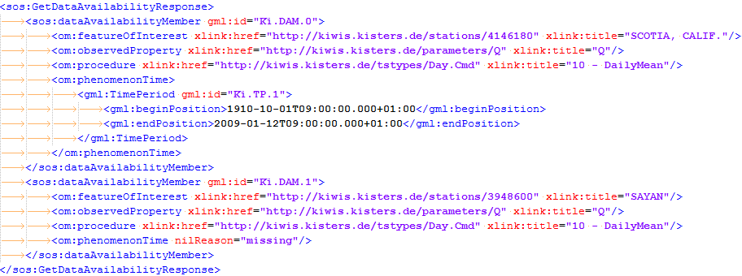
Profile Summary 2
Additional command GetDataAvailability
  To provide a filterable time series list that is missing in SOS 2.0
  Allows filtering for offerings, sampling features, properties and procedures
  Returns a list of groups of the above entities that represents existing time series with data coverage
  Possibly the command could get accepted as SOS 2.0 extension
  Command will be mandatory with the profile
Copyright © 2014 Open Geospatial Consortium

Slide 8
Remaining Work
Publish the profile as OGC Discussion Paper (see next slide)
Provide XSD Schemas for the GetDataAvailability request
Possibly get GetDataAvailability accepted as official extension
Possibly submit one or two change requests for the SOS2 SWG
make many conformal server instances publicly available to share data ☺
Copyright © 2014 Open Geospatial Consortium

Slide 9
Motion
The Hydrology DWG recommends that the OGC Technical Committee approve release of 14-004 “Sensor Observation Service 2.0 Hydrology Profile” as an OGC Discussion Document
  Pending any final edits and review by OGC staff
  Motion: Michael Utech (KISTERS)
  Second: XXX
  There was no objection to unanimous consent
https://portal.opengeospatial.org/files/?artifact_id=57327&version=1
Copyright © 2014 Open Geospatial Consortium

Slide 10
Thank you for your attention…
Any questions?
Copyright © 2014 Open Geospatial Consortium

