Slide 1
WaterML2.0 part 2 Update
90th OGC Technical Committee
Washington, DC
Paul Sheahan, Peter Taylor
26th March 2014
Copyright © 2014 Open Geospatial Consortium

Slide 2
Interoperability Experiment
Interoperability Experiment (IE) is underway:
Aims to test the initial information model
Three scenarios:
US exchange between USGS, NWS, USACE
Aus exchange between Bureau and water agencies
UK publishing national river archive
Copyright © 2014 Open Geospatial Consortium

Slide 3
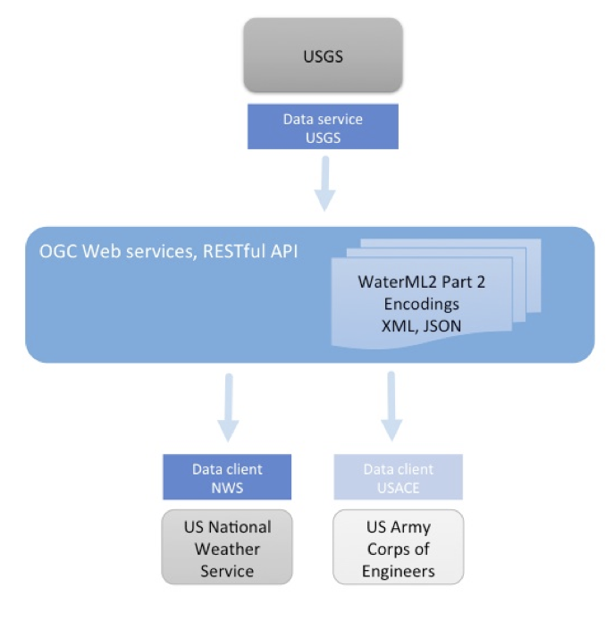
US Scenario

Slide 4
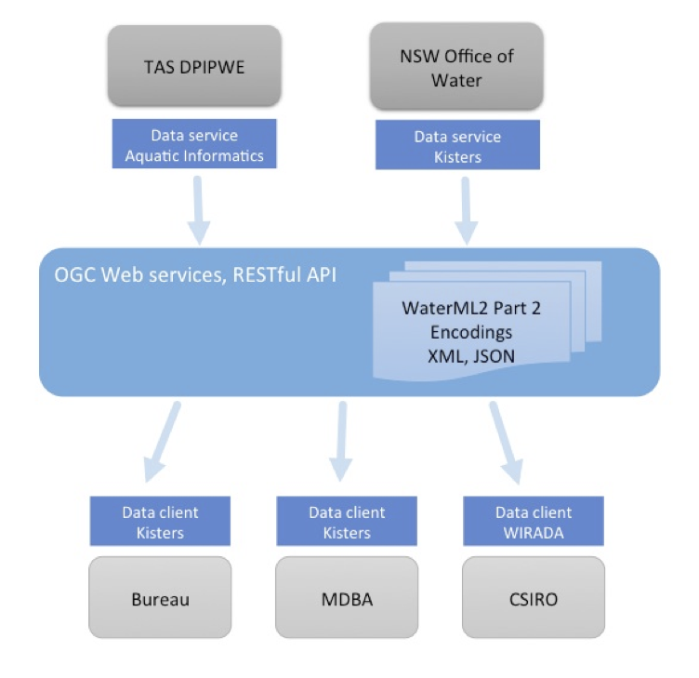
Aus Scenario

Slide 5
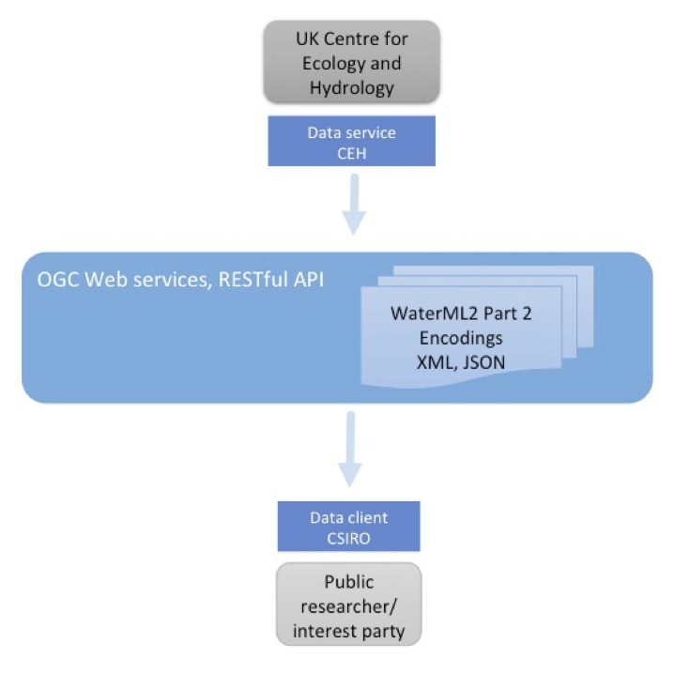
UK Scenario

Slide 6
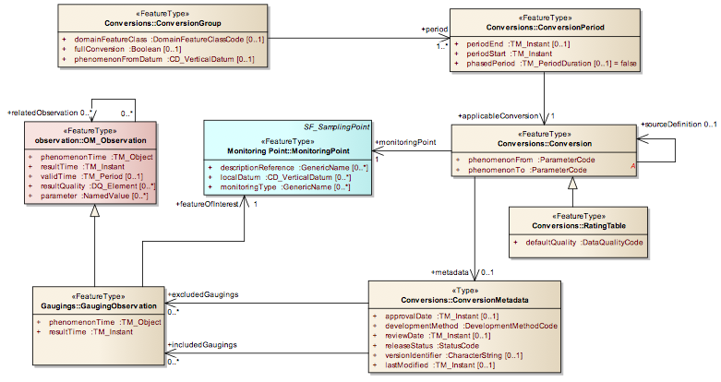
Current Model
Described in OGC discussion paper

Slide 7
Web service delivery
It is possible to deliver WaterML2.0 part 2 using:
WFS for ratings and range values
SOS for gaugings and cross-sections
Requires fair amount of customisation and filtering, and two different service implementations
Starting with a RESTful service to test the information model

Slide 8
REST API
Retrieve all rating tables for specific monitoring point: http://waterml2.csiro.au/rgs-api/v1/conversion/?monitoring-point=419009
Retrieve latest rating table for specific monitoring point: http://waterml2.csiro.au/rgs-api/v1/conversion/?monitoring-point=419009&latest
Retrieve gauging for a monitoring point after specific date: http://waterml2.csiro.au/rgs-api/v1/gauging/?monitoring-point=419009&start-date=2009-02-15
Retrieve all gaugings for a monitoring point: http://waterml2.csiro.au/rgs-api/v1/gauging/?monitoring-point=419075&format=xml
Fully expanded list of all gaugings for a monitoring point: http://waterml2.csiro.au/rgs-api/v1/gauging/?monitoring-point=419075&format=xml&expanded
API Documentation: http://waterml2.csiro.au/rgs-api/v1/docs/

Slide 9
Next steps
IE participants are implementing RESTful APIs to encode the WaterML2.0 part 2 model
JSON encodings and XML are being explored - current prototype delivers both
Results to be demonstrated at the August HydroDWG workshop
Form a new SWG? Or use WaterML2.0 Part 1 SWG?
Question for OGC/HydroDWG
Notes:
Carl Reed : SWG question

Slide 10
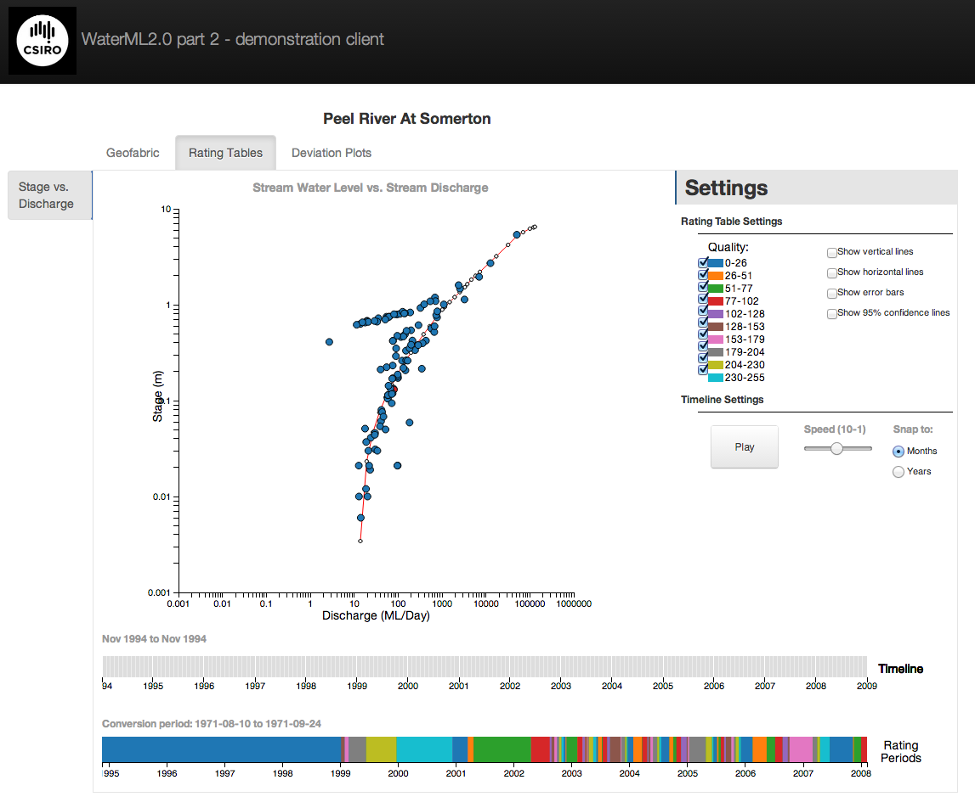
Test web client

Slide 11
References/lists etc.
http://external.opengis.org/twiki_public/HydrologyDWG/WaterML2Part2
Email list: hydro-rgs@lists.opengeospatial.org

