Slide 1
WDTF and WaterML 2.0
Water for a Healthy Country

Slide 2
Context
Two project teams in CSIRO
  AHGF – Geospatial Fabric
  WDTS – Water Observations
(at least) Three products
  AHGF
  WDTF
  WaterML 2.0 (with CUAHSI)

Slide 3
  Australian Hydrological Geospatial Fabric (AHGF)

Slide 4
Australian Hydrological Geospatial Fabric (AHGF)
Goal: the ‘blue-line’ network
  also includes catchments
  + engineering and sampling artefacts
Focus: methodology
  Model Driven design
    Multiple implementation artefacts generated from single model
  Maintenance of the dataset
    Feature identifiers are key …

Slide 5
Alignment and harmonization
ArcHydro
(Australian) ICSM Harmonized Data Model
INSPIRE Hydrography
  data product specification

Slide 6
  Water Data Transfer Format

Slide 7
WDTF – requirements
“National Plan for Water Security” 2007
  Water information coordinated through Bureau of Meteorology (BoM)
    River flows, Groundwater levels, Reservoir storage
    Water quality
    Water use, entitlements, trades
BoM establishing a Data Warehouse (‘cache’)
  ~300 supplier/custodians
  Initial regulations are rather loose re. transfer format
    mostly “CSV” with no schema!
  Will get agencies into the habit of sending data to BoM
  … but unmanagable in the long term
➔ “Water Data Transfer Format” (WDTF)

Slide 8
WDTF – design
WDTF developed July-Dec 2008:
  XML format
  Based on standards stack from Open Geospatial Consortium (OGC):
    Geography Markup Language (GML)
    Observations and Measurements (O&M)
    Simple features profile (restricts schema and GML)
  ➔compatible with WFS and SOS
  ➔compatible with other environmental data

Slide 9
WDTF – observations, sites and sampling
Uses O&M to captures the relationship between:
  Procedure (e.g. sensor taking the measurement)
  Property (e.g. water level)
  Feature of interest (e.g. river) (a type from AHGF)
  Result (e.g. a time series)
  Usually involves a sampling feature:
    Sampled feature = river
    Sampling feature = gauging station
O&M allowed rapid solution of sites/specimens/features issues

Slide 10
WDTF – specifics
In addition to ‘observation’ schema, WDTF adds support for
  Transactions
    allow for transmission of updates to central repository
  Tables for conversions
    e.g. level to flow
and enforces certain content requirements
  Station identifiers
  Measurable properties
  Organisation codes
  Status codes
  Processing codes
  Quality codes
  Interpolation codes
  SRS codes
i.e. includes a set of “controlled vocabularies”

Slide 11
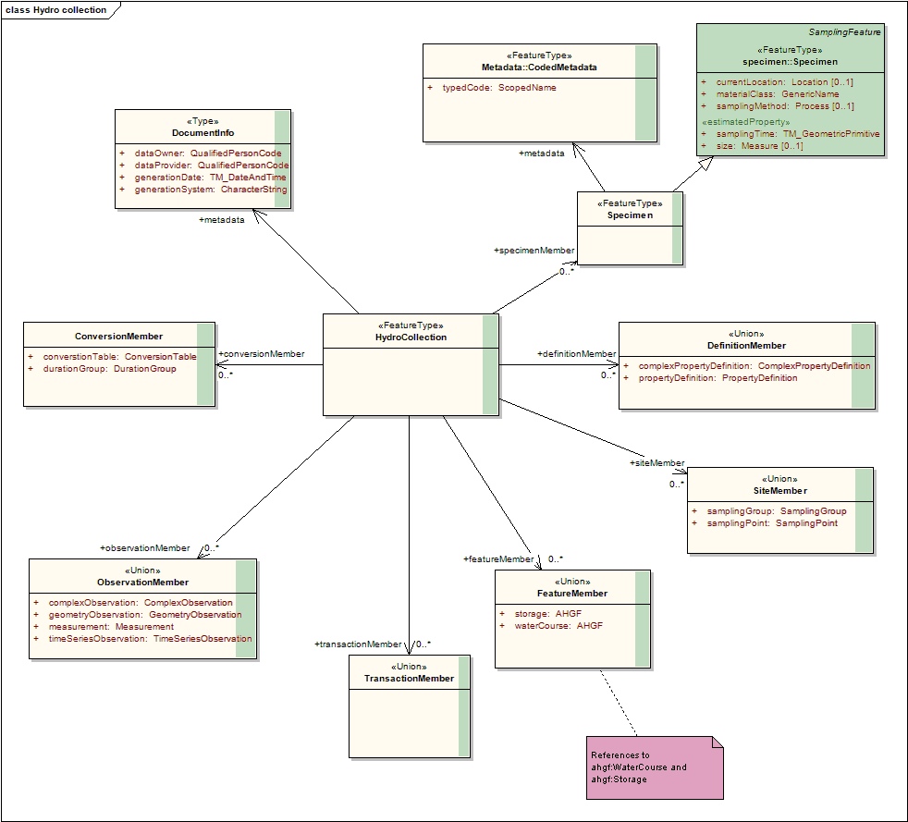
WDTF - formalization
Initially developed in XML Schema
UML model reverse engineered

Slide 12
WDTF – scope
Supports:
  Surface water, water quality, reservoir storage, conversions
In progress:
  Ground water, water use, trading and entitlement
For ingestion into BoM cache, not publication for end-users

Slide 13
  Towards WaterML 2.0

Slide 14
WaterML 2.0 – goals
Aim:
  Harmonize Australian WDTF and CUAHSI WaterML 1.X
  Link to more hydrologic feature-types
    not just point monitoring sites
  Improved vocabulary/ontology management, mapping, publication
international standard for water observations data, interoperable with other domains in environmental sciences

Slide 15
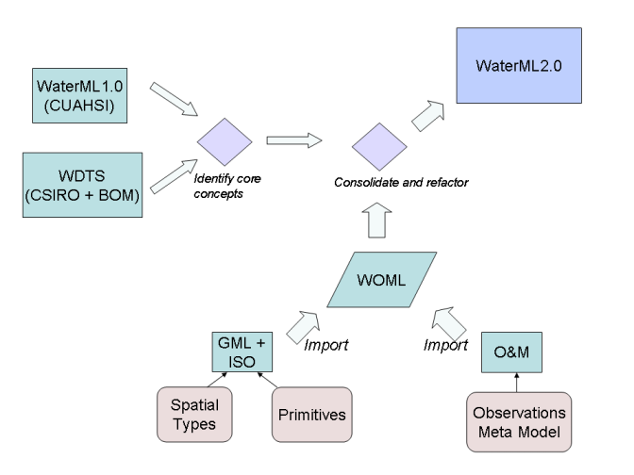
WaterML 2.0 – methodology
F

Slide 16
WaterML 2.0 – alignment and harmonization
Inputs
  WaterML 1.X, WDTF, O&M, ISO primitives …
Participating in SWE working groups
  ensure time-series handled well by OGC XML encodings
Controlled vocabularies
  Use semantic-web technologies
    RDF/SKOS/OWL
  Publish through web-services
    to support validation services
  Use best-of-breed vocabularies
    POSC/UCUM for units of measure
    EPSG for spatial reference systems
    Etc…

Slide 17
WaterML 2.0 advantages
Richer observations metadata
Share development and maintenance
Interoperable with other environmental science domains
  E.g. GeoSciML, GroundwaterML, CSML
INSPIRE compatibility

Slide 18
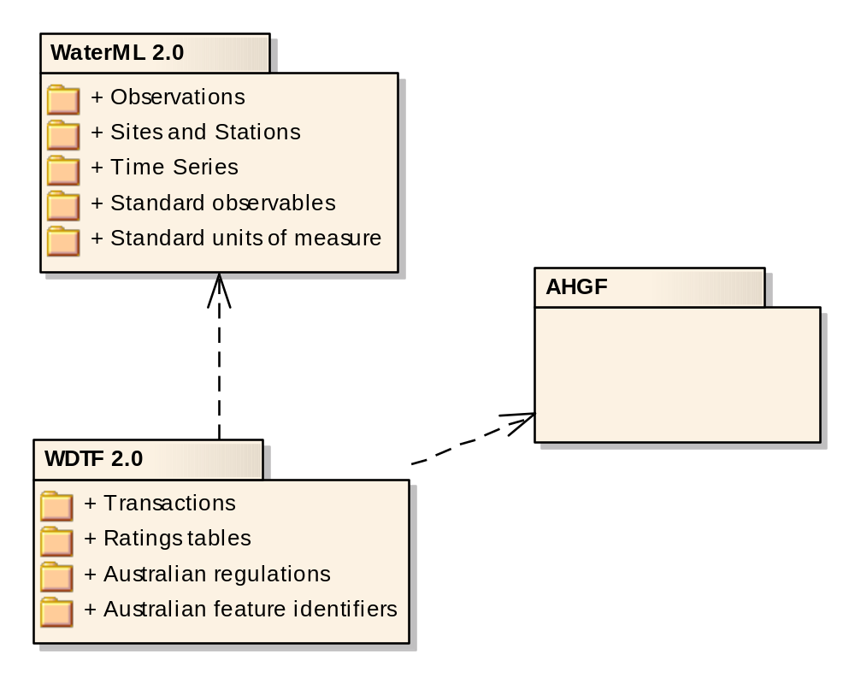
WDTF & WaterML 2.0
WDTF 2.0
Transaction support
Ratings tables
Australian vocabs
Identifiers
Links to AHGF
WaterML 2.0:
Observations
time-series
sites and stations
staodard observables
Standard uom

Slide 19
WaterML 2.0 – Pathway to adoption
CUAHSI
  HIS 2.0 to use WaterML 2.0 ?
  HIS to add WFS and SOS interfaces ?
    SOS backed by ODM 1.1 recently deployed in North Carolina
WIRADA
  substitute core of WDTF by WaterML 2.0 (data ingest)
  AWRIS to use HIS 2.0 for data publication ?
INSPIRE …
Standardization:
  OGC Hydrology DWG
    Co-chaired by WMO CHy
    GRDC, GPCC, EEA, INSPIRE involvement
    Leading to WaterML 2.0 as ‘OGC Implementation Standard”
  ISO?
  WMO
    These days are looking to adopt ISO standards where possible

