Slide 1



Hydrologic Information System for the Nation
Ilya Zaslavsky
Spatial Information Systems Lab
San Diego Supercomputer Center
UCSD
http://his.cuahsi.org
http://hiscentral.cuahsi.org
http://hydroseek.net
http://river.sdsc.edu/ucsddash
http://wron.net.au/DemosII/Modules/ODMKMLGatway.aspx
http://maxim.ucsd.edu/mattsmaps/storet.aspx
BOM talk, Melbourne, March 19, 2009

Slide 2
Outline
CUAHSI HIS Refresher
Recent developments
  WaterML, and services
    WaterML 1.1
    Towards OGC standards and WaterML 2.0
  HISCentral updates
  Ontology management updates
  Data cubes and visualization
Several difficult questions and trade-offs

Slide 3
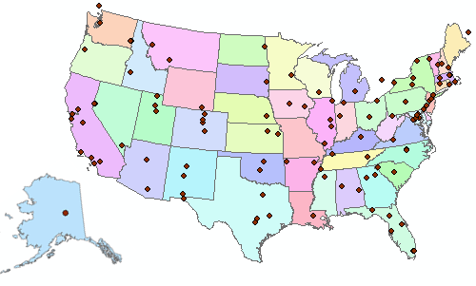

Consortium of Universities for the Advancement of Hydrologic Science, Inc.
122 US Universities as of July 2008
An organization representing more than one hundred United States universities, receives support from the National Science Foundation to develop infrastructure and services for the advancement of hydrologic science and education in the U.S.
http://www.cuahsi.org/

Slide 4
What is the CUAHSI HIS?
CUAHSI HIS: NSF support through 2012 (GEO), ~10 mil invested
Partners:
Academic: 11 NSF hydrologic observatories, CEO:P projects, LTER…
Government: USGS, EPA, NCDC, NWS, state and local
Commercial: Microsoft, ESRI, Kisters
International: Australia, UK
Standardization: OGC, WMO (Hydrology Domain WG, CHy); adopted by USGS, NCDC
An online distributed system to support the sharing of hydrologic data from multiple repositories and databases via standard water data service protocols; software for data publication, discovery, access and integration.
Notes:
The CUAHSI Hydrologic Information System (CUAHSI-HIS) provides web services, tools, standards and procedures that enhance access to more and better data for hydrologic analysis.
The web services use an XML based format for communicating hydrologic data, called WaterML. HIS web services support access to National Datasets such as the USGS National Water Information System (NWIS) and EPA Storage and Retrieval System (STORET), in a standard way. Users anywhere with access to the internet can save their data in a relational database format, called ODM, and register it with CUAHSI HIS to publish their data. Popular software for working with data, such as Excel, MATLAB and a variety of computer programming languages can access HIS data directly using web services. This lets users work with familiar software rather than having to learn something new.

Slide 5
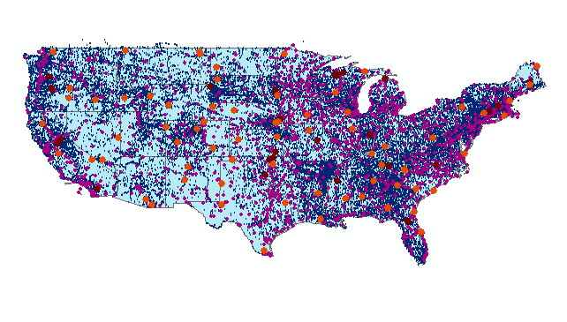
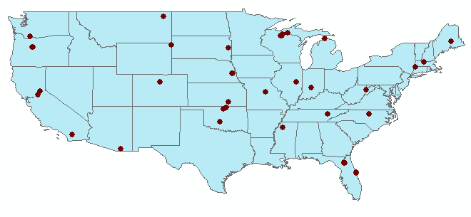
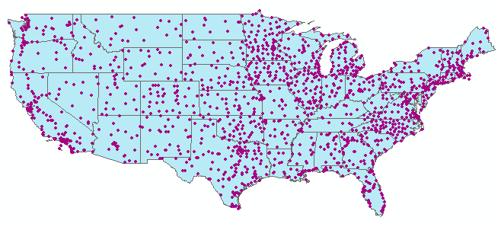
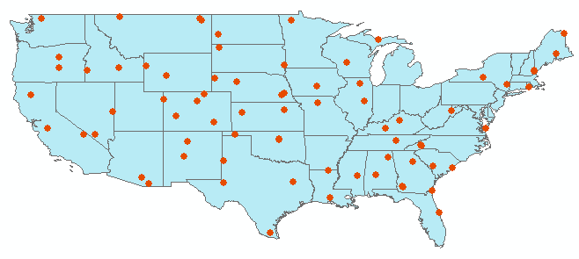
Map for the US
Ameriflux Towers (NASA & DOE)
NOAA Automated Surface
Observing System
USGS National Water Information System
NOAA Climate Reference Network
Build a common window on water data using web services
Notes:
David - for each of these site files, can you include how many points are in each one.

Slide 6
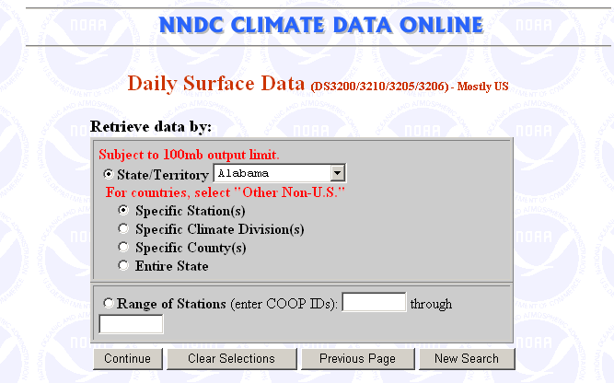
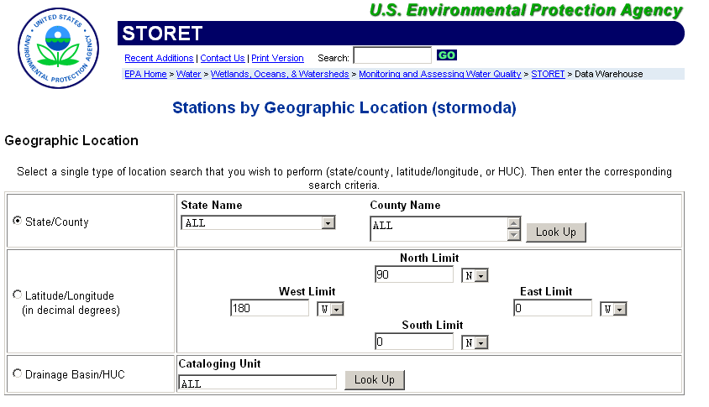
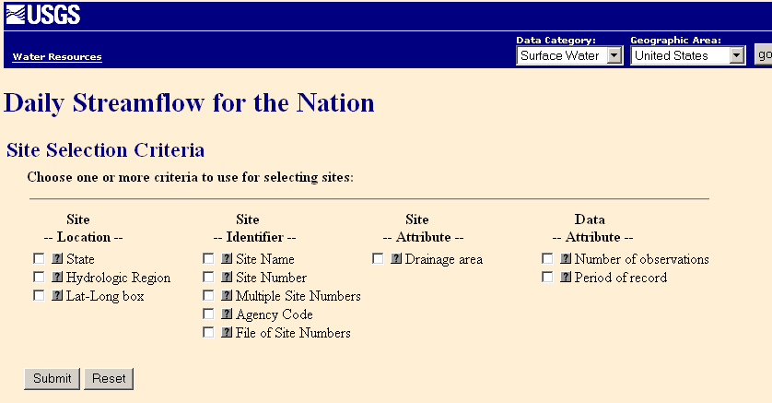
Water Data Web Sites

Slide 7
NWISWeb site output
# agency_cd Agency Code
# site_no USGS station number
# dv_dt date of daily mean streamflow
# dv_va daily mean streamflow value, in cubic-feet per-second
# dv_cd daily mean streamflow value qualification code
#
# Sites in this file include:
# USGS 02087500 NEUSE RIVER NEAR CLAYTON, NC
#
agency_cd site_no dv_dt dv_va dv_cd
USGS 02087500 2003-09-01 1190
USGS 02087500 2003-09-02 649
USGS 02087500 2003-09-03 525
USGS 02087500 2003-09-04 486
USGS 02087500 2003-09-05 733
USGS 02087500 2003-09-06 585
USGS 02087500 2003-09-07 485
USGS 02087500 2003-09-08 463
USGS 02087500 2003-09-09 673
USGS 02087500 2003-09-10 517
USGS 02087500 2003-09-11 454
Time series of
streamflow at a
gaging station

Slide 8
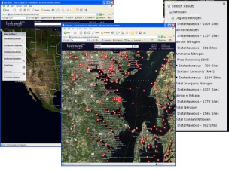
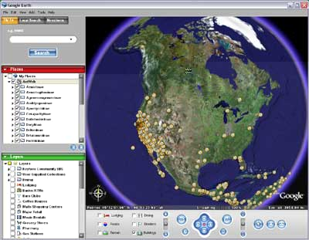
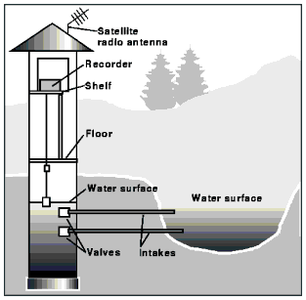
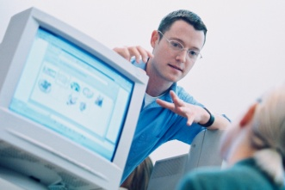




Hydrologic Information System Service Oriented Architecture
Deployment to test beds
Global search (Hydroseek)
Customizable web interface (DASH)
Other popular online clients
HTML - XML
Data publishing
Desktop clients
HIS Central
Registry & Harvester
Water Data Web Services, WaterML
Test bed HIS
Servers
WSDL - SOAP
ArcGIS
WSDL and ODM registration
Matlab
Ontology tagging (Hydrotagger)
IDL, R
MapWindow
ODM DataLoader
Excel
Streaming Data Loading
HIS Lite
Servers
Central HIS servers
External data providers
Programming (Fortran, C, VB)
ODMTools
Server config tools
Modeling (OpenMI)
Notes:
Hydrologic Information System Service Oriented Architecture

Slide 9
CUAHSI Observations Data Model
http://his.cuahsi.org/odmdatabases.html

Slide 10
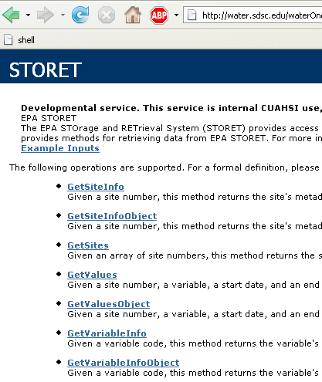
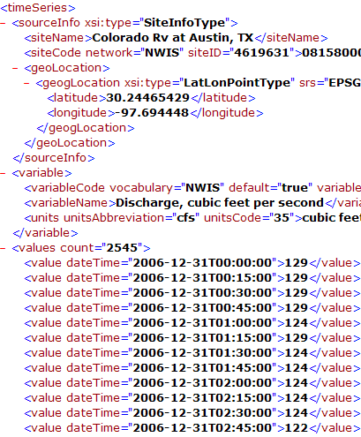
Water Data Services
Set of query functions
Returns data in WaterML
NWIS Daily Values (discharge), NWIS Ground Water, NWIS Unit Values (real time), NWIS Instantaneous Irregular Data, EPA STORET, NCDC ASOS, DAYMET, MODIS, NAM12K, USGS SNOTEL, ODM (multiple sites)

Slide 11
Water Web Services
Low barrier to entry
  Deliver data
  Variable, Sites, Series for a site, DataValues for a series.
Is the data source appropriate
  Does it have the variables I am interested in
Sites
  What sites are available
Does not answer, for my region what variables are available

Slide 12
WaterML Responses
GetVariableInfo returns a list of variables
  variablesResponse
GetSites returns a list of site information records
  sitesResponse (multiple sites, with no series information)
GetSiteInfo returns site information with list of observations
  sitesResponse (single site with series information)
GetValues returns a Time-series of data values and associated metadata (site information, variable
  timeSeriesResponse
… OGC SOS?

Slide 13
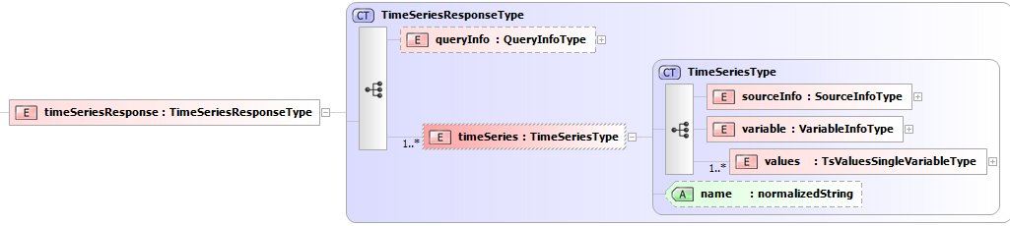
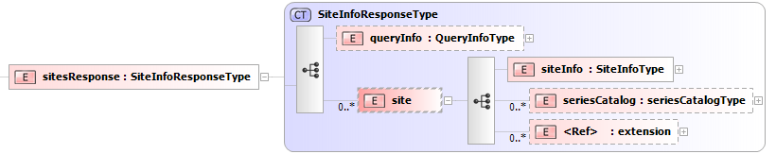

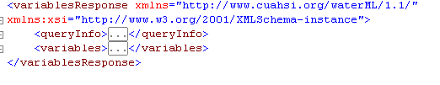
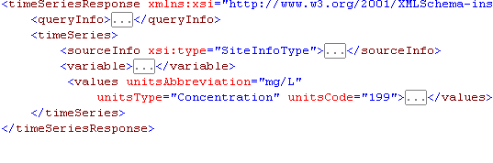
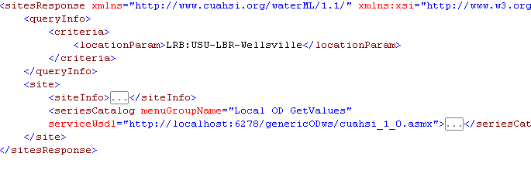
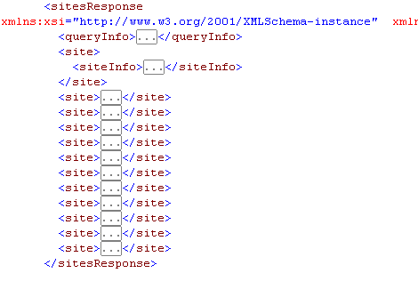
WaterML Responses
GetSites
Basic Site Information only
GetSiteInfo
Site and Series

Slide 14
On WaterML

Slide 15
Requirements for a community data exchange protocol
Ability to accommodate structurally and syntactically different data sources
Conformance with accepted semantics of hydrologic data discovery and retrieval
Following common use cases, and alignment with the CUAHSI ODM
Ability to express and re-use common structural components of the information model
Relative simplicity and transparency, to ease community adoption
Ability to integrate with other datasets within and across research domains
Fidelity and reliability in relaying core information on hydrologic observations
A governance structure, where site and variable identifiers, vocabulary and ontology conventions, structural definitions for data interchange, and other components of the exchange protocol are managed across observation networks
Reliance on implementation best practices, protocol implementation in the context of an operational distributed information system for hydrologic data
Ability to reliably and efficiently relay hydrologic information when metadata and data are at physically different locations

Slide 16
WaterML Evolution
WaterML 1.0: OGC Discussion Paper, 2007
WaterML 1.1: mid-2008
  To reflect changes in ODM 1.1 (expose additional fields)
  To remove enumerations used to implement controlled vocabularies (e.g. for ValueType, DataType, GeneralCategory)
  Consistency (e.g. remove reliance on IDs; units
WaterML 2.0: harmonizing WaterML 1.1 with O&M, to be accessed via SOS and/or WFS

Slide 17
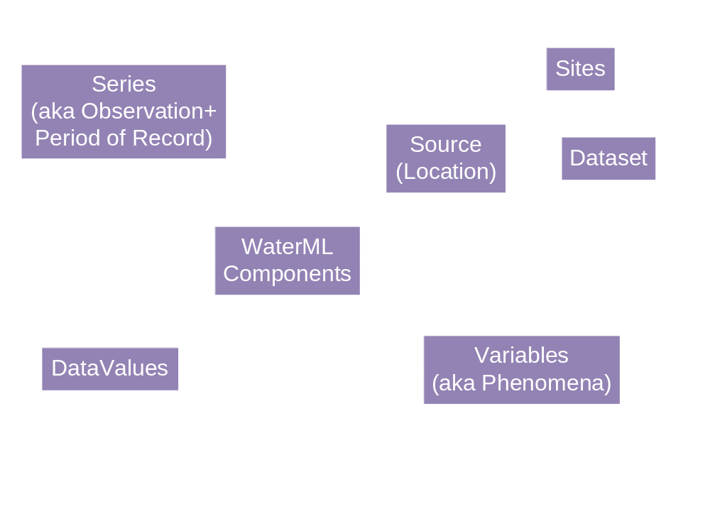
WaterML Components

Slide 18
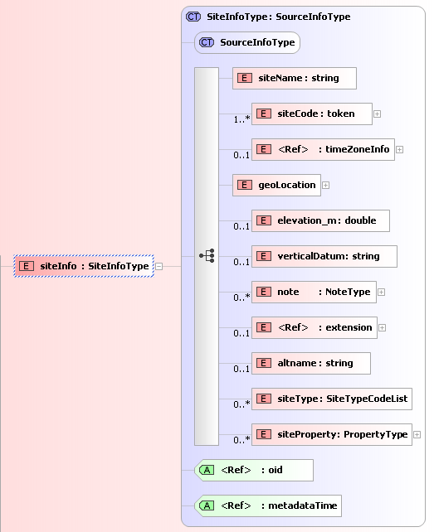
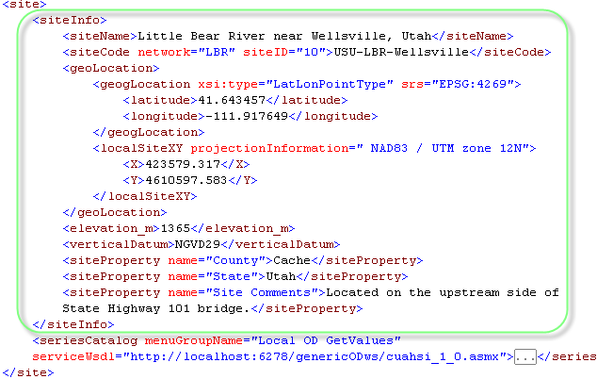
Site Information (Descriptive)
Unique Reference:
LBR:USU-LBR-Wellsville
Location:
Type: Point
feature of interest
(Sampling Feature)
Properties

Slide 19
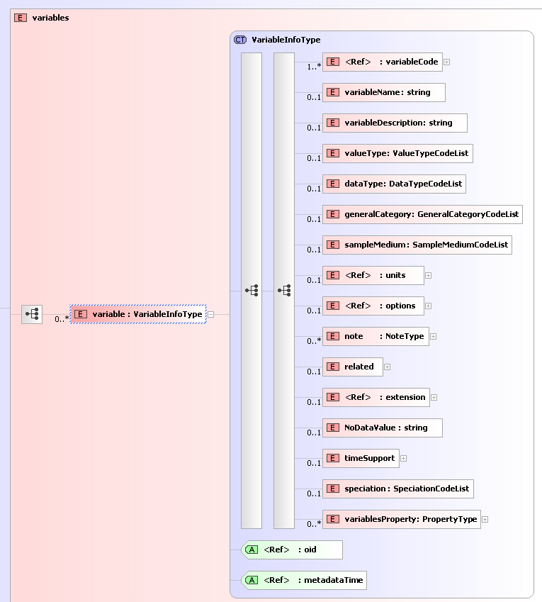
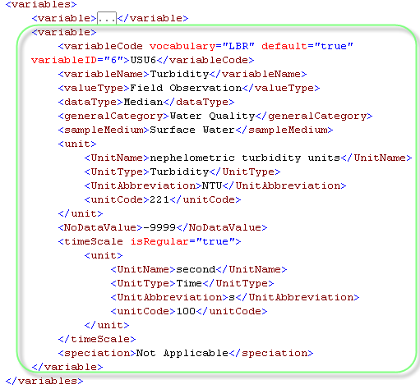
Variable
Unique Vocabulary Reference:
LBR:USU6
observed property
(Property Type)
+ uom
Unique Variable

Slide 20
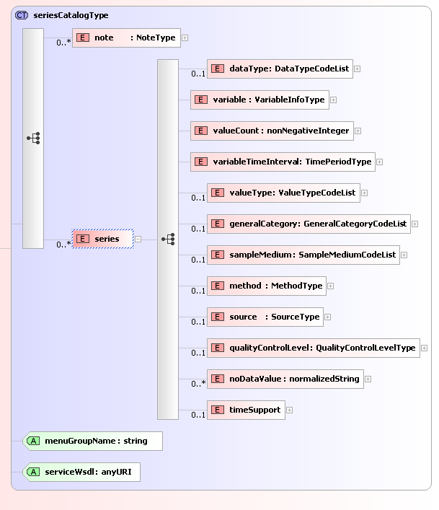
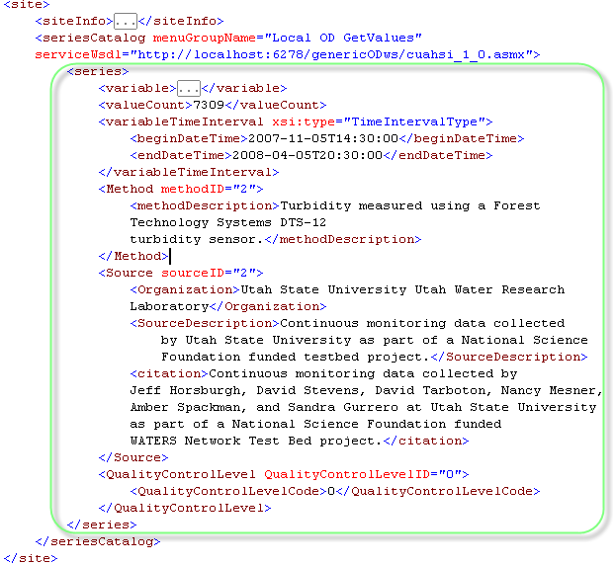
Series (Observation)
Site
Variable
TimePeriod
temporal sampling
regime is linked to
the site
Notes:
Series is part of a site

Slide 21
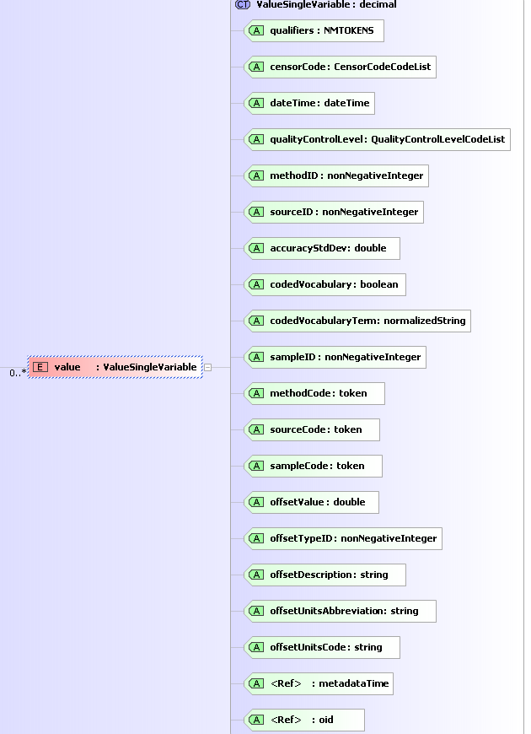
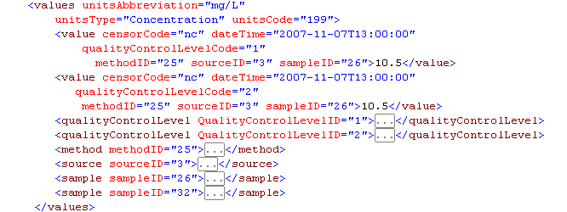
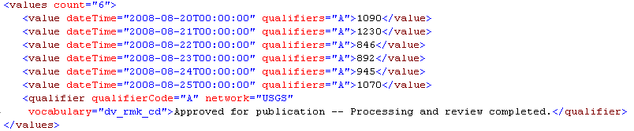
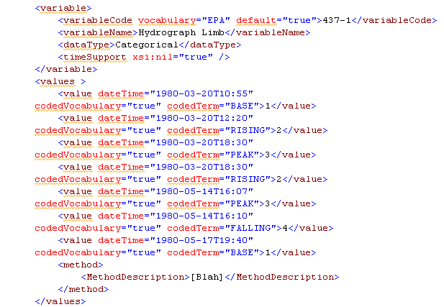
Values, aka Time Series
With source, method, and sample information
Minimal with Qualifiers
Coded
result
(temporal coverage)

Slide 22
Time Series

Slide 23
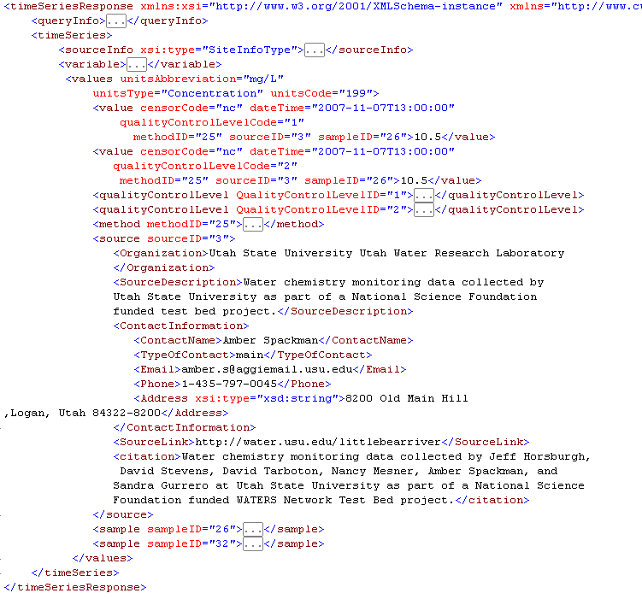
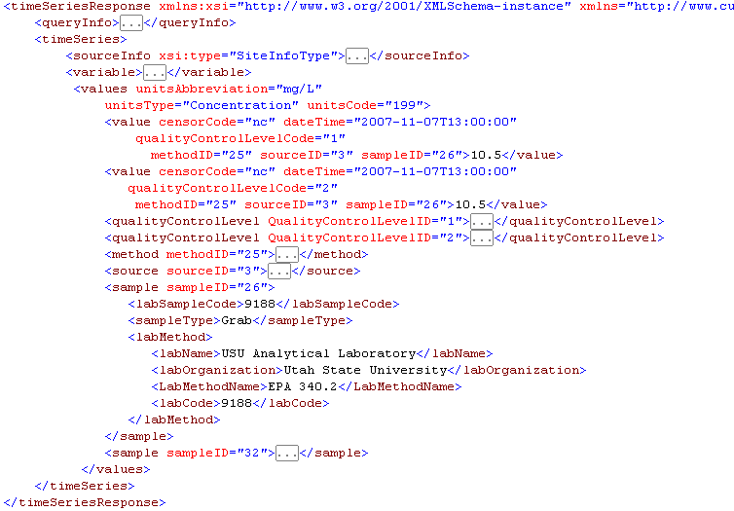
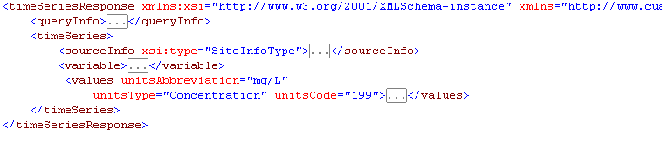
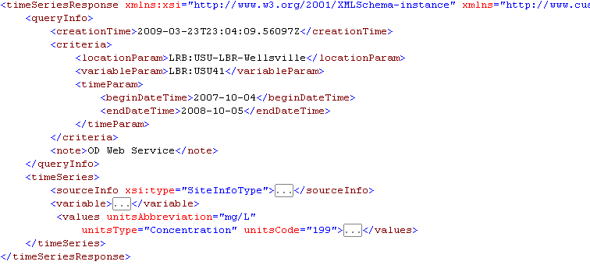
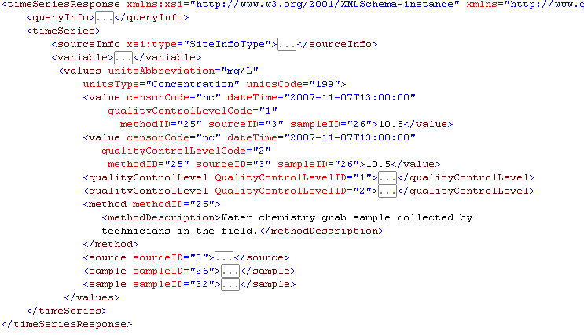
TimeSeries response
Notes:
This is a sequence to discuss the time series.
It opens with the queryInfo, which is in all responses.
Next is the sourceInfo. The sourceInfo is polymorphic. It can also be a dataset, which is used when returning information from datasources like DayMet
Next is the Variable
The next clicks take you though the

Slide 24
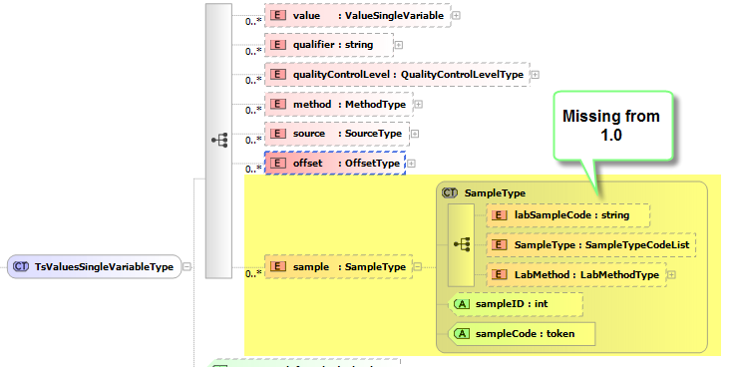
WaterML 1.1: additional sample elements

Slide 25
WaterML 1.1: Extensibility
    Additional elements: siteInfo/siteProperty; variable/variableProperty;
    series/seriesProperty; values/valuesProperty

Slide 26
WaterML 1.1: other
Space-delimited qualifiers
Added SiteType as used by EPA and USGS
Added Speciation to VariableInfo Type
Suggested lists of terms instead of enforced enumerations (doesn’t throw an error on unknown terms)
Multiple Values (change cardinality to 1+)
  A USGS site can have multiple streams of the same variable parameter from different instruments, e.g. Variable: NWISDV:00065 or NWISDV:00065/statistic=00003 or NWISDV:00065/ValueType=Average
Changes in method names (for consistency)
Added timeScale to handle “Time” associated variable information

Slide 27
Toward WaterML 2.0
Use Simple GML
Utilize XML namespaces (though need a wrapper)
Extensible to additional use cases
Prototype implementations demonstrating the use cases
Deliver information over modified Water Data Services, or WFS/WCS/SOS
Understand the implications of the change to the user community
Best Practices: Units of Measures

Slide 28
Semantics / Ontology Issues

Slide 29
Semantic Heterogeneity in Measurement Units
acre feet | acre-feet
micrograms per kilogram | micrograms per kilgram
FTU | NTU
mho | Siemens
ppm | mg/kg

Slide 30
Variable/Phenomenon
Semantics
Nitrogen
  e.g. NWIS parameter # 625 is labeled ‘ammonia + organic nitrogen‘, Kjeldahl method is used for determination but not mentioned in parameter description. In STORET this parameter is referred to as Kjeldahl Nitrogen.
Turbidity : 5 different units
And: Dissolved oxygen

Slide 31
Two mechanisms
Controlled vocabularies
Ontologies, and ontology tagging
  OWL
    http://svn.sdsc.edu/repo/WATER/CUAHSI/OntologyOwl/StarTree_Current/ontology
  Tabular
    https://svn.sdsc.edu/repo/WATER/CUAHSI/OntologyOwl/TabularLayout/OntologyTable_2_4_2009.csv
  Startree
  Wiki + Startree (e.g. http://water.sdsc.edu:7788/demo/NIF/index.html
  What are the use cases…

Slide 32
Some trade-offs…

Slide 33
WhichML
Must be considered in the context of specific information they were designed to communicate, and implementation use cases they were intended to support
USGS HydroML (mirrors NWIS)
EPA’s WQX (to submit “activity” data; activity-method-sample-result)
IWDTF (GML simple features)
GRDC (ISO/TC211 compliant)
O&M-compliant
…
  no simple schema will be able to fully communicate the details of a rich variety of information used in hydrologic modeling

Slide 34
Series vs Observations
a series: data values associated with a unique site, variable, method, source, and quality control level combination, collected between a start and end date and time.
Key construct in WaterML; most metadata associated with it
Advantages:
  better alignment with common usage scenarios;
  easier interpretation and compactness, without excessive references
  support of efficient implementation of the entire discovery phase over a SeriesCatalog.
    1.75 million stations; 134 million observation series,
  efficient formulation of “data carts” as collections of series.
Most recent: http://river.sdsc.edu/wiki/HIS%20Desktop%20Database.ashx

Slide 35
General vs rigid schema
Initial goal: a fairly small, rigid and efficient hydrologic data message format
  easy to completely implement, validate, parse and interpret
  Used as infrastructure backbone
  Has been quickly adopted
  Though support for limited use cases
Second phase:
  Expanded use cases, less rigidly defined schema
  a more general format

Slide 36
Summary
Generic method for managing and publishing observational data
  Supports many types of point observational data
  Overcomes syntactic and semantic heterogeneity using a standard data model and controlled vocabularies
  Supports a national network of observatory test beds but can grow!
WaterML is a standard language for consistently communicating water observations data from academic and government sources using web services – develops towards OGC standards
National Water Metadata Catalog is the most comprehensive index of the nation’s water observations presently existing
Join the Water Data Federation!

Slide 37
Coming soon…
All Hands Meeting of CUAHSI HIS at SDSC; April 6-7 2009
HIS expansion: SE Asia, SBRP program; water research centers
Open Geospatial Consortium: considers Hydrology Domain Working Group (end of March): focus on WaterML 2.0
Collaboration with World Meteorological Organization (joint charter between WMO’s CHy and OGC’s Hydrology DWG)
Automated facilities for uploading/hosting observations data
Integration with real-time (via DataTurbine), with hydrologic models (via OpenMI, CSDMS), animations, spatio-temporal interpolation
Desktop HIS (this year)

