Slide 1

Hydrology DWG:
INSPIRE Hydrography theme
Dr Andrew Woolf (Andrew.Woolf@stfc.ac.uk)
Rutherford Appleton Laboratory, UK
Copyright © 2009, Open Geospatial Consortium, Inc.

Slide 2
Outline
INSPIRE background
Data specifications
Hydrography theme
Use Cases
‘As-is’ analysis
Model (v2.0)
v2.0 review
Relationship with WISE
Copyright © 2009, Open Geospatial Consortium, Inc

Slide 3

INSPIRE background [1/4]
(courtesy JRC)
Needs
Better information needed to support policies
Improvement of existing information flows
Differentiation across regions to be considered
Revision of approach to reporting and monitoring, moving to concept of sharing of information
Situation in Europe
Data policy restrictions
  pricing, copyright, access rights, licensing policy
Lack of co-ordination
  across boarders and between levels of government
Lack of standards
  incompatible information and information systems
Existing data not re-usable
  fragmentation of information, redundancy, inability to integrate
DIRECTIVE 2007/2/EC OF THE EUROPEAN PARLIAMENT AND OF THE COUNCIL
establishing an Infrastructure for Spatial Information in the European Community (INSPIRE)
EU has islands of data of different standards and quality...
Copyright © 2009, Open Geospatial Consortium, Inc

Slide 4
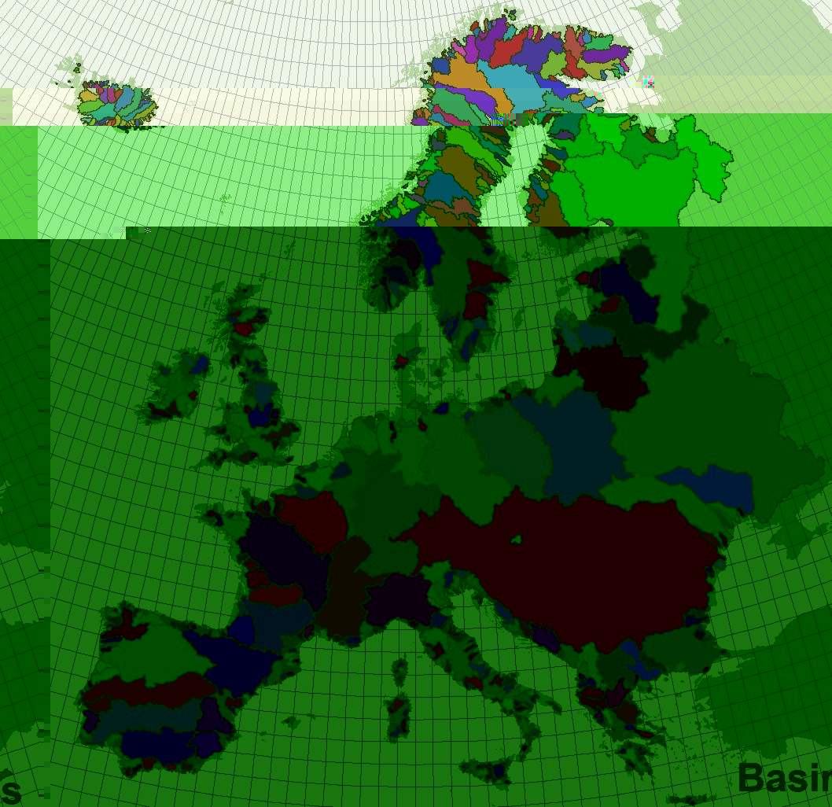
INSPIRE background [2/4]
e.g. Water Framework Directive (2000/EC/60)
Reporting needed, but ...
Catchment flows don’t follow administrative boundaries
(Water Information System for Europe, WISE)
(courtesy JRC)
Copyright © 2009, Open Geospatial Consortium, Inc

Slide 5
INSPIRE background [3/4]
INSPIRE is a Framework Directive
  lays down general requirements
  detail provided through Implementing Rules:
    metadata, data, services, sharing, monitoring & reporting
Timetable
  Preparatory phase (2004-2006)
  Transposition phase (2007-2009)
  Implementation phase (2009-2019)
Entered into force 14-Mar-2007
Transposition: 15-May-2009
Copyright © 2009, Open Geospatial Consortium, Inc

Slide 6
INSPIRE background [4/4]
Annex I
  Coordinate reference systems, Geographical grid systems, Geographical names, Administrative units, Addresses, Cadastral parcels, Transport networks, Hydrography, Protected sites
Annex II
  Elevation, Land cover, Orthoimagery, Geology
Annex III
  Statistical units, Buildings, Soil, Land use, Human health and safety, Utility and governmental services, Environmental monitoring facilities, Production and industrial facilities, Agricultural and aquaculture facilities, Population distribution – demography, Area management/restriction/regulation zones and reporting units, Natural risk zones, Atmospheric conditions, Meteorological geographical features, Oceanographic geographical features, Sea regions, Bio-geographical regions, Habitats and biotopes, Species distributions, Energy resources, Mineral resources
Copyright © 2009, Open Geospatial Consortium, Inc

Slide 7
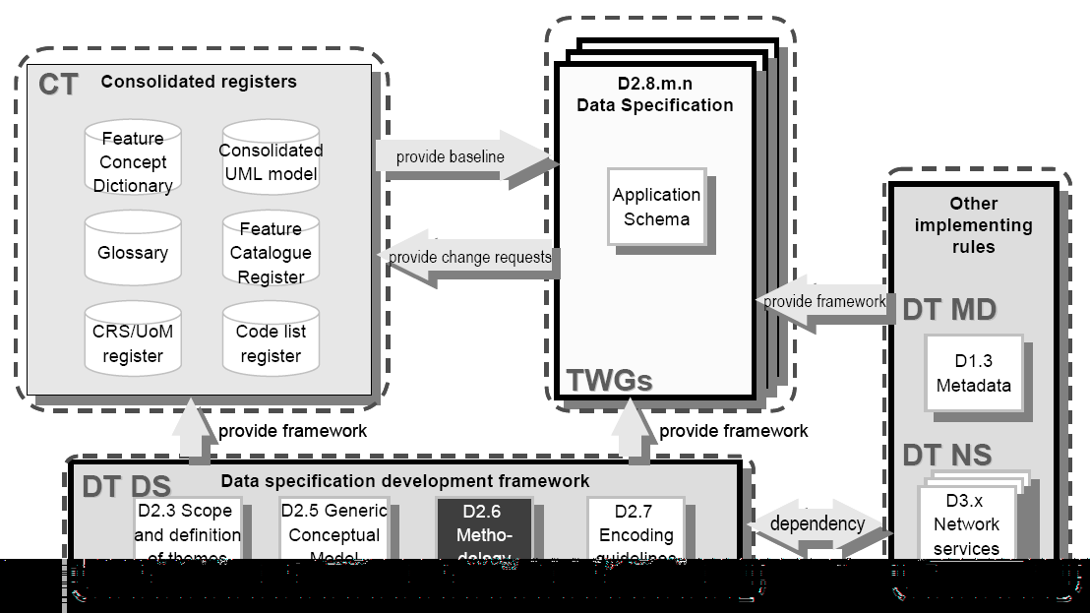
Data specifications [1/3]
Copyright © 2009, Open Geospatial Consortium, Inc

Slide 8
Data specifications [2/3]
Copyright © 2009, Open Geospatial Consortium, Inc

Slide 9
Data specifications [3/3]
Copyright © 2009, Open Geospatial Consortium, Inc

Slide 10
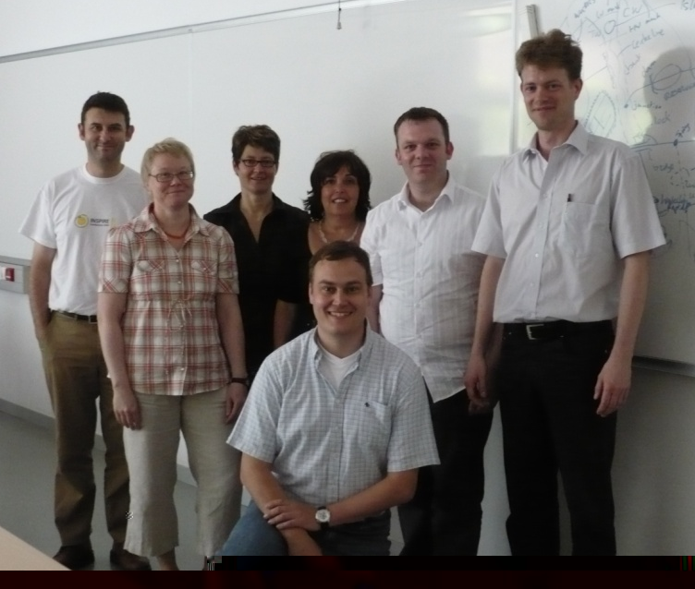
Hydrography theme [1/2]
TWG members
  Huibert-Jan Lekkerkerk (Facilitator), Information Desk Standards Water (NL)
  Andrew Woolf (Editor), Rutherford Appleton Laboratory (UK)
  Dolors Barrot, Cartographic Institute of Catalonia (ES)
  Alexander Coley, Environment Agency of England and Wales (UK)
  Helen Eriksson, Swedish National Land Survey (SE)
  Klaus Fretter, Federal Institute of Hydrology (DE)
  Anja Hopfstock, Federal Institute for Cartography and Geodesy (DE)
Copyright © 2009, Open Geospatial Consortium, Inc

Slide 11
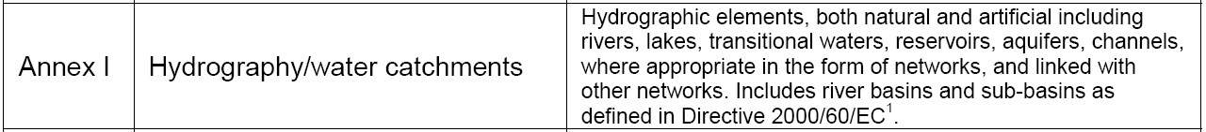
Hydrography theme [2/2]
First TWG task: refine D2.3 proposed scope
Definition
  2007/2/EC: “Hydrographic elements, including marine areas and all other water bodies and items related to them, including river basins and sub-basins. Where appropriate, according to the definitions set out in Directive 2000/60/EC of the European Parliament and of the Council of 23 October 2000 establishing a framework for Community action in the field of water policy and in the form of networks.”
  Decided nautical hydrography out of scope
  TWG ‘overview description’:
    geographically limited to inland waters & WFD marine areas
    natural & artificial hydrographic elements (mapping), river/channel network, WFD surface water bodies
    http://inspire-registry.jrc.ec.europa.eu/registers/FCD/items/163
INSPIRE scoping paper (EEA, 2004)
Implementation Strategy Issues – Data requirements (‘IMS paper’, EEA, 2003)
Copyright © 2009, Open Geospatial Consortium, Inc

Slide 12
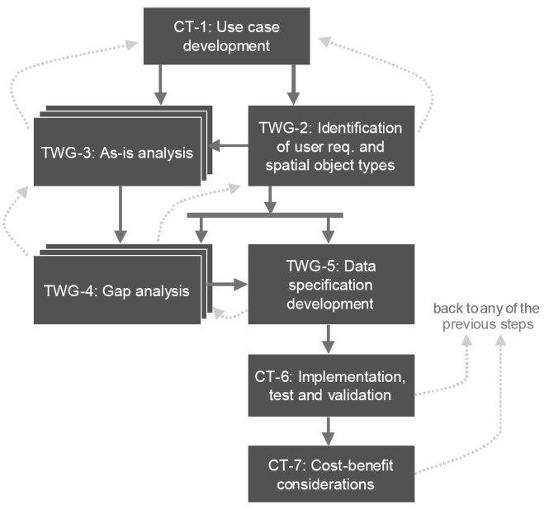
Use Cases
INSPIRE methodology starts with Use Case development
Not provided by Cion
TWG proposed general use cases for Hydrography
  Mapping
    main hydro elements (natural/artificial), other topographic objects
  Reporting
    WFD-specific data requirements
  Spatial analyses & modelling
    closed & connected network, flow direction, etc.
Copyright © 2009, Open Geospatial Consortium, Inc

Slide 13
‘As-is’ analysis
More than 50 reference documents analysed against ‘interoperability components’ (D2.5):
EuroGeoGraphics
  ERM, EGM
NEN (NL)
IGN (FR)
OS (UK)
EA (UK)
ATKIS (DE)
NHN (CA)
USGS NHD (US)
IHO
ESRI ArcMarine/Hydro
WFD
...
Copyright © 2009, Open Geospatial Consortium, Inc

Slide 14
Model (v2.0) [1/6]
Based on ‘As-is’ analysis guided by Use Cases
Initial identification of object types, developed into UML
http://inspire-twg.jrc.ec.europa.eu/inspire-model/
Copyright © 2009, Open Geospatial Consortium, Inc

Slide 15
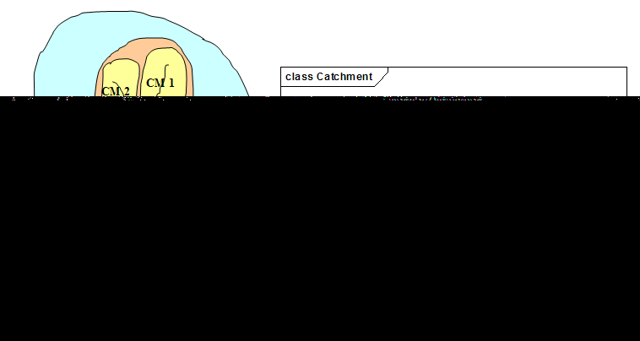
Model (v2.0) [2/6]
Physical Waters & related objects
  Watercourse, Standing Water, Sea, Land/Water Boundary, Foreshore/Riverbank, Wetland, Glacier / Snowfield
  Hydro points of interest, Hydro facilities, Man-made objects
  Catchment, Basin
Copyright © 2009, Open Geospatial Consortium, Inc

Slide 16
Model (v2.0) [3/6]
Copyright © 2009, Open Geospatial Consortium, Inc

Slide 17
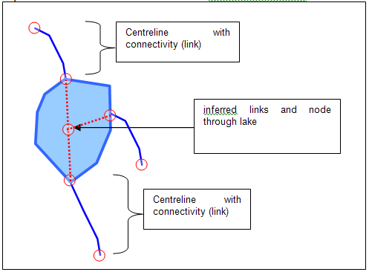
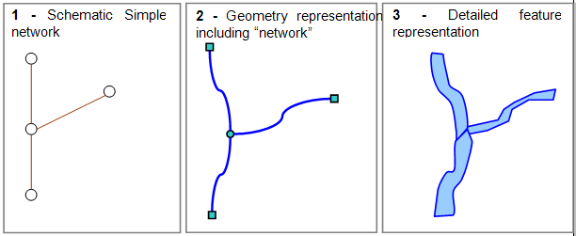
Model (v2.0) [4/6]
Network model
  Nodes (bifurcation, confluence, mouth, spring, etc.), Links
    based (with Transport) on common generic network model
    recommendations for topological closure
Copyright © 2009, Open Geospatial Consortium, Inc

Slide 18
Model (v2.0) [5/6]
Reporting
  WFD Waterbody (Surface Water, Ground Water, Coastal Water, Transitional Water, River, Lake)
    only included WFD classes strongly related to Hydrography, i.e. with clear geometric relationship
      e.g. out of scope:
        WFD ‘River Basin District’
        Bathing Waters Directive ‘Sampling Points’
        Drinking Water Directive ‘Water Supply Zones’
        Urban Waste Water Treatment Directive ‘Sensitive Areas’
        etc.....
Copyright © 2009, Open Geospatial Consortium, Inc

Slide 19
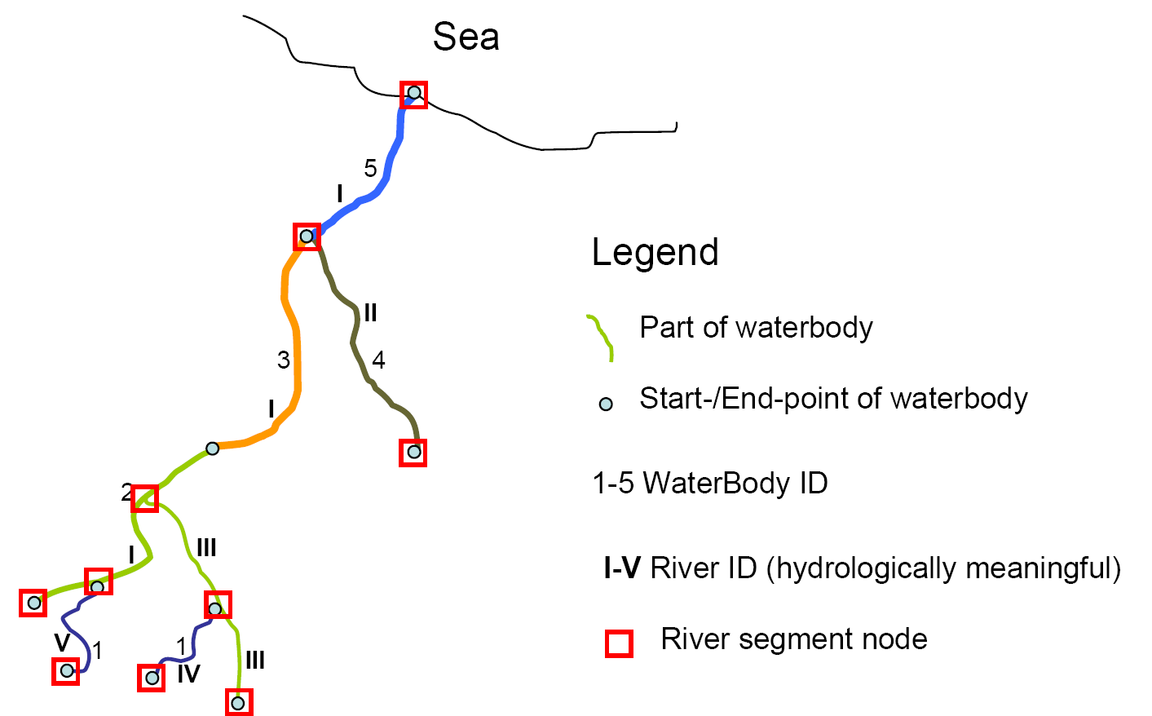
Model (v2.0) [6/6]
Physical Waters ↔ WFD relationship and identifiers
Copyright © 2009, Open Geospatial Consortium, Inc

Slide 20


Data specification
Document follows closely ISO 19131
http://inspire.jrc.ec.europa.eu/reports/ImplementingRules/DataSpecifications/INSPIRE_DataSpecification_HY_v2.0.pdf
Copyright © 2009, Open Geospatial Consortium, Inc

Slide 21
v2.0 review
644 comments
38 organisations
Comments across all areas of data specification
  model elements (feature types, associations, cardinality, constraints, codelists, etc.)
  data quality
  data capture
  portrayal
E.g.:
  ‘geometric’ associations
  coastline, shore, islands, polder, pumping station
  definitions
  network attribution, linear referencing
  object referencing physical waters ↔ network
Numerous cross-theme issues
Comments Resolution Workshop: 23-24 Apr, JRC, Ispra, Italy
Aim for v3 before summer
Copyright © 2009, Open Geospatial Consortium, Inc

Slide 22
Relationship with WISE [1/2]
Water Information System for Europe (WISE)
  reporting formats
  GIS guidance document
  reporting formats being merged into consolidated WISE data model
WISE will be affected by INSPIRE
Extensive discussions between TWG and WISE
Three options
  null option
  one integrated specification
  one specification with extensions
Solution provides model for other INSPIRE themes
Copyright © 2009, Open Geospatial Consortium, Inc

Slide 23
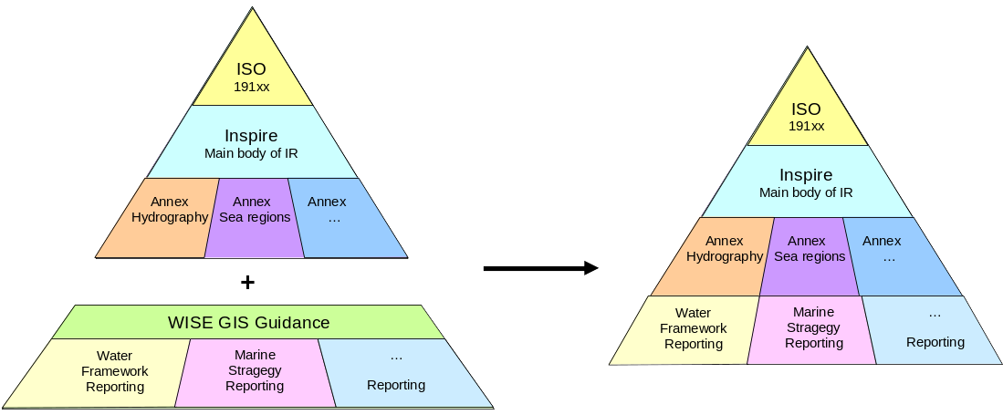
Relationship with WISE [2/2]
Identified solution (one spec with extensions)
  one specification (INSPIRE) that would be extended for specific purposes such as WISE
  WISE compliant to INSPIRE with flexibility to adapt to the changing needs of water related policies and related reporting obligations
  Member States would publish the base data set under INSPIRE which would then also serve as the base data for the reporting obligation
http://eea.eionet.europa.eu/Public/irc/eionet-circle/eionet-telematics/library?l=/technical_developments/wise_technical_group&vm=detailed&sb=Title
Copyright © 2009, Open Geospatial Consortium, Inc

Slide 24
Summary
Considerable analysis behind:
  INSPIRE Directive
  Data specifications framework (GCM, methodology)
  Hydrography data specification
Hopefully can be of use to Hydrology DWG
Copyright © 2009, Open Geospatial Consortium, Inc

Slide 25
Links
Data specification
  http://inspire.jrc.ec.europa.eu/reports/ImplementingRules/DataSpecifications/INSPIRE_DataSpecification_HY_v2.0.pdf
GML Application Schemas
  http://inspire.jrc.ec.europa.eu/reports/ImplementingRules/DataSpecifications/D2.8-I_GML-Application-Schemas_v2.0.zip
Feature Concept Dictionary
  http://inspire-registry.jrc.ec.europa.eu/registers/FCD
HTML view of UML model
  http://inspire-twg.jrc.ec.europa.eu/inspire-model
Copyright © 2009, Open Geospatial Consortium, Inc

Slide 26
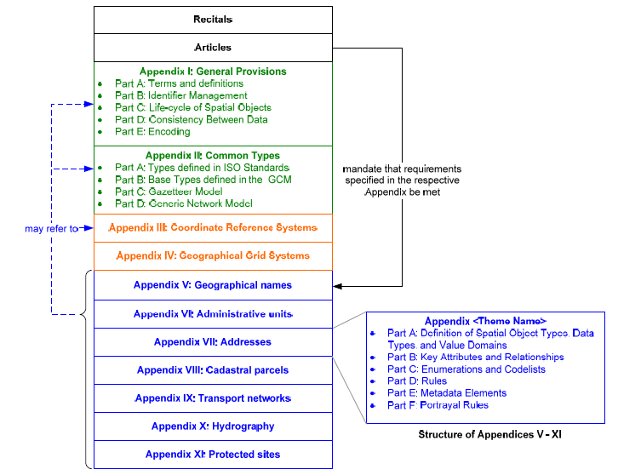
Implementing Rule
Proposed structure:
Copyright © 2009, Open Geospatial Consortium, Inc

