Slide 1
Scope
WMO/GRDC Metadata Profile for Hydrologic Datasets
presented by the Global Runoff Data Centre (I. Dornblut)
at the ad-hoc meeting of the Hydrology DWG, Athens, 31 March 2009
Concept
Hydrologic Metadata
Hydrologic Data
Hydrologic Observation
Hydrologic Phenomenon
Hydro UoM
Conformity
Way forward
Notes:
Metadata are the key to an effective data management.

Slide 2
Scope
World Meteorological Organization (WMO)
German Federal Institute of Hydrology (BfG)
Global Runoff Data Centre (GRDC)
Metadata Profile for Hydrologic Datasets
Way forward (WMO)
Concept
Hydrologic Metadata
Hydrologic Data
Hydrologic Observation
Hydrologic Phenomenon
Hydro UoM
Conformity
Way forward

Slide 3

WMO
Specialised agency of UN on weather, climate and water
Tradition in sharing data and information on a global scale
Initiator and contributor to climate-related programmes
Global data centres facilitating exchange of data and information
WMO Information System (WIS)
  co-ordinated global infrastructure
  focused on data exchange and management
  overarching all scientific and technical programmes of WMO towards their interoperability
IPET-MI: established to pursue the development of a metadata standard to be used in WIS as a WMO core profile in the context of the ISO 19115 standard
Scope
Concept
Hydrologic Metadata
Hydrologic Data
Hydrologic Observation
Hydrologic Phenomenon
Hydro UoM
Conformity
Way forward
Notes:
WMO is a specialised agency of United Nations on weather, climate and water. WMO initiates and contributes to global climate-related programmes. WMO has
long tradition in sharing data and information on a global scale. WMO operates global datacentres (e.g. GRDC) to facilitate the exchange of data and information.
WMO developes the WMO Information System (WIS), a co-ordinated global infrastructure focused on data exchange and management, overarching all scientific and technical programmes of WMO towards their interoperability. With the establishment of the Inter-programme Expert Team on Metadata Implementation (IPET-MI) WMO pursues the development of a metadata standard to be used in the WIS as a WMO core profile in the context of the ISO 19115.

Slide 4
BfG - GRDC
Scope
Concept
Hydrologic Metadata
Hydrologic Data
Hydrologic Observation
Hydrologic Phenomenon
Conformity Assurance
Way forward
Notes:
source: WMO presentation from 2007
With its use of an improved GTS, WIS removes the barriers between the traditional GTS (and its users, such as the NMCs of the NMHSs), and other WMO Programmes (and their users, such as programme centres) and will facilitate the inter-disciplinary exchange of and access to data and products. Common procedures for both real and non-real time data and standardization of data formats and metadata will enhance information discovery and exchange .
NMCs act as national network coordinator for connection and access rights to WIS for the “other” NC and DCPCs within their country (although the physical connection may be direct to a service provider).
WIS will provide the solution for the information exchange needs of NMHSs, relevant non-NMHS agencies/User, commercial providers, research facilities, and international programme centres. It will offer (“push” and “pull”) automated collection and dissemination of information (e.g., observations and forecast products); timely delivery of data and products (appropriate to requirements); and ad-hoc information discovery/access/retrieval services.
WIS will enhance the visibility and importance of the NMHS in the country. The NMHS will gain timely and cost-effective access to information, in particular new data and products, which will enhance its own operations. The NMC will also be able NMC to provide to other national agencies/users dealing in disaster mitigation, agriculture, energy and water management, and so forth, critical data that were, so far, not available to them. The NMC would “push” to them routine information, e.g., warnings, advisories, selected measurements, etc., and help discover, select and channel relevant information to the users, either ad hoc, in the “pulling” mode, or in reply to a non-real-time request.
The WIS will be based on an improved GTS and integrate
satellite two-way systems, alternative dissemination services provided by environmental satellites
and the coordinated and free use of the Internet.
The WIS architecture, functions and services will provide the solution for the information exchange needs of NMHSs, and other national centres (NCs), such as relevant non-NMHS agencies/users, national disaster management platforms, research facilities, and international programme centres. WIS will offer:
Routine collection and automated dissemination of operation-critical data (e.g., meteorological, climatological, environmental and hydrological observations, forecasts, and warnings), (“GTS function”);
Timely delivery of high-volume data and processed products (“push”);
Ad-hoc discovery/access/retrieval services for operation-critical data and value-added information (“pull”)
Discovery, access, and retrieval services for all data stored by every WMO programme regardless of location;
Common procedures for real and non-real time data exchange and standardized data formats and metadata.

Slide 5


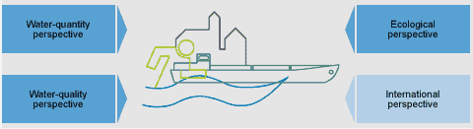
Federal Institute of Hydrology (www.bafg.de)
BfG 1(3)
Scope
Supreme federal agency of Germany
Scientific institute of the Federal Government for research, assessment and consulting in the fields of
  hydrology
  water resources management
  ecology and conservation of waters
Concept
Hydrologic Metadata
Hydrologic Data
Hydrologic Observation
Hydrologic Phenomenon
Hydro UoM
Conformity
Way forward
Notes:
GRDC is hosted by the German Bundesanstalt für Gewässerkunde, the Federal Institute of Hydrology (BfG). BfG is the scientific institute of the Federal Government for research, assessment and consulting in the fields of hydrology, water resources management, ecology and the conservation of waters.

Slide 6
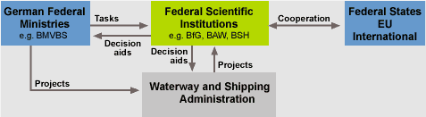
Federal Institute of Hydrology (www.bafg.de)
BfG 2(3)
Scope
Concept
Hydrologic Metadata
Hydrologic Data
Consultant for German Federal Ministries (BMVBW, BMU, BMBF) in decision-making
Advisor of the Waterways and Shipping Administration (WSV) regarding planning, development and new construction of Federal waterways
Partner of programmes of UN and their specialised agencies
  e.g. host of IHP (UNESCO), HWRP (WMO), GRDC (WMO)
Hydrologic Observation
Hydrologic Phenomenon
Hydro UoM
Conformity
Way forward
Notes:
Being a supreme federal agency, BfG is the consultant for German federal Ministries in decision-making. BfG advises the German Waterways and Shipping Administration (WSV) on the management of the federal waterways regarding planning, development and new construction of Federal waterways. Hosting the IHP and HWRP Secretariat and the GRDC, BfG contributes to programmes of United Nations and their specialised agencies.
BMVBW: Ministry of Transport, Building and Urban Affairs, BMU: Ministry of Environment, BMBF: Ministry of Education and Research

Slide 7

Federal Institute of Hydrology (www.bafg.de)
BfG 3(3)
National and international networking leads to multidisciplinary solutions
Scope
Concept
Hydrologic Metadata
Hydrologic Data
Department “Geo-Information and Remote Sensing, GRDC”
  e.g. National Reporting Platform European WFD
  e.g. National Data Centre for Water
  e.g. Member of the German SDI-Initiative
  e.g. German representative in GEOSS UIC
  e.g. Member of INSPIRE Thematic WG Hydrography
  e.g. Member of the WISE Technical Group
Hydrologic Observation
Hydrologic Phenomenon
Hydro UoM
Conformity
Way forward
Notes:
GRDC is a unit in BfG’s department “Geo-Information and Remote Sensing, GRDC”. This department is actively involved in various national and European initiatives on spatial data infrastructures, e.g. the National Reporting Platform European WFG, the National Data Cuntre for Water, and the German SDI-Initiative, is the German representative in GEOSS UIC and member of the INSPIRE Thematic WG Hydrography and the WISE Technical Group.
(SDI: Sustainable Development Initiative (SDI), UIC: User Interface Committee, INSPIRE: Infrastructure for Spatial Information in Europe, WISE: Water Information System for Europe)

Slide 8
GRDC
Global Runoff Data Centre – GRDC (www.grdc.bafg.de)
International data centre of WMO
Collection, harmonisation and dissemination of discharge data
Operation of the Global Runoff Database
  daily and monthly river discharge data
  more than 7300 stations in 156 countries
  average record length of 38 years
Faced with a wide variety of formats and transfer rules
Data collection and management projects on a global scale
  online access to river dsicharge data in near-real time (GTN-R)
  automated collection and re-distribution of data (ETN-R)
  standard description of hydrologic datasets (GTN-H)
Scope
Concept
Hydrologic Metadata
Hydrologic Data
Hydrologic Observation
Hydrologic Phenomenon
Hydro UoM
Conformity
Way forward
Notes:
GRDC is one of WMO’s global data centres, established to collect, harmonise and disseminate river dsicharge data and assiciated metadata. GRDC operates the Global Runoff Database, a collection of daily and monthly river discharge data from more than 7300 stations in 156 countries with an average time series length of 38 years. In ots work GRDC is faced with a wide variety of formats and transfer rules. As international data centre GRDC contributes to data collection and management projects on a global scale. The GTN-R shall provide online access to river discharge data in near-real time, ETN-R serves EFAS with the automated collection and re-distribution of data, and for the GTN-H a standard descrption of hydrologic datasets will be developedo

Slide 9
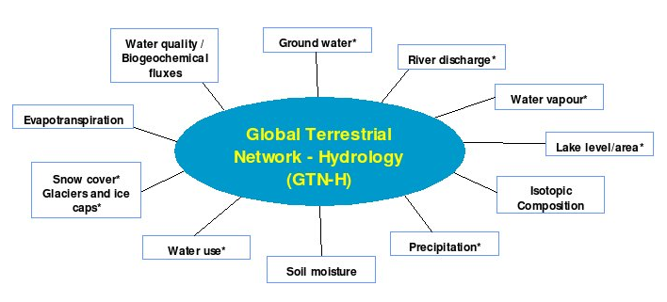
GTN-H
Global Terrestrial Network of Hydrology (GTN-H)
joint initiative of GCOS, GTOS, and WMO
global hydrological „network of networks“
access to hydrological networks and observation data
Scope
Concept
Hydrologic Metadata
Hydrologic Data
Hydrologic Observation
Hydrologic Phenomenon
* GCOS Essential Climate Variables
Hydro UoM
GRDC: - prototype system for online access to near-real time data
  prototype definition of a hydrologic metadata standard
  protoype service for the management of project metadata
Conformity
Way forward
Notes:
The Global Terrestrial Network for Hydrology (GTN-H) is a joint initiative of GCOS, GTOS, and WMO, established in 2001 as a „network of networks“ to improve the access to observation data. In this project GRDC will develop (1) a prototype system for online access to river discharge data in near-real time from 400 stations world-wide which form the GCOS baseline network, (2) a prototype definition for the standard description of project (= hydrologic) datasets, and (3) a prototype service for collection and management of project metadata, related to 11 hydrologic variables identified as essential for the GTN-H network.

Slide 10
WMO
WMO-Commission of Hydrology (XIII session, Nov 2008)
Resolution 6 (CHy-XIII) considered, that
“... information exchange within the WMO Hydrology and Water Resources Programme is a component of WIS”
“... data exchange formats and the resulting need for the development of a standard metadata profile is important”
Recommended, that
“... GRDC should undertake the development of a metadata profile ... to form part of the WMO Core Profile of the ISO Metadata Standard” under the guidance of WIS/WIGOS”
Scope
Concept
Hydrologic Metadata
Hydrologic Data
Hydrologic Observation
Hydrologic Phenomenon
Hydro UoM
Conformity
Way forward
Notes:
WMO-CHy on its XIII session in Nov 2008 pointed out the need for data exchange formats and standardised metadata.
In resolution 6 is considered, that
... information exchange within the WMO Hydrology and Water Resources Programme is a component of WMO Information System
... International data exchange formats and the resulting need for the development of a standard metadata profile is important
and recommended
... GRDC should undertake the development of the metadata profile in collaboration with interested parties,
under the overall guidance of WIS/WIGOS
to form part of the WMO Core Profile of the ISO Metadata Standard

Slide 11
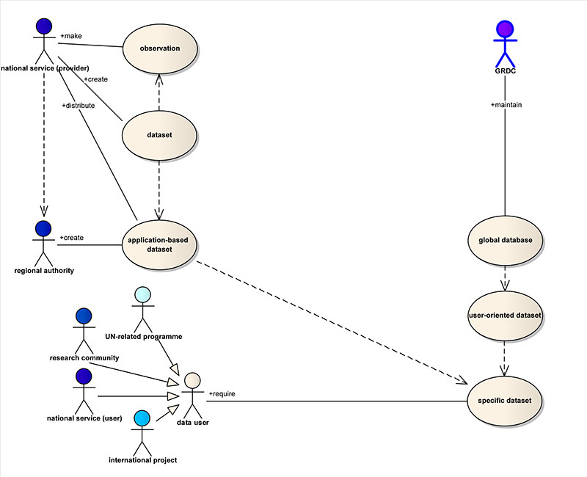
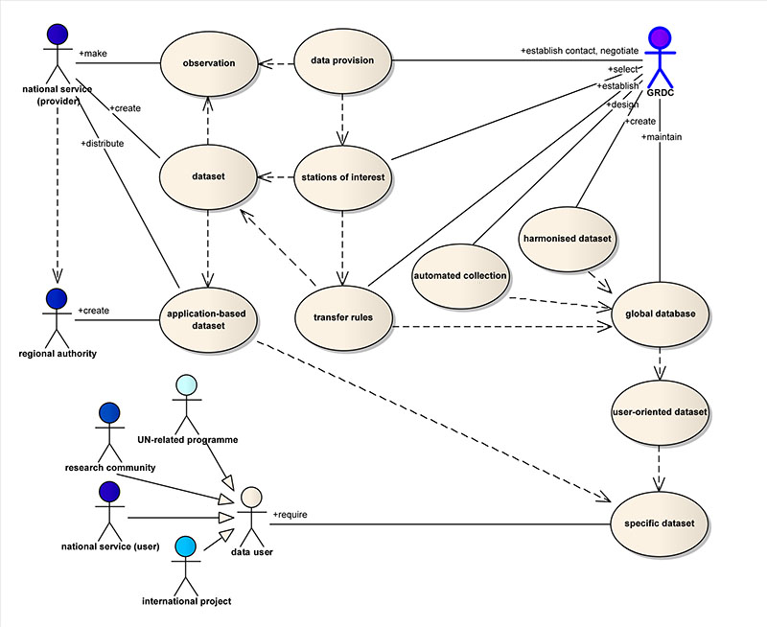
Various data users from all over the world require special datasets.
GRDC - facilitator between the producers and users of hydrologic data
GRDC
Scope
Concept
Hydrologic Metadata
Hydrologic Data
Hydrologic Observation
Hydrologic Phenomenon
Hydro UoM
Conformity
Way forward
Notes:
GRDC’s core business is the collection, harmonisation and dissemination of data. Data users from all over the world require specific datasets, provided directly by the data provider as an application-based dataset, or via a global database providing an user-oriented dataset. The latter is task of international data centres like the GRDC. This includes the establishment of contacts to the national services who made the observation and created the dataset, the selection of relevant stations, the establishment of transfer rules, the design of automated data collection, the data harmonisation und their storage in a database. Thus, GRDC serves as a facilitator between the producers of data and the international research community.

Slide 12
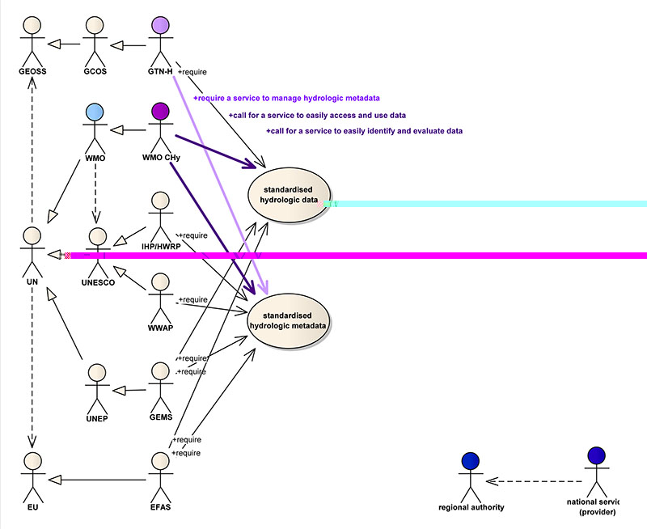
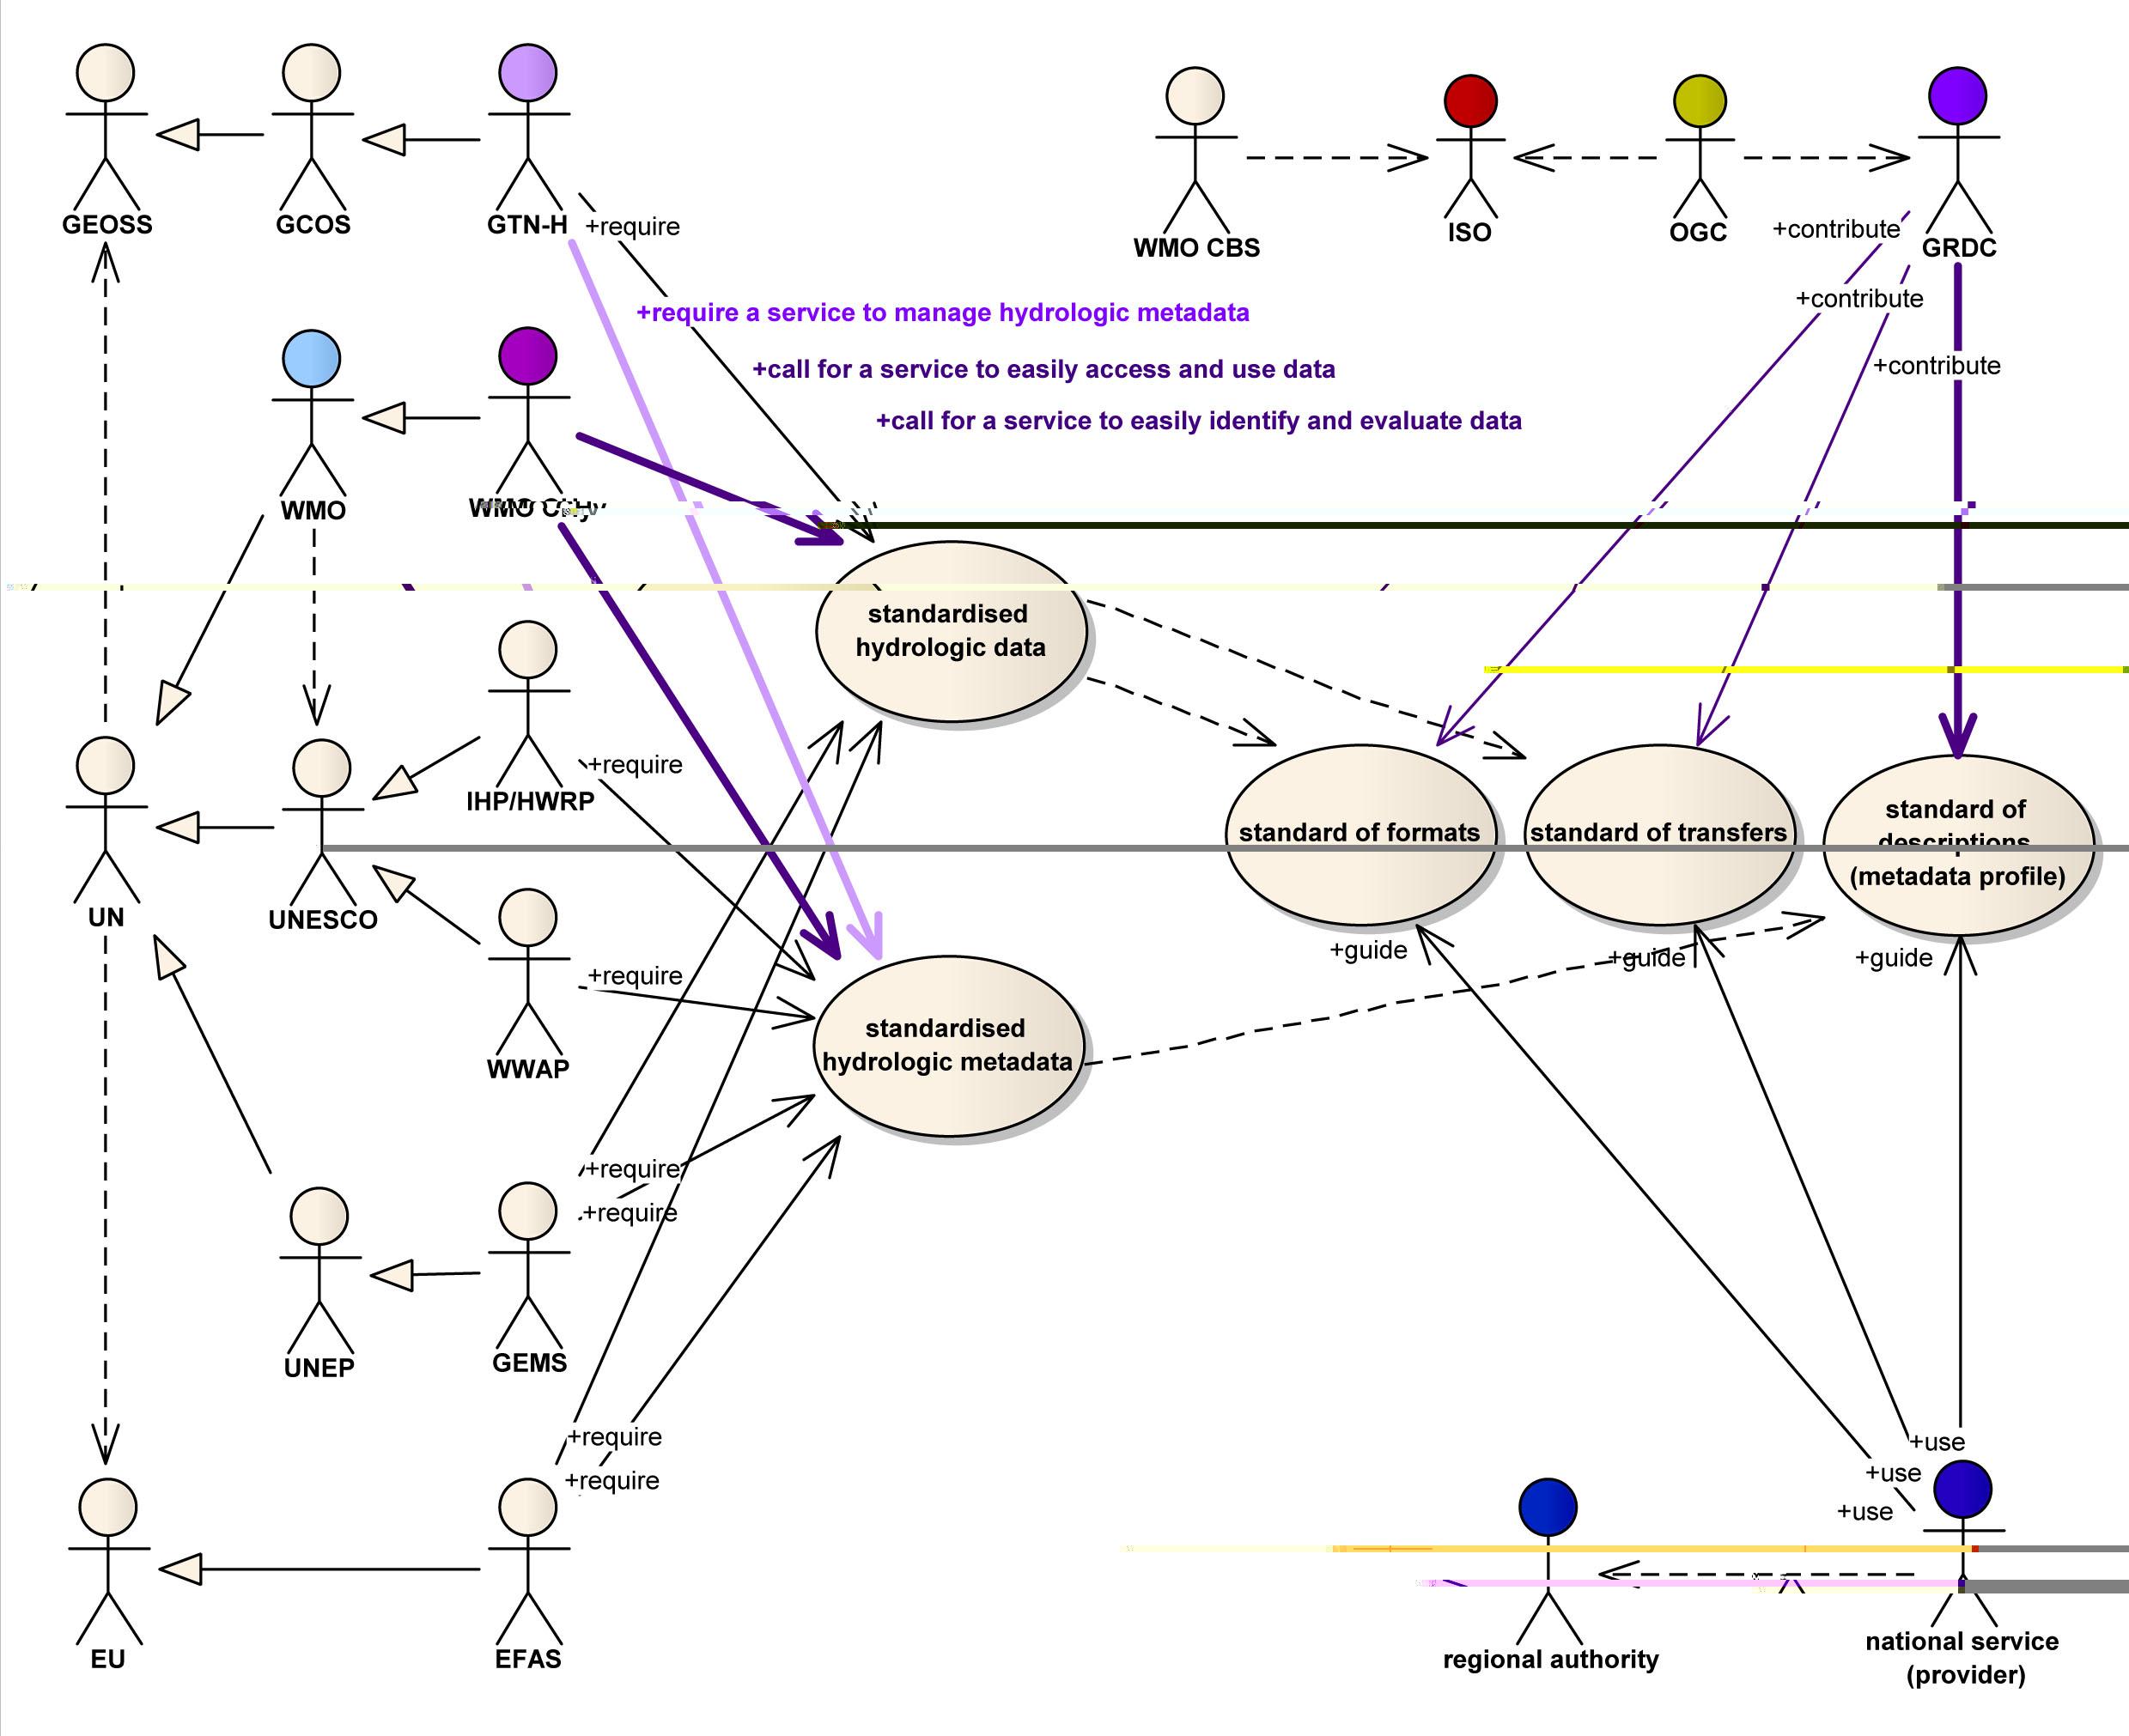
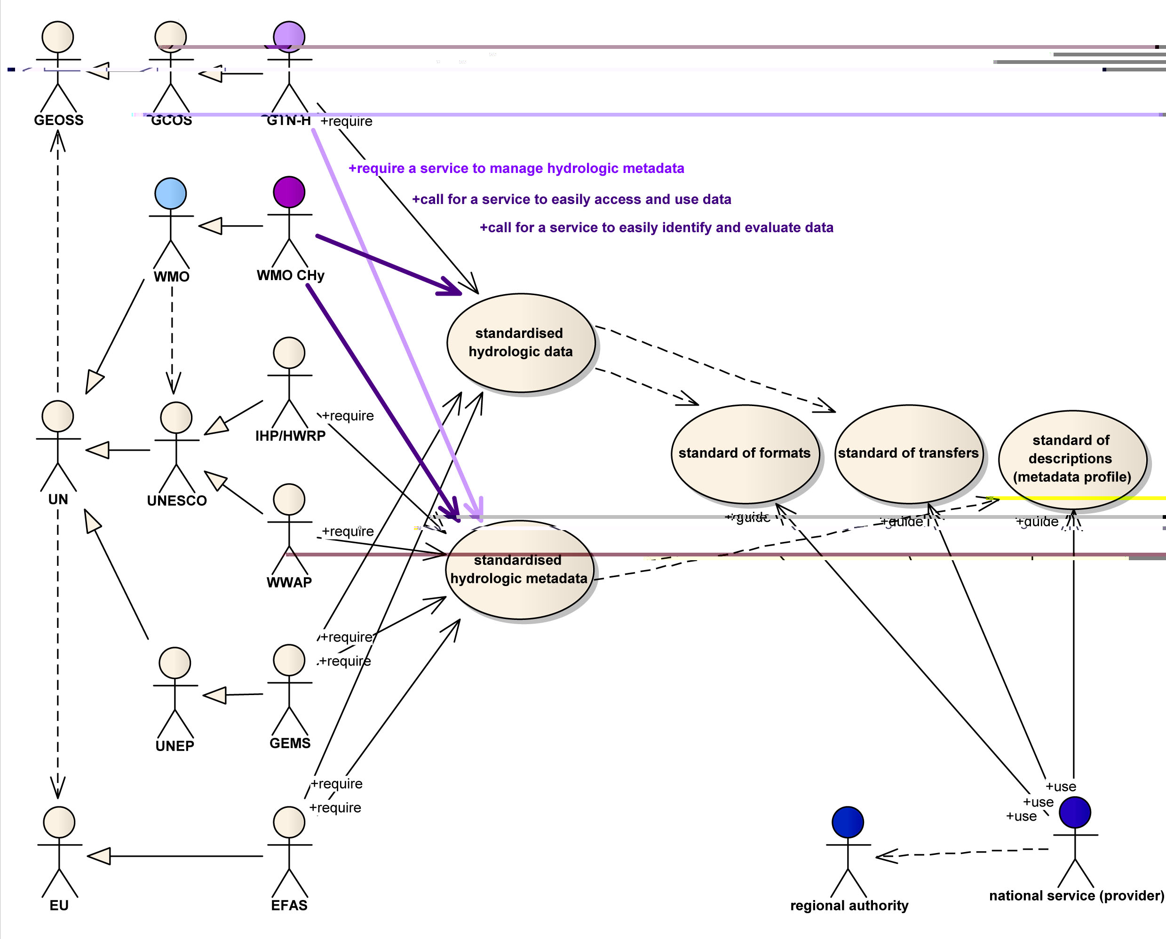
Call for standard of formats and transfers, for standard of descriptions
Call for services to easily identify, evaluate, access hydrologic data
GRDC - exchange of hydrologic data and information on global scale
GRDC
Scope
Concept
Hydrologic Metadata
Hydrologic Data
Hydrologic Observation
Hydrologic Phenomenon
Hydro UoM
Conformity
Way forward
Notes:
Exchange of hydrologic data and information on the global scale is the principal reason for operating of GRDC. WMO and CHy require the provision of services to easily identify, evaluate, access and use hydrologic data beyond national borders. International, regional and UN-related programmes, projects and initiatives require standardised hydrologic data and metadata. Standardisation of hydrologic data and metadata implies standard of formats and transfers and standard of description, all developed to guide and assist the provider of the data. In this context GRDC contributes actively to standardisation of hydrologic data and metadata.

Slide 13
Scope
Draft GRDC Metadata Profile for Hydrologic Datasets
Hydrologic data as a special form of geographic data
High abstraction hierarchy level (WMO-CHy community)
Wide range of hydrologic features and related variables
Semantic structure describing
  hydrologic datasets
  observation that generated the dataset
  real-world phenomenon reflected by the dataset
→ Part of the WMO Core Profile of ISO 19115 standard
Concept
Hydrologic Metadata
Hydrologic Data
Hydrologic Observation
Hydrologic Phenomenon
Hydro UoM
Conformity
Way forward
Notes:
Draft GRDC Metadata Profile for Hydrologic Datasets provides a domain-specific description of a set of hydrologic data as a special form of geographic data on a high abstraction hierarchy level (“WMO-CHy community level”), applicable to a wide range of hydrologic features and related variables under consideration of the heterogeinity providing and using hydrologic data calls for a definition of metadata . Focus of the semantic structure is on the description of the dataset, the observation that generated the dataset, and the real-world phenomenon which is reflected by the dataset. It is intended to develop the profile to a constituent part of the WMO Core Profile of the ISO Metadata Standard.

Slide 14
Scope
Hydrologic Metadata
Information about
  Dataset (identification, history, references)
  Data Extent (geographic, vertical and temporal extent)
  Data Quality (lineage, processing, validity)
  Data Distribution (contact, maintenance, transfer, access)
  Origin of the data (observation event)
  Investigated real-world phenomenon
documented in line with
  ISO 19115: Geographic Information – Metadata
  OGC O&M Spec: Observations and Measurements
Concept
Hydrologic Metadata
Hydrologic Data
Hydrologic Observation
Hydrologic Phenomenon
Hydro UoM
Conformity
Way forward
Notes:
Hydrologic metadata provides information about the dataset, its extent, quality and distribution, about the observation that generated the dataset and about the real-world phenomenon reflected by the dataset. Hydrologic metadata shall be documented according to the standards set by ISO 19000 series, and in line with the ideas of OGC O&M/SWE specifications.
The information about the dataset, its extent, quality, distribution, citation, etc. will be covered by the WMO Core Profile, version 1.0, developed by the CBS InterProgramme Expert Team on Metadata Implementation (IPET-MI). Thus, the focus here is on the description of the observation event and the real-world phenomenon.

Slide 15
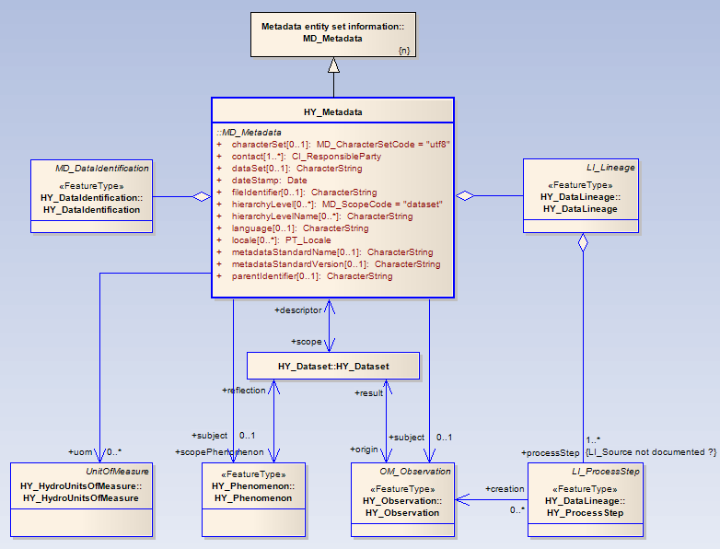
Scope
DRAFT GRDC, March 2009
Concept
Hydrologic Metadata
Hydrologic Data
Hydrologic Observation
Hydrologic Phenomenon
Hydro UoM
Conformity
UML model
Way forward
Notes:
HY_Metadata is specialisation of MD-Metadata, aggregating specialisations of MD_DataIdentifcation and LI_Lineage. HY_Metadata associates the dataset and the information about the specific unit of measure used. The lineage information associates the observation as process step. The information baout the observation and about the scope phenomenon is associated to both metadata and dataset. This allows a description of the dataset without having the dataset, which is mostly required by projects on a global scale, but also a description directed from the dataset, which is requested by data providers.

Slide 16
Scope
Hydrologic Data
Identifiable collection of data
Reference to a location on Earth
Reference to a location in time
Correspond to a body of water
Originate from observation (result)
→ special form of geographic data whose origin is an observation corresponding to a body of water
Concept
Hydrologic Metadata
Hydrologic Data
Hydrologic Observation
Hydrologic Phenomenon
Hydro UoM
Conformity
Way forward
Notes:
Having a reference to a location on Earth and to a location in time, corresponding to a body of water and originated from an observation, hydrologic data are considered as specific geographic data whose origin is an observation corresponding to a body of water, which is a real world phenomenon. Thus, Hydrologic data are considered as special form of geographic data whose origin is an observation corresponding to a body of water (real-world phenomenon).

Slide 17
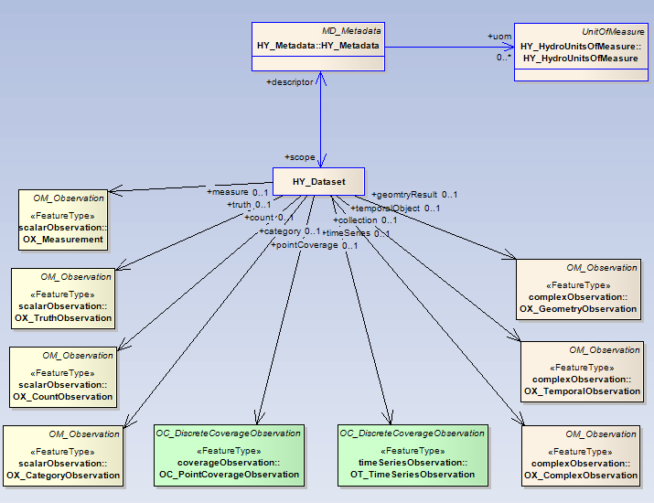
Scope
DRAFT GRDC, March 2009
Concept
Hydrologic Metadata
Hydrologic Data
Hydrologic Observation
Hydrologic Phenomenon
Hydro UoM
Conformity
UML model
Way forward
Notes:
identifiable collection of hydrologic data. This ranges from a single feature, like map, chart or indicator, to large or complex datasets like time-series, thematic archive or data-provision service. According to the logic data type, which corresponds to the result types defined in OGC O&M Specs), the dataset associates the typical observation.

Slide 18
Scope
Hydrologic Observation
Investigates a real-world phenomenon (water body)
Generates a value of the observed property
Typical result (→ dataset)
Unambigously assigned to place and time
Follows a defined procedure
Precisely documented
→ unique and unchangeable action (event) which binds a typical result to a hydrologic phenomenon
Concept
Hydrologic Metadata
Hydrologic Data
Hydrologic Observation
Hydrologic Phenomenon
Hydro UoM
Conformity
Way forward
Notes:
A hydrologic observation investigates a water body (a real-world pheonomenon), generates a value of the observed property by a typical result which forms the dataset. An observation is unambigously assigned to place and time, follows a defined procedure and is precisly documented. Thus, an hydrologic observation is an unique and unchangeable action (event) which binds a typical result to a hydrologic phenomenon.

Slide 19
Scope
Concept
Hydrologic Metadata
DRAFT GRDC, March 2009
Hydrologic Data
Hydrologic Observation
Hydrologic Phenomenon
Hydro UoM
Conformity
UML model
Way forward
Notes:
HY_Observation is defined as specialisation of OM_Observation. It contains the information about the observed property, the procedure and the sampling feature used. The descriptions of these should be specialisations from classes defined in O&M or SWE.
(1) HY_Observation.samplingTime: time which is spent to take the sample of the observed property.
The period of interest of time series observation is understood as sampling time which is described by the positions of beginning and end. The reference period of an analysis or simulation procedure is understood as sampling time.
(2) HY_Observation.resultTime: time when the procedure associated with the observation was applied
The period of interest of a time series of simulated values is understood as result time which is described by the positions of beginning and end.

Slide 20
Scope
Hydrologic Phenomenon
Real-world phenomenon
Relation to water on Earth
Corresponding catchment (basin, snowfield, hydrotope)
Typical properties
Typical behavoir
Precisly documented
Examples: river, lake, glacier, aquifer, soilwater
status march 2009: definition of “river” and “lake”
Concept
Hydrologic Metadata
Hydrologic Data
Hydrologic Observation
Hydrologic Phenomenon
Hydro UoM
Conformity
Way forward
Notes:
A hydrologic phenomenon is a real-world phenomenon, which relates to water on Earth, has a corresponding cacthment (basin, snowfield, hydrotope) and is characterised by typical properties or a typical behaviour, and it is precisly documented. Examples are: river, lake, glacier, aquifer and soilwater.

Slide 21
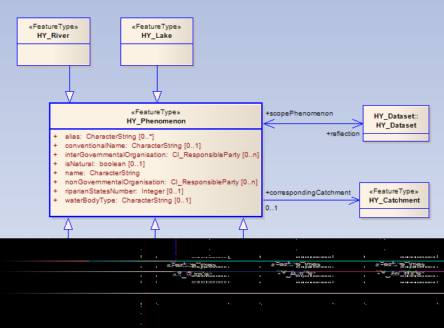
Scope
DRAFT GRDC, March 2009
Concept
Hydrologic Metadata
Hydrologic Data
Hydrologic Observation
Hydrologic Phenomenon
Hydro UoM
Conformity
UML model
Way forward
Notes:
A hydrologic phenomenon stands for a typical body of water, which specialise this class. A hydrologic phenomenon has a corresponding catchment, whichis specialised by the water body type.

Slide 22
Scope
Hydrologic Units of Measure
Specific units of measure, commonly used in hydrology
Derived from SI base units
Expressed as ratio of a physical quantity to a unit of time, or between quantities
Sometimes normalised by a given area
→ Definition of specific measures (flow, flux, mass, ...)
Codelist of specific names of measures (discharge, waterLevel, bedLoadDischarge, suspendedLoadDischarge, etc.)
Harmonization with ISO 80000 series
Concept
Hydrologic Metadata
Hydrologic Data
Hydrologic Observation
Hydrologic Phenomenon
Hydro UoM
Conformity
Way forward
Notes:
In hydrology specific units of measure are used to report the typical result of a measure, expressed as ratio of a physical quantity to a unit of time, or between quantities, sometimes normalised by a given area. Example: flow per unit of time, mass or energy flux per area and/or time, length per area and/or time.
This requires the definition of specific measures, and a codelist of specific names of measures conventionally used.
Question: How to be solved in O&M, SWE, WaterML, and Hydrography ? How hydro units of measure are covered by ISO80000 series ?

Slide 23
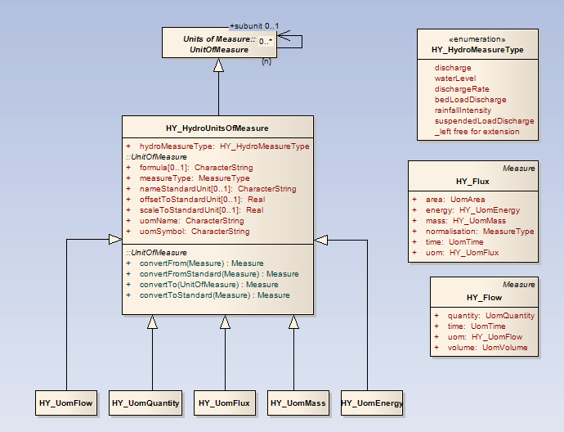
Scope
DRAFT GRDC, March 2009
Concept
Hydrologic Metadata
Hydrologic Data
Hydrologic Observation
Hydrologic Phenomenon
Hydro UoM
Conformity
UML model
Way forward
Notes:
This is a first approach to describe the special non-geographic units of measure which are not covered by ISO 19103, defined similar to ISO 19103. Possibly a lot of other approaches exist. Therefore, the harmonization with ISO 80000, and definitions within O&M, SWE, and ??? ...is urgently needed.

Slide 24
Scope
Conformity
Dataset description
  use of suitable classes from ISO 19115
  specialisation of pre-defined classes
Observation description
  use of suitable classes of OGC O&M/SWE Spec
  specialisation of pre-defined classes
  definition of new classes, where necessary
Implementation of codelists
  currently no codelist is recommended beyond ISO 19115
  use of free text fields allows the use of domain specific glossaries as far as available (WMO code lists, UNESCO Glossary of Hydrology, etc.)
Concept
Hydrologic Metadata
Hydrologic Data
Hydrologic Observation
Hydrologic Phenomenon
Hydro UoM
Conformity
Way forward
Notes:
Description of dataset and observation using the pre-defined classes of ISO 19000 series and the OGC O&M/SWE specifications where ever applicable. Where necessary, new classes were defined additionally.

Slide 25
DRAFT GRDC, March 2009
Scope
Concept
Hydrologic Metadata
Hydrologic Data
Hydrologic Observation
Hydrologic Phenomenon
Hydro UoM
Conformity
Dependencies
Way forward
Notes:
Dependencies of HY_Metadata illustrates the use of ISO 19115 packages, the specialisations of quality and identification information, and the new defined packages including there dependencies.
A separate presentation includes all class diagrams (as prepared by GRDC in March 2009)

Slide 26
Scope
☑
(1st) Draft GRDC Metadata Profile (semantics)
Modifications on the semantic level (GRDC)
UML model (class diagrams) (GRDC)
Convergence discussion with WMO-WIS
Review and Consolidation of the UML model
Generation of XML schema
Contact to OGC Hydrology DWG and INSPIRE
Integration of other ECV’s (within GTN-H)
WMO Metadata Profile for Hydrologic Datasets
Aug 2008
Dec 2008
Apr 2009
24 Apr ‘09
Mar 2009
Concept
☑
Hydrologic Metadata
☑
Hydrologic Data
Hydrologic Observation
Hydrologic Phenomenon
Hydro UoM
☑
Conformity
UML model
Way forward
Notes:
Outlook, time schedule - currently GRDC finalise the semantics (class diagrams) – in April 2009 a meeting is planned at WMO in Geneva to co-ordinate further development and next tasks (way forward).
Next steps might be:
- discussion of the structure with WMO Expert Team on Metadata Implementation,
- implementation of code-lists prepared by WMO for the WMO Core Metadata Profile
- check against the semantics of “Hydrography” prepared by INSPIRE, and of WaterML prepared by CUAHSI

Slide 27
Scope
Concept
Thank you for your attention!
Contact:
Global Runoff Data Centre (GRDC)
in the Federal Institute of Hydrology (BfG)
Am Mainzer Tor 1
56068 Koblenz, Germany
Tel.: +49 261 1306 5224
Fax: +49 261 1306 5722
Email: grdc@bafg.de
Homepage: http://grdc.bafg.de
Hydrologic Metadata
Hydrologic Data
Hydrologic Observation
Hydrologic Phenomenon
Hydro UoM
Conformity
UML model
Contact
Notes:
Outlook, time schedule - currently GRDC finalise the semantics (class diagrams) – in April 2009 a meeting is planned at WMO in Geneva to co-ordinate further development and next tasks (way forward).
Next steps might be:
- discussion of the structure with WMO Expert Team on Metadata Implementation,
- implementation of code-lists prepared by WMO for the WMO Core Metadata Profile
- check against the semantics of “Hydrography” prepared by INSPIRE, and of WaterML prepared by CUAHSI

