Slide 1
What is CUAHSI?
UCAR
CUAHSI – Consortium of Universities for the Advancement of Hydrologic Science, Inc
Formed in 2001 as a legal entity
Program office in Washington (5 staff)
NSF supports CUAHSI to develop infrastructure and services to advance hydrologic science in US universities
Unidata
Atmospheric
Sciences
Earth
Sciences
Ocean
Sciences
CUAHSI
National Science Foundation
Geosciences Directorate
HIS

Slide 2
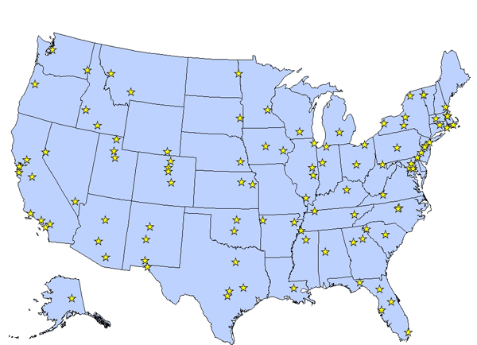
CUAHSI Member Institutions
115 US Universities as of November 2007

Slide 3
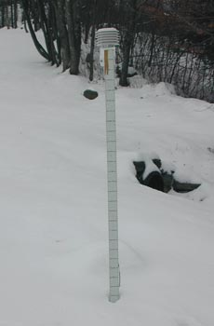
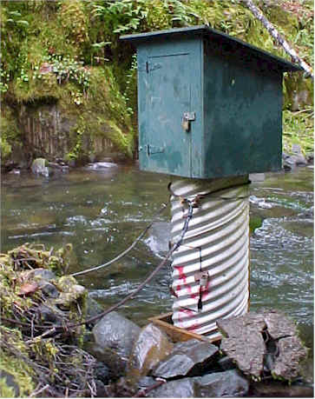
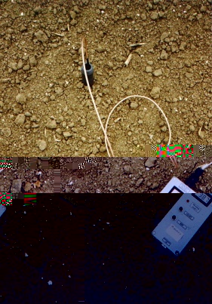
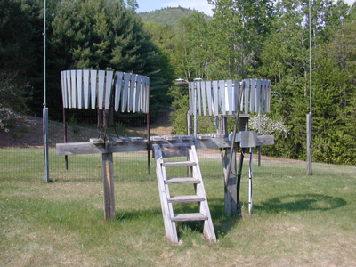
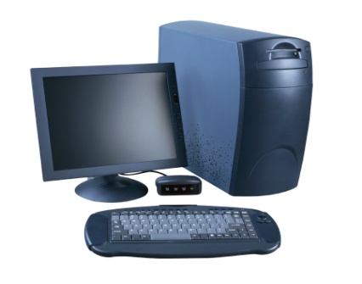
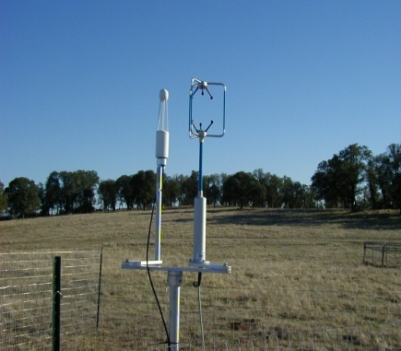
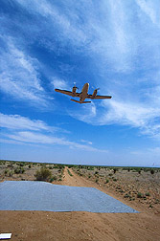
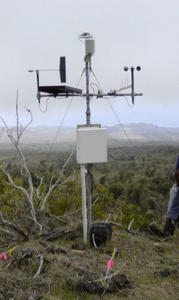
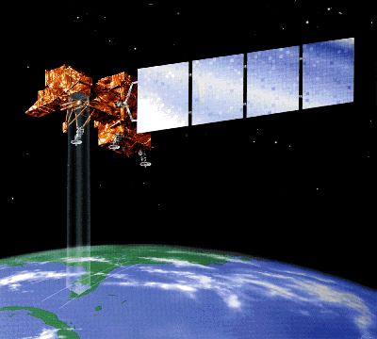
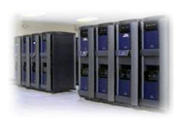
Water Data
Water quantity
and quality
Soil water
Rainfall & Snow
Modeling
Meteorology
Remote sensing

Slide 4
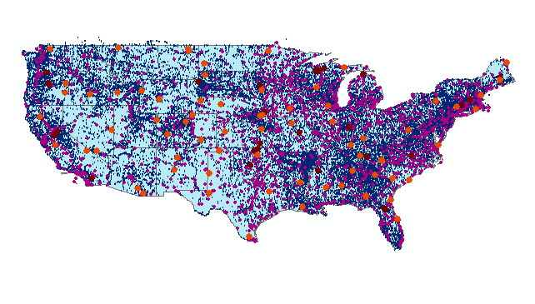
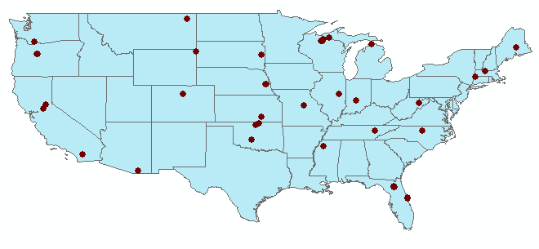
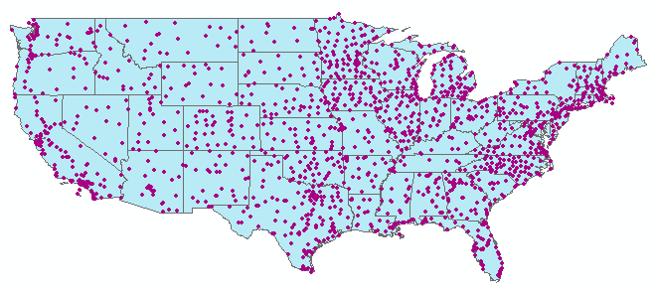
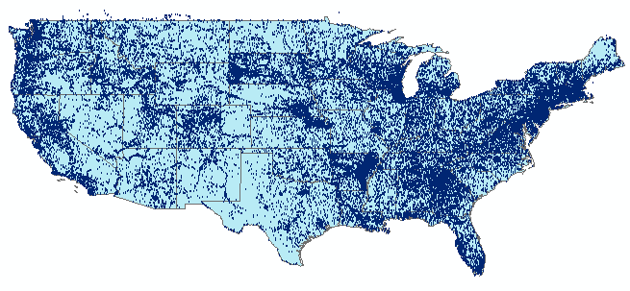
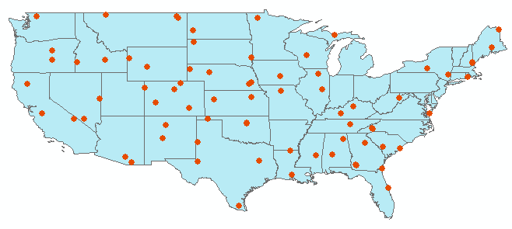
Observation Stations
Map for the US
Ameriflux Towers (NASA & DOE)
NOAA Automated Surface
Observing System
USGS National Water Information System
NOAA Climate Reference Network
Build a common window on water data using web services
Notes:
David - for each of these site files, can you include how many points are in each one.

Slide 5
HIS for the WATERS Network
HIS Central at San Diego Supercomputer Center

Slide 6
CUAHSI Point Observation Data Services
Data Loading
  Put data into the CUAHSI Observations Data Model
Data Publishing
  Provide web services access to the data
Data Indexing
  Summarize the data in a centralized cataloging system

Slide 7
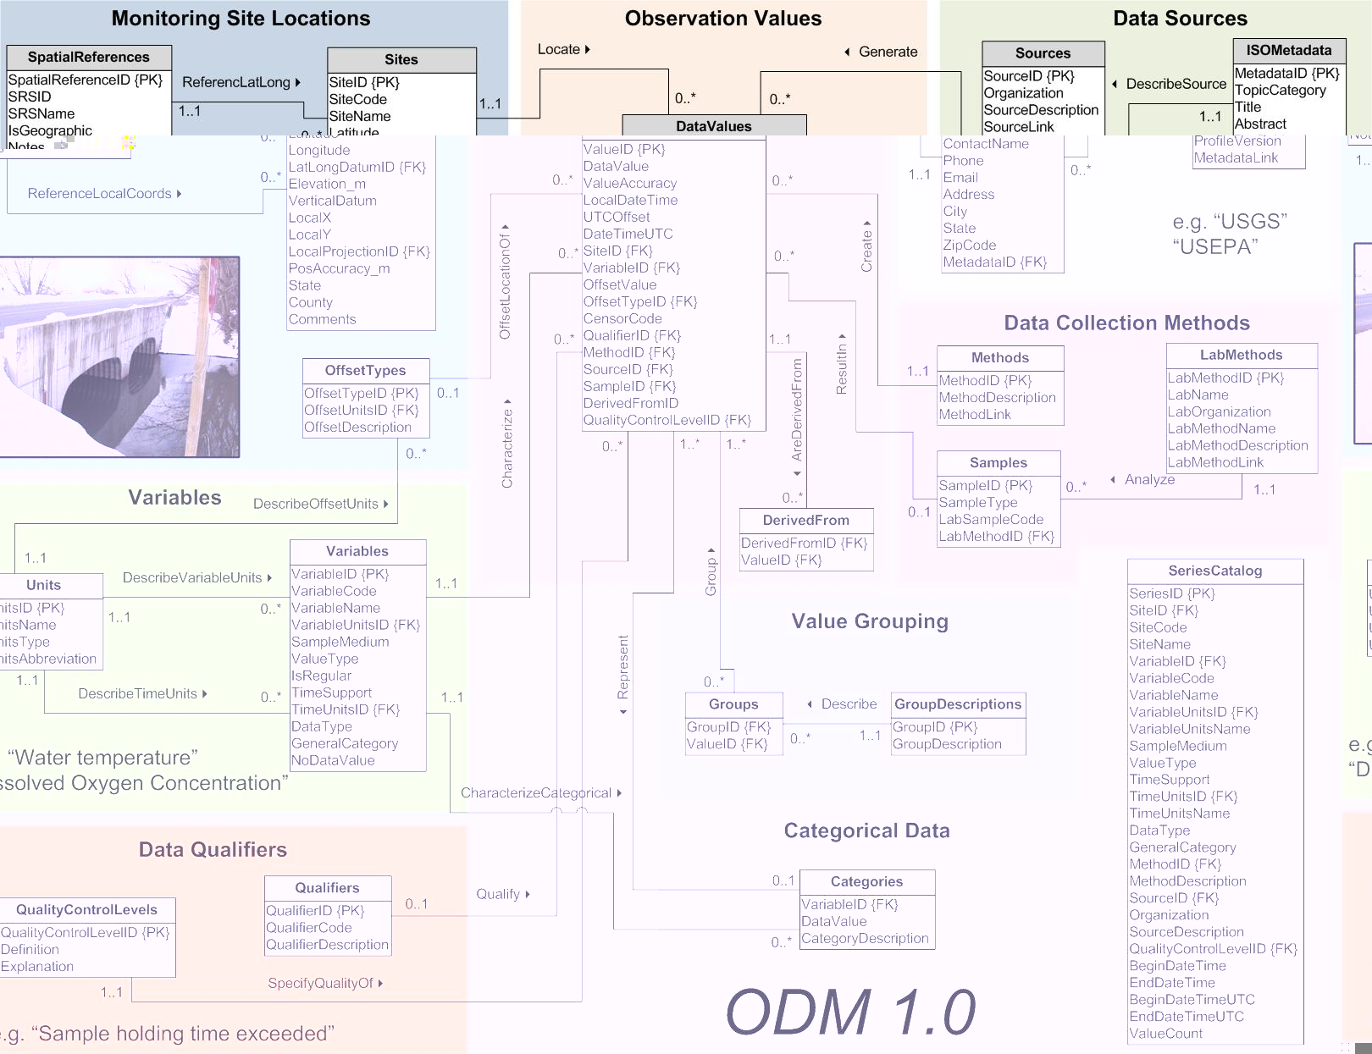
Data Loading
Data Entry
  Put the data into the ODM database (SQL/Server)
  OD Data Loader, Streaming data loader, SQL/Server Integration Services
Data Editing
  ODM Tools
  Check (1) View and graph data in ODM Tools
CUAHSI Observations Data Model (ODM)
http://www.cuahsi.org/his/odm.html

Slide 8
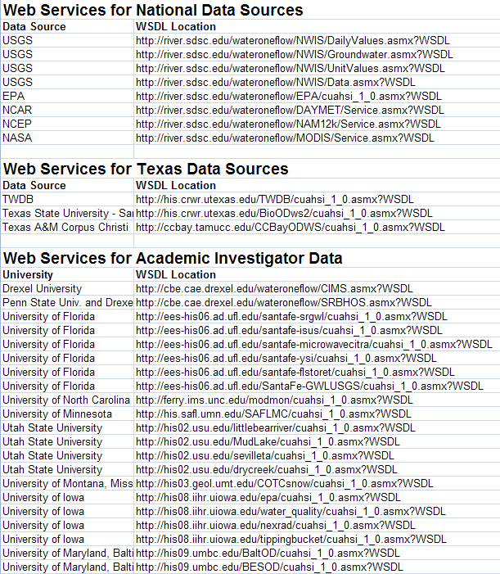
Data Publishing
Data Storage
  Move the ODM to a publication server
  Wrap it with CUAHSI web services code
Data Access
  Provide the WSDL address
  Use CUAHSI WaterOneFlow web service functions
  Check (2) Web services spreadsheet for site locations and data series

Slide 9

WaterML and WaterOneFlow
STORET
Locations
GetSiteInfo
GetVariableInfo
GetValues
Data
Variable Codes
Data
NAM
Date Ranges
WaterML
NWIS
Data
WaterOneFlow
Web Service
Data
Repositories
Client
TRANSFORM
EXTRACT
LOAD
WaterML is an XML language for communicating water data
WaterOneFlow is a set of web services based on WaterML

Slide 10
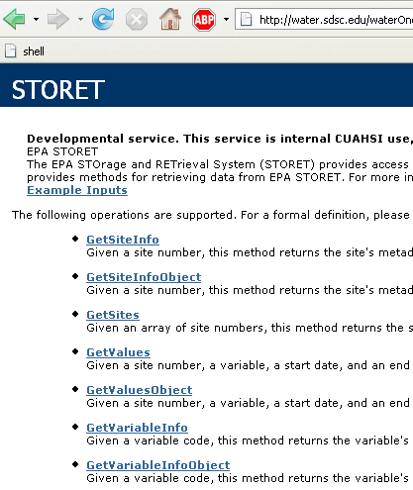
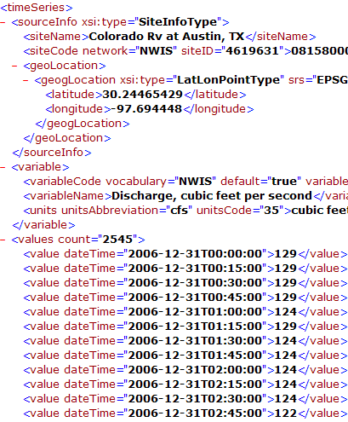
WaterOneFlow
Set of query functions
Returns data in WaterML

Slide 11
SNOTEL in WaterML
809 sites
10 variables
http://river.sdsc.edu/snotel/cuahsi_1_0.asmx?WSDL

Slide 12
Point Observations Information Model for USGS Daily Values
USGS
Data Source
Streamflow gages
Network
GetSites
GetSiteInfo
Neuse River near Clayton, NC
Sites
GetVariables
Discharge, stage
(Daily or instantaneous)
Variables
GetVariableInfo
GetValues
Values
206 cfs, 13 August 2006
{Value, Time, Qualifier}

Slide 13
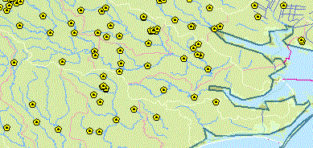
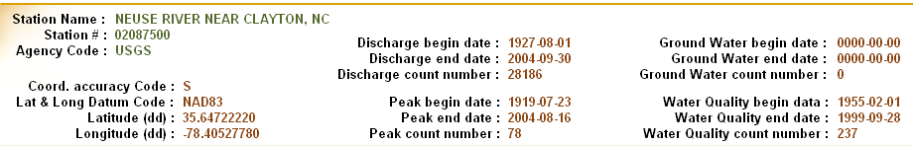
Observations Catalog
Specifies what variables are measured at each site, over what time interval,
and how many observations of each variable are available

Slide 14
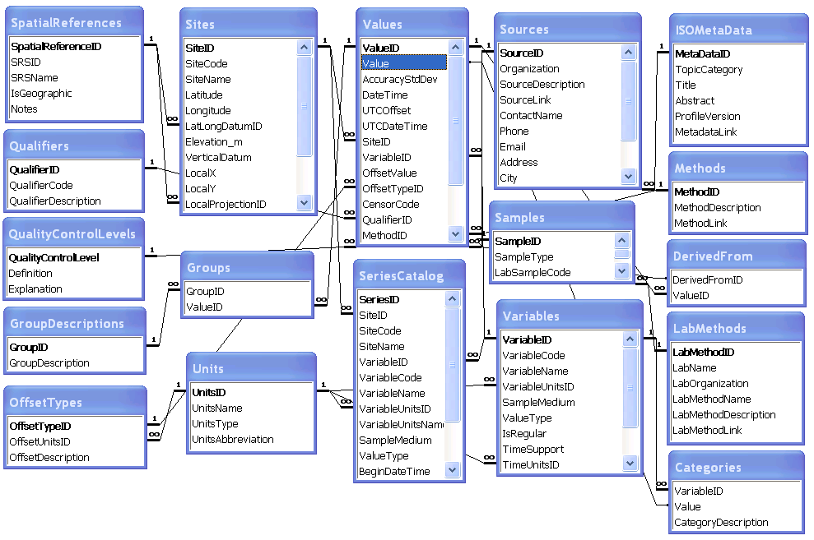
Hydrologic Information Server
WaterOneFlow services
DASH – data access system for hydrology
GetSites
GetSiteInfo
GetVariables
GetVariableInfo
GetValues
ArcGIS Server
Observations Data
Geospatial Data
Microsoft SQLServer Relational Database

Slide 15


We are at a tipping point ….
Web pages
Web services
Internet
Internet
Computer
Person
Computer
Computer
People interact with a
remote information server
Networks of information servers
provide services to one another

Slide 16

Information communication
Water web pages
Water web services
Water Markup Language (WaterML)
HyperText Markup Language (HTML)

Slide 17









Objective
Search multiple heterogeneous data sources simultaneously regardless of semantic or structural differences between them
What we used to do …..
NWIS
request
return
request
request
return
return
NAWQA
request
return
NAM-12
request
return
request
return
request
return
request
return
NARR
Michael Piasecki
Drexel University

Slide 18

Semantic Mediator
What we are doing now …..
GetValues
GetValues
NWIS
GetValues
GetValues
generic
request
GetValues
GetValues
NAWQA
Michael Piasecki
Drexel University
GetValues
NARR
GetValues
HODM

Slide 19
Hydroseek http://www.hydroseek.org
Supports search by location and type of data across multiple observation networks including NWIS, Storet, and university data

Slide 20
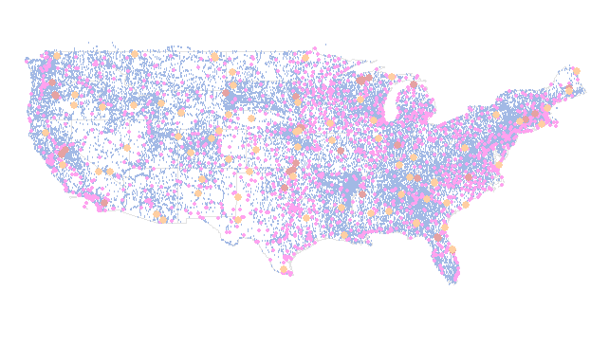
Definition
The CUAHSI Hydrologic Information System (HIS) is a geographically distributed network of data sources and functions that are integrated using web services so that they operate as a connected whole.

