Slide 1
Water Information Challenges Down Under
David Lemon and Peter Fitch
OGC TC September 2008

Slide 2
Overview
The Australian Water Crisis
WIRADA
  Geospatial Fabric
  Water Data Transfer Standards
South Esk Project

Slide 3
Australian Water Crisis

Slide 4
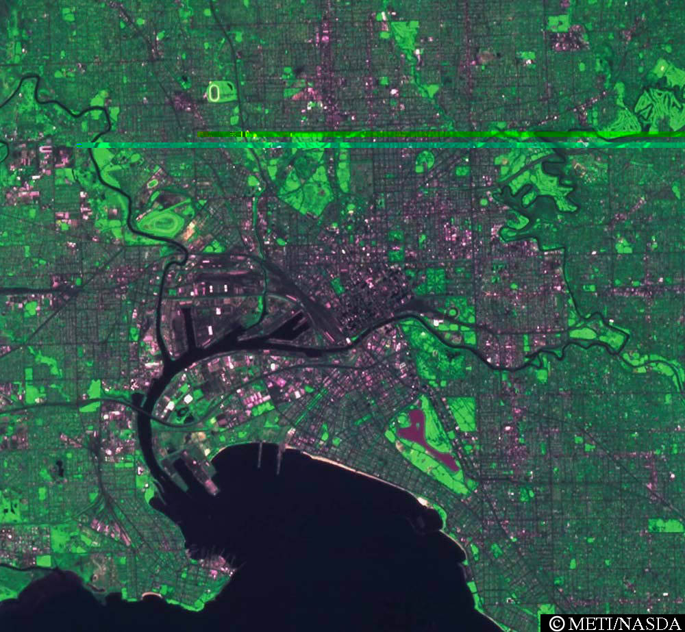

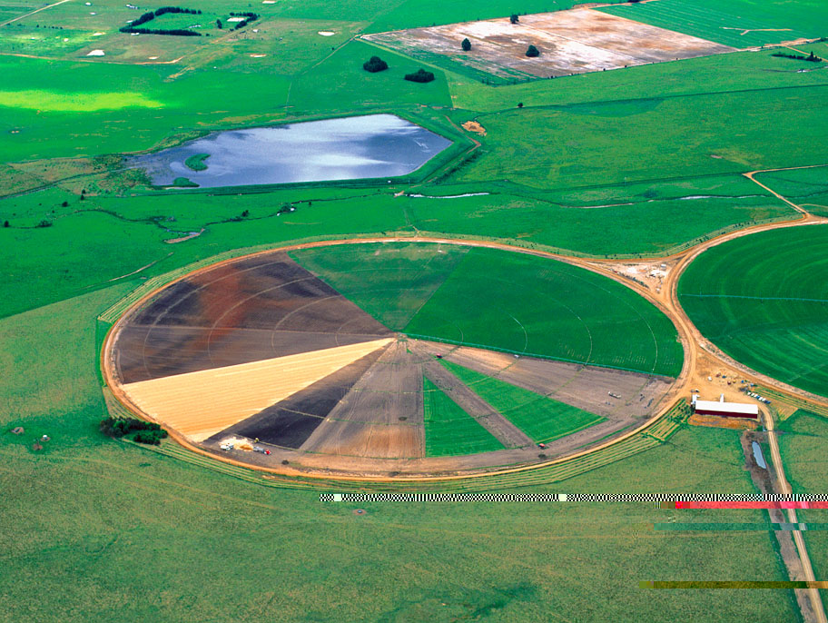
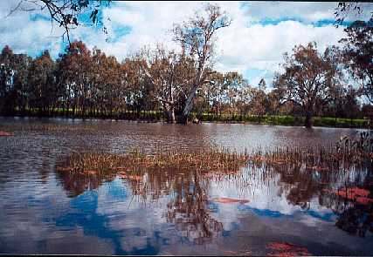
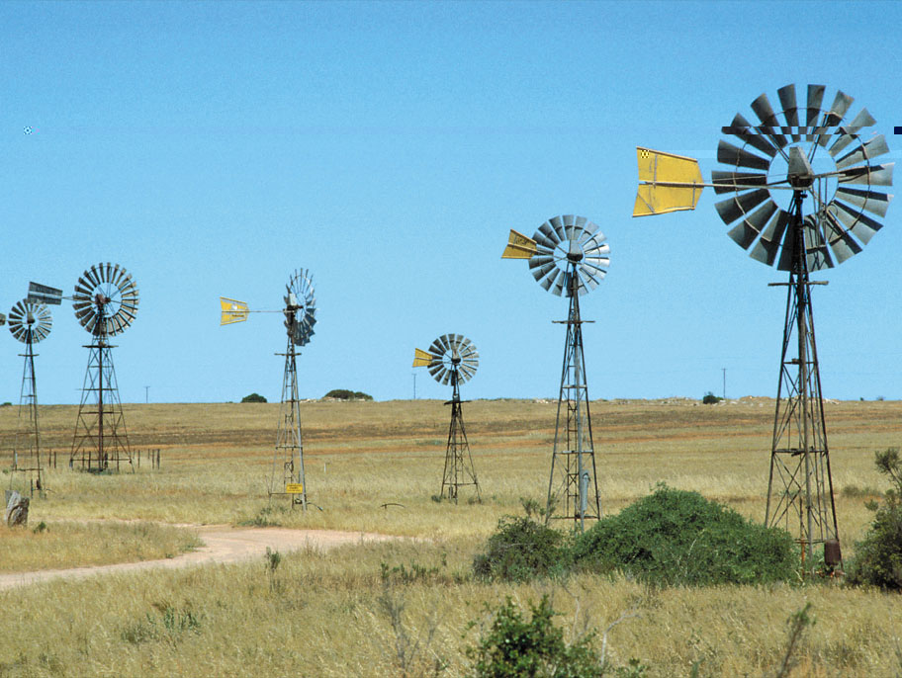
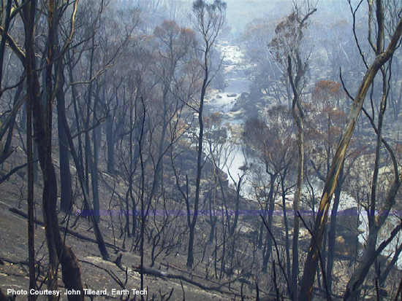
Water scarcity: A deepening problem.
Growing Urban Demand
Drying & Warming Climate
Over-allocation to Irrigation
The big
8
water scarcity factors
The big
8
water scarcity factors
The Environmental Flows Imperative
Uncapped Groundwater Extraction
Bushfire Recovery Impacts
Expanding Plantations
Expanding Farm Dams
Notes:
Best estimate reduction from climate change = 5%
Best estimate reduction from farm dams = 5% (but could be as high as 13% in itself)
Total best estimate reduction = 13%
I’ll highlight dams and groundwater extraction

Slide 5
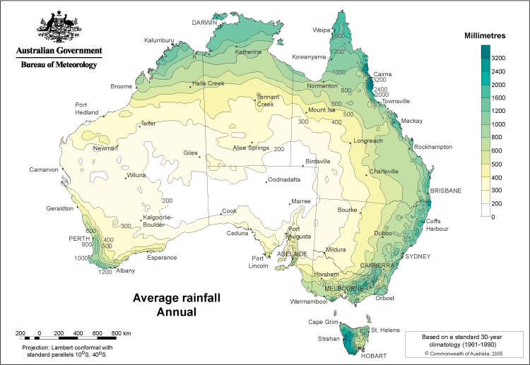
Average annual rainfall
El Nino Southern
Oscillation
Indian
Ocean
Dipole
Southern Annular Mode
Notes:
Map from BOM

Slide 6
Trend in annual rainfall
Major water supply systems

Slide 7
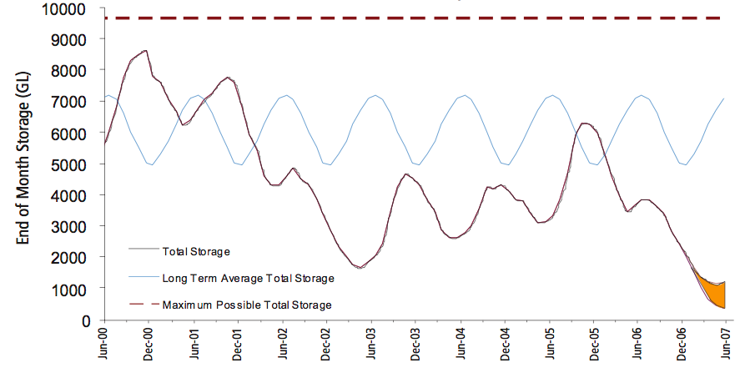
Water storage volumes in the MDB system.
1700 GL

Slide 8
The National Response

Slide 9
A National Plan for Water Security.
Announced by the then Prime Minister in January, 2007
  Re-announced by new government as ‘Water for the Future’ in April this year
$12.9B over 10 years to reform water management throughout the country
  Accelerates existing initiatives
  Some new initiatives
Bureau of Meteorology (BOM) given new mandate with respect to water information
Notes:
Update this

Slide 10
The questions BOM needs to answer
How much water is available in different parts of the country today and how does it compare with history?
How much water is likely to be available in the coming days, weeks, months and years?
Who is entitled to use water and how much are they using?
How much water is being allocated and how is the security of particular water entitlements changing?
How much water is being traded and to where?
How much water is the environment getting?
How is water quality changing?
How much water is being intercepted by farm dams and various land management changes?

Slide 11
The BOM’s new functions
Set standards for water data measurement and transmission.
Gather water information and make it freely available, with value-added analyses.
Conduct annual national water resource assessments.
Produce an annual national water account.
Provide continuously updated water availability forecasts
Invest in water information research

Slide 12
Water Information Research and Development Alliance (WIRADA)

Slide 13
WIRADA
A $50M/5 year research alliance between the BOM and CSIRO
Focussed in 4 major areas:
  Water Information Systems
    Data transfer standards
    System architectures
    Workbenches
  Foundation Data Products
    Digital Elevation Model
    Continental measurement of Et and Precipitation
  Water Accounting and Assessment
  Water Forecasting
    Short term (7 day)
    Seasonal

Slide 14
The Australian Hydrological Geospatial Fabric
The AHGF will be a suite of well maintained, evolving, authoritative data products containing a consistent representation of every feature, and the connectivity between features, of the Australian water system.
These products will be capable of supporting a wide variety of uses for many users.
The AHGF will become the framework geospatial information upon which Australia’s water information related activities are based and through which they are related

Slide 15
Key Use Cases
Provide a set of identifiers for hydrologic features for monitoring and observational data
Provide topological connectivity information
  Accounting, Modelling, Forecasting etc
Provide a set of reporting units for monitoring trends
  Water Accounting
Provide a means of collating the sum total of available knowledge about the hydrosphere
  Flow
  Ratings
  Monitoring
  Groundwater interactions
  Channel shape
  Studies (document index)

Slide 16
A priori requirements
Well-maintained
  on-going maintenance, extending from a one-off build
  version management (can retrieve state at a given time)
Authoritative
  it can be relied upon
  guarantee that it meets specifications
Topological consistency
  more than a cartographic product
  topology is consistent across scales
  simplified topology available (node-link, dendritic, braided)
Many use cases, many users
  users will need simplified views of a more comprehensive model
Evolving
  the AHGF will change over time
    new input data sets
    new use cases to support

Slide 17
Best practice from around the world
Implementations:
  NHD/NHD+
  CCM2
  Canadian Groundwater Model
  LYNX data management
Tools
  ArcHydro
  LYNX/Radius topology
Models and Data Product Specification Methodologies
  Hydro ad-hoc
  INSPIRE will adopt a DPS for each theme
  ANZLIC Harmonised Data Model
Much to learn from these but many challenges still to be addressed.

Slide 18
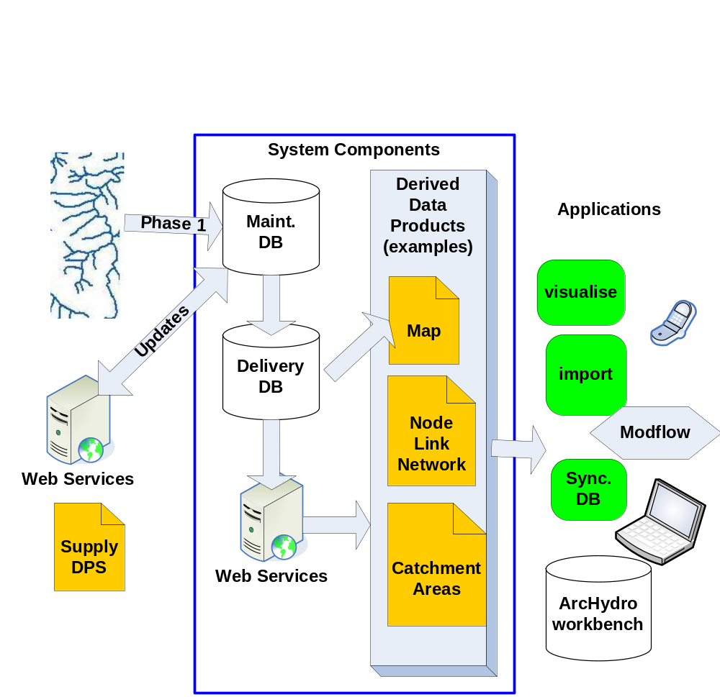
A Very Conceptual Architecture

Slide 19
AHGF Data Product Specifications
A key requirement of the AHGF is a clear understanding between data providers and data subscribers on what a data product needs to contain.
That is, the existence of a contract between both parties that describes such things as:
    How the data product is to be identified;
    Who will own the data product;
    How the data product is structured;
    What quality criteria are to be applied to the data product; and
    How the data is to be delivered.
Each AHGF data product will require a robust specification of many aspects of the data, from structure to data management processes – a Data Product Specification (DPS)

Slide 20

Role of the conceptual model
Conceptual Model
Data maintenance
environment
ArcHydro
Implementation
Cartographic
Product
Gazetteers
(lists of controlled
identifiers)
Node/
Link
Analysis
Discovery
Related data
specifications
Models
“Model data integration” exploiting ids and common semantics

Slide 21
Concrete data products
Conceptual Model
Data maintenance
Environment
Implementation
Specifications
Logical Views
A
A | B
A | C
A | C
A | B
Data
ArcHydro
Implementation
Cartographic
Product
Gazetteers
(lists of controlled
identifiers)
Node/
Link

Slide 22
Key challenges
A set of problems to be solved:
  Known issues with status quo – motivation for investment.
Domain specific:
  What objects? What scales?
  Hydrological connectivity
  Identifiers
Common (“framework data set”):
  Update cycles
  Partitioning of large problem into phased work packages
  Multiple scales
  Maintaining versions
  Topological consistency
  Derivation of multiple products from a knowledge base
  Documentation – ease of creation, maintenance and use
  Stakeholder engagement – value accrues through adoption

Slide 23
Water Data Transfer Standards
Water observations are a key element of a resource information system
Required for transfer of water data from 261 data custodians to BOM.
Standardised information model and interfaces are required
Current work has been on:
  WOML- Water Observation Markup Language*
Applied to
  Preliminary data ingestion project
* Working title only

Slide 24
WOML
Water Observations Markup Language
  model and XML encoding for water observations
  ≈ CUAHSI WaterML (XML for ODM)
Formalised as a profile of OGC/ISO O&M
Builds on
  Observation schema
  Sampling features
  ISO Coverage model

Slide 25
Methodology
Model-driven, standards-based
  UML formalization
Automatic transformation to implementation platform (e.g. XML)
Standard meta-model
  ISO General Feature Model + Coverage
Standard X-domain components
  Geometry, CRS, Temporal
  Observations, Sampling Features
Formally governed vocabularies
  Published in online registers
… compatible with standard service interfaces
  WFS, SOS, CS/W

Slide 26
Attractions for the BOM
Data-transfer format ⇒ data model
  An explicit model makes design and maintenance easier
Water observations will not be used in isolation
  Deploy technology compatible with other natural resources and environment applications
  Publish definitions for services in web-accessible registers
    model, schema, vocabularies
There are standards and tooling available
  UML/GML + HollowWorld/FullMoon for design
  WFS, SOS, WCS, CSW for service delivery
A standards-based implementation works
  WOML can support all requirements of BOM

Slide 27
Next Steps
Harmonisation with WaterML
Adoption by appropriate standards body
  ( Our suggestion: WMO)

Slide 28
Tasmanian ICT Centre – WRON
South Esk Hydrological Sensor Web
Water for a Healthy Country
Siddeswara Guru, Yanfeng Shu, Daniel Smith,
Andrew Terhorst, Peter Taylor,
29 August 2008

Slide 29
Characteristics
Covers an area of 3350km²
High spatial and temporal variability in rainfall
Flood events not uncommon
Unregulated upstream of Perth
Flows into the Trevallyn hydro-electric storage
Targeted for irrigation development
Significant land use changes across the entire catchment
Much interest in this catchment

Slide 30
Management Challenges
The high seasonal and spatial variability in stream flow makes management of water allocations/restrictions very difficult
The long-term impact of forestry development in the upper reaches of the catchment is not properly understood
Likewise it is not known how the proposed irrigation schemes will impact stream flow
There will be increased demand for water for agricultural use in coming years due to climate change

Slide 31
Project Goals
Assess the performance characteristics of the SWE standards for in a near real-time hydrological application i.e. continuous stream flow forecasting
Contribute to the development of SWE standards
Investigate what kind of middleware is needed for Hydrological Sensor Webs
Open architectural design for Hydrological Sensor Webs

Slide 32
Explore Practical Issues
Usability of OGC standards
Meta data modelling
Time series encoding – WOML
Near Real-Time Performance
Quality of Service
Service querying and messaging
Model integration

Slide 33

Too many Daves

Slide 34

Thank you
CSIRO Land and Water
Dr David Lemon
Research Stream Leader – Water Informatics
Phone: +61 2 6246 5724
Email: david.lemon@csiro.au
Web: www.csiro.au/clw
CSIRO Land and Water
Peter Fitch
Research Group Leader – Environmental Information Systems
Phone: +61 2 6246 5763
Email: peter.fitch@csiro.au
Web: www.csiro.au/clw
Contact Us
Phone: 1300 363 400 or +61 3 9545 2176
Email: Enquiries@csiro.au Web: www.csiro.au

