Slide 1
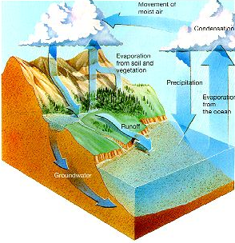
Proposed Domain Working Group on Hydrology
David Maidment (University of Texas, CUAHSI)
David Lemon and Peter Fitch (CSIRO)
David Valentine (San Diego Supercomputer Center, CUAHSI)
Ken Galluppi (Renaissance Computing Institute, UNC)
David Arctur (OGC)
OGC Technical Committee, Plenary Session, Atlanta, 18 Sept 2008

Slide 2
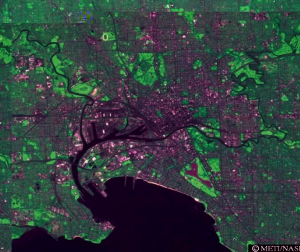

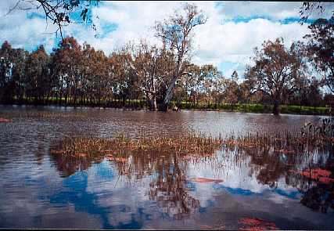
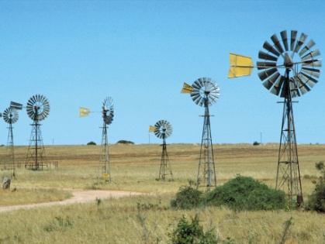
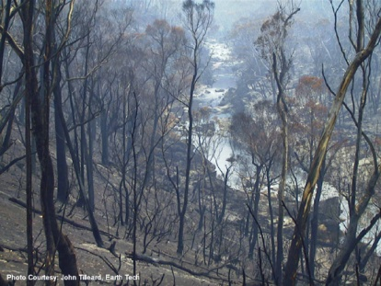
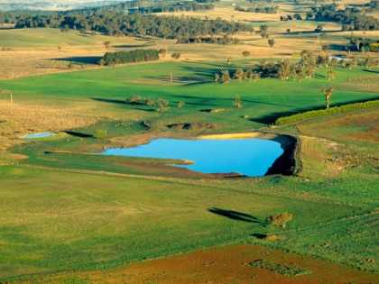
Water scarcity: A deepening problem.
Growing Urban Demand
Drying & Warming Climate
Over-allocation to Irrigation
The big
8
water scarcity factors
The Environmental Flows Imperative
Uncapped Groundwater Extraction
Bushfire Recovery Impacts
Expanding Plantations
Expanding Farm Dams
Notes:
Best estimate reduction from climate change = 5%
Best estimate reduction from farm dams = 5% (but could be as high as 13% in itself)
Total best estimate reduction = 13%
I’ll highlight dams and groundwater extraction

Slide 3
Sustainable water resources management
Judicious infrastructure investments
Australia: Overall $13 Billion over 10 years
Australian Water Information: $450 million over 10 years
Properly functioning water markets
Good
water information
is the key
Prudent
environmental
flow
management
Fair pricing and equitable sharing of a scarce resource
Notes:
Meant to show that water info is central to many of the NWI water reform objectives

Slide 4
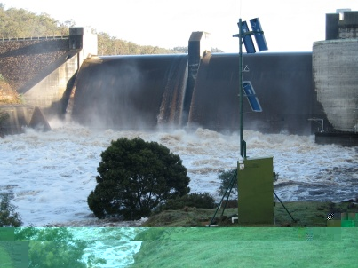
The water information value ladder.
Forecasting
Reporting
Analysis
Done poorly
Data >>> Information >>> Insight
Integration
>>> Increasing value >>>
Distribution
WaterML
Done poorly to well
Aggregation
Quality assurance
Collation
Generally done well, by over many groups, but
could be vastly improved with new technology
Monitoring
SensorML

Slide 5
What is “Hydro”?
Hydrology
Hydrography
Circulation of the waters of the earth through the hydrologic cycle
The “blue lines” on maps
Properties of Water – WaterML
Features of Water Environment

Slide 6
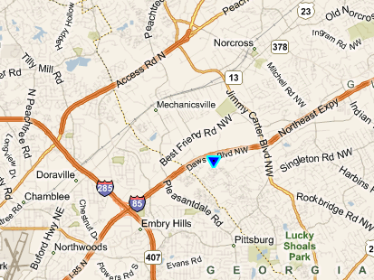
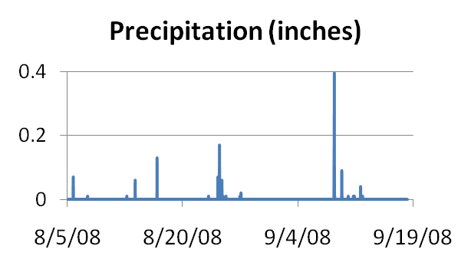
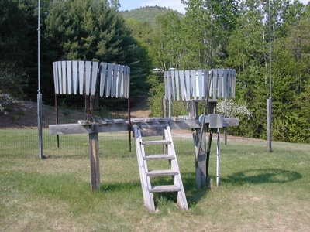
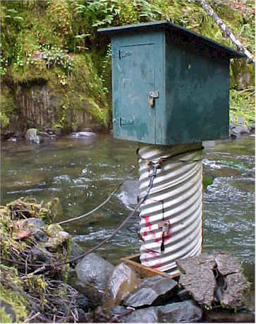
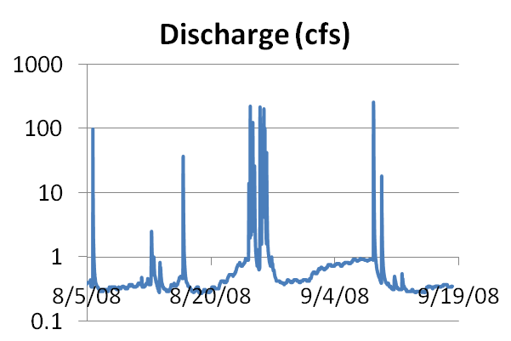
Hydro Data Time Series
http://river.sdsc.edu/wateroneflow/NWIS/UnitValues.asmx?WSDL

Slide 7
What is CUAHSI?
UCAR
CUAHSI – Consortium of Universities for the Advancement of Hydrologic Science, Inc
Formed in 2001 as a legal entity
Program office in Washington (5 staff)
NSF supports CUAHSI to develop infrastructure and services to advance hydrologic science in US universities
Unidata
Atmospheric
Sciences
Earth
Sciences
Ocean
Sciences
CUAHSI
National Science Foundation
Geosciences Directorate
HIS

Slide 8
CUAHSI Member Institutions
122 Universities as of September 2008
11 International affiliates

Slide 9
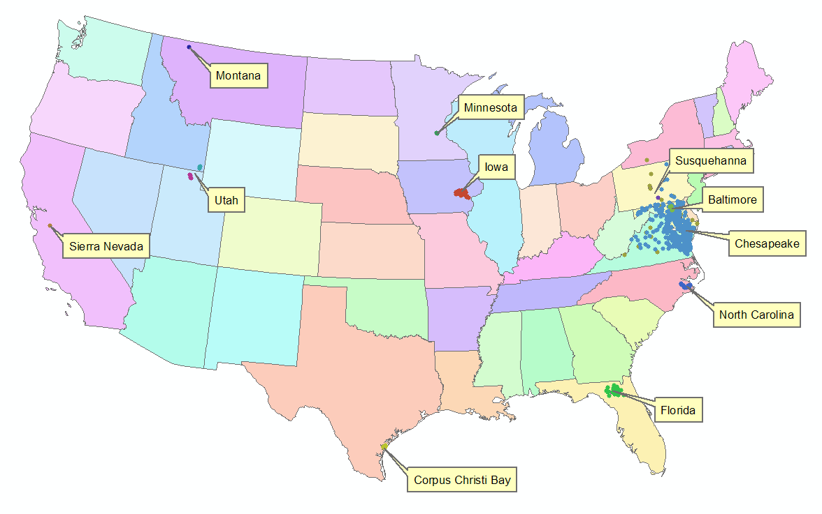

Services-Oriented Architecture for Water Data
Links geographically distributed information servers through internet
Web Services Description Language (WSDL from W3C)
We designed WaterML as a web services language for water data
Functions for computer to computer interaction
HIS Servers in the WATERS Network
HIS Central at San Diego Supercomputer Center
Web Services

Slide 10
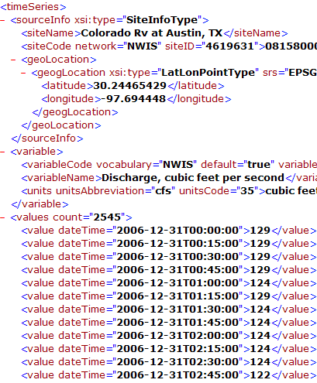

Get Data
HIS Central
WaterML
National Water Metadata Catalog
Get Metadata

Slide 11











Synthesis and communication of the nation’s water data http://his.cuahsi.org
Government Water Data
Academic Water Data
National Water Metadata Catalog
Hydroseek
WaterML

Slide 12
Point Observations Information Model
Utah State
Univ
Data Source
Little Bear River
Network
GetSites
Little Bear River at Mendon Rd
Sites
GetSiteInfo
Dissolved Oxygen
Variables
GetVariableInfo
GetValues
9.78 mg/L, 1 October 2007, 5PM
Values
{Value, Time, Metadata}
A data source operates an observation network
A network is a set of observation sites
A site is a point location where one or more variables are measured
A variable is a property describing the flow or quality of water
A value is an observation of a variable at a particular time
A metadata quantity provides additional information about the value

Slide 13
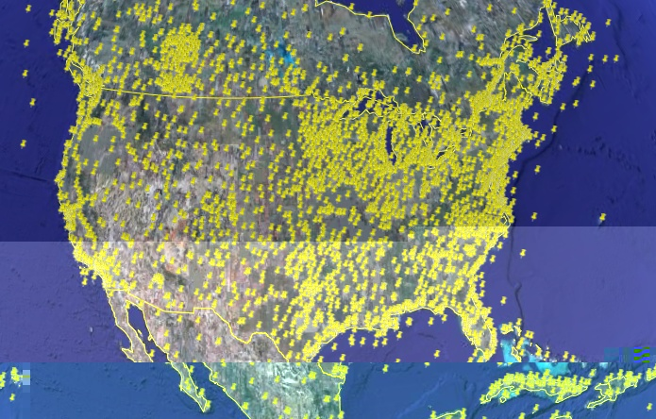
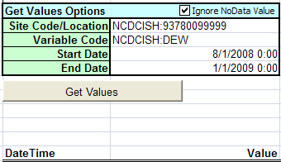
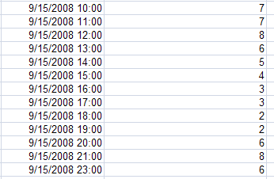
NCDC Integrated Surface Hourly Data Series
http://water.sdsc.edu/wateroneflow/NCDC/ISH_1_0.asmx?WSDL
Hourly Dewpoint Temperature
from Christchurch, New Zealand in “HydroExcel”
1.5 day latency
13,600 stations globally
Geography – Spatial Features
Water – Time Series

Slide 15
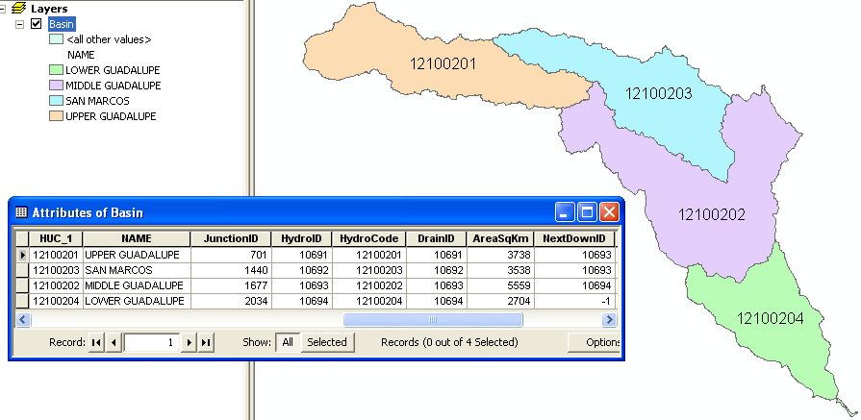
Guadalupe HydroFeatures: Basins

Slide 16
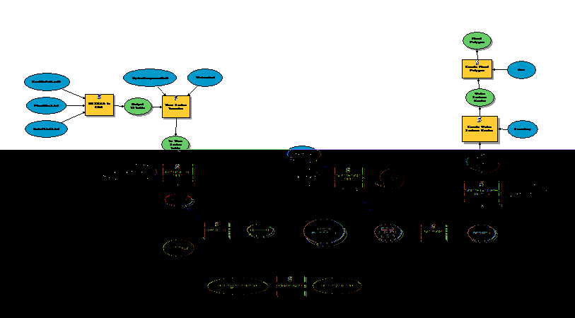


Storm Rain Map to Flood Map
FLOODPLAIN MAP
Flood map
as output
(Time varying features)
Model for
flood flow
HMS
Model
for flood
depth
Rain map as input (Time varying coverages)

Slide 17

Hydrology Ad Hoc
Hosted by
66th OGC Technical Committee
Atlanta, Georgia USA
David Arctur
September 17, 2008
Copyright © 2008, Open Geospatial Consortium, Inc., All Rights Reserved.

Slide 18
Possible Hydrology Working Group
What do we have?
  WaterML 1.0 operational but not OGC compliant
  Observations Data Model to provide semantics for future development
Some issues for us:
  WaterML and WFS are independent
  WaterML and WCS are independent
What do we need?
  WaterML 2.0 that is OGC compliant (O&M application?) – work underway led by Simon Cox
We would like to see:
  WFS with time varying attributes
  WCS with coverages varying in space and time
Relationship to Earth Systems Science DWG?

Slide 19
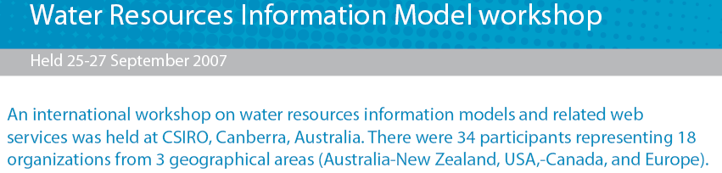
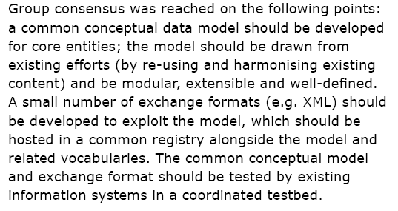

Slide 20
OGC Observations and Measurements
Properties
Flow
Water level
Water quality
Process
Gaging
Sampling
Modeling
O &M Application
WaterML 2.0
Features
Observation sites
Watersheds
Rivers
Results
Time series
Coverage series
Feature series

Slide 21
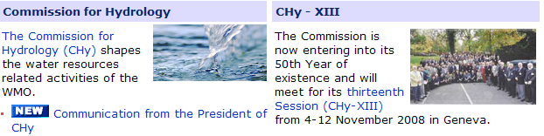
Possible Collaboration with WMO
(Bruce Stewart, Bureau of Meteorology, Australia)

Slide 22
Output/Outcomes
Bring multiple groups to the table
  Government
  Industry
  Research
Leverage existing nationally focussed initiatives
  Use an existing standards organisation
Enable cross domain information exchange
  Climate, Oceans, Hydrology, Geology
Work with other OGC working groups to handle time-space data exchange for Hydrology
Proposed standards working group for WaterML2

