Slide 1
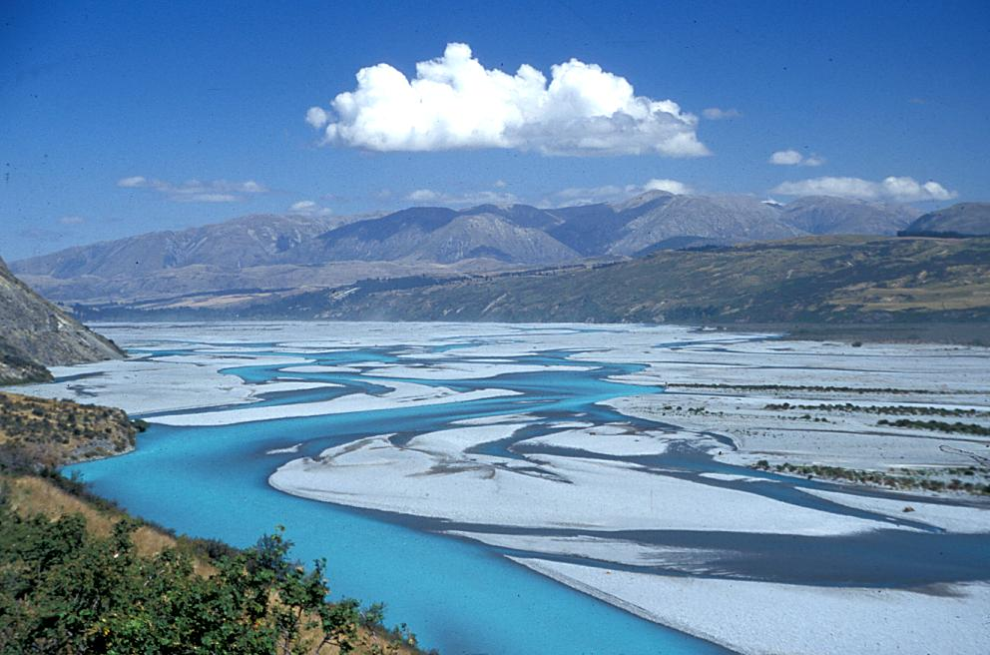
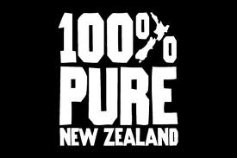
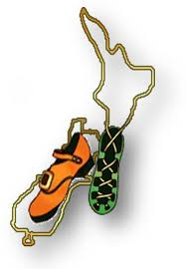
Initiatives in Interoperability in New Zealand
80th OGC Technical Committee
Austin, Texas (USA)
Jochen Schmidt, NIWA, New Zealand
Alexander Kmoch, GNS, New Zealand
March 21st, 2012

Slide 2
Initiatives into Interoperability in New Zealand
NZ: Heterogeneous environment in terms of legislation, governance, management (freedom!).
Lead to a diversity of information system used across the country.
BIG PUSH since ~4 years to make information better accessible (particular freshwater).
Lots of ducks are running around (portals build, statements made, etc.).
Since about ~2 years more engagement with OGC etc. through various organizations – seems ducks getting in a row?

Slide 3
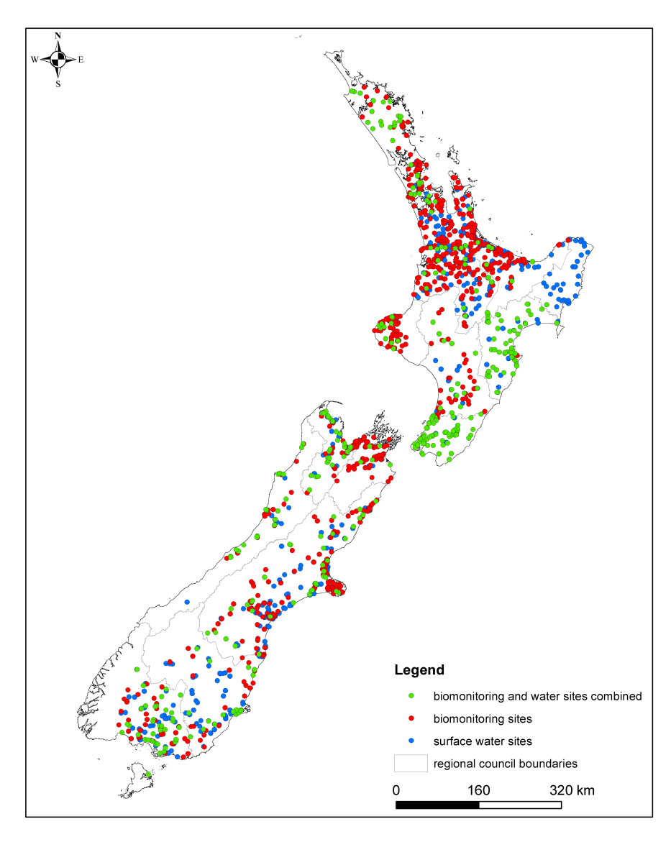
New Zealand (hydrological) monitoring
Variety of stakeholders – Regional Councils, Energy Companies, NIWA.
Variable in space, varying densities, e.g. Auckland very well sampled whereas Alpine areas (where most of water / energy is coming from) under sampled.
Done for varying objectives and therefore to varying standards using varying technologies (sensors, telemetry, etc.).

Slide 4
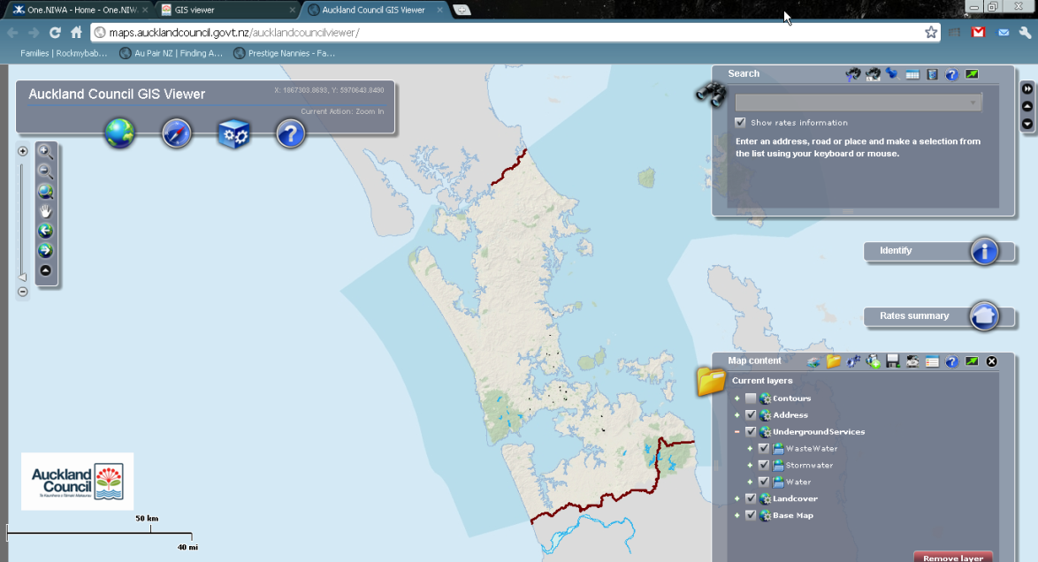
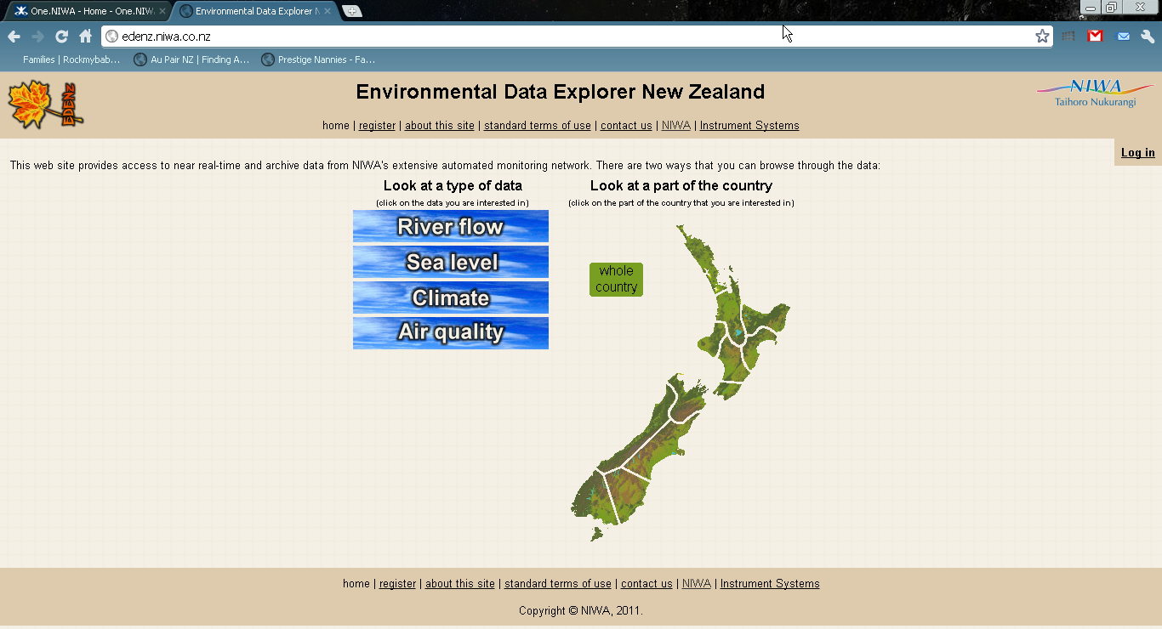
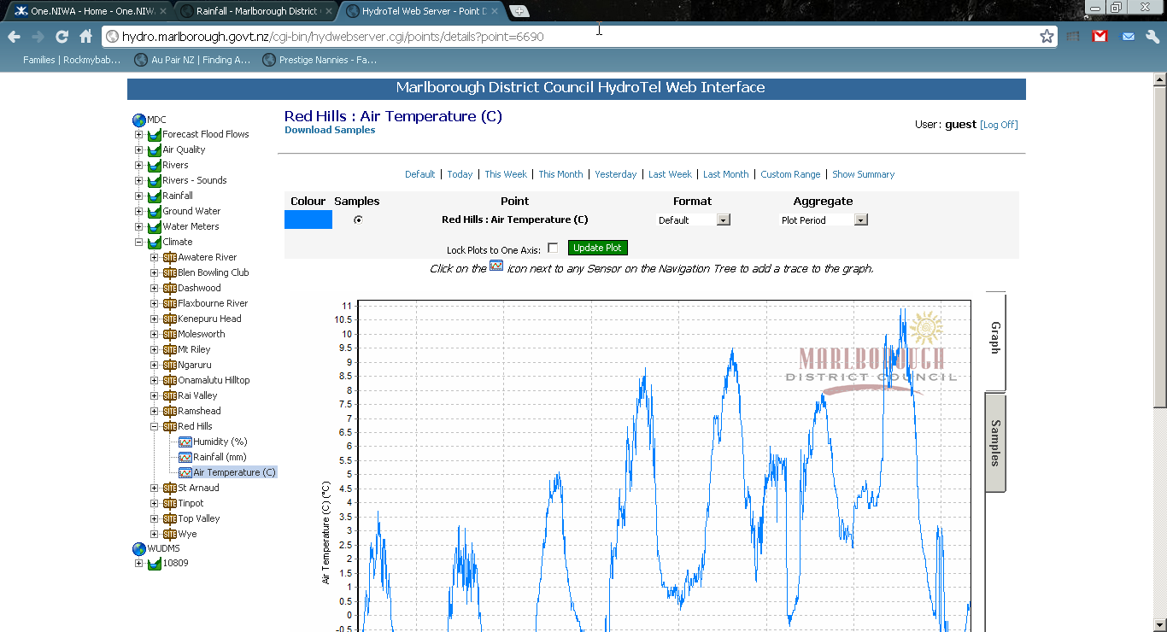
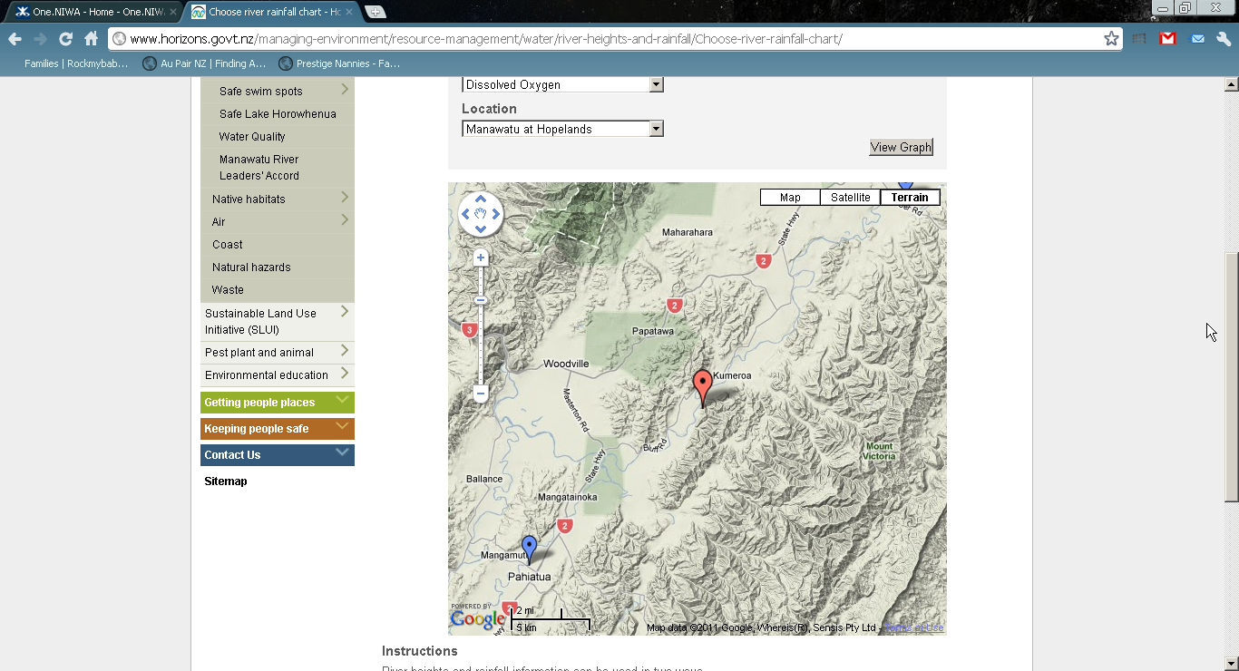
Different Organisations – Different networks – Different databases – different delivery systems

Slide 5
NZ environmental monitoring situation
Vision: consistent NZ Monitoring and Reporting
How is data made shareable?
procedures/standards
IP / legal
How is data documented?
procedures/standards
How is data collected?
procedures/standards
What is important?
for different objectives?
“filtering” necessary?
?
NZ environmental monitoring – situation
Different agencies
Different projects
Different objectives
Different monitoring networks
Different standards
Notes:
In almost all GEO benefit areas New Zealand situation is that monitoring is carried out:
by Different agencies
for Different projects
for Different objectives
by Different monitoring networks
to Different standards
This makes data sharing difficult because of:
Varying IP / legal issues
Documentation issues (no standard)
Data Standard Issues (collected to differing standards, not comparable)
Observations not homogenized according to objective

Slide 6

Consistent National Environmental Monitoring and Reporting
Issues:
Different agencies
Different projects
Different objectives
Different monitoring networks
Different standards
Challenges:
National Consistency in Monitoring
Mandate?
Resources?
Agreement!

Slide 7
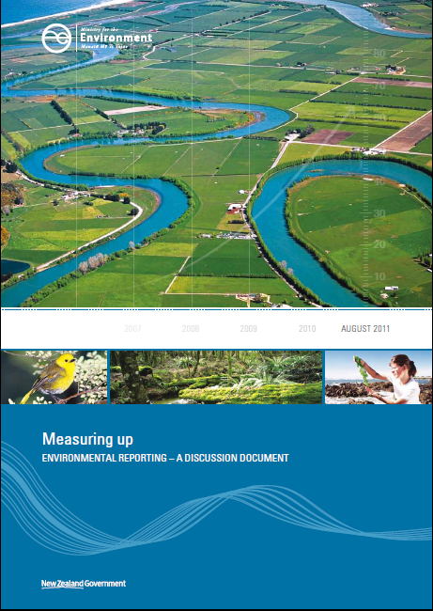
Government got attention of the problem! Proposal for an Environmental Reporting Bill
Identified Issues:
There is a lack of statutory obligation in New Zealand requiring regular and independent state of the environment reporting.
Inconsistent regional state of the environment monitoring programmes.
Proposed Actions:
give the PCE an explicit role under the Environment Act1986 by requiring five-yearly reports on the state of the environment
expand regulation-making powers under section 360 of the RMA to improve the consistency of state of the environment monitoring statistics at the local level. This could be supported by the application of the Official Statistics System principles and protocols, particularly in the area of quality and related standards.

Slide 8
Relevant national projects
National Environmental Monitoring Qualification NEMQ
National Environmental Monitoring Standards NEMS
National Environmental Monitoring and Reporting NEMAR
Lead by Local Authorities, Ministry for Environment, NIWA, Industry

Slide 9
The Challenge
Develop a federated information infrastructure which allows easy sharing of environmental information based on community standards.

Slide 10
(Some) current NZ Interoperability initiatives
NZ Geospatial Strategy – NZ Geospatial Office + others.
NZ SDI Cookbook – NZ Geospatial Office.
BOI / Oceans & Coasts Portal – NIWA/LINZ
Government “Open Data” => Catalogues
geodata.govt.nz, data.govt.nz, ei.niwa.co.nz
Various Data Cataloguing exercises across the sector.
NZ deployment station catalogue (WFS) – NIWA.
IMOS-NIWA collaboration – NZ marine data through THREDDS/CSW.
Groundwater interoperability SMART – GNS, Hilltop
Regional Council SOS – Waikato, Kisters, Hilltop
CSIRO SISS / SOS workshops in Wellington – NIWA, NZGO, LCR, GNS
NIWA experiments with SOS – MapServer, Kisters, CSIRO
Biodiversity Interoperability – NIWA, LCR, Regional Councils

Slide 11

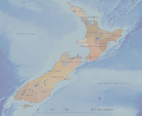


SMART Project
www.smart-project.info
Aquifer characterisation, groundwater volume change, hydraulic properties, water age, groundwater-surface water interaction
Data will be published in groundwater portal
prototype presentation July 2012 at GI_Forum conference (gi-forum.org)
Recent research to publish NGMP data as SOS / WaterML (National Groundwater Monitoring Program)
CSW
SMART- GeoPortal Software
Registry Service
Discovery Service
View
Download
Transformation
Internet
multiple data
sources, local repository+ other OGC services)
Spatial Data
Web Site / Maps
Data
Sources
CSW
WMS/WFS/WCS
SOS

Slide 12



New NIWA Interoperability Architecture
http://ei.niwa.co.nz
http://geodata.govt.nz
http://data.govt.nz
http://os2020.org.nz
…
CSW
WFS
SOS
GBIF??
THREDDS
NIWA
data & services catalogue
DC
NIWA
station information management system SIMS
NIWA Taxonomic Reference Systems
TRS
NIWA
(bio-)
observationdatabase
NEMO
NIWA climate database CLIDB
NIWA freshwater database WRA
NIWA marine database MarineDB

Slide 13
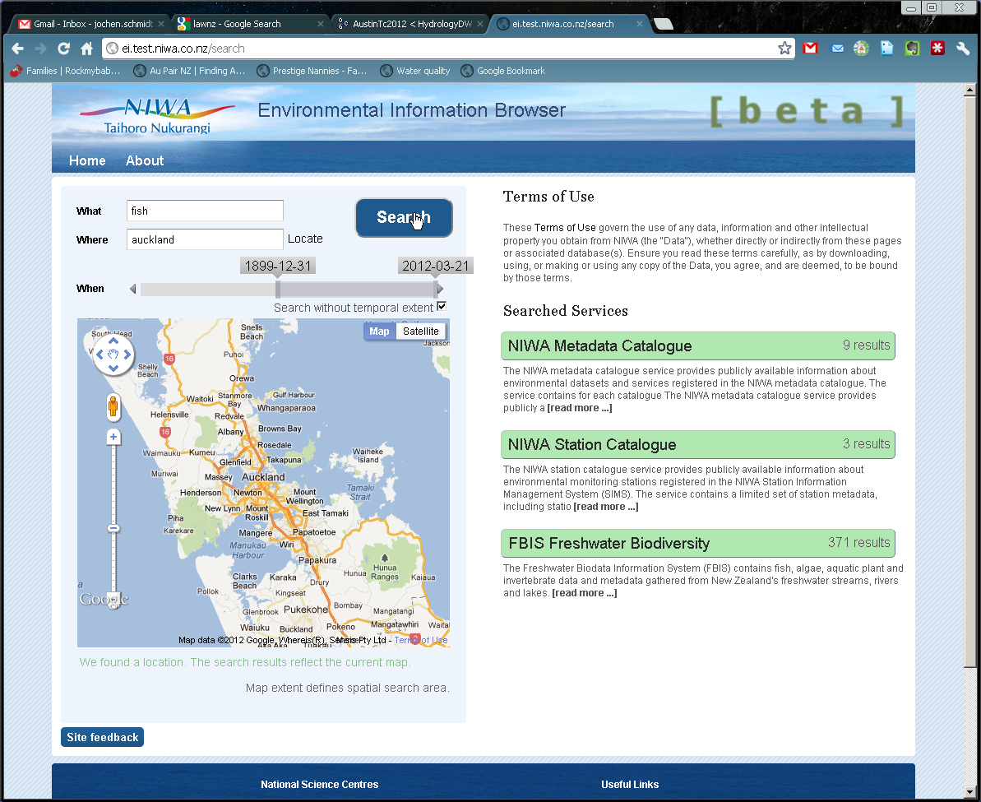
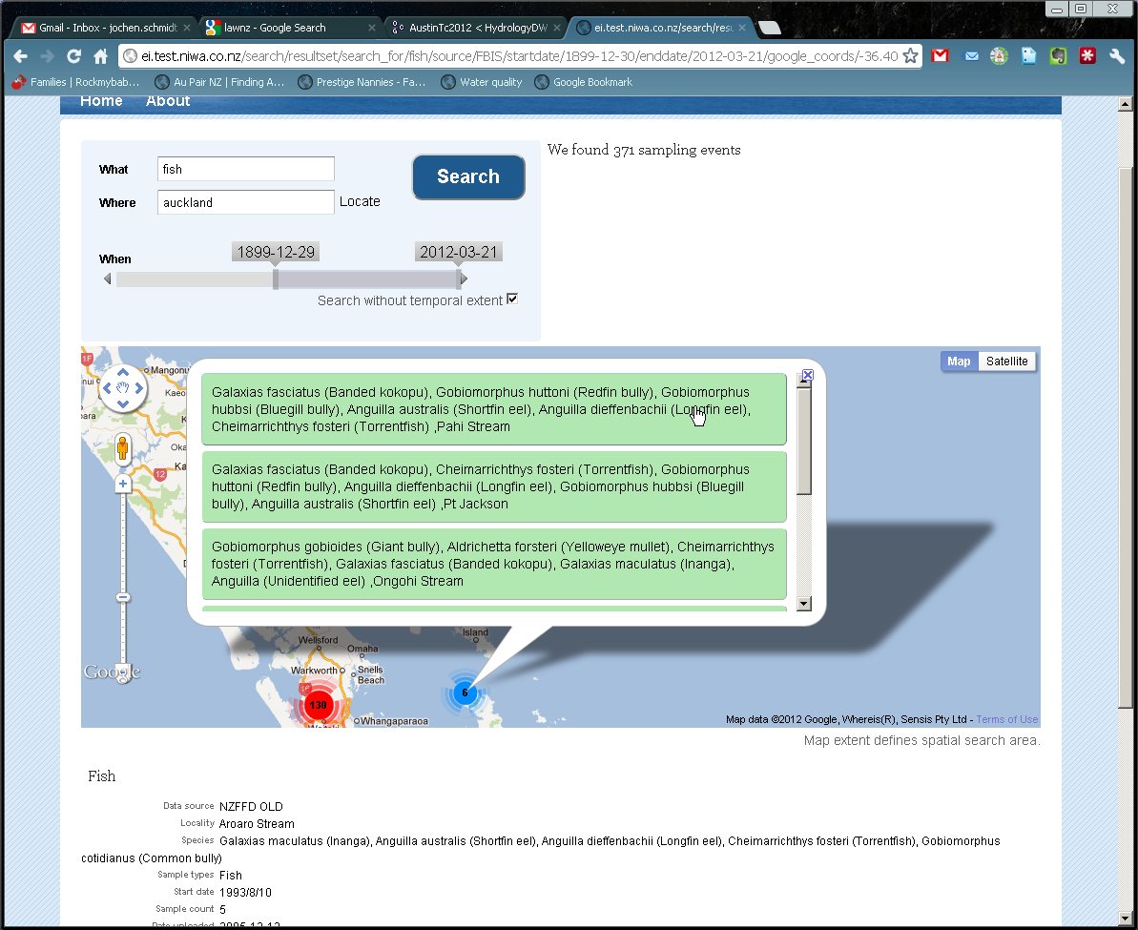
Vision: Environmental Information from anywhere, available anytime, enabled through standards
Services provided through standards (CSW, WFS, SOS?, GBIF?).
Geospatial, temporal, contextual discovery.
Information visualisation components.
Geospatial, temporal, contextual selection.
Data provided through community standards.
Report & Download options.

