Slide 1
Hydro DWG
Feedback from the WMO CHy
Advisory Working Group
80th OGC Technical Committee
Austin, Texas (USA)
Ulrich Looser
19 March 2012
Copyright © 2012 Open Geospatial Consortium

Slide 2
OGC – WMO Communication
Meeting of Advisory Working Group (AWG) of the WMO CHy
12-16 December 2011 Geneva
Attendance:
  President of CHy
  6 members of AWG
  5 Regional Hydrological Advisors (RHAs)
  Representatives from UNESCO IHP
  IAHS
  GRDC
  3 advisors to AWG members or RHAs
  WMO secretariat staff
Presentation on Hydro DWG and WaterML 2.0 SWG activities to the WMO CHy AWG
  WaterML 2.0 development status
  Hydro Feature model
  Status of HDWG IEs
Copyright © 2012 Open Geospatial Consortium

Slide 3
AWG discussion
Discussion:
Increasing importance of water information technology e.g.
Protocols for data transfer
Electronic access to hydrological information
Extensive discussion and awareness raising in the NHSs community required
Publish Hydro DWG documents on the CHy E-Board discussion forum
To be part of the CHy pre-session discussions and Scientific Lectures
Endorsement of data transfer formats necessary from CHy and WMO Commission for Basic Systems (CBS)

Slide 4
AWG findings
Addition of a new thematic area to CHy activities on:
“Data Operations and Management”
Revision of CHy structure to accommodate new thematic area
Resolution proposal for upcoming CHy session (Nov. 2012) on:
“Data Exchange and Protocols, and Information Management”
Suggested topics for the scientific programme of the next CHy session:
“Data exchange protocols (OGC, WaterML 2.0, etc.)”

Slide 5
CHy Thematic Area Draft Programme
The draft programme for the CHy Thematic Area:
“Data Operations and Management” contains amongst others the following
…
“Monitor and report on new developments dealing with data management issues, such as observations, data exchange and protocols, data transfer formats, data information, WIS and WIGOS”
“Provide a focal point for CHy’s involvement in the OGC”
…
…all mentioned changes subject to CHy Session approval in November 2012

Slide 6
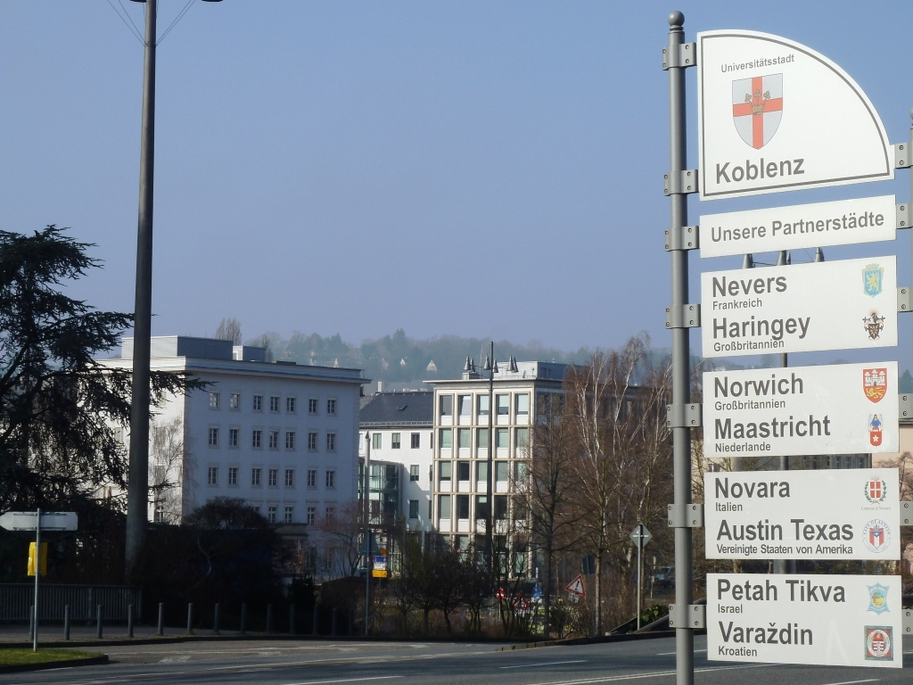
Thank you for your attention

