Slide 1
What is needed to support an integrated geo-temporal system based on CUAHSI experience
Zichuan Ye, Ph.D.
Senior Application Developer
ESRI, Inc.
Dean Djokic, Ph.D.
Senior Application Developer
ESRI, Inc.

Slide 2
HydroViewer
Provide a unified web-based interface to hydrologic data coming from different agencies and universities in order to:
  Explore Data
  Access Data
  Assemble Data in a commonly referenced geo-temporal database
    Spatial
    Temporal
    Variable
Notes:
Why these goals,
In two areas:
(1) Through survey – next page
(2) Theory (Dr. Maidment’s presentation)

Slide 3
Spatially Referenced Time Series Data Element
Time Series Data Access
Variable Descriptions
Spatial Data Locations
Time TSDateTime
TS Value
Spatial FeatureID
Variable TSType
The three “dimensions”/axes of a time series data element
Notes:
Data element defined in 3 dimension
Spatial dimension – where the data is located, Time – when the time is observed, Variable – what is observed.
Spatial variable cross reference – at where and what are observed.

Slide 4
Data Integration – Single Source
Utah State
Univ
Data Source
Little Bear River
Network
Little Bear River at Mendon Rd
Sites
Dissolved Oxygen
Variables
9.78 mg/L, 1 October 2007, 5PM
Values
{Value, Time, Metadata}
A data source operates an observation network
A network is a set of observation sites
A site is a point location where one or more variables are measured
A variable is a property describing the flow or quality of water
A value is an observation of a variable at a particular time
A metadata quantity provides additional information about the value
Notes:
Representational state transfer (REST) is a style of software architecture for distributed hypermedia systems such as the World Wide Web. As such, it is not just a method for building "web services." The terms "representational state transfer" and "REST" were introduced in 2000 in the doctoral dissertation of Roy Fielding,^{[1]} one of the principal authors of the Hypertext Transfer Protocol (HTTP) specification.
REST refers in the strictest sense to a collection of network architecture principles which outline how resources are defined and addressed. The term is often used more loosely to describe any simple interface which transmits domain-specific data over HTTP without an additional messaging layer such as SOAP or session tracking via HTTP cookies. These two meanings can conflict as well as overlap. It is possible to design a software system in accordance with Fielding's REST architectural style without using HTTP and without interacting with the World Wide Web.^{[2]} It is also possible to design simple XML+HTTP interfaces which do not conform to REST principles, and instead follow a model of remote procedure call. The difference between the uses of the term "REST" therefore causes some confusion in technical discussions.
Systems which follow Fielding's REST principles are often referred to as "RESTful".
Using the spatial location to assemble data collected by the observatories belonging to different networks (USGS, EPA, NWS etc).
GetSiteInfo
Given a site number, this method returns the site's metadata. Send the site code in this format: 'NetworkName:SiteCode'
GetSiteInfoObject
Given a site number, this method returns the site's metadata. Send the site code in this format: 'NetworkName:SiteCode'
GetSites
(50,000 site limit) Given an array of site numbers, this method returns the site metadata for each one. Send the array of site codes in this format: 'NetworkName:SiteCode'
GetSitesXml
(50,000 site limit) Given an array of site numbers, this method returns the site metadata for each one. Send the array of site codes in this format: 'NetworkName:SiteCode'
GetValues
Given a site number, a variable, a start date, and an end date, this method returns a time series. Pass in the sitecode and variable in this format: 'NetworkName:SiteCode' and 'NetworkName:Variable'
GetValuesObject
Given a site number, a variable, a start date, and an end date, this method returns a time series. Pass in the sitecode and variable in this format: 'NetworkName:SiteCode' and 'NetworkName:Variable'
GetVariableInfo
Given a variable code, this method returns the variable's name. Pass in the variable in this format: 'NetworkName:Variable'
GetVariableInfoObject
Given a variable code, this method returns the variable's siteName. Pass in the variable in this format: 'NetworkName:Variable'
NCDC: * National Climatic Data Center (NCDC) *
NASA - The National Aeronautics and Space Administration

Slide 5
Data Integration – Multiple Sources
CUAHSI Water Data Services
35 services
15,000 variables
1.75 million sites
8.33 million series
342 million data

Slide 6

Data Integration – Problem
Data are owned and provided by a lot of agencies in different back and front end formats
  USGS
  EPA
  NCDC (National Climatic Data Center)
  NASA (The National Aeronautics and Space Administration)
  Etc
Difficult to integrate over the three “dimensions” across different agencies (even within one)
USGS
EPA
NCDC
Notes:
Need create a way to integrate these data providers into the system
to server spatial data, provide access to their TS catalog and time series data

Slide 7
Data Integration – Solution
Define a set of common web service functions for management of:
  Space
  Time
  Variable
All participating agencies would implement these services so the end users would access each agency’s data through a consistent web service API
Notes:
Need create a way to integrate these data providers into the system
to server spatial data, provide access to their TS catalog and time series data

Slide 8
Data Integration – Solution
Sets of services to integrate queries across the three axes (direct and cross-axes queries).
Numerous types of queries:
  Spatial (e.g. stations within the watershed)
  Variable-spatial (e.g. variables measured at these stations)
  Temporal-variable (e.g. time interval over which these variables were measured)
  Spatial-temporal-variable (e.g. stations for which this variable was measured over this time)
  Many other types of queries – needs flexibility
Notes:
For a given extent, returns SiteCode of the station points

Slide 9
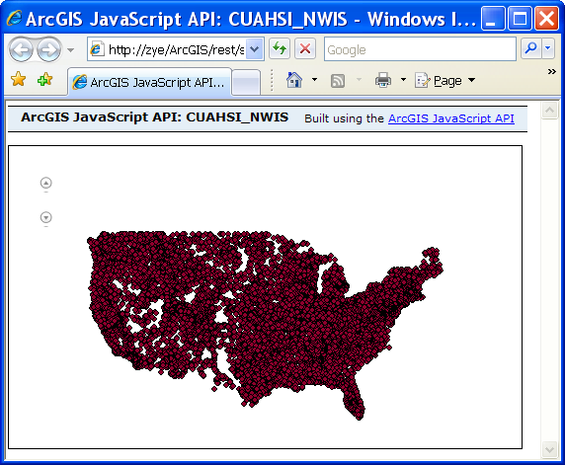
Data Discovery: ArcGIS Services
Functionality:
  Serving station geography and information
  Allows spatial and attribute query
  Execution of geoprocessing functions
Use standard SOAP and REST ArcGIS Server API
Notes:
For a given extent, returns SiteCode of the station points

Slide 10
Data Discovery: WaterOneFlow Services
Serving station information
  GetSites
Serving variable information
  GetVariableInfo
Serving time series data
  GetValues
Serving cross-reference information about space and variables
  GetSiteInfo
Notes:
GetSiteInfo
Given a site number, this method returns the site's metadata. Send the site code in this format: 'NetworkName:SiteCode'
GetSiteInfoObject
Given a site number, this method returns the site's metadata. Send the site code in this format: 'NetworkName:SiteCode'
GetSites
Given an array of site numbers, this method returns the site metadata for each one. Send the array of site codes in this format: 'NetworkName:SiteCode'. Sending an empty array will return all sites, up to a limit of 50,000.
GetSitesXml
Given an array of site numbers, this method returns the site metadata for each one. Send the array of site codes in this format: 'NetworkName:SiteCode'. Sending an empty array will return all sites, up to a limit of 50,000.
GetValues
Given a site number, a variable, a start date, and an end date, this method returns a time series. Pass in the sitecode and variable in this format: 'NetworkName:SiteCode' and 'NetworkName:Variable'. Sending a null BeginDate and EndDate will return all values for the given parameters. This may not work with all services.
GetValuesObject
Given a site number, a variable, a start date, and an end date, this method returns a time series. Pass in the sitecode and variable in this format: 'NetworkName:SiteCode' and 'NetworkName:Variable'. Sending a null BeginDate and EndDate will return all values for the given parameters. This may not work with all services.
GetVariableInfo
Given a variable code, this method returns the variable's name. Pass in the variable in this format: 'NetworkName:Variable'. Sending no variable, or an empty variable will return a list of all variables.
GetVariableInfoObject
Given a variable code, this method returns the variable's siteName. Pass in the variable in this format: 'NetworkName:Variable'. Sending no variable, or an empty variable will return a list of all variables.

Slide 11
Data Discovery: DataAccess Services
(to be rolled into WaterOneFlow services)
Serving cross-reference information about space and variables
  GetVariables
  GetVaraibleStats
Serving variable information (ontology)
  GetConcepts (to be implemented)
  GetVariableTree (to be implemented)

Slide 12
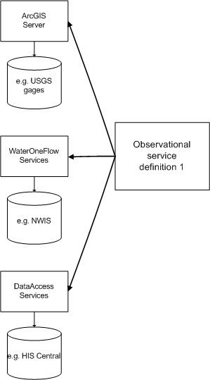
Observational Service: Configuration
A single observational service is uniquely defined by:
  Map service serving the location of the observational elements
  WaterOneFlow service serving the time series and variable data
  DataAccess service serving series catalog
  Auxiliary info (e.g. unique identifier of the location element)
There is not necessarily a one to one relationship between Map, WaterOneFlow, and DataAccess services
  e.g. one Map service can support several WaterOneFlow services
Notes:
Practical implementation – All agencies is abstractly represented via a observational data (OD) service definition node and each node would all provide 3 web services to allow the access to its Spatial, Time, Variable dimensions as well as the cross references between these 3 dimensions.

Slide 13
Service Discovery: Portal Services
HydroPortal (custom implementation of ESRI Geo Portal Toolkit)
  Allows registration of spatial, data access, and time series services using standard metadata catalog approach
    Observational services
    Themes (curated set of spatial and temporal data for defined set of variables)
  Serving information about registered observational services and “themes”
    Standard PTK SOAP and REST interface
Notes:
Now that we have the Observation Data Service Definition Node an abstract and homogeneous representation of the agencies, we need a common place to

Slide 14
Service Discovery: Portal Services
Many observational services and themes can be registered with a single Portal

Slide 15

Solution Implementation – HydroViewer
HydroViewer uses HydroPortal (one or many) to discover and consume observational services (Map, WaterOneFlow, DataAccess)
Portal M
Discover services
Portal 2
HydroViewer
Web App
Register at Portal M
Register at Portal
Register at Portal 2
Consume services
Service M
Service M
Service M
Service M
Service 2
Service 2
Service 2
Service 2
Map Service 1
Data Access Web Service 1
WaterOneFlow Web Service
Ontology
Web Service
Server N
Catalog N
SeriesN
Server 2
Server N
Server 2
Catalog 2
Series 2
ArcGIS
Server 1
Series
Catalog 1
Time Series 1
Ontology
Server 1

Slide 16
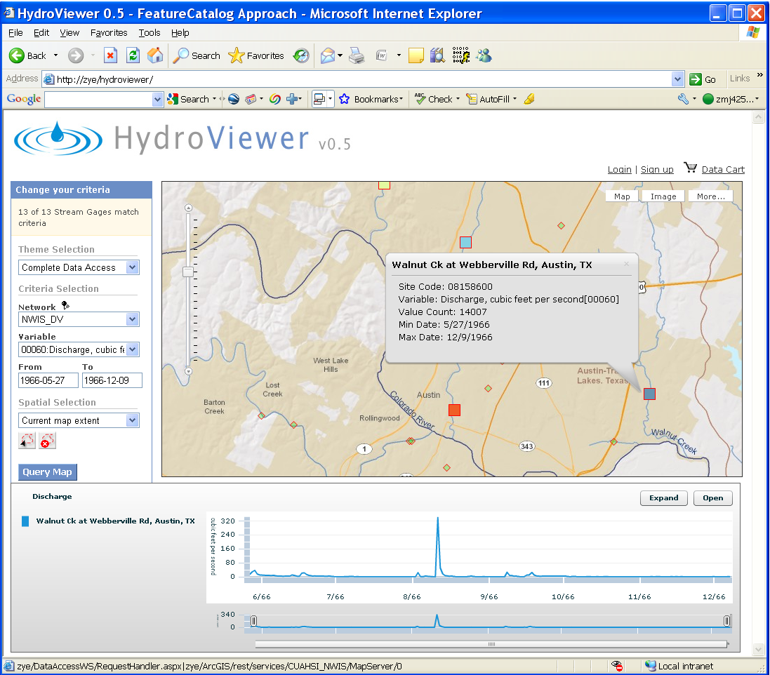
HydroViewer
EPA
NCDC
NASA
NWS
Observatory Data
USGS
ODSD
ODSD
ODSD
ODSD
ODSD
ODSD
HydroViewer is a common data window for accessing, viewing and downloading hydrologic information
Notes:
Key to success:
Defined a set of webservice functions
All the participated networks need to implement the webservice
Leave the implementations to each of the networks.
Create a MapBased web site to consume the webservices
GetSiteInfo
Given a site number, this method returns the site's metadata. Send the site code in this format: 'NetworkName:SiteCode'
GetSiteInfoObject
Given a site number, this method returns the site's metadata. Send the site code in this format: 'NetworkName:SiteCode'
GetSites
(50,000 site limit) Given an array of site numbers, this method returns the site metadata for each one. Send the array of site codes in this format: 'NetworkName:SiteCode'
GetSitesXml
(50,000 site limit) Given an array of site numbers, this method returns the site metadata for each one. Send the array of site codes in this format: 'NetworkName:SiteCode'
GetValues
Given a site number, a variable, a start date, and an end date, this method returns a time series. Pass in the sitecode and variable in this format: 'NetworkName:SiteCode' and 'NetworkName:Variable'
GetValuesObject
Given a site number, a variable, a start date, and an end date, this method returns a time series. Pass in the sitecode and variable in this format: 'NetworkName:SiteCode' and 'NetworkName:Variable'
GetVariableInfo
Given a variable code, this method returns the variable's name. Pass in the variable in this format: 'NetworkName:Variable'
GetVariableInfoObject
Given a variable code, this method returns the variable's siteName. Pass in the variable in this format: 'NetworkName:Variable'
NCDC: * National Climatic Data Center (NCDC) *
NASA - The National Aeronautics and Space Administration

Slide 17
Code Sample – Portal Call
var portalURL = "http://zichuanye:8181/GPT9/rest/find/document?f=georss&rid=";
function getPortalNet() {
sendRequest2Portal(portalURL, "callback_getPortalNet",true);
}
function callback_getPortalNet(oXML) {
****
for (var i = 0; i < iCnt; i++) {
item = items.item(i);
sNetworkLink = getItemProperty(item, 'link');
sendRequest2Portal(sNetworkLink, "callback_getNetworkLink" ,true);
}
}
function callback_getNetworkLink(oXML) {
*****
for (var i = 0; i < iCnt; i++) {
oNode = cPropertyNodes.item(i);
}
} //for (var i = 0; i < iCnt; i++)
oHisNetwork = new HISNetwork(*, *, sNetworkName, sDataServiceURL, sSiteCodeField, sMapServiceURL);
cHISNetworks.add(oHisNetwork);
}
Notes:
var portalURL = "http://zichuanye:8181/GPT9/rest/find/document?f=georss&rid=";
//get a list of HISNode registered with Portal
function getPortalNet() {
sendRequest2Portal(portalURL, "callback_getPortalNet",true);
}
//..Loop through each HISNode name registered with portal, make a call to get its content.
function callback_getPortalNet(oXML) {
var items = oXML.getElementsByTagName("item");
var item;
var txtRslt = document.getElementById("rslt");
var sMsg;
var sNetworkLink;
if (items != null) {
var iCnt = items.length;
for (var i = 0; i < iCnt; i++) {
item = items.item(i);
sNetworkLink = getItemProperty(item, 'link');
sendRequest2Portal(sNetworkLink, "callback_getNetworkLink" ,true);
}
}
}
//..parse each HISNode contents into HISNode object to be added to the list
function callback_getNetworkLink(oXML) {
var oDescNode = oXML.childNodes.item(0);
var cPropertyNodes = oDescNode.childNodes;
var iCnt = cPropertyNodes.length;
var sTagName;
var sName;
var sNetworkName;
//var sLayerName;
//var sWebServiceURL;
var sDataServiceURL;
var sSiteCodeField;
var sMapServiceURL;
var oHisNetwork;
var ddlNetworks = document.getElementById('ddlNetwork');
for (var i = 0; i < iCnt; i++) {
oNode = cPropertyNodes.item(i);
switch (oNode.tagName) {
case (xND_Name):
sName = oNode.text;
break;
case (xND_TagName):
sTagName = oNode.text;
break;
case (xND_NetworkName):
sNetworkName = oNode.text;
break;
case (xND_DataServiceURL):
sDataServiceURL = oNode.text;
break;
case (xND_SiteCodeField):
sSiteCodeField = oNode.text;
break;
case (xND_MapServiceURL):
sMapServiceURL = oNode.text;
break;
}
} //for (var i = 0; i < iCnt; i++)
if (!cHISNetworks.networkExistByName(sName)) {
oHisNetwork = new HISNetwork(sTagName, sName, sNetworkName, sDataServiceURL, sSiteCodeField, sMapServiceURL);
cHISNetworks.add(oHisNetwork);
var option = new Option(sName, sMapServiceURL);
ddlNetworks.options.add(option);
}
}
function sendRequest2Portal(sURL, callBackFunction,bASync) {
var ds = new Date().getTime();
var xmlHttp = getXmlHttpObject();
showLoading(true);
xmlHttp.onreadystatechange = function() {
if (xmlHttp.readyState == 4) {
if (xmlHttp.status == 200) {
showLoading(false);
var sResp = xmlHttp.responseXML;
var xmlDoc = xmlHttp.responseXML.documentElement;
if (xmlDoc == null) { // || xmlDoc.nodeValue==null) {
alert("Invalid XML response\n" + xmlHttp.responseText);
} else {
eval(callBackFunction + "(xmlDoc)");
}
}else {
alert("request failed.");
showLoading(false);
}
if (bShowTime) {
setStatus(callBackFunction + " " + getTimeDS(ds));
}
}
}
xmlHttp.open("GET", "fastproxy.aspx?" + escape(sURL), bASync);
xmlHttp.send(null);
}

Slide 18
Code Sample – Map Call
Adding a map layer:
pMapLayer = new esri.layers.ArcGISDynamicMapServiceLayer(MapServiceURL);
map.addLayer(pMapLayer);
pMapLayer.show();
Construct a query:
function designFlood(id, v) {
pQueryFloodTask = new esri.tasks.QueryTask(FloodMapService);
pQueryFlood = new esri.tasks.Query();
pQueryFlood.returnGeometry = true;
pQueryFlood.outFields = ["OBJECTID","EventFrequency","EventDischarge"];
pQueryFlood.geometry = map.extent;
pQueryFlood.where = "EventFrequency>"+100+"And SiteCode="+floodid;
pQueryFloodTask.execute(queryFlood,showResults);
}
function showResults(featureSet) {
var resultFeatures = featureSet.features;
if (resultFeatures.length>=1){
for (var i=0, il=resultFeatures.length; i<il; i++){
var graphic = new esri.Graphic(resultFeatures[i].geometry);
map.graphics.add(graphic);
}
******
}
Notes:
function designFlood(id, v){
floodid = id;
floodEvtFrequency = v;
queryFloodTask = new esri.tasks.QueryTask(FloodMapService);
queryFlood = new esri.tasks.Query();
queryFlood.returnGeometry = true;
queryFlood.outFields = ["OBJECTID","EventFrequency","EventDischarge"];
queryFlood.geometry = map.extent;
queryFlood.where = "EventFrequency>"+100+"And SiteCode="+floodid;
queryFloodTask.execute(queryFlood,showResults);
isFloodLayerActive = true;
}
function showResults(featureSet) {
//remove all graphics on the maps graphics layer
//map.graphics.clear();
map.infoWindow.hide();
//Performance enhancer - assign featureSet array to a single variable.
var resultFeatures = featureSet.features;
if (resultFeatures.length>=1){
for (var i=0, il=resultFeatures.length; i<il; i++)
{
//Get the current feature from the featureSet.
//Feature is a graphic
var graphic = new esri.Graphic(resultFeatures[i].geometry);
//var graphic = resultFeatures[i];
graphic.setSymbol(floodSymbol);
//Set the infoTemplate.
graphic.setInfoTemplate(infoTemplateFlood);
graphic.setAttributes(resultFeatures[0].attributes);
//Add graphic to the map graphics layer.
map.graphics.add(graphic);
}
}
else
{
alert("No Flood data for this Station ");
}
}

Slide 19
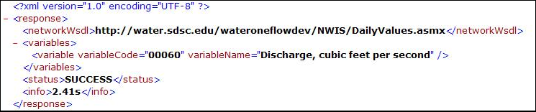
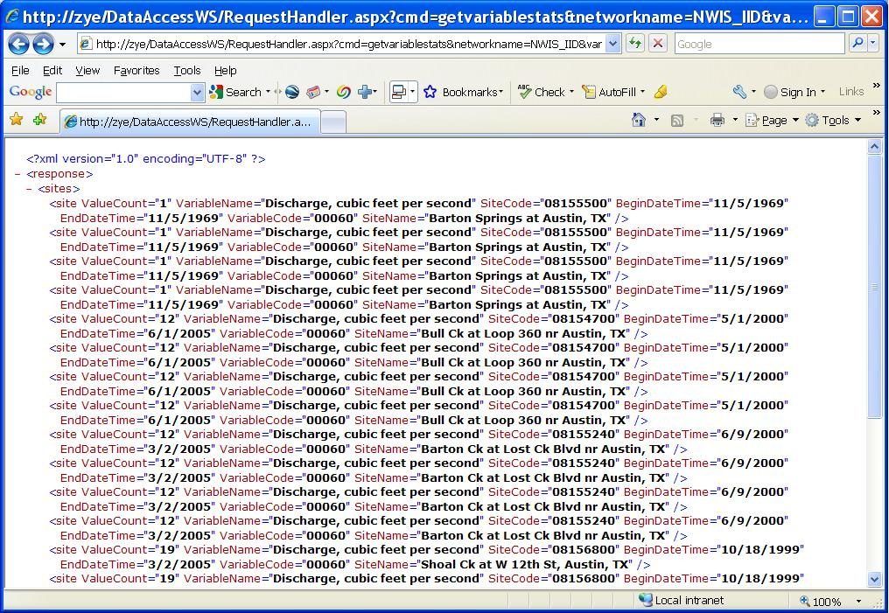
Code Sample – DataAccess Call
GetVariables
http://zye/DataAccessWS/RequestHandler.aspx?cmd=getvariables&networkname=NWIS_DV&sitecodes='08156800','08155240','08154700','08158600','08158600','08158600','08155500'
GetVariableStats
http://zye/DataAccessWS/RequestHandler.aspx?cmd=getvariablestats&networkname=NWIS_DV&variablecode=00060&sitecodes='08156800','08155240','08154700','08158600','08158600','08158600','08155500'

Slide 20
Code Sample – WaterOneFlow Call
Reference the Web Service at design time and pointing the URL to a WaterOneFlow Web Service at run time.
Public Function GetValues(ByVal sName As String, ByVal NetworkName As String, ByVal SiteCode As String, ByVal VariableCode As String, ByVal StartDate As String, ByVal EndDate As String, ByVal strToken As String) As String
Dim ds As Long
Dim oHisNetwork As HISNetwork
Dim pServer As edu.sdsc.water.WaterOneFlow
Dim TSValues As String
Dim sWSDL As String = ""
ds = DateTime.Now.Ticks
pServer = New edu.sdsc.water.WaterOneFlow
Try
oHisNetwork = ApConfigWeb.HisNetworks.GetNetworkByName(sName)
If oHisNetwork Is Nothing Then
oHisNetwork = ApConfigWeb.HisNetworks.GetNetworkByTagName(sName)
End If
pServer.Url = oHisNetwork.WebServiceURL
TSValues = pServer.GetValues(NetworkName & ":" & SiteCode, NetworkName & ":" & VariableCode, StartDate, EndDate, "")
Catch ex As Exception
TSValues = ex.ToString
End Try
Return TSValues
End Function

Slide 21
Instead of Conclusion: Services Needed for General Consumption (Web/Desktop)
Portal services – PTK
Map services – ArcGIS Server / OGC
GetSites – W1F
GetVariableInfo – W1F
GetValues – W1F
GetSiteInfo – W1F
GetVariables – DA
GetVaraibleStats – DA
GetConcepts (to be implemented)
GetVariableTree (to be implemented)

Slide 22
Questions/Suggestions/Solutions?

