Slide 1
Geospatial Information Interoperability in the Canadian Groundwater Information Network
Boyan Brodaric
Eric Boisvert
Geological Survey of Canada

Slide 2
Context
Section 7.3: Improved Access to Groundwater Data and Information
Web access to GW data
National framework for connecting GW databases
Analysis and modeling tools for decision-making
Education, outreach and aid to regional agencies

Slide 3
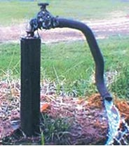
GW data in Canada
Distributed, Uncoordinated
Federal depts, Provincial depts,
Municipalities, Watershed authorities
Heterogeneous
Data content, structure, systems (sensors, dbs)
Moderate volume
few aquifers (~30 key)
moderate number of water-well records (~1Ms)
much time-indexed data for readings
Variable quality
Completeness, consistency, location

Slide 4
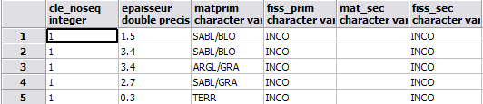
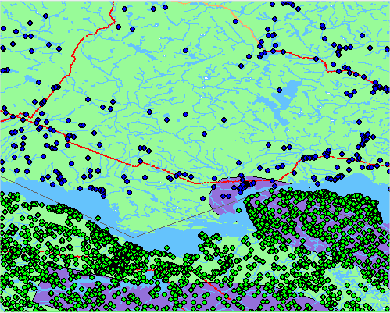
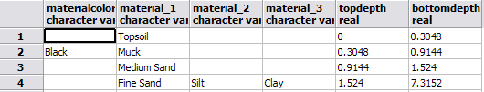
GW data in Canada
Ontario & Quebec
heterogeneity in water-well data
Quebec lithology
Ontario lithology

Slide 5
Approach
Groundwater Information Network
Collaboration of NRCan and 6 provinces (BC, AB, MB, ON, QC, NS)
Seamless access to GW information
Start with linked water well databases
Principles
Distributed: data stays with owners
Seamless: acts as one virtual database
Multi-access: multiple portals, tools
Standards-based: use nat’l & int’l standards
e.g. Groundwater ML (GWML)

Slide 6
Approach: interoperability
Overcome levels of heterogeneity
pragmatic
  GW Practices (data usage)
semantic
  GW Ontology (data content)
schema
  GWML (data structure)
  Hydrogeology
  OpenGIS
syntax
  GML (data language)
system
  WFS, WMS,… (data systems)

Slide 7


Approach
Groundwater Information Network
Applications
GIN Panorama:
3D, analysis
GIN PX:
2D, download
GML GWML
WMS, WFS, (SOS)
Data Pipeline
Mediator
Standard web services
Standard themes, layers, lithology
GML
WMS, WFS, (SOS)
GWML
GML-BC
GML-AB
GML-MB
GML-ON
GML-QC
GML-NS
Data
NRCan
BC
AB
MB
ON
QC
NS

Slide 8
Mediator architectures
translate query (global→local)
translate results (local→global)
distribute query
integrate results
distribute results
Wrapper
global
local
sand
clay
soil
ON
“find all water wells with unconsolidated materials”
Mediator
global
Wrapper
global
local
<RockMaterial>
<geneticCategory>
<CGI_TermValue>
<value…>Sedimentary</value>
</CGI_TermValue>
</geneticCategory>
<lithology>
…
<name…>Sand</name>
</lithology>
SABL
ARGL
TERR
QC

Slide 9
GIN Mediator architecture
receive & translate query
distribute query
receive results
translate & integrate results
distribute results
WFS/WMS
local
sand
clay
soil
ON
“find all water wells with unconsolidated material”
WFS/WMS
Mediator
global
local
WFS/WMS
local
<RockMaterial>
<geneticCategory>
<CGI_TermValue>
<value…>Sedimentary</value>
</CGI_TermValue>
</geneticCategory>
<lithology>
…
<name…>Sand</name>
</lithology>
SABL
ARGL
TERR
QC

Slide 10
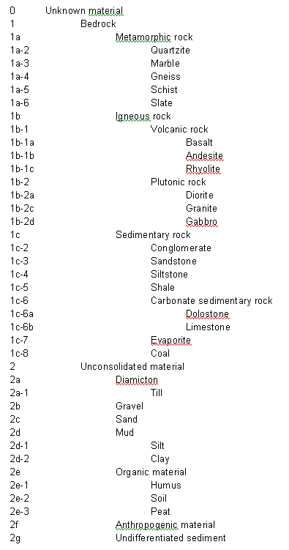
GIN translation of results
 |  | Lithology
syntactic
GWML
<lithology>
…
<name…>Sand</name>
</lithoogy>
ON Sand
QC Sand
schematic
semantic
GIN simple lithology ontology

Slide 11
Semantics
GIN lithology ontology (subset of GeoSciML)
language-neutral concepts (URN), multi-lingual terms, defs
- concept = urn:x-ngwd:vocabulary:gin:2c
- terms = “sand” (English), “sable” (French)
- definition =
enables: multi-lingual query and data download

Slide 12
Semantic mapping
Semantic mapping
LAV: local terms mapped to global concepts
mapping specification: XML file (moving to OWL)
conflates equivalent and subclass mapping, ignores disjoint and overlap
ON ‘sand’ mapping
<map:rule global="urn:x-ngwd:vocabulary:gin:2c" local="Sand" />
<map:rule global="urn:x-ngwd:vocabulary:gin:2c" local="sand" />
<map:rule global="urn:x-ngwd:vocabulary:gin:2c" local="sadn" />
<map:rule global="urn:x-ngwd:vocabulary:gin:2c" local="sad" />
<map:rule global="urn:x-ngwd:vocabulary:gin:2c" local="Fine Sand" />
<map:rule global="urn:x-ngwd:vocabulary:gin:2c" local="medium fine sand" />
<map:rule global="urn:x-ngwd:vocabulary:gin:2c" local="Medium Sand" />
<map:rule global="urn:x-ngwd:vocabulary:gin:2c" local="Coarse Sand" />
<map:rule global="urn:x-ngwd:vocabulary:gin:2c" local="Sandy" />
<map:rule global="urn:x-ngwd:vocabulary:gin:2c" local="Ssandy" />
<map:rule global="urn:x-ngwd:vocabulary:gin:2c" local="sand silt" />
<map:rule global="urn:x-ngwd:vocabulary:gin:2c" local="Quicksand" />

Slide 13
Schema mapping
Schema mapping
LAV: local schema mapped to global schema
mapping specification: modified GWML data file
<gsml:lithology>
<gsml:ControlledConcept> <gsml:identifier>ont:geostratumlog/ont:GeologyStratum/ont:material_1</gsml:identifier> <gsml:identifier>ont:geostratumlog/ont:GeologyStratum/ont:material_2</gsml:identifier>
<gsml:identifier>ont:geostratumlog/ont:GeologyStratum/ont:material_3</gsml:identifier>
</gsml:ControlledConcept>
</gsml:lithology>

Slide 14
GWML example
standard structure
standard content
<gsml:lithology>
  <gsml:ControlledConcept gml:id="gin.cc.2d-2">
  <gsml:identifier codeSpace="urn:ietf:rfc:2141">urn:x-ngwd:vocabulary:gin:2d-2"</gsml:identifier>
  <gsml:name codeSpace="urn:x-ngwd:classifierScheme:GIN:Lithology:2008" xml:lang="fr">Argile</gsml:name>
  <gsml:name codeSpace="urn:x-ngwd:classifierScheme:GIN:Lithology:2008" xml:lang="eng">Clay</gsml:name>
  <gml:description>A naturally occurring material composed primarily of fine-grained minerals.
  It is generally plastic at appropriate water contents and will harden when
  dried of fired (Neuendorf et al. 2005)</gml:description>
  </gsml:lithology>
  <gsml:material>
  <gsml:UnconsolidatedMaterial>
  <gsml:consolidationDegree>
  <gsml:CGI_TermValue>
  <gsml:value codeSpace="urn:cgi:classifierScheme:BGS:consolidationTerms">UNCONSOLIDATED</gsml:value>
  </gsml:CGI_TermValue>
  </gsml:consolidationDegree>
  <gsml:physicalProperty>
  <gwml:HydrogeologicDescription>
  <gwml:hydraulicConductivity>
  <gsml:CGI_NumericValue>
  <gsml:qualifier>approximate</gsml:qualifier>
  <gsml:principalValue uom="y_K_md-1">0.001</gsml:principalValue>
  </gsml:CGI_NumericValue>
  </gwml:hydraulicConductivity>
  </gwml:HydrogeologicDescription>
  </gsml:physicalProperty>
  </gsml:UnconsolidatedMaterial>
  </gsml:material>

Slide 15
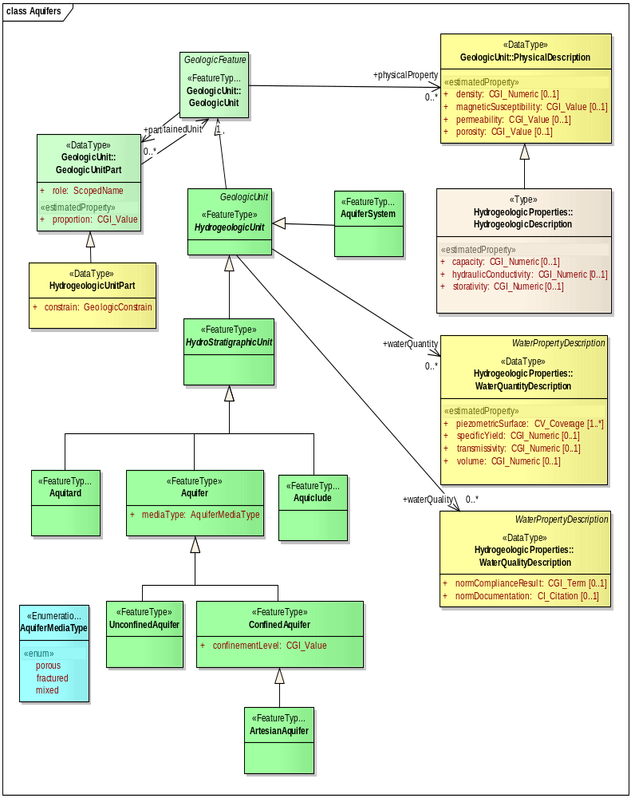
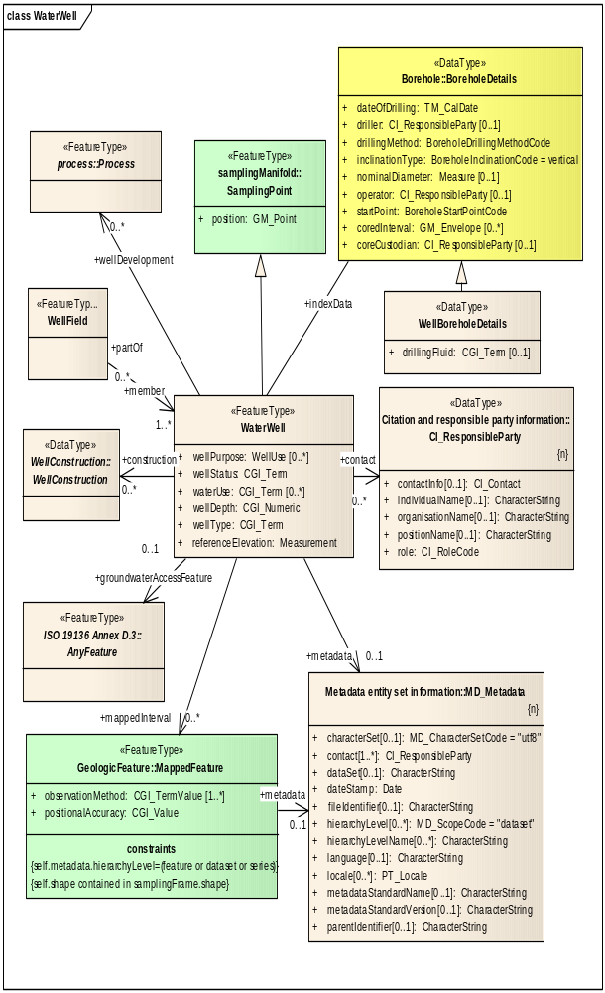
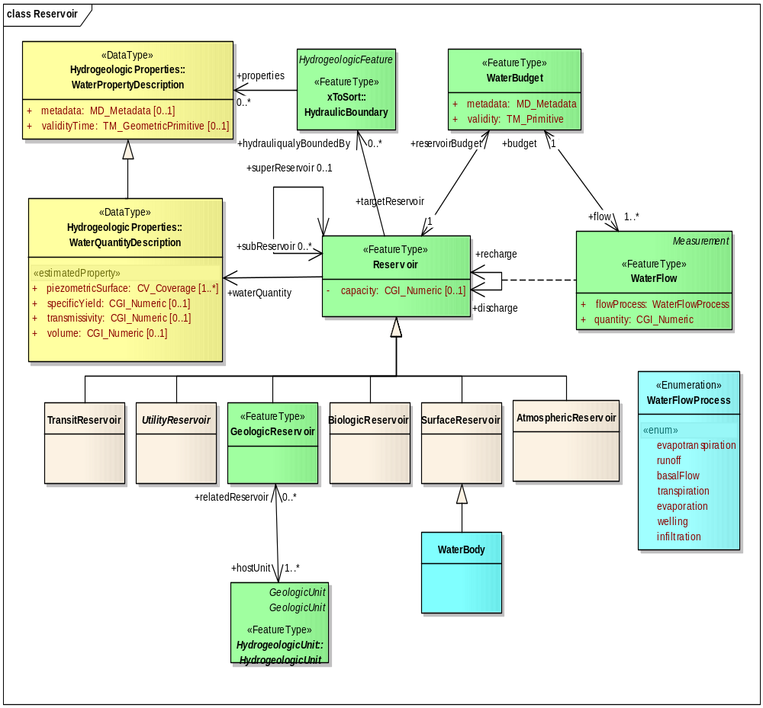
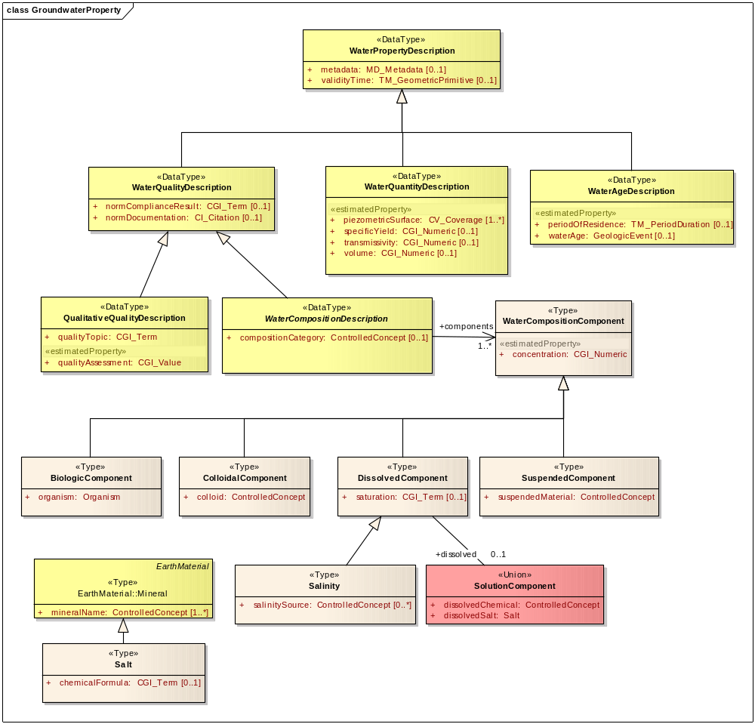
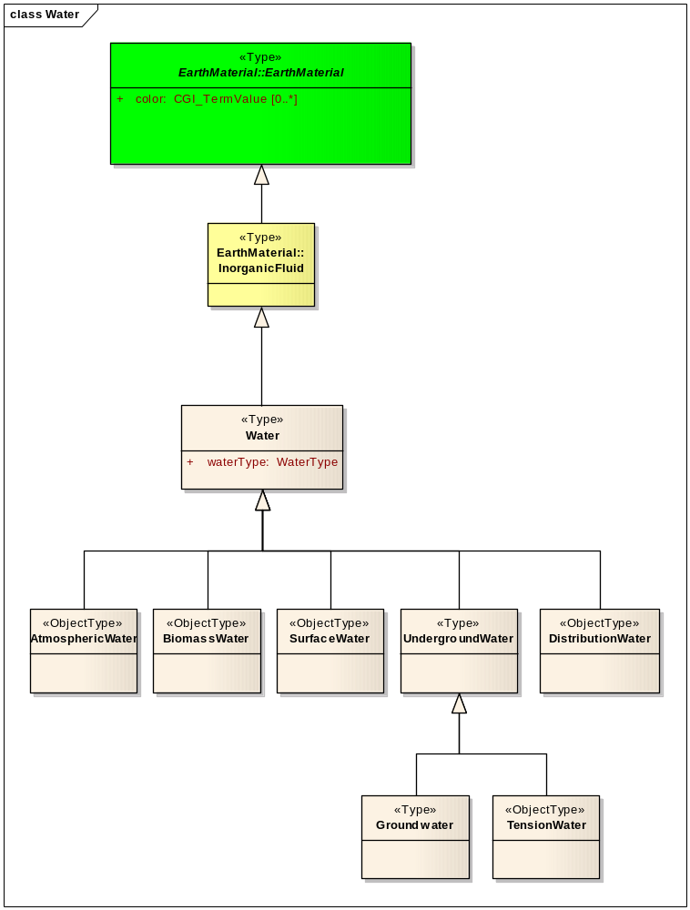
GWML scope
water properties
water budget , reservoirs
aquifers
wells
water
observations

Slide 16
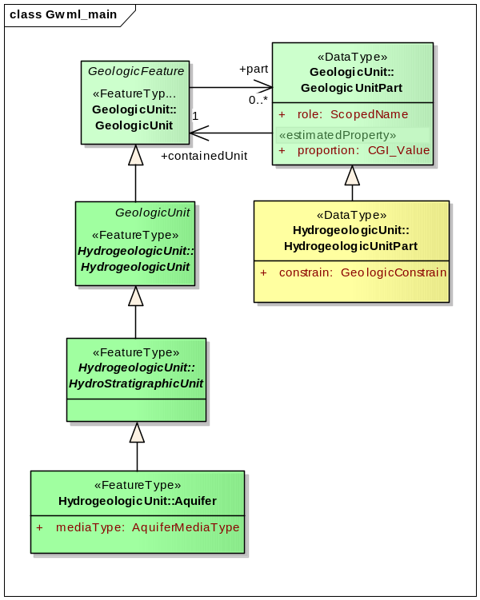
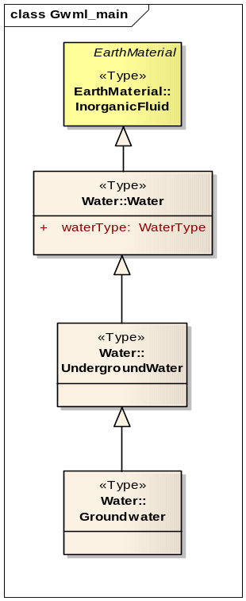
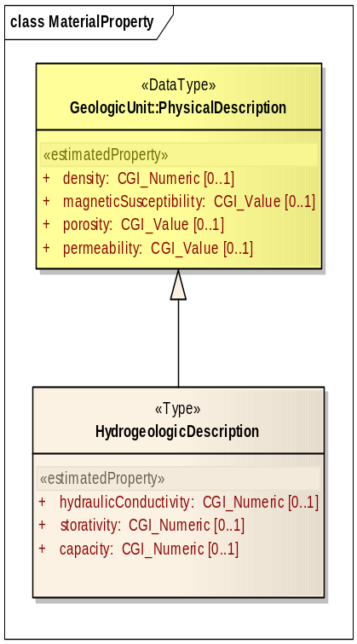
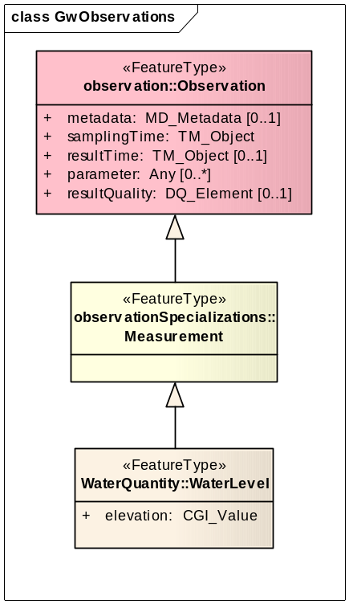
GWML lineage
parts of GWML extend GeoSciML, O&M
GeologicUnit
EarthMaterial
PhysicalDescription
Observation

Slide 17
GIN Example
Performance (4 provs)
50 wells = 3 secs
500 wells = 16 secs
5000 wells = 134 secs (2:14 min)

Slide 18
GIN Main Site: www.gw-info.net

Slide 19
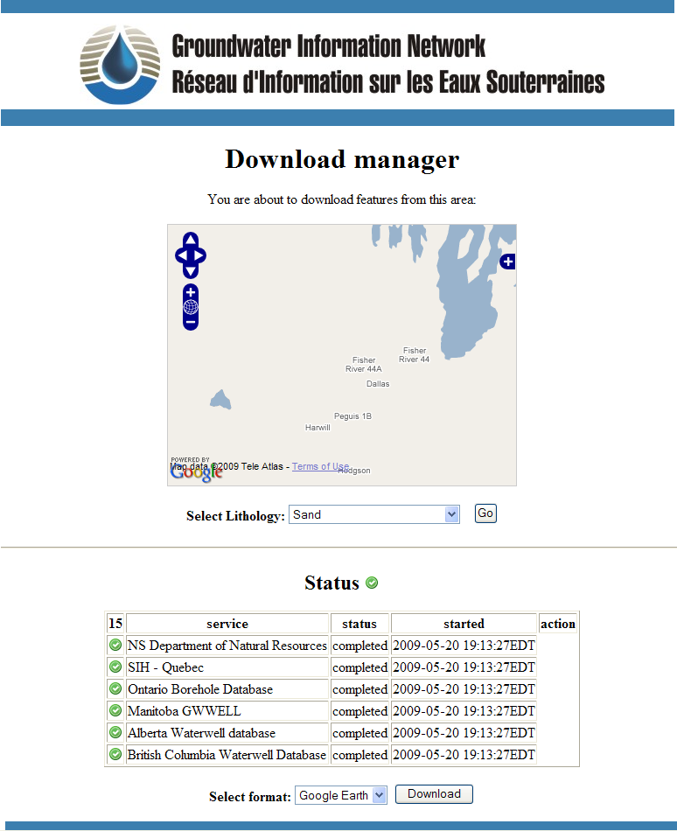
GIN PX Portal
<gsml:lithology>
  <gsml:ControlledConcept gml:id="gin.cc.2d-2">
  <gsml:identifier codeSpace="urn:ietf:rfc:2141">urn:x-ngwd:vocabulary:gin:2d-2"</gsml:identifier>
  <gsml:name codeSpace="urn:x-ngwd:classifierScheme:GIN:Lithology:2008" xml:lang="fr">Argile</gsml:name>
  <gsml:name codeSpace="urn:x-ngwd:classifierScheme:GIN:Lithology:2008" xml:lang="eng">Clay</gsml:name>
  <gml:description>A naturally occurring material composed primarily of fine-grained minerals.
  It is generally plastic at appropriate water contents and will harden when
  dried of fired (Neuendorf et al. 2005)</gml:description>
  </gsml:lithology>
  <gsml:material>
  <gsml:UnconsolidatedMaterial>
  <gsml:consolidationDegree>
  <gsml:CGI_TermValue>
  <gsml:value codeSpace="urn:cgi:classifierScheme:BGS:consolidationTerms">UNCONSOLIDATED</gsml:value>
  </gsml:CGI_TermValue>
  </gsml:consolidationDegree>
  <gsml:physicalProperty>
  <gwml:HydrogeologicDescription>
  <gwml:hydraulicConductivity>
  <gsml:CGI_NumericValue>
  <gsml:qualifier>approximate</gsml:qualifier>
  <gsml:principalValue uom="y_K_md-1">0.001</gsml:principalValue>
  </gsml:CGI_NumericValue>
  </gwml:hydraulicConductivity>
  </gwml:HydrogeologicDescription>
  </gsml:physicalProperty>
  </gsml:UnconsolidatedMaterial>
  </gsml:material>
GWML
Google Earth
Excel

Slide 20
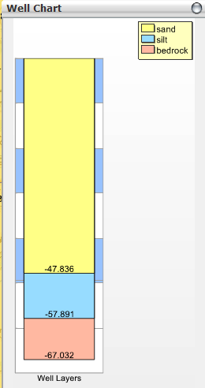
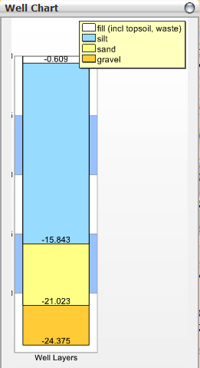
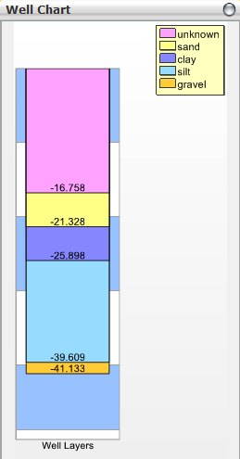
GIN Panorama portal

Slide 21
Next Steps
More geographic coverage
other Canadian partners
Higher quality data
time-indexed data: water levels, flow rates, quality
More types of data
aquifers, geology, 3D,…
More tools
3D Modeling,…

Slide 22
Conclusions
Hydrogeologic data interoperability achieved
for water well information
Dynamic mediation effective and efficient
modest data volumes are realistic within wait-times
GIN is live since March 2009

Slide 23
URLs
Groundwater Information Network (GIN)
www.gw-info.net
Groundwater Markup Language (GWML)
http://ngwd-bdnes.cits.rncan.gc.ca/gwml
Thank you!

Slide 25
Mediator implementation
Open source
Cocoon, Java, SAX, XML, XSLT
Re-usable
Customizable: plug and play data sources and mappings
Efficient
Multi-threaded, parallel, cached data stream
Tested
GIN, GeoSciML Testbed, OneGeology
Freely available

Slide 26
GIN demo
demo

