Slide 1
WaterML2.0 part 2
RESTful API and JSON encoding
95th OGC Technical Committee
Boulder, Colorado USA
Peter Taylor
3rd June 2015
Copyright © 2015 Open Geospatial Consortium

Slide 2
Background
WaterML2.0 part 2 supports exchange of:
  Rating/conversion tables
  Gauging observations
  Section observations
The RFC package contains:
  UML model
  XML encoding following standard GML encoding rules
Copyright © 2015 Open Geospatial Consortium

Slide 3
Interoperability Experiment
Ran in 2013-14
Developed RESTful services and JSON encodings of the part 2 information model
This allowed (more) rapid development and testing
  We ended up with 5 different service implementations
What were the implementation options?
Copyright © 2015 Open Geospatial Consortium

Slide 4
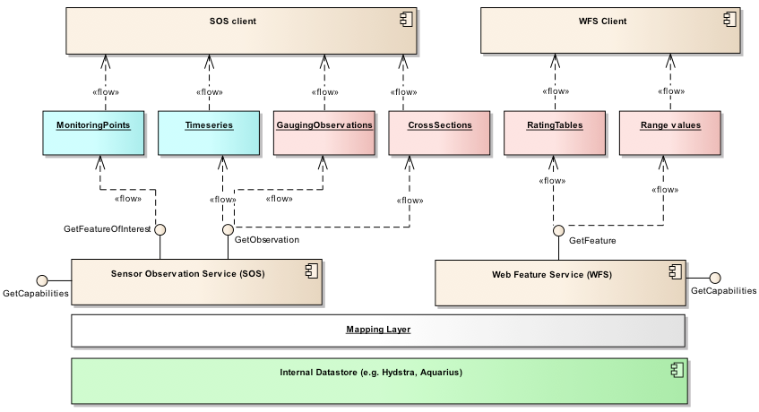
OGC services approach

Slide 5
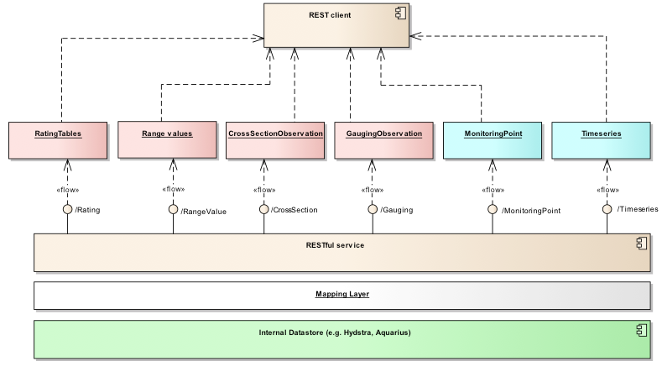
RESTful service approach

Slide 6
Best practice
A best practice document has been submitted that outlines the RESTful API and JSON encoding
  https://portal.opengeospatial.org/files/?artifact_id=63302&version=1
Separate conformance classes for each
Captures a useful implementation
  Would be lost as not part of the main standard
Copyright © 2015 Open Geospatial Consortium

Slide 7
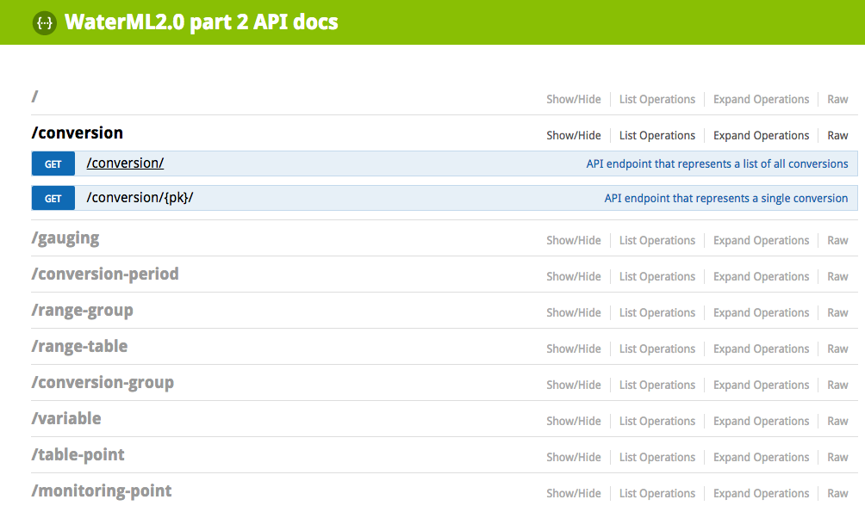
The RESTful service
Copyright © 2015 Open Geospatial Consortium

Slide 8
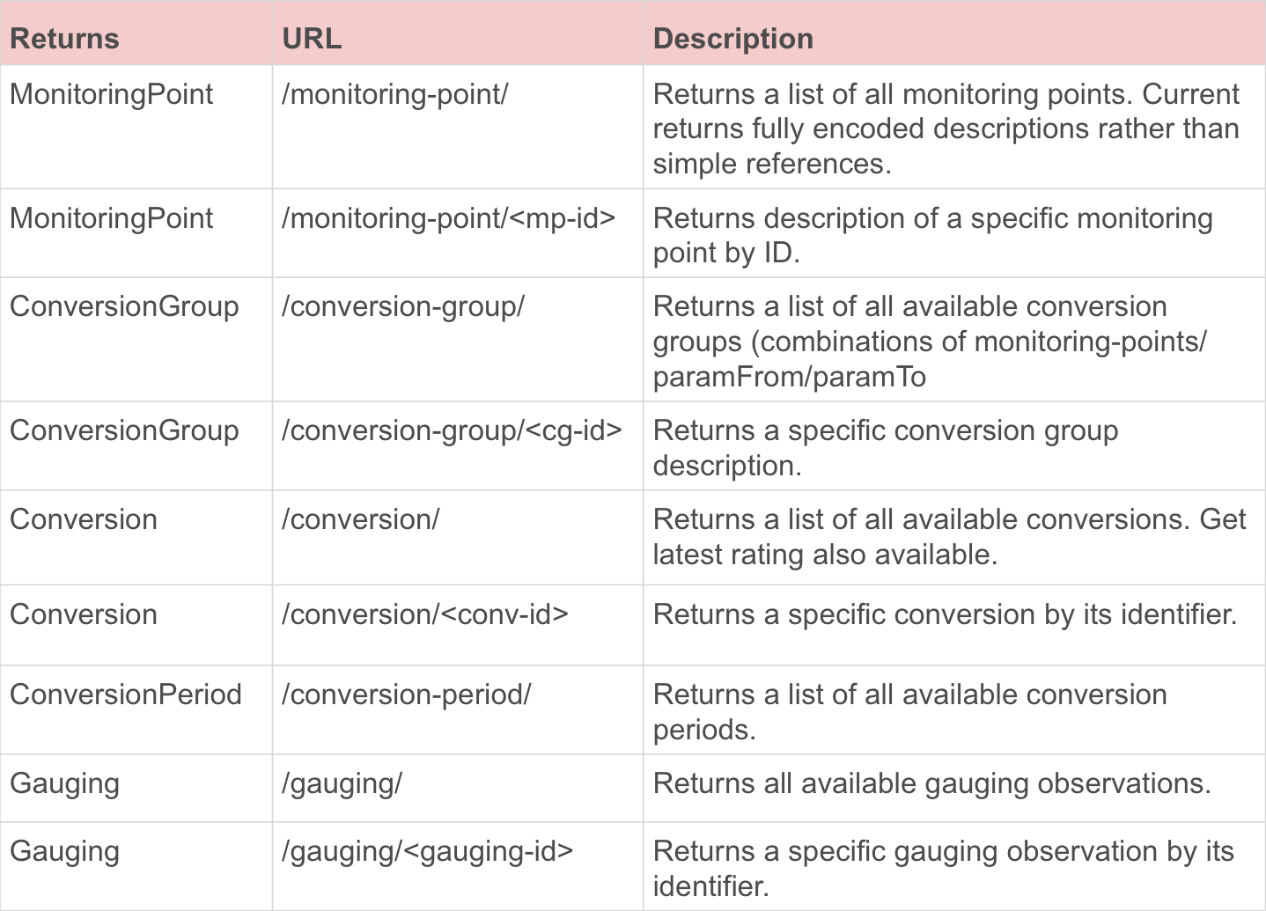
API
Base RESTful API calls

Slide 9
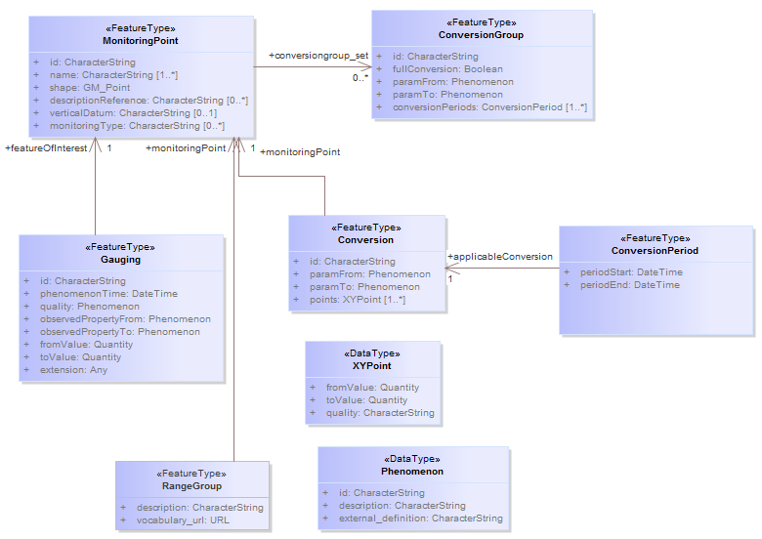
Information model
Copyright © 2015 Open Geospatial Consortium

Slide 10
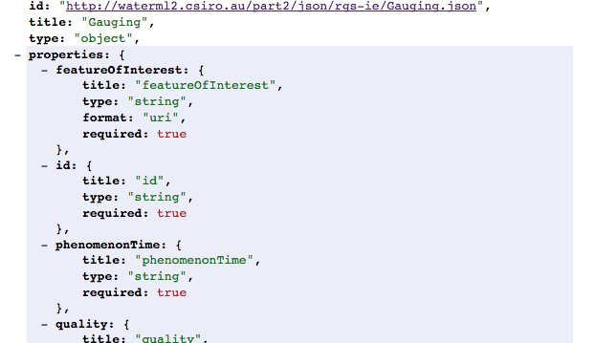
JSON Schema
Copyright © 2015 Open Geospatial Consortium

Slide 11
Services & tools
Service API documentation URL: http://waterml2.csiro.au/rgs-api/v1/docs/
API landing/root page: http://waterml2.csiro.au/rgs-api/v1/
Validation client: http://waterml2.csiro.au/validator
Visualisation client: http://waterml2.csiro.au/rgs-api/v1/viz/
Copyright © 2015 Open Geospatial Consortium

Slide 12
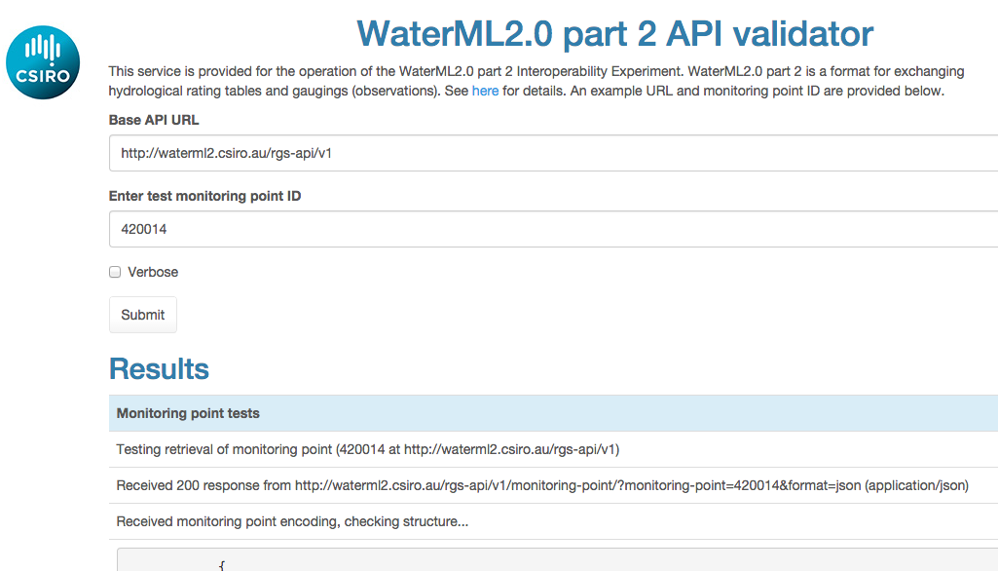
Service validator
Copyright © 2015 Open Geospatial Consortium

Slide 13
Open questions/issues
Harmonise approaches (ala OWS common) to:
  JSON headers, paging, service capabilities
  Encoding links in JSON
  Units of measure encoding (units, hrefs etc)
  Quality code encodings
  GeoJSON encoding/usage
RESTful query parameterization
More testing of ‘range values’ concepts
Use of JSON Schema
Harmonisation with the part 2 RFC information model
Copyright © 2015 Open Geospatial Consortium

Slide 14
Motivation
The services captured the core parts of the part 2 information model
Valuable resource for use as is, or as a basis for future work
Copyright © 2015 Open Geospatial Consortium

Slide 15
E-vote for best practice document
The Hydro DWG recommends that the OGC Technical Committee approve an electronic vote to approve release of 15-033 “WaterML2.0 part 2 – RESTful API and JSON encoding” as an OGC Best Practice
  Pending and final edits and review by OGC staff
  No discussion
  Motion: David Maidment
  Second: David Blodgett
  There was no objection to unanimous consent
Copyright © 2015 Open Geospatial Consortium

