Slide 1
U.S. Open Water Data Initiative
Status and update of activities.
Copyright © 2015 Open Geospatial Consortium

Slide 2
Outline
Water Theme of data.gov and Climate Resilience Toolkit
Subcommittee on Spatial Water Data
OWS-11 Hydrology Progress
USGS Implementation Update
Sensor Metadata Best Practices Call to Arms
Copyright © 2015 Open Geospatial Consortium

Slide 3
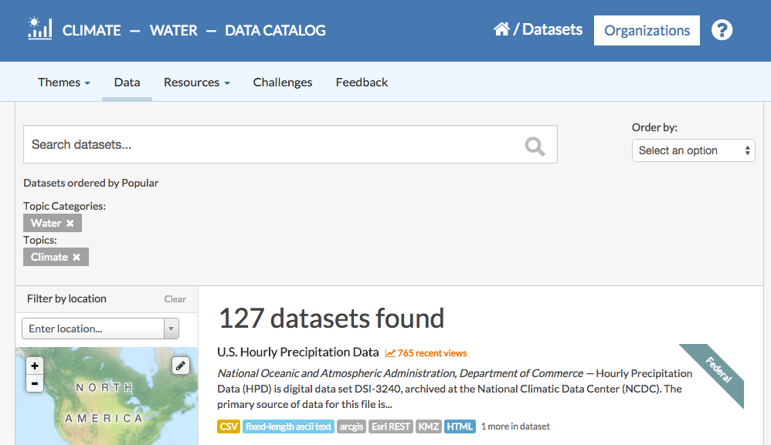
Central Water Data Catalog
Copyright © 2015 Open Geospatial Consortium

Slide 4
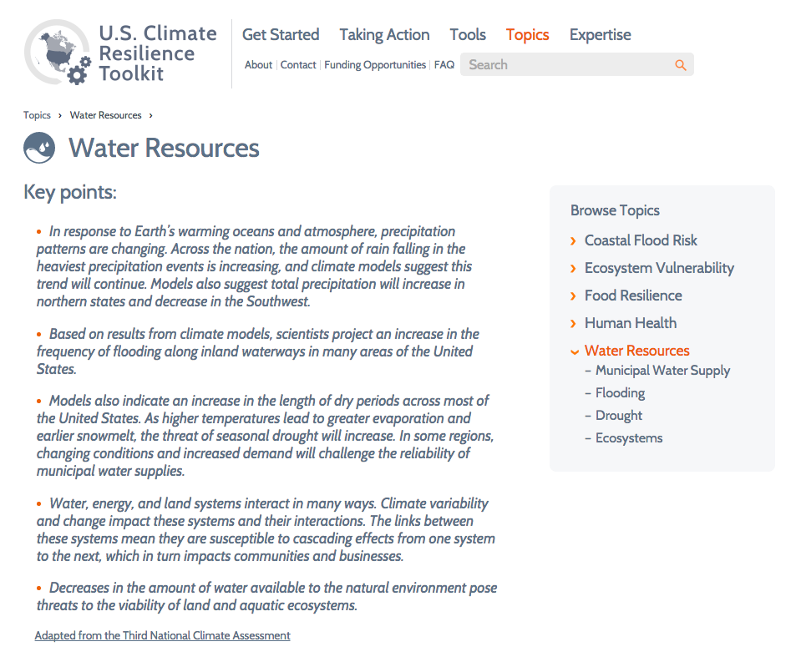
Copyright © 2015 Open Geospatial Consortium

Slide 5





Climate Data and Tools Initiative
Climate Data Initiative
--
Datasets
Tools
Maps
Climate Resilience Toolkit
--
References
Success Stories
Decision Support
Case Studies
climate.data.gov toolkit.climate.gov

Slide 6
Subcommittee on Spatial Water Data
Flooding Interoperability Experiment
Long Term Drought
Toxic Spill Response
Water Use Information
NHDPlus Dataset
Analysis of Existing Infrastructure
Copyright © 2015 Open Geospatial Consortium

Slide 7
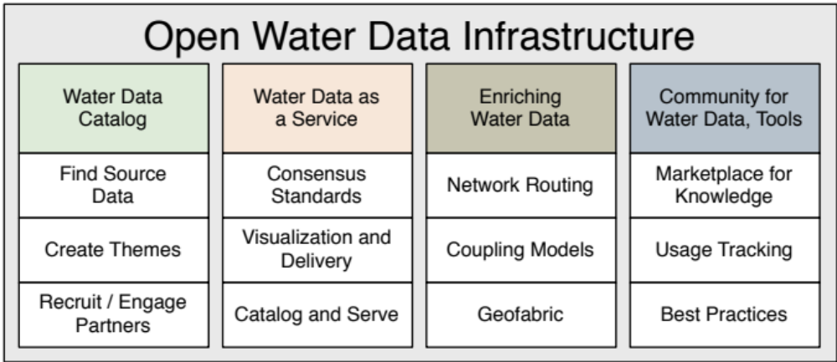
Copyright © 2015 Open Geospatial Consortium

Slide 8
OWDI / SSWD Ideals
Information owner is responsible for and maintains control of data.
Data is available in common formats requiring no license for access.
Machine interfaces are generalized according to standards where possible.
Data uses machine interpretable documentation. Example.

Slide 9
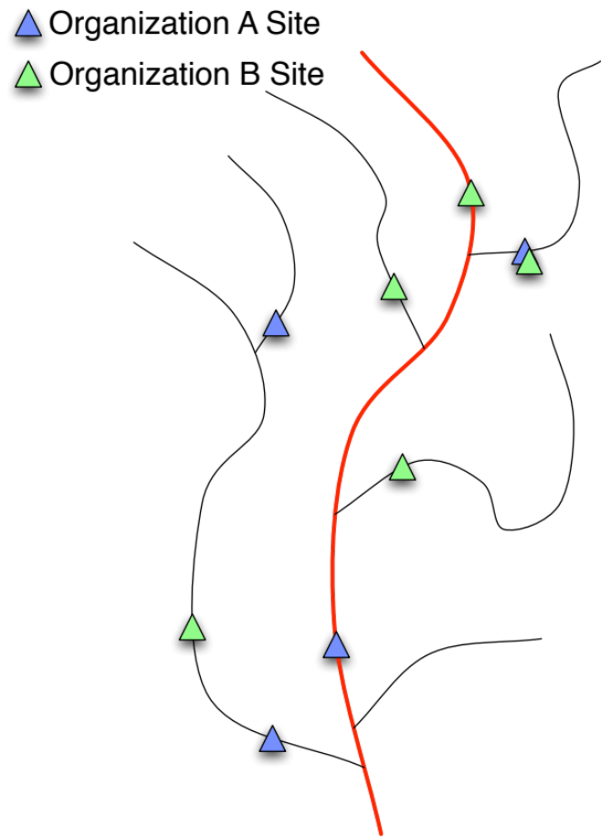
OWS11 Hydrology Linked Data
Why Publish Semantic Data? (In this hydrologic data case… )
Internal Semantic Structure
Data is a ‘reference network’
Data is linked to a network
Yeah, I know there are other reasons…
See Demonstration tomorrow!
Notes:
Why publish our data using a semantic approach.
1) Because the data has significant internal semantic structure (topology or other relationships) (OGC asked NOT to look at this and Dalia will talk about later)
2) Because the data is a 'reference network' that others may link in to. (OGC project looking at this in concept)
3) Because the data is on a ‘reference network’ and needs to be contextualized within that network. (The linked feature clearinghouse concept)
Strictly, another categorization of reasons would be:
1) Spatial relationships
2) Logical relationships
3) Computation/network relationships

Slide 10
USGS Hydrology Profile Update
Implementation starting to be planned.
Have to overload observedProperty to be the NWIS parameter code + extension.
Copyright © 2015 Open Geospatial Consortium

Slide 11
Sensor Metadata Best Practice
Need a consistent mechanism to describe the quality of data being generated by a sensor.
  the documented accuracy and precision of the sensors,
  the date on which the sensor was last calibrated,
  a mechanism to identify corresponding calibration samples,
  information on the brand and type of sensor, and
  references to the deployment and calibration methods.
  This metadata should be associated with a given ‘collection’ of data (i.e. a data set from a sensor from date/time ‘A’ to date/time ‘B’ that would correspond with the calibration date).
  Propose to start an IE(?) to evaluate existing standards and best practices to determine if a new best practice or spec is needed.
Copyright © 2015 Open Geospatial Consortium

