Slide 1

The French Water Information System
OGC – TC – Hydrology DWG – Darmstadt 09-29-2009
  Sylvain Grellet
International Office for Water - Sandre

Slide 2

Table of content
The French water information system,
Sandre’s activities,
Water observation related models,
Water data exchange,
Coming soon.

Slide 3


The French Water Information System
Many partners & data producers:
  French Ministry of Environment,
  6 French Water Agencies, Water Offices, State administration at regional level for the protection of the environment,
  BRGM, IFREMER, International Office For Water,
  …
One standardization structure :
  The Sandre (Service d’Administration Nationale des Données et des Référentiels sur l’Eau - French National Service for Water Data and Common Repositories Management).

Slide 4
The French Water Information System
Scope
  Data
    Surface Physical Waters, GroundWater,
    WFD WaterBodies,
    Management/Restriction Zones,
    Monitoring Stations : Surface/Ground, Quality/Quantity,
    Waste Water,
    Man Made objects (Dam, Weir …),
    Coastal waters,
    Water resources (fish resources, …),…

Slide 5
The French Water Information System
A service oriented architecture
  Sandre’s technical interoperability rules :
    No imposed technology, protocol (REST & SOAP compatible),
    Compliant with open standards : W3C (data access and exchange), OGC (for geospatial data), International System of Units
    69 rules on : data types, data exchange protocols, GIS data, exceptions management,…
    Based on prototypes developed to validate those rules on the 3 main languages : .Net, Java, Php.
  This architecture is :
    Distributed: data stays with owners
    Seamless: acts as one virtual database
    Multi-access: multiple portals, tools

Slide 6

The French Water Information System
A service oriented architecture
  Example of Sandre’s cartographic interface (same rational for many thematic portals)
Base
layers
BRGM WMS
JRC WMS
Sandre WMS
Internet public access
Data
producers
Sandre web site (Metadata
Catalog, Webmapping)
Partner A
Partner B
Datasets
Sandre’s reference datasets
OGC Web services
Partners databases
Webservice for attributes data
Partner C
Local portal
Local portal

Slide 7
Table of content
The French water information system,
Sandre’s activities,
Water observation related models,
Water data exchange,
Coming soon.

Slide 8
Sandre’s activities
Scope of action
  Thematic : Same as the French Water Information System,
  Methodological :
    Architecture of the French Water Information System,
    Data models,
    Exchange scenarios,
    Webservices,
    Helpdesk for Sandre’s specifications application.

Slide 9
Sandre’s activities
Scope of action
  Content :
    Sandre’s website is the public repository for French water referential datasets,
    Access via OGC Webservices : WMS, WFS, CSW
    Access via Sandre’s Webservice : code, status, dates (creation, update),
    Access via Metadata catalogue tool : to date ISO-19115.

Slide 10
Sandre’s activities
Modeling choices
  From UML -> Xsd using automated routines (no reverse engineering),
  Each model has a specific scope :
    Following end user needs & not overlapping with others.
  Sandre’s modeling team ensures coherence between models :
    E.g : concept import from another model, …
  Controlled vocabulary wherever possible
    Via nomenclatures,
    Maintained outside the data model,
    Published through web-services,
    Not managed via ontologies (the entry point being the data model).

Slide 11
Sandre’s activities
Data dictionary ‘layered’ organization (monitoring aspects)
Evaluation
Evaluation
Processed data, indicators development
Surface water
Quantity data
acquisition
Surface water
Biology data
acquisition
Surface water
physics-chemistry,
micro-biology data
acquisition
Ground water
Quality data
acquisition
Ground water
Quantity data
acquisition
Monitoring (raw data)
SW continental
Quantity Monitoring
station
SW continental
Quality Monitoring
station
SW coastal
Quality Monitoring
station
GW Quality
Monitoring
station
GW Quantity
Monitoring
station
Monitoring Facility
Water Body (surface, ground)
Physical Surface Waters
Physical Ground Waters
Referential datasets
Parameters
Administrative
Taxon
Water actors
Cartographic
pattern

Slide 12
Table of content
The French water information system,
Sandre’s activities,
Water observation related models,
Water data exchange,
Coming soon.

Slide 13
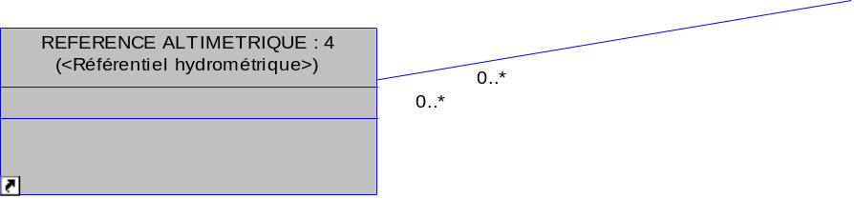
Water observation related models
Hydrometry
O&M Sampling Feature
O&M Observation
O&M Result

Slide 14
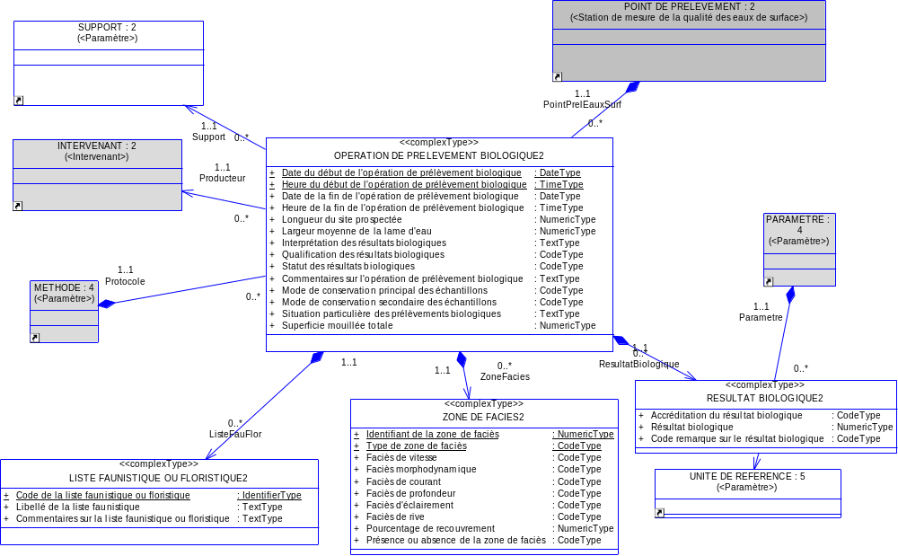
Water observation related models
Quality : biology
O&M Sampling Feature
O&M Observation
O&M Result
Notes:
Method linked at the operation level because the method normalizes everything from the sampling operation to the various results and also because everything is carried out by the same operator.
Schematron rules between method/parameter

Slide 15
Water observation related models
Quality : physics-chemistry, micro-biology
O&M Sampling Feature
O&M Observation
O&M Result
Notes:
Here operators are really often different structures (e.g : one ‘sampler’ and one laboratory) -> explains why the method is linked to the analysi

Slide 16
Water observation related models
GroundWater/quality:
O&M Sampling Feature
O&M Observation
O&M Result

Slide 17
Table of content
The French water information system,
Sandre’s activities,
Water observation related models,
Water data exchange,
Coming soon.

Slide 18
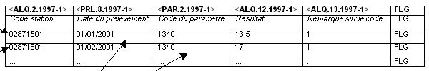
Water data exchange
Content structure
  Defined in an exchange scenario
‘Frame’ &
‘Simplified format’
XML &
‘Simplified format’
Unstructured
Simplified
Header
Frame (based on EDIFACT)
Record 1
DEC;.7 11
EMT;104;AELB;;;;;ORLEANS;45234;DDP;
DES;333;BNDE;OFFICE INTERNATIONAL DE L'EAU;;15 RUE EDOUARD CHAMBERLAND;;LIMOGES CEDEX;
87065;DAVID FARINA;
ALQ;;04000948;04/09/2008;10:45:00;1;;104;1295;04/09/2008;10:45:00;6,7;1;;0;;;1;41054531300018;0;0;23;17;;;;;
ALQ;;04000948;04/09/2008;10:45:00;1;;104;1301;04/09/2008;10:45:00;14,4;1;;0;;;1;31088075200038;0;0;23;13;;;;;
ALQ;;04000948;04/09/2008;10:45:00;1;;104;1302;04/09/2008;10:45:00;7,55;1;;0;;;1;31088075200038;0;0;23;12;;;;;
ALQ;;04000948;04/09/2008;10:45:00;1;;104;1303;04/09/2008;10:45:00;98;1;;0;;;1;31088075200038;0;0;23;8;;;;;
ALQ;;04000948;04/09/2008;10:45:00;1;;104;1305;04/09/2008;10:45:00;11;1;;0;;;1;41054531300018;237;0;23;6;;;;;
ALQ;;04000948;04/09/2008;10:45:00;1;;104;1311;04/09/2008;10:45:00;10,8;1;;0;;;1;31088075200038;0;0;23;11;;;;;
ALQ;;04000948;04/09/2008;10:45:00;1;;104;1312;04/09/2008;10:45:00;100,9;1;;0;;;1;31088075200038;0;0;23;9;;;;;
ALQ;;04000948;04/09/2008;10:45:00;1;;104;1313;04/09/2008;10:45:00;1,5;1;;0;;;1;41054531300018;0;0;23;10;;;;;
Sender
Recipient
Data
Record 2
Data
Notes:
Frame : EDIFACT : Electronic Data Interchange for Administration, Commerce and Transport. United Nations norm then -> ISO 9735.
Simplified : répond à la demande d'un format allégé dans le cadre des échanges entre banques de données et utilisateurs, les échanges entre laboratoires, producteurs et banques continuant à utiliser le format SANDRE initial qui, seul, permet de transmettre toute l'information nécessaire.
Néanmoins, le format simplifié ne se substitue pas au format trame du SANDRE :
ce format ne permet pas d’échanger toute la richesse sémantique définie par le SANDRE. Par exemple, il est difficile de transiter l’ensemble des descriptions des files d’une station d’épuration par ce format,
ce format ne présente pas la robuste pour sécuriser les échanges de données ou pour automatiser les échanges de données entre deux applications.

Slide 19
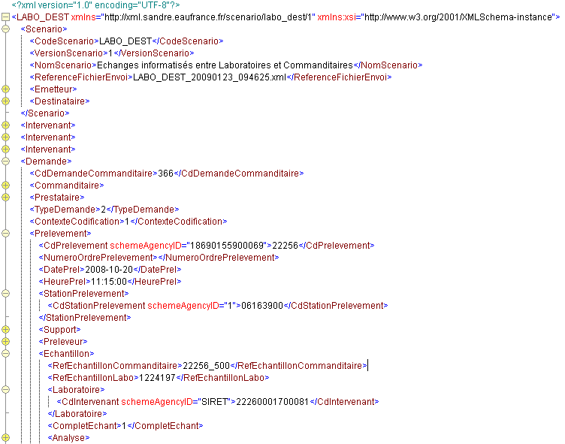
Water data exchange
XML 1/2
History
Scenario
Information on the analysis order
Sampling operation information
Media component sampled
Sampler
Sample
Result

Slide 20
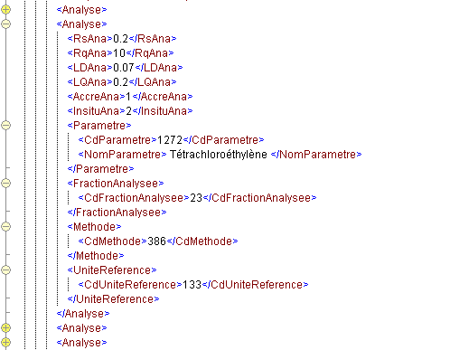
Water data exchange
Content structure
XML 2/2
Result
Comments
Analysis limits
Analysis accreditation
Parameter analysed
Media component analysed fraction
Analysis method
Unit of measure

Slide 21
Water data exchange
Exchange method
  Depending on the context : e-mail, ftp, webservice
  First webservice specification in 2005,
  Webservices now available :
    Referential dataset & controlled vocabulary,
    Metadata information on objects : for a given layer, BBOX, …
    Water data quality (O&M not available at that time),
    Water data quantity : in validation process now (O&M not available at that time),
    …

Slide 22
Water data exchange
Modeling rational
Example : water data quality exchange
  Laboratory -> data producer : EDILABO exchange scenario (imposed by a law decree),
  Data producer -> National internet portal, … : Water quality webservice
Data dictionary 1
Exchange scenario 1
Data dictionary 2
Webservice
specification
Data dictionary 3
Exchange scenario 2
Data dictionary 4
Data dictionary 5
Exchange scenario 3
…
…
…
Notes:
- Un scénario d’échanges décrit les modalités d’échanges dans un contexte spécifique. En s’appuyant sur l’un des formats d’échanges du SANDRE, le document détaille les données échangées (obligatoires et facultative), le descriptif technique du ou des fichiers d’échanges et les modalités techniques et organisationnelles de l’échange.
- Webservice : précise les interfaces à mettre en œuvre entre un fournisseur de données de qualité des eaux
et un organisme chargé de la diffusion des données sur l’eau (portail Internet, rapportage, valorisation des
données,…).

Slide 23
Water data exchange
Water quality webservice specifications
  Methods
    getCapabilities,
    getSites (synchronous & asynchronous mode) :
    Search for one or many sites based on constraints. Returns site list + site metadata.
    getSiteDescription : Info on a specific site.
    getDataAvailability : Number of sampling and analysis available for one or many sites.
    getData (synchronous & asynchronous mode) : Access to data for one or many sites based on constraints.

Slide 24
Water data exchange
Water quality web service specifications
  Constraints/Filtering possibilities
    Domain : Coastal waters, river, lake, ground water, …
    Spatial : Administrative, drainage basin level, BBOX, …
    Thematic : Monitoring site code/name, monitoring network code, parameter family code,
    Temporal : begin/end date,
    Analytic : Media component, taxa, taxonomic family code, sampling type …
    Thematic data : Analysis result qualification, result accreditation, water actor involved,…

Slide 25
Table of content
The French water information system,
Sandre’s activities,
Water observation related models,
Water data exchange,
Coming soon.

Slide 26
Coming soon
OGC standards
  OGC O&M implementation study (going up to SWE ?),
  Work with Hydro DWG,
  Progressive model transfer to ISO 19100 Framework.
European integration
  Hydrographic model redesign : higher scale (up to 1/5000), new French needs, interoperability with INSPIRE hydrography model.
  INSPIRE / WISE metadata profile implementation,
  Better WISE reporting integration into our models:
    Ontology mapping between European and French codelists ?,
    Try closer work with WISE modeling teams to avoid the ‘implementation rush’ in our own models.

Slide 27


Thank you for your attention
Contact :
  Sylvain Grellet : s.grellet@oieau.fr

