Slide 1

Towards a Common Information Model of Water
Sponsored by
Gold
Silver
And Hosted by
Fraunhofer Institute for Computer Graphics Research (IGD)
70th OGC Technical Committee
Darmstadt, Germany
Rob Atkinson
September 29, 2009
Copyright © 2009, Open Geospatial Consortium, Inc.

Slide 2
Scope
Charter implies Who, Why
  WMO auspices
  Multiple stakeholders
  Experiences around the table
  Route to implementation
What?
  Core requirements
Technical
  How?
Practical
  Who
  When

Slide 3
What is the role of a common information model?
WMO
Metadata
Profile
INSPIRE
Model
WMOId:definition
InspireId:definition
lineage
geometry
Rhine
<GML>
Common concept, need to link or share data across domains

Slide 4
Design
WMO
Metadata
Profile
INSPIRE
Model 1
WMO_Id:ref
InspireId:ref
lineage
geometry
Domain
Model
INSPIRE
Model 2
Id:definition
relatedFeature:ref
Model 2 not dependent on detail of model 1

Slide 5
Identifiers
Identifiers are not trivial…
Architectural specification
  relationship of identifiers to a common model
  Global scope of identifiers or ability to declare relationships?
Implementation choices…

Slide 6
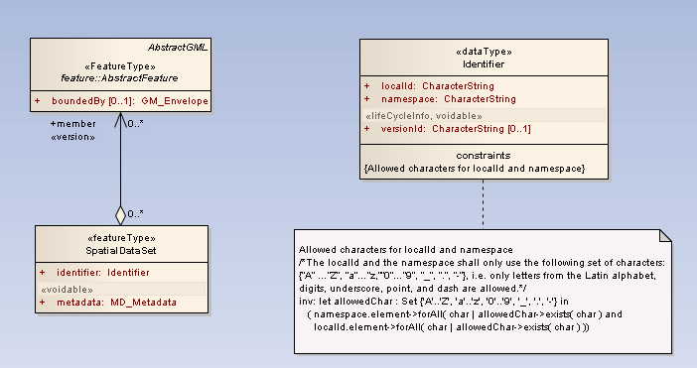
INSPIRE base types

Slide 7
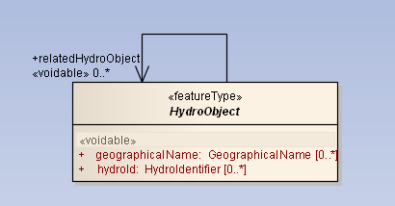
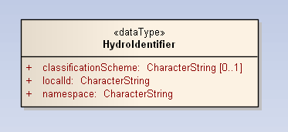
An example
No direct link to base types in model

Slide 8
<Watercourse xmlns="urn:x-inspire:specification:gmlas:HydroPhysicalWaters:3.0"
<gml:identifier codeSpace="inspire....">Rhine</gml:identifier>
<inspireId>
<Identifier xmlns="urn:x-inspire:specification:gmlas:BaseTypes:3.2">
<localId>a123-3312-abfg-2334-44501</localId>
<namespace>UUID</namespace>
</Identifier>
</inspireId>
<Hydroid>
<localId>Rhine</localId>
<namespace>GRDC</namespace>
</Hydroid>
<drainsBasin gml:href="urn:some_id"/>
…
</Watercourse>

Slide 9
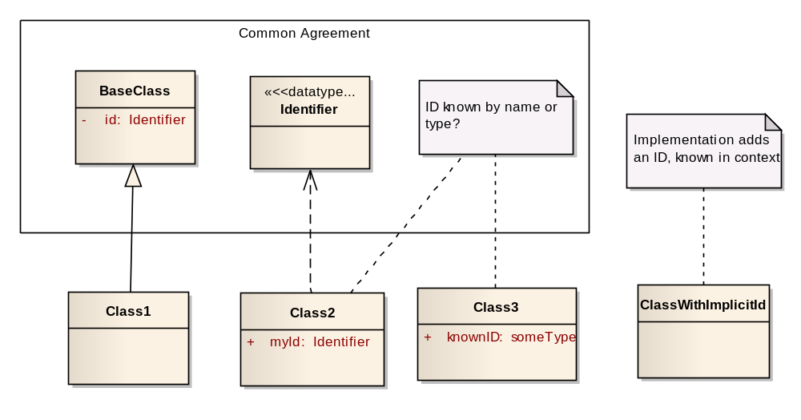
Multiple patterns

Slide 10
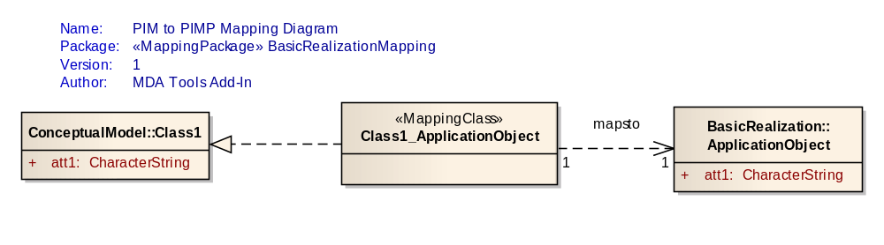
Possible solution
Model identity explicitly in a conceptual (semantic) framework and always explicitly map implementation models back to this.
C.f. the “identity carrier pattern” Atkinson et al, IJSDI vol2
Can be retrofitted to INSPIRE suit of specs (and solutions)
“idiom” to be refined, but mapping is external to both source and target (like RDF model), and can be retrofitted.

Slide 11
An architectural option..
Separate common domain model from implementation profiles
  Allow multiple implementations to be mapped to common semantics
  Common semantics can be used to support identifier mapping
  Mapping is part of any system model
  Mappings do not need to “pollute” either implementation or conceptual model
  Decouples governance cycle of key aspects
  Versioning key to keep multiple mappings up to date,

Slide 12
Testing
It is possible to test a common domain model by mapping available implementations to it.
Are there Use Cases out there not supported by current implementations?
Who is willing to provide a minimal set of real data as test cases for the model?
  Need someone willing to create mapping to model
  CSIRO can assist with some tools
  HUMBOLDT project may provide mapping tools too
  (CSIRO to at least interoperate with HUMBOLDT mappings)

Slide 13
Towards a common domain model..
Scope
  identifiers of real world objects independent of implementation profiles
  WMO definition consistent
  Link between WaterML and Hydrology Feature Types
  Informative mappings to key implementations
Decisions
  UML as normative – is there a realistic alternative?
  Which version – ISO HMWG compatible, not INSPIRE idiom?
  Where (Registry Owner)
  Who (WMO is Register Owner, who is Register Control Body?)
  CSIRO can play role as model editors (Register Manager)

