Slide 1
Harmonisation of water observations data standards
Water for a Healthy Country
Pete Taylor
29th September
OGC TC – Darmstadt 2009

Slide 2
Presentation Outline
The need for standards and harmonisation
A proposed approach to develop a common model
Moving forward

Slide 3
“At least one of the people out there has a smarter idea about what to do with your content than you do.”
- James Boyle

Slide 4
The need for standards
Sharing of hydrological data is somewhat ad-hoc, based largely on CSV files and FTP
Leads to very inefficient (or non-existent) transfer and sharing of data
Sharing requires a lot of transformation effort on the behalf of the data requestor
  Parse different file formats
  Understand the concepts
  Metadata is often limited or non-existent, requiring follow up conversations

Slide 5
Hydrological observations
Measurements of
  Water level,
  Water temperature,
  Discharge,
  Sediment,
  Water quality
  etc..
Different sampling techniques (in-situ, laboratory etc.)
Why do people want to share hydrological observations?
  Provide data to national systems (AWRIS, CUAHSI)
  Share data between agencies
    Hydro company to local water authority
    Researchers (learning hydrology, modelling)
  Other domains
    Climatology
    Oceanography
    Meteorology

Slide 6
A common situation
Hydro Jack
Need flow data!
Don
Hmm maybe Don can help…
*RING RING*
Hi Don, I need some upper Derwent flow readings for my geochemical model. Any ideas?
To: Jack
01/02/09, 3.2, 3, 1
01/02/09, 3.1, 3, 1
Hmm, I’ve got one site. I’ll send it through…
*RING RING*
Ok. Got the data. Where is the site located?
10 minutes…
10 minutes…
Oh, it’s at laughing jack bridge.
Ummm. (papers shuffle)
147.123 -41.588
Coordinates?
What reference system??
I think it’s GDA94
Ok. What sensor is used?
It’s calculated from the stream gauge reading using a rating curve..
Oh…how accurate is that?
Umm......
DON?
*CLICK*

Slide 7
The need for harmonisation
A number of initiatives exist to develop standards for water observation data:
  WaterML1.0
  WDTF
  XHydro
  UK Environmental Agencies time series transfer format
  Others..
A lot of commonalities exist between the standards
  Partial duplication of effort
  Inconsistencies across the standards
  Hard to re-use tools
Potential for a harmonised, re-usable information model
  Define common semantics of concepts
  See Document 09-124 (Harmonising standards for water observation data)

Slide 8
The need for a common model
  Sharing can be easy; understanding is difficult.

Slide 9
A proposed approach
Identify common concepts within existing hydrological data standards
Identify use cases/patterns/structures of hydrological observation data
Identify methodologies that can be leveraged to assist the development of a harmonised standard
Re-use existing definitions of concepts where appropriate – don’t re-invent the wheel

Slide 10
Re-use existing standards
Sensor Web Enablement
  SWE Common
  Sensor Observation Service
  Observations & Measurements
GML & ISO
  Primitive types
  Spatial
Allows us to focus on the domain concepts rather than types that are fairly common across domains (units, spatial types etc.)

Slide 11
OGC Observations & Measurements
Provides a definition of common concepts and relationships of the observation process
A baseline from which we can develop a specific model for hydrological observations
Appears to be the emerging best practice, used by:
  Integrated Ocean Observing System (IOOS)
  Climate Science Markup Language (CSML)
  Global Runoff Data Centre’s (GRDC) meta data profile
  Submitted to ISO

Slide 12
Model-driven approaches
A model-driven approach to information modeling allows specification of model in UML and various encodings can be generated (e.g. GML XML)
Also an emerging best practice in ISO211 for developing specifications for spatial data (ISO19101, ISO19109)
Tools exist that facilitate the development process:
  FullMoon for encoding UML into GML-compliant XML
  HollowWorld to allow re-use of exisiting standards in UML

Slide 13
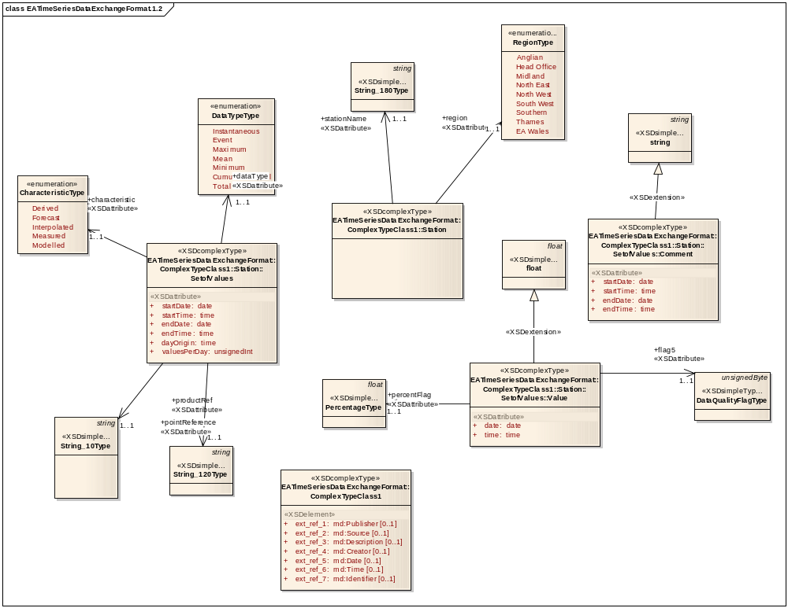
UK Environmental Agency – TS format
Sampling features
Time series

Slide 14
Sampling Features
Result type
(time series)
Procedure
Observed property

Slide 15
Proposed approach
Existing best practices and standards provide a framework which can facilitate the development of a common model

Slide 16
Benefits of a harmonised model
Access to a wider range of developed tools, libraries and applications – reduced duplication of effort
Adapters for existing systems can be shared
Access to documented and explicit definitions of concepts
Helps pave the way for increased interoperability of water information systems

Slide 17
Going forward - issues
How well do existing site/location/station/measuring point concepts fit into the model?
How do we provide common grouping mechanisms that satisfy existing and future discovery requirements?
How do we describe our sampling regimes?
How do we encode observation results (time series etc.)?
Managing dependencies between derived time series?
Define a core set of use cases to address

Slide 18
Get involved!
Provide input into particular use cases for sharing water information
Do you have existing techniques that you want to ensure align with developed approaches?
Document 09-124 (harmonising standards for water observation data) describes initial work: http://portal.opengeospatial.org/files/?artifact_id=35507&version=1
Get involved through teleconferences

Slide 19
Development of a harmonised model will bring benefits to a large number of parties and will promote improved sharing of data and meta data, by both humans and computers.

Slide 20
The future?
Hydro Jack
Need flow data!
Laughing Jack Bridge 147.123 -41.588 (AGD66)
Upper Derwent River
Observed properties: River level, River Flow, Rainfall
River Flow
-Measured by Sontek Acoustic Doppler Sensor (ID232)
-Accuracy: +/- 0.02
-Installed: 01/04/2012

Slide 21

Thank you
CSIRO ICT Centre
Pete Taylor
Research Engineer
Phone: +61 3 6232 5530
Email: peter.taylor@csiro.au
Web: www.csiro.au/science/TasICTCentre.html
Contact Us
Phone: 1300 363 400 or +61 3 9545 2176
Email: Enquiries@csiro.au Web: www.csiro.au

