Slide 1

QGIS / GDAL GML application schema support update : use case on French groundwater monitoring system
102nd OGC Technical Committee
Delft, The Netherlands
S.Grellet – M.Beaufils
BRGM
20 March 2017

Slide 2
Overall context reminder
NO DATA
?
NO CLIENT
« another approach to demonstrate
the usefuleness of interoperable standards »
or
« having something to show to those
who consider XML is not sexy »
Notes:
Because
- structure: we need a common conceptual vision
- encode: we need to agree on a shared encoding of that vision
- dereference: even if we are efficient on the previous 2 ones a lot will happen when dereferencing those links. What if content negotiation fails because clients asks for something the server does not understand or ask it in a way the server does not understand (for example passing a 'profile' parameter as suggested by http://www.iana.org/assignments/media-types/application/gml+xml ).

Slide 3
Overall context reminder
Initial idea
Reuse information available in XML compliant to xsd(s) to handle those flow with no hardcoded configuration -> enriched XML and database generation on the fly.
Koblenz 2016 Hydro DWG Workshop presentation of the Proof Of Concept QGIS plugin
Name: gml application schema toolbox
https://plugins.qgis.org/plugins/gml_application_schema_toolbox/
XML handling with ad-hoc PyXB code
QGIS 2.x GUI to interact with either enriched XML or generated DB
Specific widgets to handle WaterML2 timeseries

Slide 4





Overall context update
From the ProofOfConcept to an enhanced approach run n
2016
2017
Run n° 1
QGIS 2.x GML application schema toolbox POC
Run n°2
GML App Schema OGR Driver and QGIS 3 integration
Run n°3
(now)
GML App Schema OGR Driver and QGIS 3 integration enhancements

Slide 5


Overall context update
From the ProofOfConcept to an enhanced approach run n
Run n° 1
QGIS 2.x GML application schema toolbox POC
Run n°2
GML App Schema OGR Driver and QGIS 3 integration
PyXB -> specific OGR/GDAL GMLAS driver (targetting GDAL 2.2), handling both reading and writing
Integration within QGIS 3
Run n°3
(now)
GML App Schema OGR Driver and QGIS 3 integration enhancements
- GDAL GMLAS : addition handling specific SWE types based on GWML2 GW_GeologyLogCoverage and EU Air Quality Reportings (dataArray, dataRecord, …)
- QGIS 3 : enhanced widgets for timeseries, and borehole logs + some commit to the trunk
2.2
3

Slide 6
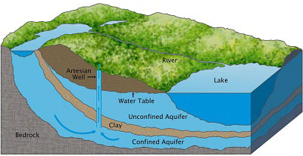

Application to groundwater monitoring system
Objectives
To provide stable and resolvable links to resources
To allow reference / data citation
Independant from underlying technologies used to provide data
I am #Piezometre/00634X0147/PZ1.2
attached to #Borehole/00634X0147/PZ1.2
I have a lot of #GroundWater Levels observations regarding #EntiteHydroGeol/107AK01
I am #Piezometre/00634X0147/PZ1.2
attached to #Borehole/00634X0147/PZ1.2
I am #EntiteHydroGeol/107AK01
I am monitored by #Piezometre/00634X0147/PZ1.2
I am #EntiteHydroGeol/107AK01
#GroundWater Levels obs. from #Piezometre/00634X0147/PZ1.2

Slide 7



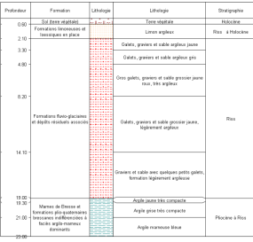

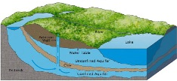
Application to groundwater monitoring system
Flows based on OGC and INSPIRE defined featureTypes
Env. Monitoring Facility
monitoring equipment
hasObservation
GroundWater
raw levels
Borehole
attachedTo
relatedMonitoringFeature
GroundWater validated levels
featureOfInterest
relatedObservation
featureOfInterest
Observations/ Geological logs
Geology / HydroGeology
xx
Legend:
Feature(s)
Observation(s)

Slide 8
Application to groundwater monitoring system
Object instances are associated by their URI
Env. Monitoring Facility
URI
URI
GroundWater
raw levels
Borehole
URI
URI
GroundWater validated levels
URI
URI
URI
Observations/ Geological logs
Geology / HydroGeology
URI
Legend:
Feature(s)
Observation(s)

Slide 9
Application to groundwater monitoring system
URI allowing to dereference content exposed by OGC services
Env. Monitoring Facility
URI
WFS
URI
GroundWater
raw levels
Borehole
URI
WFS
URI
SOS
GroundWater validated levels
URI
URI
URI
SOS
Observations/ Geological logs
Geology / HydroGeology
URI
WFS
SOS
Legend:
Feature(s)
Observation(s)

Slide 10
GML application schema toolbox use
Retrieves objects of interest described according to a standard
= semantic and geographical representation
interacts with the content (XML and Database). Database -> plug other tools
Resolves XLinks to add more content
vocabulary registry definitions (multilinguism is handled)
linked domain features / observation
Uses custom widgets
working: Waterml 2 timeseries, Inspire PointTimeSeries
on-going dev : GW_GeologyLogCoverage, EU AirqualityDirective timeseries
Writes content (file not WFS-T)
Standalone OGR/GDAL driver -> reuse

Slide 11
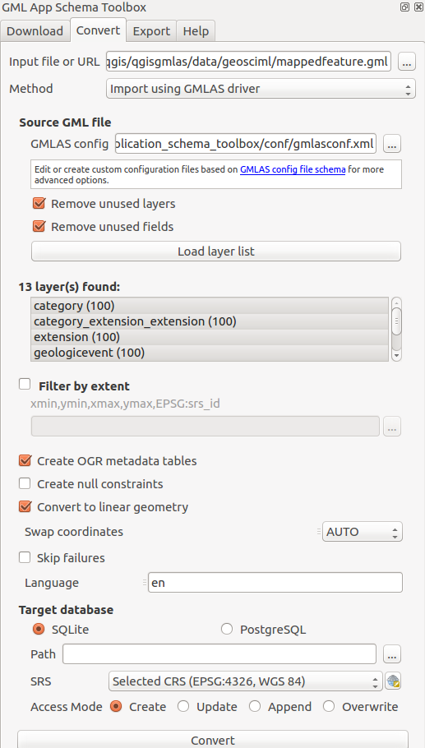
GML application schema toolbox use – QGIS 3

Slide 12
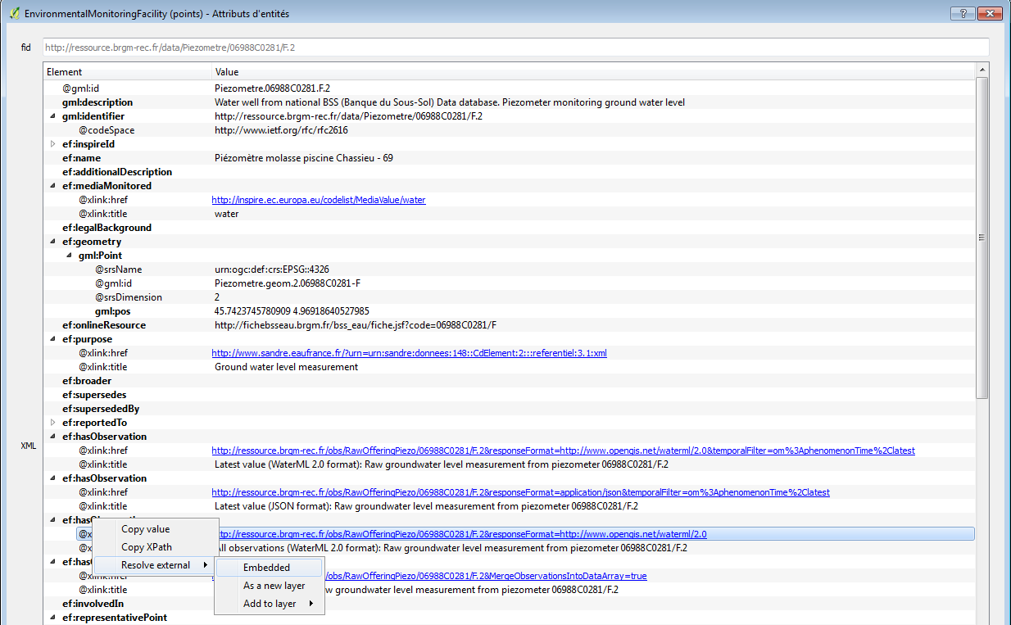
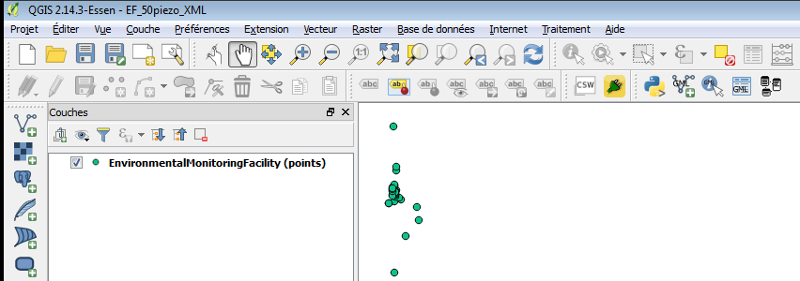
GML application schema toolbox use – XML
1
2

Slide 13
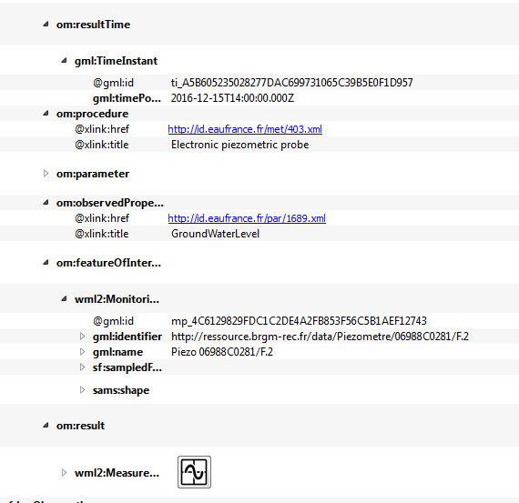
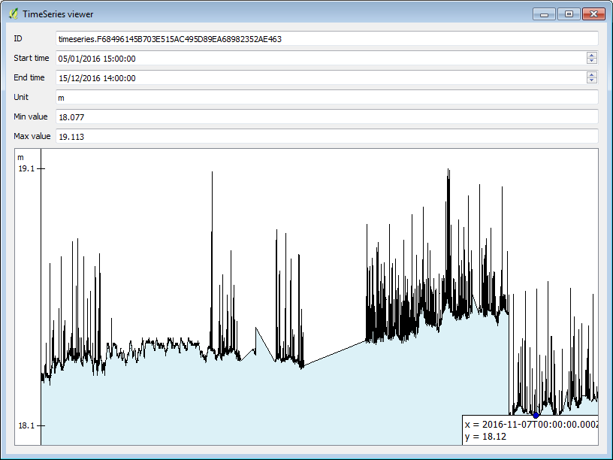
GML application schema toolbox use – XML
3

Slide 14
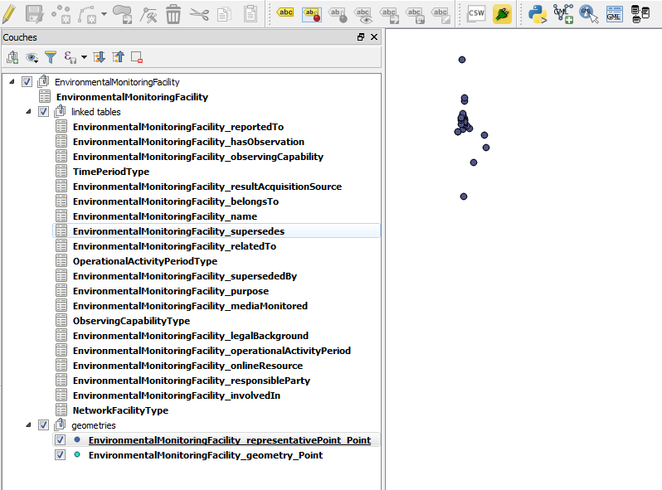
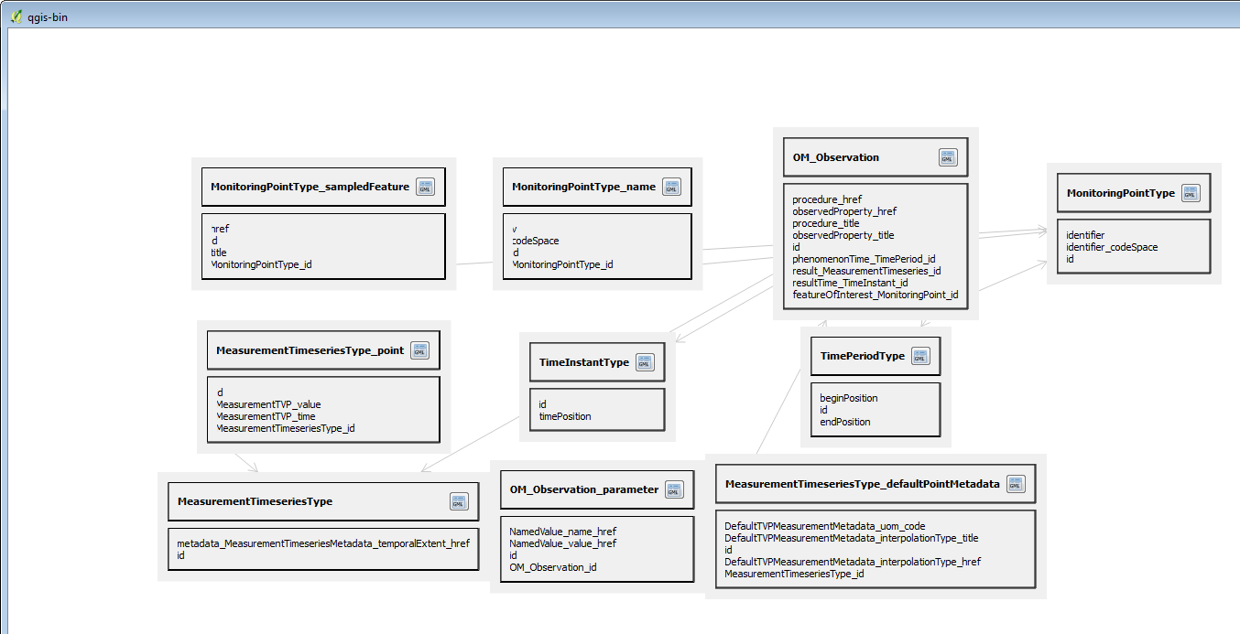
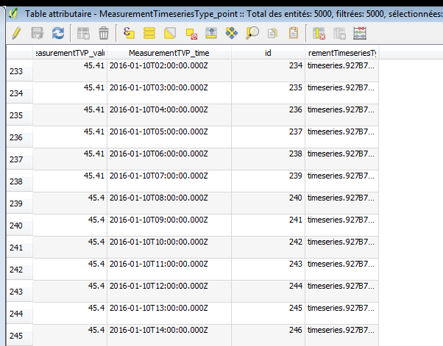
GML application schema toolbox use – DB
Exact same entry flow but client in database mode

Slide 15
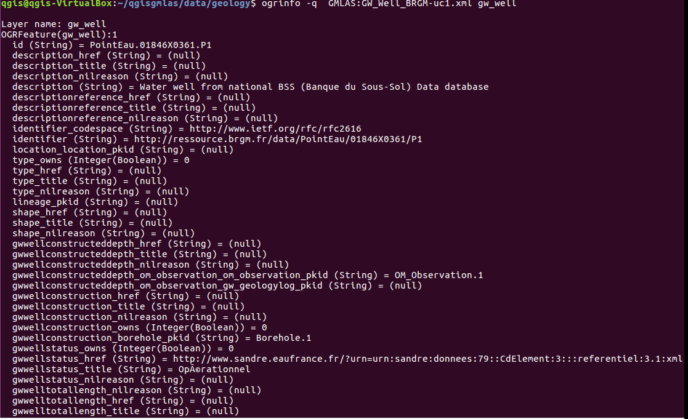
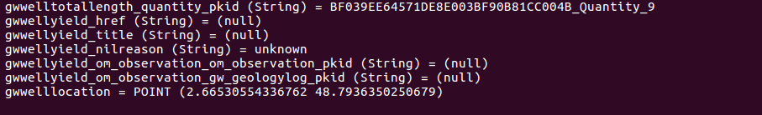
GML application schema toolbox use – ogrinfo
Ex: direct driver access to GroundWaterML2 GW_Well

Slide 16
Useful links
https://plugins.qgis.org/plugins/gml_application_schema_toolbox/
https://github.com/BRGM/gml_application_schema_toolbox
+Documentation, GUI presentation
Multilinguism handling
on INSPIRE registry: same flow asking for English then Greek definitions
https://www.youtube.com/watch?v=EeAyyUOykVE
Ubuntu VirtualBox to play with QGIS V3 + plugin under Windows
http://file.titellus.net/vbox/

Slide 17
Conclusion
Generic work successfully tested on
OGC : GroundWaterML2, GeoSciML4, WaterML2
INSPIRE : EnvironmentalMonitoringFacilities, BioGeographicalRegions, LandCover, ProtectedSites, MineralResources, PointTimeSeriesObservation
Our domain colleagues can now finally make use of standardized content ☺
Next steps
Address (some) SWE specificities
Have more domain widgets
Handle other content type (JSON-LD ?)
Feel free to use, test, enhance it, propose evolutions

Slide 18
Conclusion - whishlist
Input
data
reading
Data
format
Data
use
Output
data
writing
Input
connector
GUI-Widget WaterML2
WFS 2 client
<XML>
GUI-Widget GWML2 BoreholeLog
File
GMLAS
GUI-Widget EU AQD
TimeSeries
GMLAS
PostreGre/GIS
Spatialite
SOS 2 client
More data structures
More data structures
More domain
GUI-widgets
Data processing libs
GML Application schema toobox
Existing
Evolution idea

Slide 19
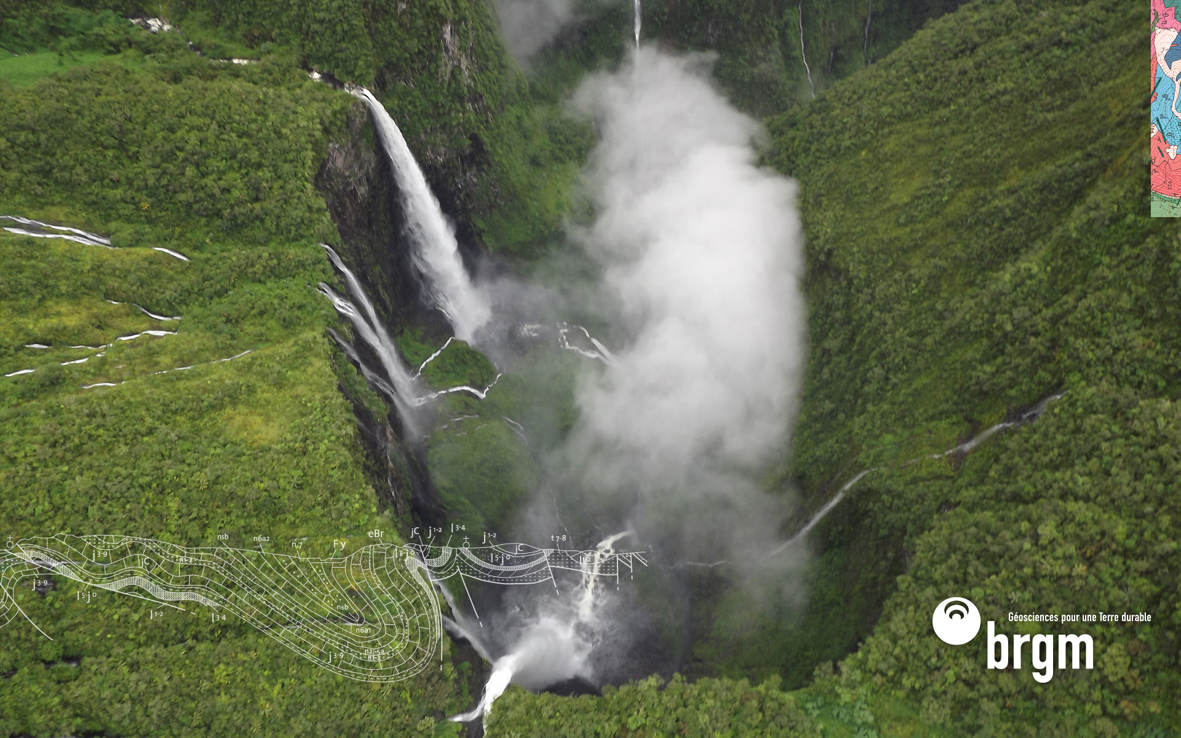
Thank you
s.grellet@brgm.fr
m.beaufils@brgm.fr

