Slide 1
Groundwater SWG GroundWaterML2 (GWML2)
99th OGC Technical Committee
Dublin, Ireland
Boyan Brodaric & GW SWG
20-24 June 2016

Slide 2
Agenda
GWML2 History
GWML2 Recent Progress
GWML2 Next Steps
GWML2 Scope
Wrap-up

Slide 3
GWML2: History
2009-2011: GW1IE (OGC HDWG)
Test GW data interoperability using OGC standards and GWML1
2012-2015: GW2IE (OGC HDWG)
Objectives: develop and test draft GWML2
Participants: 13 agencies; N. America, EU, AU/NZ
Activities: 49 meetings since June 2012 Kick-off (Reading, UK)
Results: GW2IE Eng Report (15-082)
completed Sept 2015, approved Nov 2015, released Apr 2016
14 web services (WMS, WFS, SOS, WPS)
draft GWML2 specification
17 change requests

Slide 4
GWML2: Recent Progress
2015-2016: GW SWG
Sept 2015: charter submitted (OGC 15-110)
Feb 2016: GW SWG approved/initiated
Mar 2016: GWML2 revised & submitted (OGC 16-032)
Apr 2016: OAB review
May 2016: GWML2 standard doc revised (OGC 16-032r1)
Conceptual model made normative (+ reqs & conf classes)
Clarifications re: linked data principles, association classes
May 2016: OGC-NA review
June 02 2016: GWML2 standard doc revised (OGC 16-032r2)
URL template revision
Empty req & conf classes: due to inheritence → change request pending
June 17 2016: Public review ends: no changes requested
June 23 2016: OGC vote to begin final vote @ Dublin TC closing plenary

Slide 5
GWML2: Next Steps
2016: GW SWG
OGC e-vote to ratify GWML2r2
public release of GWML2r2
journal paper submission (in progress)
SWG meetings as required (maintenance, changes)
JSON, RDF, RESTful implementations?
initiate WMO submission process (Silvano Pecora champion)

Slide 6

GWML2: Scope
GW_Basin
GW_ManagementArea
Wellfield
GW_MonitoringSite
Groundwater basin
Observation
well
Well
Well Construction
Bedrock
aquifer
Unconfined aquifer
Aquifer
Well
GW_Aquifer
Confining bed
GW_Aquifer
GW_ConfiningBed
Confined aquifer
Fractured rock aquifer
GW_ConfiningBed
GW_Aquifer
Confining bed
Groundwater filling the pore space
GW_AquiferUnit
Particulate rock aquifer
GW_FluidBody
GW_HydrogeoVoid
Solutes, suspended solids, and organisms in groundwater
GW_ChemicalConstituent
GW_MaterialConstituent
GW_BiologicConstituent
Main
Constituent

Slide 7
GWML2: Scope
Flow
GW_Recharge
GW_Discharge
Well
Well Construction
Aquifer Test
Pumping well
Well
GW_Discharge
GW_Flow
GW_BodySurface
GW_Spring
Land
surface
GW_Divide
GW_Well
watertable
Unconfined
aquifer
Confining bed
GW_ConfiningBed
GW_AquiferSystem
Main
Confined aquifer
Ground
water
flow
line
Bedrock aquifer
GW_Basin
GW_Aquifer
GW_IntraFlow
GW_InterFlow
GW_FlowSystem
Flow

Slide 8
GWML2: Wrap-up
Since HDWG Workshop 2015 (Orleans)
GW2IE completed
GW SWG started
GWML2 submitted to OGC, reviewed & revised
journal paper draft begun
Next Steps
OGC ratification
WMO standard initiation
GW SWG maintenance / new activities?

Slide 9
Questions?
Comments?

Slide 10
GWML2: Overview
2009-2011: GW1 IE (OGC HDWG)
Test GW data interoperability: OGC standards and GWML1
2012-2015: GW2 IE (OGC HDWG)
Objectives: develop and test draft GWML2
Participants: 13 agencies (N. America, EU, AU/NZ)
Activities: 49 meetings since June 2012 Kick-off
Results: Eng Report (15-082), 14 web services, 17 change requests
2016: GWML2 (OGC GW SWG)
Objectives: refine and submit GWML2 (from 15-082)
Participants: same as above
Activities: 5 meetings (>Feb 2016); 3 reviews: OAB, OGC-NA, Public
Results: 16-032, 16-032r1, 16-032r2 (final)

Slide 11
GWML2: Content Overview
5 Use-cases
Conceptual Model (CM: text + UML)
technology-neutral, domain-specific
narrative defs (vocabulary) → UML
Logical Model (LM: UML)
technology-specific implementation of CM (e.g. GML abstract model)
Packages (6): Main, Fluid Bodies, Constituent, Flow, Well, Well Construction, Aquifer Test
Features (9): e.g. GW_HydrogeoUnit (Aquifer), GW_Well, …
Extends (3): GeoSciML4, O&M, Interleaved Coverage
Physical Model (GML-XML schema)
for the syntactical encoding of logical model
GML-XML instance examples
syntactical encoding examples

Slide 12
GWML2: Use-cases
Commercial - find water wells, estimate water well cost
http://external.opengis.org/twiki_public/HydrologyDWG/UseCase1
Policy - meet EU Water Framework Directive needs
http://external.opengis.org/twiki_public/HydrologyDWG/UseCase2
Environmental - risks to gw dependent ecosystems
http://external.opengis.org/twiki_public/HydrologyDWG/UseCase3
Scientific - groundwater flow modeling
http://external.opengis.org/twiki_public/HydrologyDWG/UseCase4
Technologic – map GWML2 to existing info models
http://external.opengis.org/twiki_public/HydrologyDWG/UseCase5

Slide 13
GWML2: Scope
GW_Basin
GW_ManagementArea
Wellfield
GW_MonitoringSite
Groundwater basin
Observation
well
Well
Well Construction
Bedrock
aquifer
Unconfined aquifer
Aquifer
Well
GW_Aquifer
Confining bed
GW_Aquifer
GW_ConfiningBed
Confined aquifer
Fractured rock aquifer
GW_ConfiningBed
GW_Aquifer
Confining bed
Groundwater filling the pore space
GW_AquiferUnit
Particulate rock aquifer
GW_FluidBody
GW_HydrogeoVoid
Solutes, suspended solids, and organisms in groundwater
GW_ChemicalConstituent
GW_MaterialConstituent
GW_BiologicConstituent
Main
Constituent

Slide 14
GWML2: Scope
Flow
GW_Recharge
GW_Discharge
Well
Well Construction
Aquifer Test
Pumping well
Well
GW_Discharge
GW_Flow
GW_BodySurface
GW_Spring
Land
surface
GW_Divide
GW_Well
watertable
Unconfined
aquifer
Confining bed
GW_ConfiningBed
GW_AquiferSystem
Main
Confined aquifer
Ground
water
flow
line
Bedrock aquifer
GW_Basin
GW_Aquifer
GW_IntraFlow
GW_InterFlow
GW_FlowSystem
Flow

Slide 15
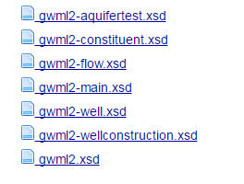
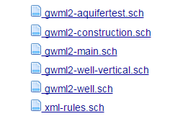
GWML2: GML-XML Schemas
Publically available from SVN
Schemas: https://xp-dev.com/svn/gwml2/schemas/
Constraints: https://xp-dev.com/svn/gwml2/Documents/schematron/
To be migrated to OGC repository upon approval
URL pending

Slide 16
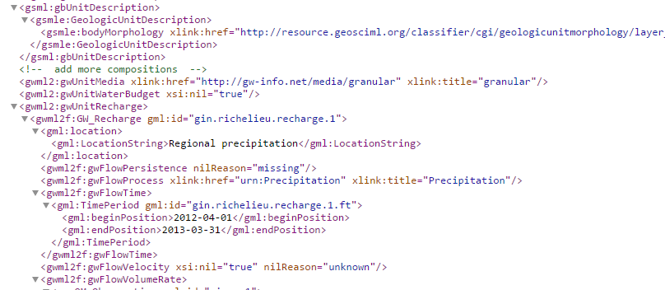
GWML2: GML-XML instance examples
Complete coverage: all parts of GWML2
Publically available: via SVN
https://xp-dev.com/svn/gwml2/Documents/instance/
Public web services: URLs forthcoming (CAN, USA, FR, AU (FU/BOM), NZ)
Copyright © 2016 Open Geospatial Consortium

