Slide 1
Progress towards a standard WMO/OGC Hydrologic Feature Model
86th OGC Technical Committee
Frascati, Italy
Irina Dornblut, Rob Atkinson
23 September 2013
Copyright © 2013 Open Geospatial Consortium

Slide 2
HY_Features, Hydrologic Feature Model
OGC 11-039r3 – Discussion Paper, r3
  Conformance Requirements
  Compatibility of concepts
  Hydrologic referencing
Future work
Document approval motion
Copyright © 2013 Open Geospatial Consortium

Slide 3
OGC 11-039r3 – Discussion Paper, r3
According to the UML modifications arisen from discussions
at WMO CHy-14 (Geneva, Nov 2012)
  “… reflect a wide range of features, recognising the different concepts that CHy-Members have … ”
    take into account water from atmospheric origin and its accumulation on and below the Earth’s surface, the hydrologically significant geologic conditions, groundwater/soil moisture, the stratification of water bodies.
  “… support compatibility with other spatial information platforms …”
    such as EU-INSPIRE initiative, or the AU Hydrological GeoFabric.
in the HydrologyDWG (2012 - 2013)
  to support compatibility with similar feature concepts,
    such those intended for WaterML2, RiverML, GroundwaterML.
  to assist the definition of appropriate conformance requirements for testing in application domains related to hydrology.
Copyright © 2013 Open Geospatial Consortium

Slide 4
Conformance requirements
The conceptual model addresses the general requirements
  integrate hydrologic data and information available across the scientific and technical programs of the WMO,
  assist the WMO Members to discover, access und use hydrologic data from different sources.
Technical requirements need to be defined in respect to
  usability for hydrologic referencing (persistent and de-referencable URIs for features),
  system interoperability of information services (link between different representations of a shared base concept),
  data infrastructures (tools for discovery of and access to data)
Copyright © 2013 Open Geospatial Consortium

Slide 5
Conformance requirements
The standardization (conformance) target of HY_Features:
  application schema for data products describing hydrologic features, either the direct encoding of HY_Features or another schema formally mapped to HY_Features equivalent classes.
  implementation model referencing HY_Features features inline
Conformance to the HY_Features model requires that an implementation defines the mapping of:
  the feature type of each implemented GF_Feature to the equivalent semantic concept in HY_Features, wherever such an instance may be referenced as a hydrologic feature
  all properties of the implemented feature, where such properties contain references to hydrologic features, to the equivalent property expressed within the HY_Features model
Copyright © 2013 Open Geospatial Consortium

Slide 6
Compatibility of concepts (8.1)
8.1.1 Basin vs. DrainageBasin as of INSPIRE*
The INSPIRE Hydrography specification refers to surface waters. It defines an abstract HydroObject covering PhysicalWaters including the relation between the “area having a common outlet for its surface runoff” (DrainageBasin) and a “physical surface body of water” (SurfaceWater).
The DrainageBasin has multiple (1..*) SurfaceWater outlets, and may contain (0..*) sub-basins (“possibility to build basins from other basins”).
This definition corresponds to the definition of the BasinAggregate rather than Basin which is defined in HY_Features as a link between single inflow and outflow nodes. For referencing, the BasinAggregate may be addressed, which aggregates (1..*) subBasins each identified by an Outfall whose location may be a surface water body.
* D2.8.I.8: INSPIRE Data Specification on Hydrography“ v.3.0.1, the basic reference for use in the INSPIRE context.
Copyright © 2013 Open Geospatial Consortium

Slide 7
Compatibility of concepts (8.1)
8.1.2 Outfall vs. ContractedNode as of AHGF
Australian Hydrological Geofabric identifies important water features in the landscape as well as the connections between these features. Identifying persistent ContractedNodes of hydrological significance that carry identity, the AHGF supports the linkage between multiple representations of water features.
Such a ContractedNode may be an Outfall as defined in HY_Features.
Concepts of HY_Features have been implemented within the Geofabric as “HR_Catchments” (in terms of Catchment), as “Contracted Catchments” (in terms of BasinAggregate) and “AHGF Node” (in terms of Outfall). “Link” (in terms of Basin as a link) represents the topological connection in the catchment hierarchy.
Copyright © 2013 Open Geospatial Consortium

Slide 8
Compatibility of concepts (8.1)
8.1.3 IndirectPosition vs. NetworkPosition as of ISO19133
IndirectPosition is introduced to describe the position of Outfall in the hydrographic network using a linear reference system (river mileage).
The underlying concept is that of a distance between two positions. One, which is the origin of the LRS, is the Outfall determined by its network position; the other is the ReferencePoint fixed by coordinates. Since Outfall may be of any geometry, IndirectPosition may address (via ReferencePoint) both the node, or the link the position is on. IndirectPosition associates a ReferencePoint, that can be seen as a specific “marker” and the MileageSystem in sense of a “link measure”.
Even if navigation on watercourses is not in the scope of the HY_Features model, this similarity allows to address Outfall or ReferencePoint as start and stop positions of a Route as of ISO19133:Tracking and navigation.
Copyright © 2013 Open Geospatial Consortium

Slide 9
Compatibility of concepts (8.1)
8.1.4 HydrometricFeature vs. WaterMonitoringPoint as of WML2P1
Hydrologic observations make use of hydrometric stations as proxy to measure the characteristic properties of the ultimate object of study. WaterML2P1 defines a WaterMonitoringPoint using the sampling feature concept of ISO19156.
The description of sampling features is not in the scope of HY_Features.
HY_HydrometricFeatureNetwork is introduced to provide a means to relate a logic network of (fictive) hydrometric stations to the catchment they represent, without the detail of the observation strategy, as usually required in the context of processing primary data from preceding observations into new data products.
HY_HydrometricFeature is introduced to provide a means to define a persistent identifier positioned on a hydrographic feature.
Copyright © 2013 Open Geospatial Consortium

Slide 10
Compatibility of concepts (8.1)
8.1.5 RiverML (under development)
Against the background of an evolving RiverML, the channel hydraulics and river morphology are not in the scope of HY_Features.
HY_Features provides generally applicable concepts for reference, to which application-specific concepts may refer either by specialisation or by mapping.
Channel and ChannelSegment as well as RiverBed and Bank are introduced to provide a means to generally take into account the hydrologically significant hydraulic and morphological characteristics of open channels and closed conduits.
CrossSection and LongitudinalSection are associated to provide a means to define a persistent identifier at longitudinal and transversal bed profiles.
Copyright © 2013 Open Geospatial Consortium

Slide 11
Compatibility of concepts (8.1)
8.1.6 GroundwaterML (under development)
Against the background of an evolving GroundwaterML, the accumulation of groundwater as well as the interaction between surface water and groundwater are not in the scope of HY_Features.
HY_Features provides generally applicable concepts for reference. Bodies of groundwater, or parts of these, may be mapped to WaterBody, -Segment or -Stratum for reference, or in case of storage to Reservoir.
HydrogeologicUnit is introduced to provide a means to generally take into account the hydrologically significant geologic characteristics of a formation of rock or soil representing a catchment/basin.
VadoseWater, Groundwater, Aquifer and Well are introduced to provide means to define a persistent identifier for groundwater or soil water features.
Copyright © 2013 Open Geospatial Consortium

Slide 12
Compatibility of concepts (8.1)
8.1.7 Outfall vs. Pour Point as of ArcHydro GIS
Outfall is a topological concept. It is defined under the premises that all waters in the Basin are channelled to a common outlet.
The same meaning is applied for the “eight-direction pour point” of ArcHydro GIS, defined to model the flow from a grid cell into the adjacent cell according to the flow paths in the “direction of the steepest descent”.
Consequently, the drainage lines, catchment area and watersheds created using the ArcHydro GIS are CatchmentRepresentations in terms of HY_Features.
Copyright © 2013 Open Geospatial Consortium

Slide 13
Hydrologic Referencing (8.2)
Hydrologic features are the sampled features of observation, the allocated features in water use, the reported features at local or regional scales, and as such the key criteria for discovery of hydrologic data and products.
Even if the Feature is recognised as the abstract notion of a real-world phenomenon, different semantic concepts from different perspectives at different levels of detail are applied when modelling aspects of the hydrology phenomenon.
HY_Features will support the alignment of different perspectives on the shared feature and the linkage of application-specific concepts using standard patterns.
Copyright © 2013 Open Geospatial Consortium

Slide 14
Hydrologic Referencing (8.2)
A wide range of applications in hydrology should use common concepts to relate application-specific features to the shared unit of study, management or reporting.
HY_Features provides commonly agreed concepts of the fundamental relationships between the most important hydrologic features, particularly the relation to the catchment or basin they represent. It provides a concept of persistent identifier across multiple representations.
The model may be used as a basis for referencing hydrologic features that have persistent identity across multiple data products and systems.
Copyright © 2013 Open Geospatial Consortium

Slide 15
Hydrologic Referencing (8.2)
Linking data across multiple systems, e.g. on the Web, means “linking references”.
With respect to hydrologic data, topologic and hydrologic references are needed, rather than geometry.
Identifiers must be able to stably reflect hydrologic significance and network connectivity, independent from application and scale.
HY_Features, expressed using OWL, allows URLs using Linked Data principles: a hydrologic feature can be cross-referenced to a base concept and linked to a particular representation.
This will support the development of common tools for discovery, access and sharing of hydrologic information.
Copyright © 2013 Open Geospatial Consortium

Slide 16
Future Work - XML Encoding (9.1)
The HY_Features is specified using UML according to ISO 19103. This allows a GML Application Schema to be generated by following the encoding rules in ISO DIS 19136 to assure conformity with GML requirements.
  Hydrologic features defined in the model may be used as references to hydrologic features to avoid introducing platform specific schemas for referenced features into independent data products.
  Feature classes may be exposed from data products using HY_Features, to provide a well-known, agreed schema for hydrologic features in distributed, federated contexts.
Copyright © 2013 Open Geospatial Consortium

Slide 17
Future Work - OWL Encoding (9.2)
HY_Features specifies how instances of hydrologic features may be associated. Such a model may be encoded using formal semantics.
  A draft encoding of HY_Features model is available using a set of standard encoding rules being developed under ISO19150 (2012): Ontologies has been created, and will be available along with the XML schemas.
  A Feature Type Catalog service is being developed to provide a means to access the definitions of, and mappings between, conceptual models and multiple implementation models. It is intended to use this work to support validation and exploitation of the HY_Features model.
Copyright © 2013 Open Geospatial Consortium

Slide 18
Future Work – Validation (9.3)
The conceptual model should be validated through mappings to application schemas and implementation models of data products realizing similar concepts.
  Mappings can be exercised and tested by delivering HY_Features instance data from data repositories holding data that can itself be mapped to alternative implementations.
  CSIRO is currently exploring using HY_Features to establish stable URIs for features in the AHGF Data Products, and to link such persistent identifiers to multiple representations within different hydrologic data products.
  This work intends to use the relationships defined in HY_Features to establish a means to discover and access such data using the Linked Data principles.
Copyright © 2013 Open Geospatial Consortium

Slide 19
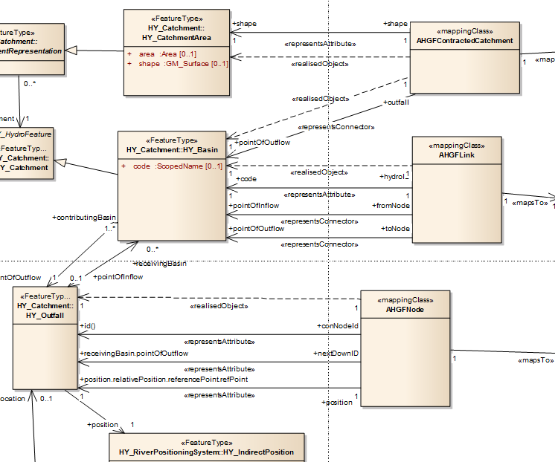
Mapping HY_Features to the AU-Geofabric
Rob Atkinson, June 2013
Copyright © 2013 Open Geospatial Consortium

Slide 20
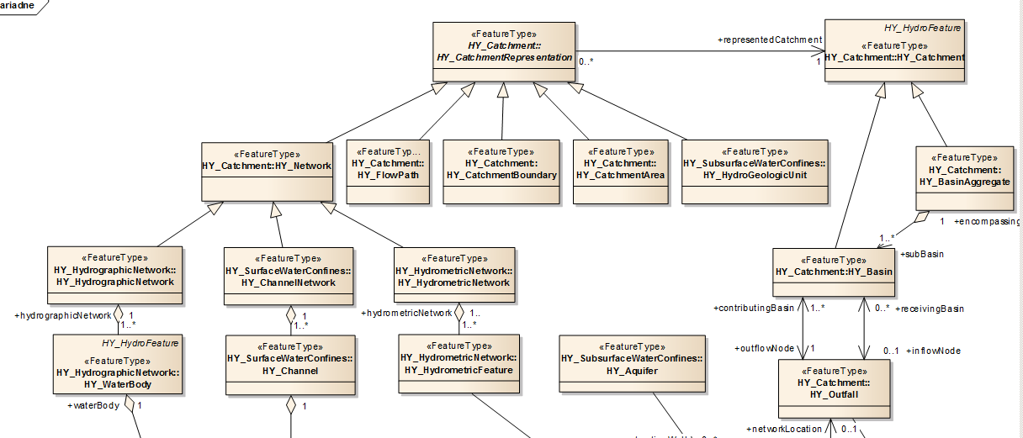
HY_Features – Basic concepts, 1(3)
Catchment and catchment representation
Copyright © 2013 Open Geospatial Consortium

Slide 21
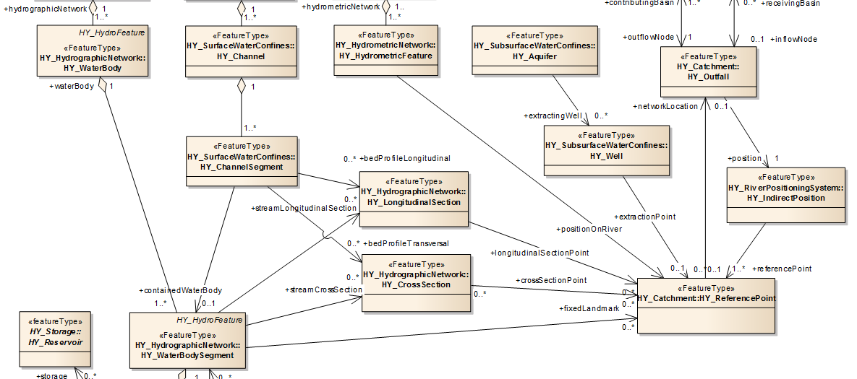
HY_Features – Basic concepts, 2(3)
Outfall, indirect position and reference point
Copyright © 2013 Open Geospatial Consortium

Slide 22
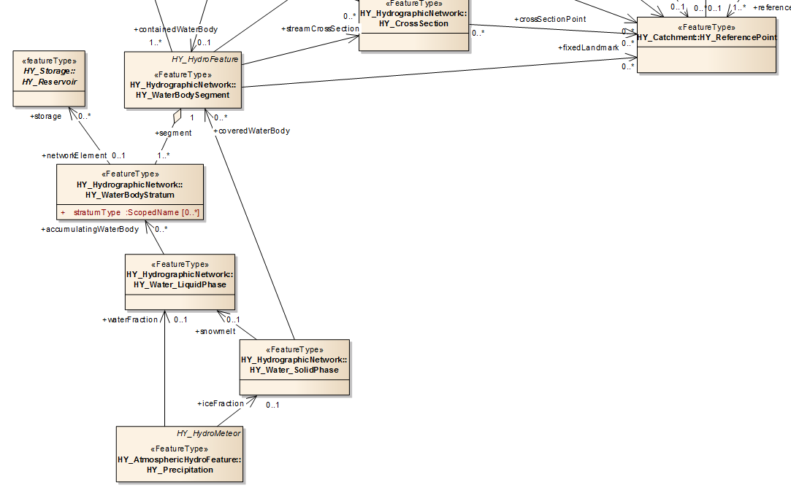
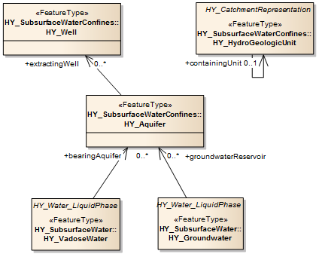
HY_Features – Basic concepts, 3(3)
Water, water accumulation and storage
Copyright © 2013 Open Geospatial Consortium

Slide 23
HY_Features – towards a standard reference model
Next steps within OGC context
OGC Specification work
  Discussion paper, release 3, (OGC/TC-83, Frascati, Sep 2013)
  Document approval motion for OGC 11-039r3
XML schema location for public
  OGC schema repository / PURL repo at CSIRO (for the time being)
Part of an OGC “Water Suite” (?) (tbd)
Next steps within WIS/WIGOS context
HY_Features Data Dictionary in the context of Hydrologic Metadata (draft)
  Summary to Chy-14 (WMO CHy-14, Geneva, Nov 2012 )
XML schema location for WMO Member countries
  within WIS/WIGOS (tbd)
HY_Features Report (Dec 2013)
→ WMO Best Practice document for referencing hydrologic features
Copyright © 2013 Open Geospatial Consortium

Slide 24
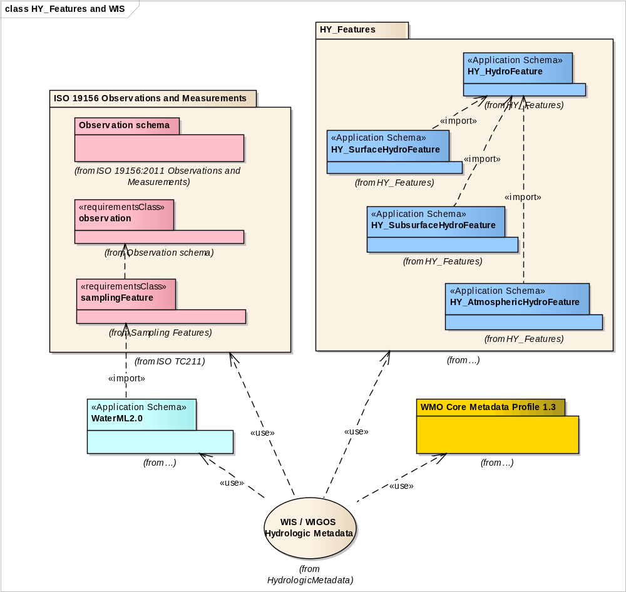
HY_Features in the context of WIS / WIGOS
Copyright © 2013 Open Geospatial Consortium

Slide 25
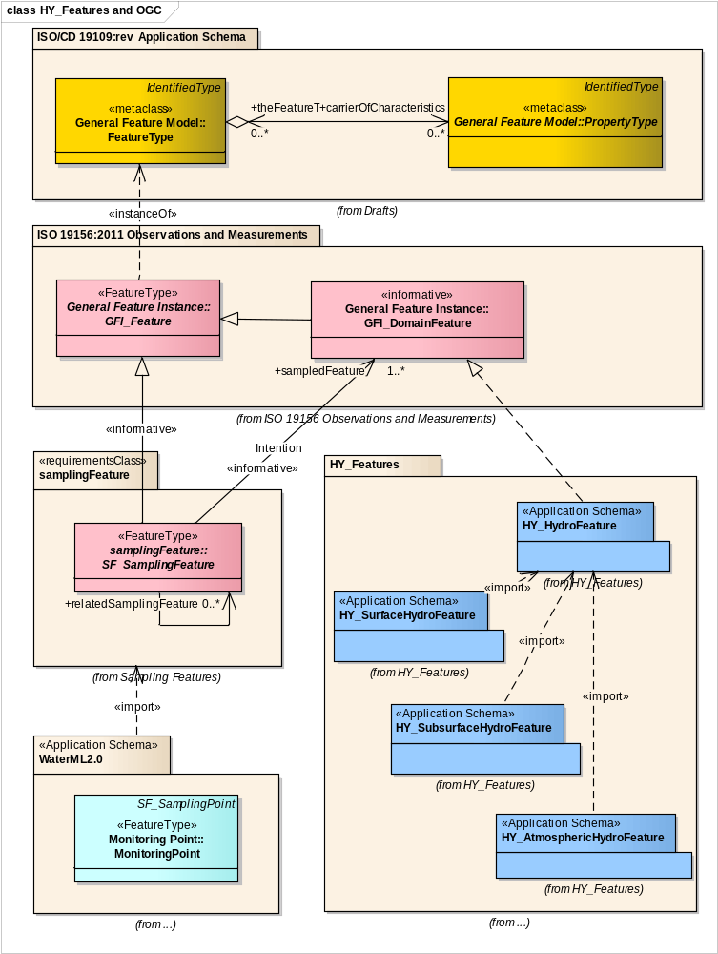
… in the context of the OGC/ISO Specifications
Copyright © 2013 Open Geospatial Consortium

Slide 26
… in the context of the OGC Specifications
Copyright © 2013 Open Geospatial Consortium

Slide 27
Document Approval Motion #1
The Hydrology DWG recommends that the OGC Technical Committee approve 3rd release of OGC 11-039r3 “HY_Features: Common Hydrological Feature Model” as an OGC Discussion Paper
  Pending and final edits and review by OGC staff
  Motion: Irina Dornblut (WMO Global Runoff Data Centre)
  Second: <name of the person seconding the motion>
  There was no objection to unanimous consent
This document describes the updated version (r3) of the hydrologic feature model, HY_Features, following the modifications of the UML model (r2) arisen from the discussions within the community of the WMO CHy (WMO_CHy14, Nov 2012) and in the HydrologyDWG (2012-2013).
HY_Features model provides concepts of the fundamental relationships between the most important hydrologic features and a concept of persistent identifier across multiple representations. This provides a basis for referencing hydrologic features that have persistent identity across multiple data products and information systems.
HY_Features allows to realise the Linked Data principle in support of common tools for discovery, access and sharing of hydrologic information in such a way that a hydrologic feature can be cross-referenced to a base concept and may be linked to a particular representation.
Copyright © 2013 Open Geospatial Consortium

Slide 28
Where to find ?
Discussion Paper (OGC 11-039r3, 28 Oct 2013)
HTML documentation (OGC 12-021r2, 19 Sep 2013)
XML schema definitions at SVN repository (https://svn.sdsc.edu/repo/WaterML/GRDC/trunk//schemas/gml3.2)
OWL schema definitions at SVN repository (https://svn.sdsc.edu/repo/WaterML/GRDC/trunk/schemas/OWL)
Atkinson, R., I. Dornblut and D. Smith, An international standard conceptual model for sharing references to hydrologic features. Journal of Hydrology, 2012, 424-425(2012): p.24-36
Thank you!
Copyright © 2013 Open Geospatial Consortium

