Slide 1
CHISP-1 Summary and Outcomes
Lew Leinenweber, OGC - Initiative Manager
Peter Vretanos, CubeWerx - Initiative Architect
23 September 2013

Slide 2
CHISP-1 Pilot Objectives
Create a virtual observatory system for surface and subsurface water resources observations in parts of the U.S. and Canada, building on current networks and capabilities
Link observations data to the stream network, enabling queries of conditions upstream from a given location to return all relevant gages and well locations.
Model and calculate nutrient loads for Great Lakes by accessing water-quality data from multiple cross-border agencies integrating stream flow and discrete sampled water quality observations.
Notes:
This Pilot project was conceived, in this initial phase, to develop and demonstrate a virtual observatory system to integrate the use of
water resource observations for the U.S. and Canada,
While building on existing networks and capabilities, and exploring opportunities for enhancement of these networks using geospatial standards.
This project aimed to link water resource observations, encoded using OGC’s Water Markup Language Version 2, or WaterML2, with river and stream network resources.
This linkage with stream network resources
Enabled queries of surface and ground water conditions upstream in a watershed from a given location to
Identify sensors for relevant surface gauges and and groundwater well locations and then
Retrieve historical and real-time sensor measurements

Slide 3
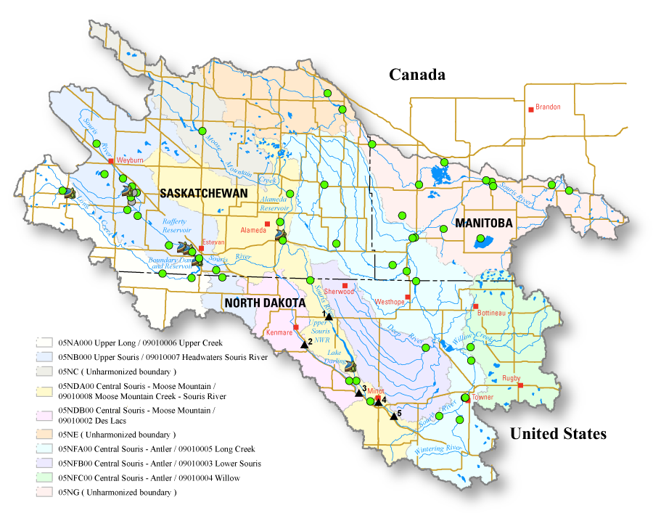
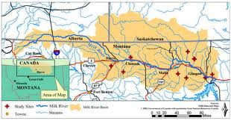
River Basins considered
Souris River Basin
Milk River Basin
SELECTED
Notes:
To focus the efforts for test and demonstration, this project considered two basins with portions in both the U.S. and Canada. The Milk River basin includes parts of Alberta, Saskatchewan, and Montana and the Souris River basin includes parts of Manitoba, North Dakota, and Saskatchewan. This project selected the Milk River basin to demonstrate the systems functions and capabilities.

Slide 4

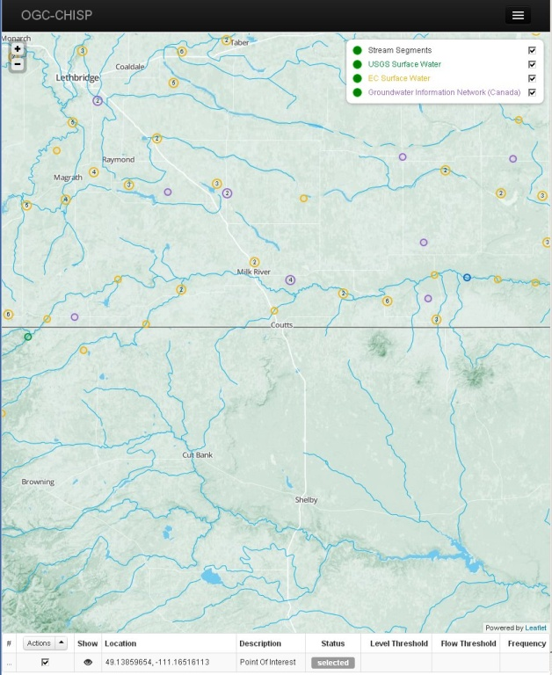
Cross-Border Upstream Monitoring & Alerting
SOS /WML2
(Water Level, Flow)
EC/NRCan
CSW
Explorus
WFS
(Station Info)
USGS
Event Notification
Service
(GIS-FCU)
Harvester
SOS / WML2
(Water Level, Flow)
USGS
WPS
(Upstream Gauges)
RPS-ASA
+ NRCan
Broker
SOS / GWML
(GW Level)
NRCan
WNS
RSS Feed
Upstream Monitoring Web Client
(Explorus)
CAP Info Editor
GIS.FCU
Multi-Agency Situational
Awareness System (MASAS)

Slide 5
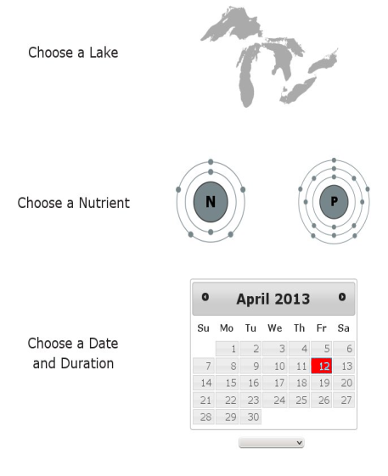
Great Lakes Nutrient Load Calculation Service
SOS2/WML2
(EC/NRCan)
Catalog
(RPS ASA)
SOS2/WML2
(USGS)
WPS
Nutrient Load
Calculation Service
(RPS ASA)
SOS2/WQX
(RPS ASA)
Canadian
WQ Server
Nutrient Load Web Client
(RPS ASA)
SPARQL Server
(NRCan)
USGS/EPA
WQ Server
Notes:
SPARQL Server was deployed by sponsor, but ontology data was not loaded due to personnel resource time constraints; alternatively, the project used an simple internal cross-reference database to accommodate differences in terminology.

Slide 6
CHISP-1 Achievements - Summary
System Functionality
US-Canada cross-border upstream flood monitoring & alerting
US-Canada Great Lakes nutrient load calculation using cross-border national datasets
System architecture
OGC Standards-based technology components and data formats utilized for international cross-border water resources management
OGC WaterML 2.0 standard used for encoding and retrieval of time-series water observations
OGC CSW catalog used for storage and update of last-value SOS time-series data encoded in WaterML 2.0 to monitor for potential flood event thresholds.
SOS Profile and Implementation practices
Created and implemented an SOS profile for surface and subsurface water domains serving WaterML 2.0 encoded data
SOS profile adaptations for handling massive stream and groundwater sensor networks
Adaptations to handle large numbers of measured water quality parameters using existing open standards.

Slide 7
Technical Achievements - Details
Map-based subscription web client
Integrated display of cross-border streamflow, groundwater and water level information
Subscription and Notification capabilities and interfaces (CAP and MASAS)
CSW (Python Implementation)
SOS GetDataAvailability
Notification broker
Harvester method
CAP alert client for Multi-Agency Situational Awareness System (MASAS)
Notes:
This slide and the next provides a brief summary of the Achievements that were realized during this project
Map-based subscription web client
Displays a map and allows client to choose flood monitoring point/gauge
Python implementation of CSW (PYCSW)
Deployed and tested open source CSW server
Found and corrected a number of bugs (community service)
GetDataAvailability
Not yet an approved operation of the SOS standard.
Developed and used a prototype implementation for the operation and tested during CHISP-1
Extends 52-North source to include GDA operation
Plan to migrate this code into the existing 52North code base for community use
Harmonize GDA response across all servers in CHISP-1
Notification broker
Coordinating service that interacts with multiple services in the CHISP-1 architecture
Upstream WPS, WNS, NRCAN/USGS SOS’s, CSW, Harvester Module
Checks sensor reading to see if they exceed thresholds set during subscription
Performs notification using the Web Notification Service (WNS)
Harvester Module
Reads and stores last value from sensors/gauges in order to perform threshold tests
Stores last value in the catalog (CSW) along with station metadata
CAP Alert client
Web-based client to enter parameters necessary to send information for a CAP alert
Interfaces with the MASAS system to form and send the alert

Slide 8
Technical Achievements - Details
Web-based NLCS client
SOS facade on existing non-OGC sources of water quality information
Indexing service
Nutrient load calculation service (WPS)
Upstream gauges/wells (WPS)
SPARQL server for mediation of analyte vocabularies
Notes:
First:
NLCS client
Deployed as a Web-based client that allows the user to choose a Great Lake and analyte in order to compute nutrient loads entering the lake
Water quality SOS façade was created to:
Integrate existing non-OGC water quality source data services
Using an OGC compliant Sensor Observation Service (SOS) API (i.e. façade) for access to those sources
Nutrient Load Calculation Service (NLCS) was developed
Given the selection of a Great Lake and an analyte, the NLCS computes the nutrient loads using
An Indexing service that
Identifies stream flow gauges and water quality stations – and tributaries and lakes with which they are associated
The Indexing service was deployed as a local data store
2. Upstream service
Identifies upstream gauges and sensors given a selected point of interest
Deployed as a WPS
Lastly:
SPARQL server
Deployed to serve as a semantic mediator of analyte vocabularies between US and Canada
Loading of ontology data was not completed in time for this demo due to personnel resource constraints
In the meantime, the NLCS used a local, internal mapping of vocabularies for mediation

Slide 9
Technical Challenges
Service performance and stability
Required use of robust error handling to mitigate
Large networks of sensors are not sufficiently supported in SOS standard
Listing of procedures and features of interest not manageable
Catalogue implementation issues
Selected alternative service implementation
SPARQL server
deployed but not populated due to resource constraints
Data and software issues implementing NLC model
Open source calculation model exhibited bugs; insufficient data for cross-border nutrients information
Harvester module issues
Performance issues with back-end services; used robust error handling to mitigate
GDA extension for SOS
Implemented enhancement to GDA; however, not merged with Sponsor code base awaiting database migration scripts between 52North database versions
Notes:
Service performance and stability
There were issues of stability and performance with some of the backend services necessitating the development of more robust error handling
Large networks of sensors are not sufficiently supported in SOS standard
Listing all procedures and features of interest is not usually manageable for large networks (getCapabilities response can become very large and unmanageable)
Catalogue issues
The initial deployment using GeoNetwork CSW was not stable or complete; moving to pycsw – developed by Tom Kralidis from EC resolved most of the issues
SPARQL server
Deployed but not populated with ontologies because of personnel resource time constraints
NLCS WPS
Bugs with the open source software libraries used to implement the model and the sparseness of data on the Canadian side necessitated the move to a simpler model
Harvester module issues
The last-value harvester module was impacted by the previously mentioned performance issues with the SOSs
It is very difficult to demonstrate a back-end service and the client that was demonstrated by GIS-FCU was developed to step through in processing actions
GDA extension for SOS
GetDataAvailability operations conforming to the NRCan SOS profile was implemented using the latest 52North code base
However, since the current 52North SOS code base did not yet include the necessary database migration scripts in order to move the existing data to the newer SOS version to demonstrate the operation with most current data

Slide 10
CHISP-1 ER & Motion
13-053r1 - CHISP-1 Engineering Report on pending:
https://portal.opengeospatial.org/files/?artifact_id=55244&version=1
The Hydrology DWG recommends that the OGC Technical Committee approve release of OGC 13-053r1, CHISP-1 Engineering Report as an OGC Public Engineering Report
Pending and final edits and review by OGC staff
Motion: Simon Cox
Second: Uli Looser
Vote: approved by unanimous consent

Slide 11
Initiative Summary ER & Motion
13-046r2 - CHISP-1 Summary Engineering Report
(r2 consists of editorial updates/corrections from previous version r1 posted on pending since 15 July 2013)
https://portal.opengeospatial.org/files/?artifact_id=55432&version=1
The Hydrology DWG recommends that the OGC Technical Committee approve release of OGC 13-046r2, CHISP-1 Summary Engineering Report as an OGC Public Engineering Report
Pending and final edits and review by OGC staff
Motion: Simon Cox
Second: Uli Looser
Vote: approved by unanimous consent

Slide 12
Thank you!
Questions?

