Slide 1
Experiments in CityGML-Based Surface and Groundwater Modelling – Can the Hydrology DWG Help?
86th OGC Technical Committee
Frascati, Italy
Steve Smyth – Co-chair CityGML SWG - steve@opensiteplan.org
23rd September 2013
Copyright © 2013 Open Geospatial Consortium

Slide 2
CityGML
CityGML 2.0 is both a conceptual model and an encoding standard for representations of the built environment.
A site is a group of related structures, infrastructure, and the land and water upon or inside of which the structures and infrastructure are located.
The CityGML core and extensions can represent all of the important features of a site
  Land surface
  Water features
  Subsurface geology
  Pipes, cables, and other infrastructure
  Tunnels, bridges, roads, paths, trees, furniture
  Buildings and other built structures
Copyright © 2013 Open Geospatial Consortium

Slide 3
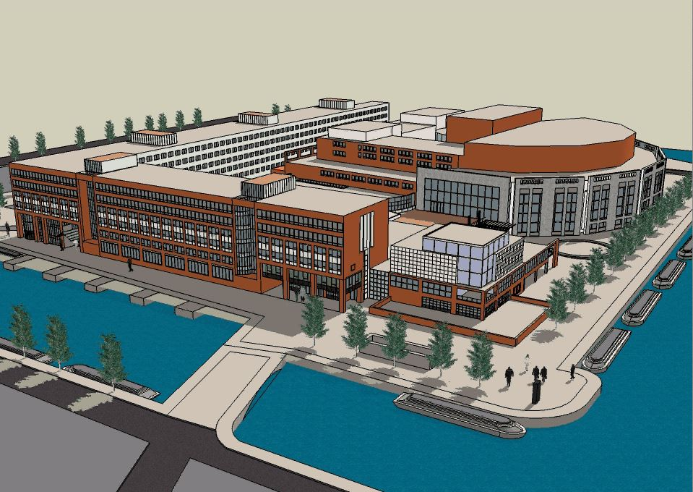
Example: The Stopera – A Site
Copyright © 2013 Open Geospatial Consortium

Slide 4
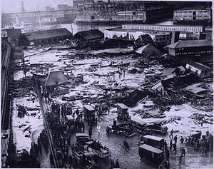
Site Simulations
Site simulations are an important CityGML application area
  Sound, Solar potential, Heating, Heat Loss, Fire, Blast Effects
  Fluid flow
    Precipitation/runoff
    Pipe breaks
    Dam and tank breaks
    Surface
      Waves, including tsunamis
      Channeled flow
      Storage
      Runoff
      Infiltration
    Subsurface
    We are beginning experiments to apply Smoothed Particle Hydrodynamics (SPH) to sites http://www.youtube.com/watch?feature=player_embedded&v=F5KuP6qEuew
Copyright © 2013 Open Geospatial Consortium

Slide 5
Hydrology DWG
The Hydrology DWG appears to have support for input variables that could drive flow simulations
  Streamflow measurements
    Stage
    Discharge
    Velocity
    Relationships between the above
  Precipitation measurements
  Groundwater and Subsurface Geology
    Top of saturated zone
    Well-bore lithology
Copyright © 2013 Open Geospatial Consortium

Slide 6
Connection with Hydrology DWG?
Things we are looking for
  Historical and real-time inputs for surface and groundwater simulations
  Data to support validation of simulation algorithms
  Changes/additions to CityGML can do to connect better to hydrological information.
Can the Hydrology DWG help?
Copyright © 2013 Open Geospatial Consortium

