Slide 1
AIP-6 Water SBA GEOSS Water Services (GWS) Progress Update
OGC/WMO Hydrology DWG
OGC TC, Frascati Italy
23 September 2013
David Arctur
University of Texas at Austin
Open Geospatial Consortium

Slide 2
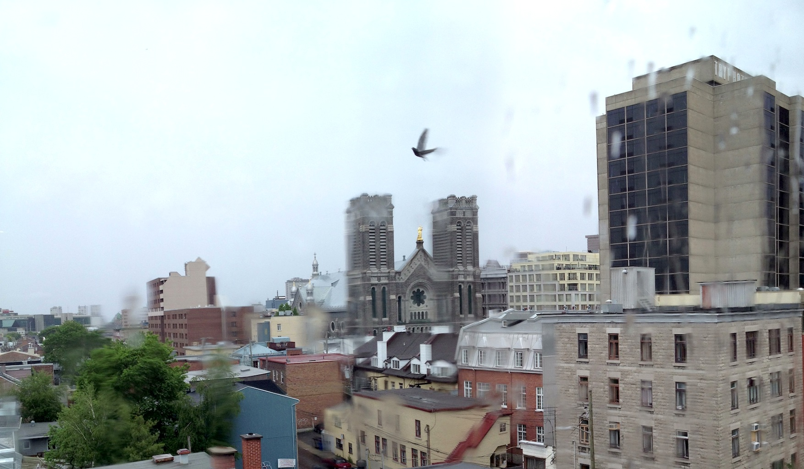
OGC Hydro DWG Workshop, Québec City, Canada, 17-21 June 2013

Slide 3
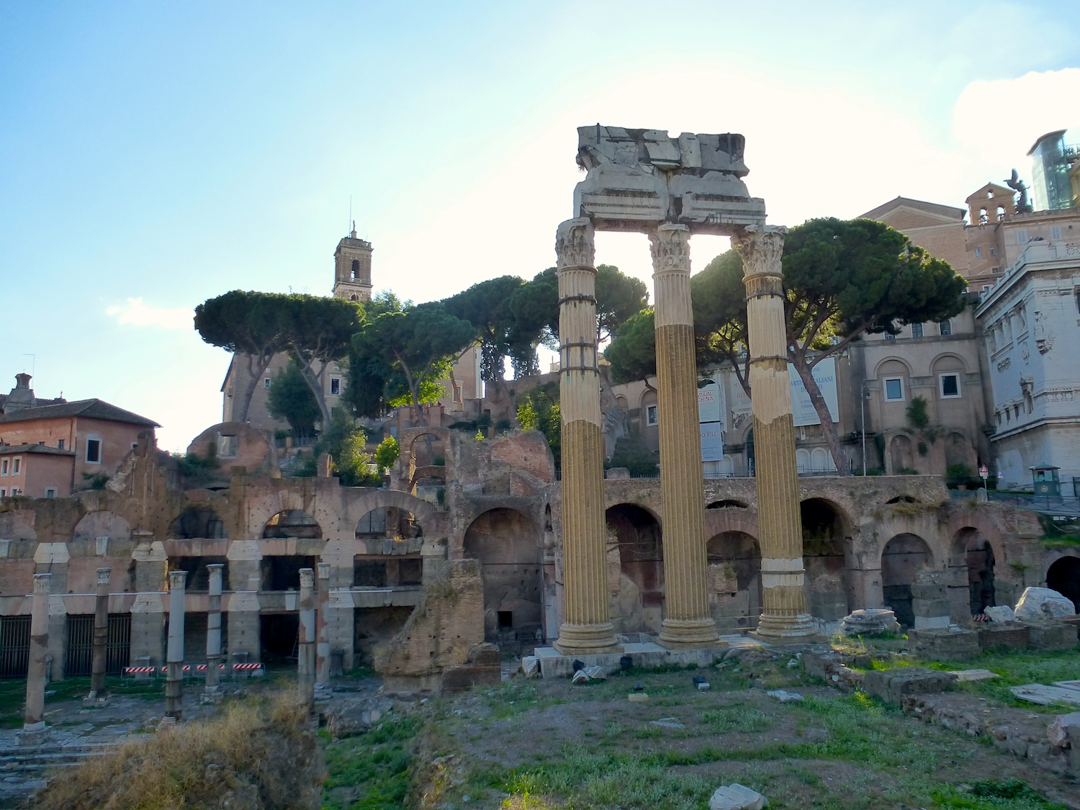
OGC TC, Frascati Italy, 23-27 September 2013

Slide 4
AIP-6 GEOSS Water Services
Purpose: Provide additional operational, federated water information resources in GEOSS
Scope: A global registry of water data, map and modeling services catalogued using the standards and procedures of the OGC and the WMO
In collaboration with WMO CHy Theme 2 “Data Operations and Management”, 2012-16
In support of GEO Water Task and Integrated Global Water Cycle Observations (IGWCO) Community of Practice

Slide 5
Importance of regional / national data federation
WMO has legally binding agreements with all member nations to share meteorology data
But very few nations share water resource data
Establishing conventions and ‘best practices’…
Supports creating a national picture from disparate regional data providers
Supports interregional and international coordination of water policies and data for cross-border watersheds

Slide 6
AIP-6 GEOSS Water Services
Application Services
Community info services, for serving:
Observation Services
Water time series
Model Services
Computed water time series
Map Services
Web maps, geoprocessing
Based on OGC WaterML, WFS, WMS, SOS, CSW

Slide 7
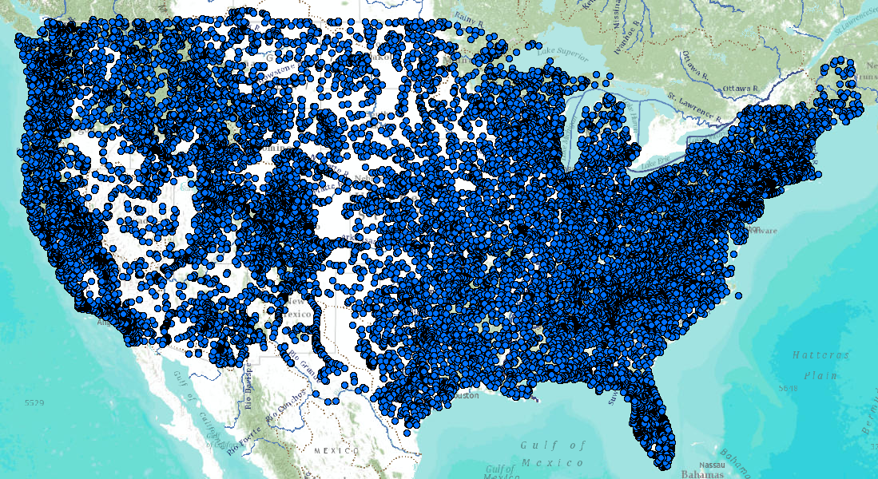
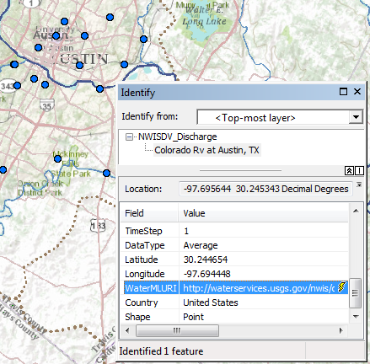
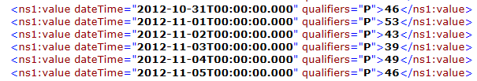
Water Time Series Services Stack
Catalog
Metadata
Data
Web Feature Service for Observation Metadata
Colorado River
at Austin, Texas
WaterML time series service for data
An attribute of each mapped observation point . . .
. . . is a web link to the WaterML data service

Slide 8
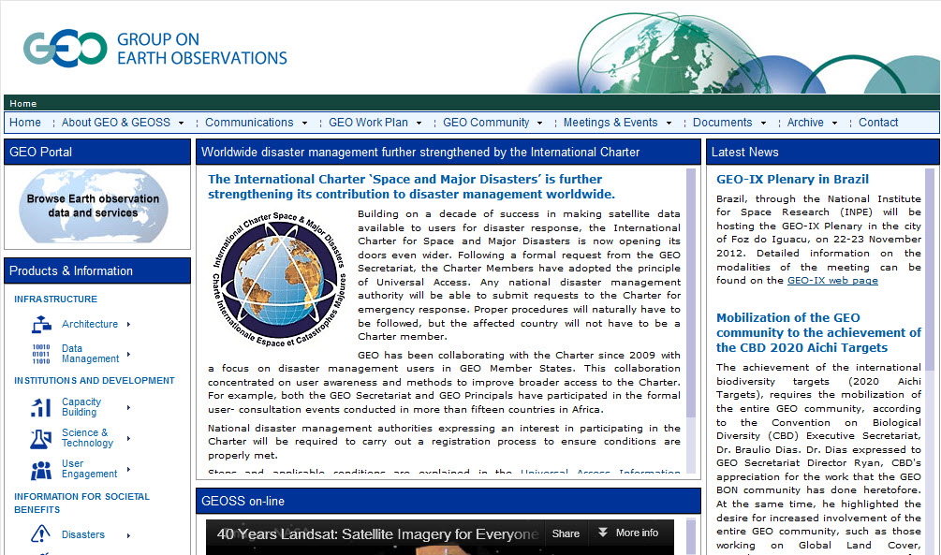
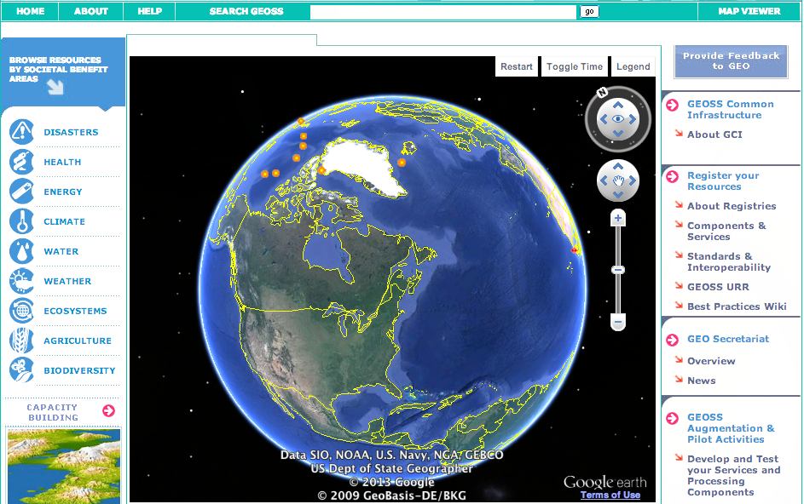
Global Earth Observation System of Systems (GEOSS) http://earthobservations.org - http://www.geoportal.org/
Notes:
As of Sept 9, Search results for all data: 624 million resources registered

Slide 9
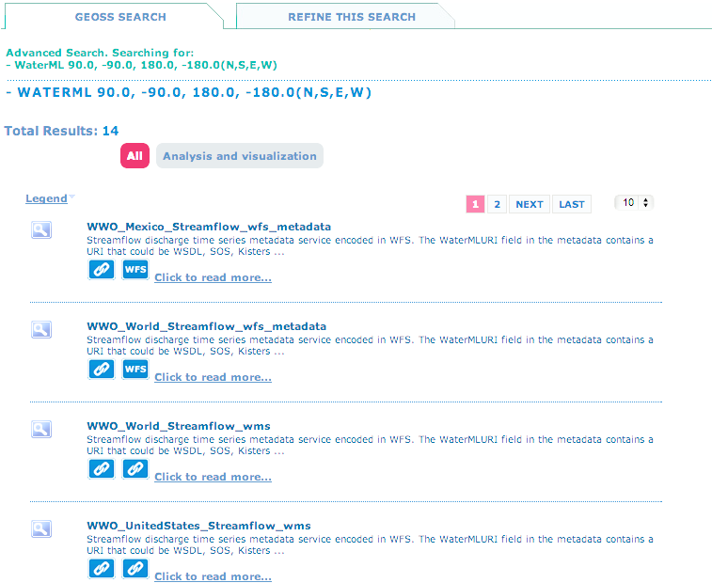
For quick discovery & access
http://bit.ly/19BPbrv
Notes:
http://www.geoportal.org/web/guest/geo_search_overview?p_p_id=srgPortlet_WAR_geoportal&p_p_lifecycle=0&p_p_state=normal&searchType=advanced&newregionid=-180%2C-90%2C180%2C90&north=90&west=-180&east=180&south=-90&ftext=WaterML&startDate=&endDate=&numberRecordsForPage=10&x=-458&y=-855 http://bit.ly/19BPbrv

Slide 10
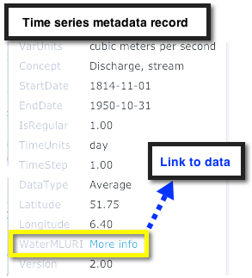
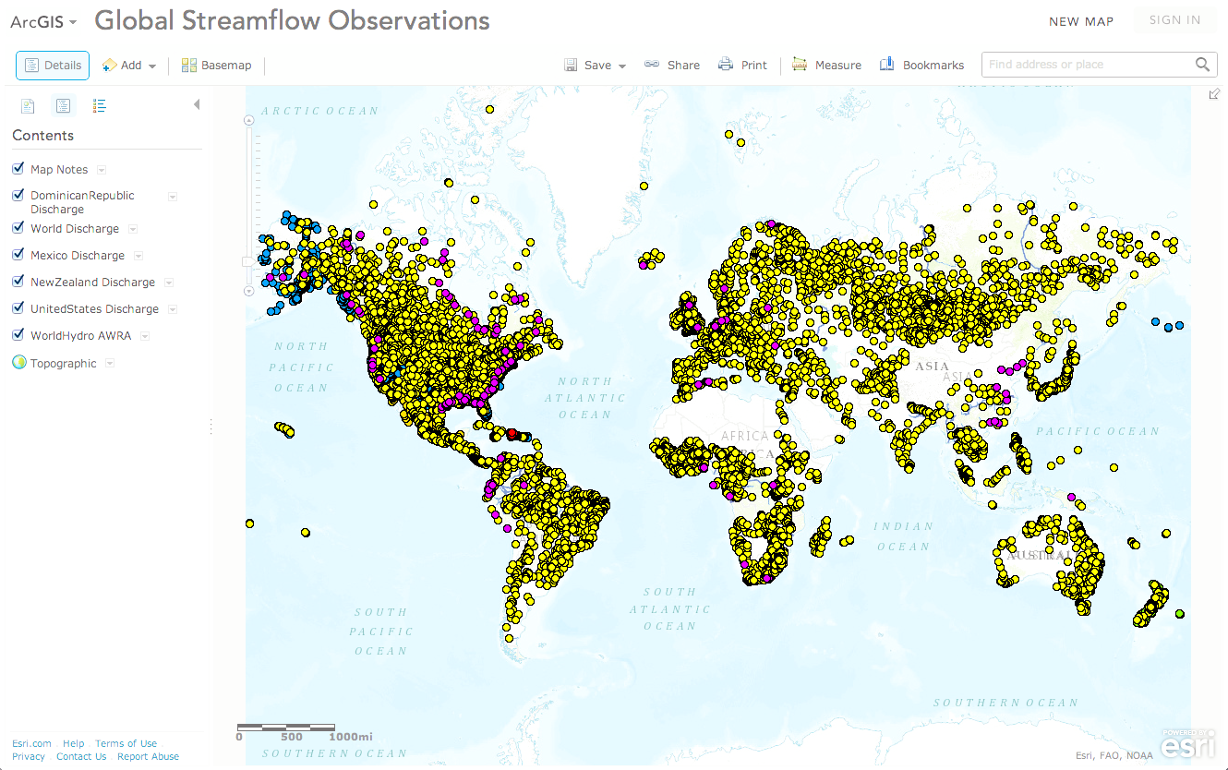
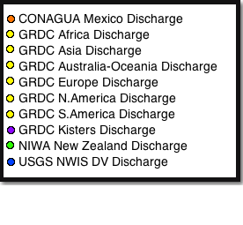
http://www.arcgis.com/home/webmap/viewer.html?webmap=87ab07e2aba840828033e80b15fd6727
Notes:
http://www.arcgis.com/home/webmap/viewer.html?webmap=87ab07e2aba840828033e80b15fd6727

Slide 11





AIP-5 Architecture and Interaction
WFS
GRDC
Metadata
(Univ Tx host)
GEOSS Search
WWO Map Viewer
WFS
Dominican Republic Metadata
(Univ Tx host)
ArcGIS Online /
PYXIS WorldView
WFS
USGS Metadata
(Univ Tx host)
Notes:
Here is the current architecture for WWO within GEOSS. A user can search the GEOSS registry for “WWO” and access the World Water Online Portal or Map Viewer. If you go to the map viewer, you will see a map containing rendered Web Feature services representing the locations of monitoring stations. A user can zoom in and select a monitoring station to see a pop-up with metadata and possibly other content as well such as a graph. If the metadata provides a WaterMLURI, the user can click on the link to send a request to the data server, returning WaterML data. In the current architecture, the University of Texas is hosting the metadata services while the data services are coming from different hosts. Each of these hosts are publishing WaterML data through both proven industry and open technologies.
User searches GEOSS registry for “WWO”, gets back list of components and data services.
(click) User selects WorldWaterOnline Portal from search result, and zooms into map viewer.
(click) User selects a monitoring station, and sees a popup with time series metadata, and possibly other content such as graph of recent water discharge at that station.
(click) If metadata provides a “WaterMLURI” field value (link) this will send a request to the data server, returning WaterML data, ready for use in an application.

Slide 12
AIP-5 Architecture and Interaction
SOS
GRDC WaterML2
(Kisters host)
WWO Map Viewer
WOF
Dominican Republic WaterML1
(BYU host)
ArcGIS Online /
PYXIS WorldView
REST
USGS WaterML1
(USGS host)
Notes:
Here is the current architecture for WWO within GEOSS. A user can search the GEOSS registry for “WWO” and access the World Water Online Portal or Map Viewer. If you go to the map viewer, you will see a map containing rendered Web Feature services representing the locations of monitoring stations. A user can zoom in and select a monitoring station to see a pop-up with metadata and possibly other content as well such as a graph. If the metadata provides a WaterMLURI, the user can click on the link to send a request to the data server, returning WaterML data. In the current architecture, the University of Texas is hosting the metadata services while the data services are coming from different hosts. Each of these hosts are publishing WaterML data through both proven industry and open technologies.
User searches GEOSS registry for “WWO”, gets back list of components and data services.
(click) User selects WorldWaterOnline Portal from search result, and zooms into map viewer.
(click) User selects a monitoring station, and sees a popup with time series metadata, and possibly other content such as graph of recent water discharge at that station.
(click) If metadata provides a “WaterMLURI” field value (link) this will send a request to the data server, returning WaterML data, ready for use in an application.

Slide 13



















AIP-6 GEOSS Water Services Team

Slide 14
AIP-6 Thematic Goals – 1
Provide a systematic way for publishing map services of water observations that index locations of accessible WaterML time series services.
Produce web services of the results of global models for flood and drought analysis, including:
EC Global Flood Awareness System (GloFAS)
NASA/NOAA Global Land Data Assimilation System for drought assessments
Link web services for observations and modeling, so observations can inform model calibration, and so models can furnish larger context for observations

Slide 15
AIP-6 Thematic Goals – 2
Form federated national water data services for common variables
Italy: ISPRA national, ARPA regional agencies
New Zealand: NIWA national, HRC regional
Synthesize data, map, and modeling services to support specific useful applications, eg, linkage of watershed delineation with precipitation mapping over watershed + flow observations + model results at outlet
Advance the utilization of water services in developing countries, through access to global web services, and lightweight methods of publishing local data

Slide 16
Project Output: enabling Thematic Maps of water information anyone can find & use
Water data & model output providers follow consistent practices in applying the OGC O&M model and WaterML 2 standard
This model description becomes part of the WMO Glossary of Terms
GEOSS provides rules for publishing these maps
Easy registration and quick, consistent discovery
How we’ll know we’re done:
We can register and perform distributed search through GEOSS for time series of stream flow, and get maps and data for the results
We can search from Esri ArcGIS Online and find resources registered in GEOSS; and we can search from GEOSS and find resources registered in ArcGIS Online.
Same applies to distributed search using CUAHSI Hydrologic Information System and HydroDesktop app, and to PYXIS WorldView.

Slide 17
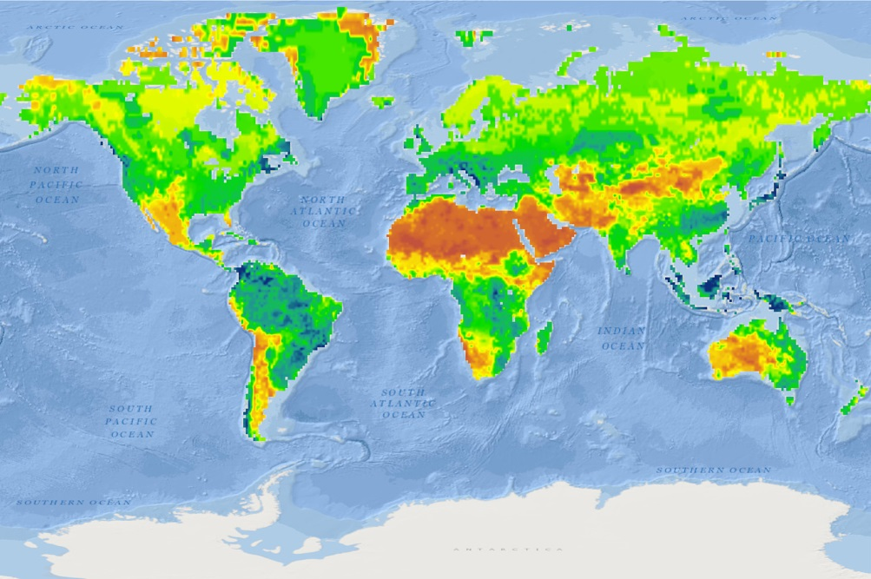
Global Water Maps
Describe a water property over a domain of space and time
History
Current conditions
Forecasts
Model Web
Sensor Web
Precipitation
Evaporation
Transpiration
Soil Moisture
Streamflow
Groundwater
Reservoirs
Water Property
Past
Present
Future

Slide 18
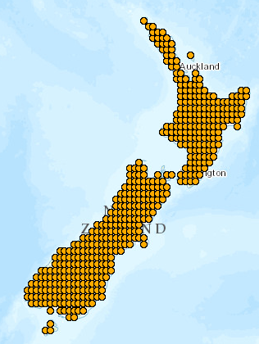
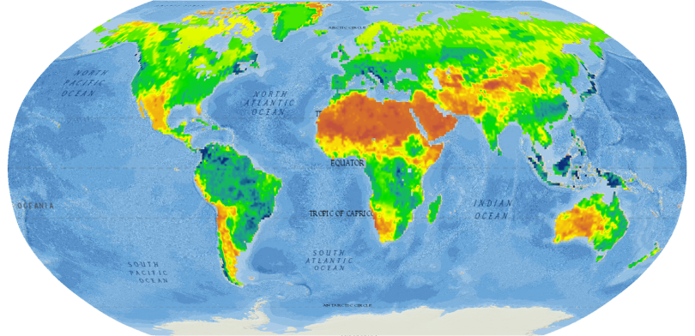
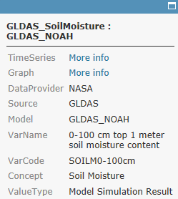
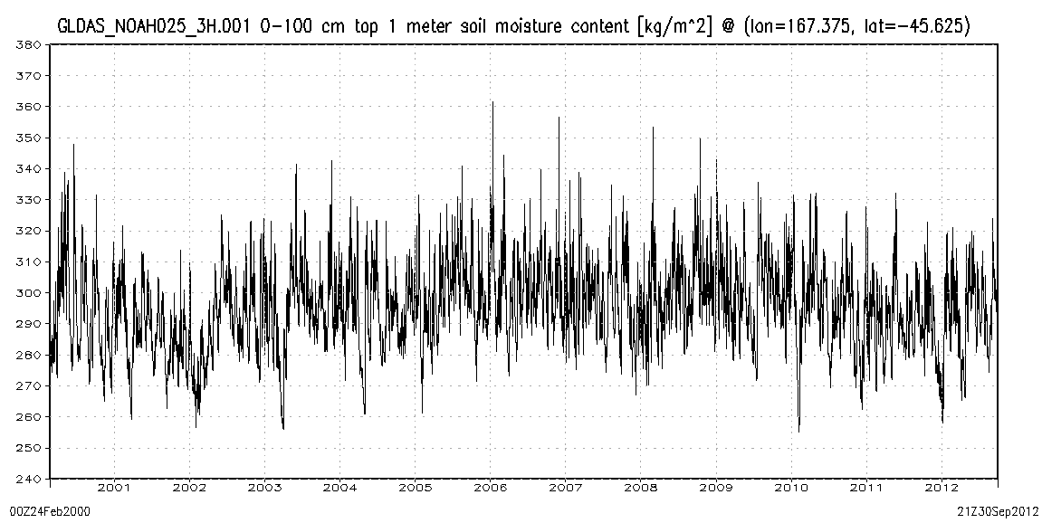
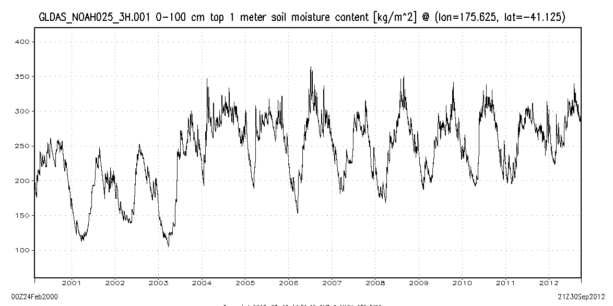
World Soil Moisture
from the NASA Global Land Data Assimilation System (GLDAS)
http://www.arcgis.com/home/webmap/viewer.html?webmap=7d6cefdf3f324b55b08c136654e91612
Charts show 3-hourly variation (37,000 values) of soil water content of the top 1m of soil from 2000 to 2012
Popup on point links to data and chart
New Zealand
A very wet region with little seasonality
A dryer region with distinct seasonality
A dryer region with significant seasonality

Slide 19
Demonstration Scenarios, Use Cases
Regional / national federation of time series metadata and water resources data
Italy
New Zealand
Canada
Latin America
Dominican Republic
Nicaragua
Guatemala
Honduras
Flooding response for hurricane storm surge, flash floods

Slide 20
Water SBA progress to date
Silvano Pecora, Italian regional water agency:
Leading “sensor web” subgroup of GEOSS Water Services team
Ported and implemented CUAHSI HIS to Linux/MySQL in Italy
Coordinating with Stefano Nativi, Italy CNR, for integration with GI-CAT and GEOSS Discovery & Access Broker framework
Implementing CUAHSI HIS throughout all Italian water regions
Working with USask Canada, and New Zealand agencies to encourage consistent practice for federating regional data providers for national picture

Slide 21
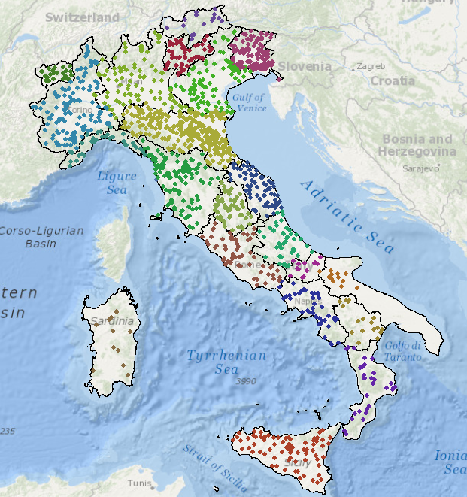
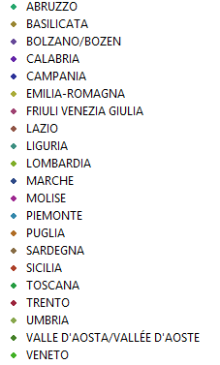

Italy – 19 regions and 2 provinces
National Institute for Environmental Protection and Research (ISPRA)
ISPRA is the NIWA of Italy ….
….Hydrometric measurement was regionalized in 2002

Slide 22
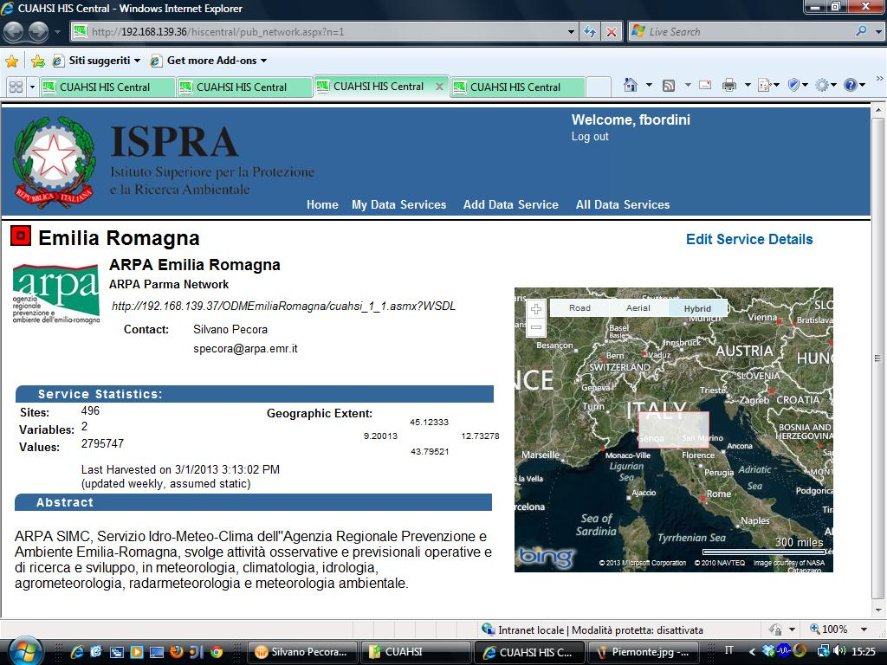
Water data hub in Italy

Slide 23
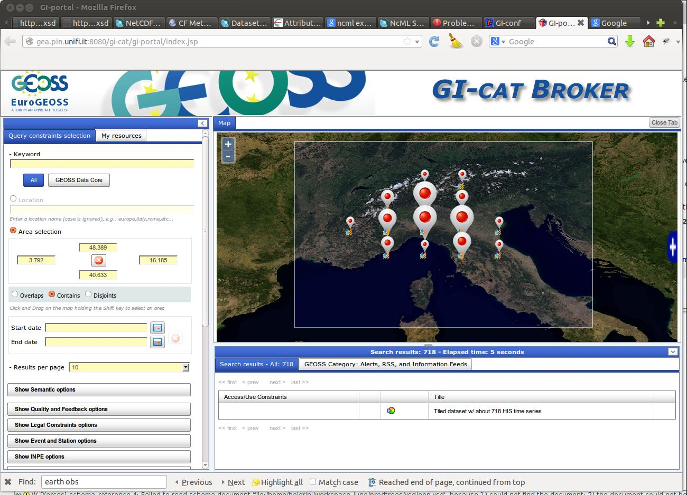
Water data hub in Italy

Slide 24
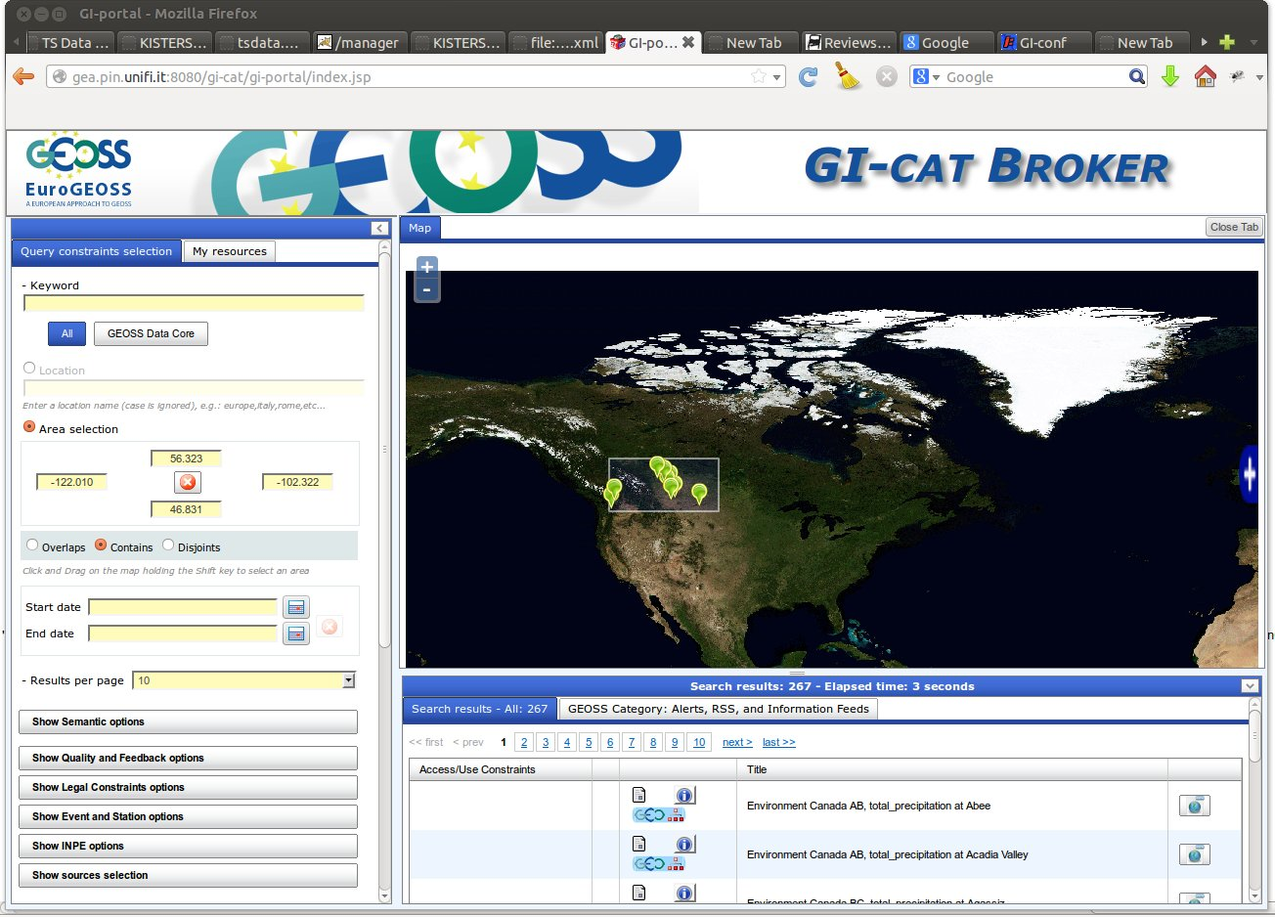
Canada hub from USask-GIWS

Slide 25

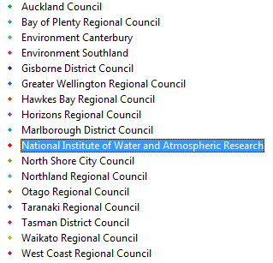
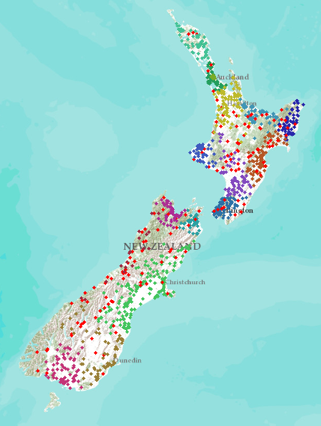
New Zealand – 16 regions
NIWA operates about 20% of 1300 hydrometric stations Regional authorities operate about 80% of stations
Develop a federated hydrological information infrastructure . . .
. . . linking nationally and regionally collected data

Slide 26
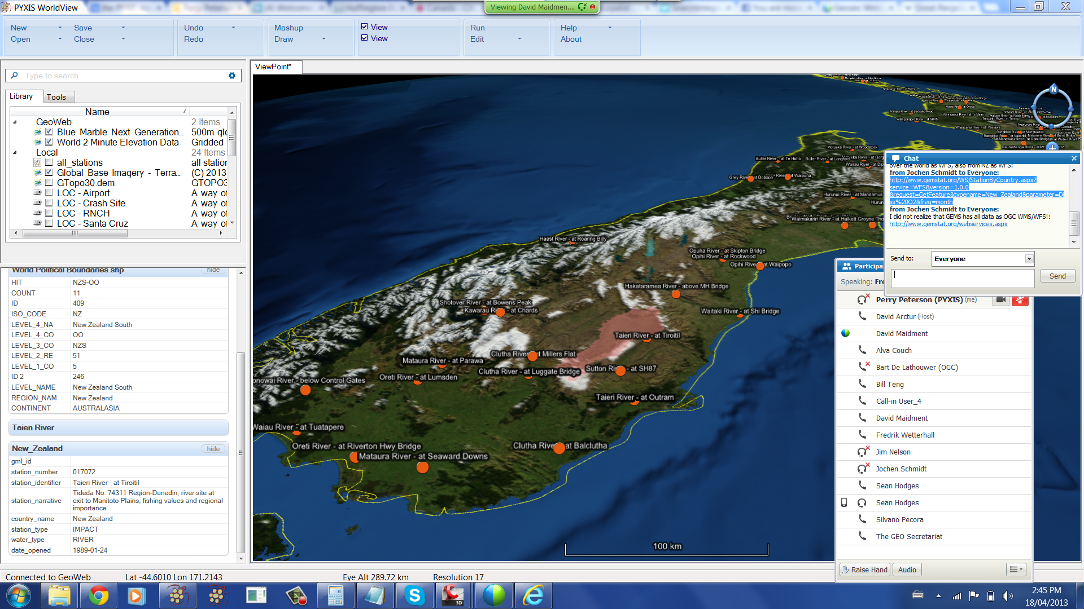
Interoperability by WorldView client

Slide 27
Significant issues, lessons learned
GEOSS Common Infrastructure (GCI) integration needs work
GEOSS Clearinghouse harvests metadata from resources registered in the GEOSS Components and Services Registry (CSR)
GEO Discovery and Access Broker (DAB) provides syntactic & semantic mediation services, and can work with resources found via Clearinghouse or registered directly with DAB
GEOSS Clearinghouse does not provide full support for non-ISO type resources, eg, THREDDS, OPeNDAP; these must be registered directly in DAB
But resources should not be registered in both CSR and DAB, to avoid redundant metadata capture (not synchronized)
This is fairly recent issue; GEO Standards & Interoperability Forum (SIF) exploring [GEO IN-03 task?]

Slide 28
For more info…
Wiki hosted by UAB CREAF http://twiki.grumets.uab.es/twiki/bin/view/AIP6/WaterSBATopic
Proposed outline of work; meeting notes
Prep for target event: GEO Summit, 14-17 January 2014, Geneva
Ministerial Showcase (closed session)
Demos, scenarios, use cases, servers/client apps
AIP6 Client-Server Interoperability Matrix
Powerpoint template and capture guidelines for AIP-6 demo videos

Slide 29

Thanks! David Arctur Open Geospatial Consortium University of Texas at Austin david.arctur@utexas.edu

