Slide 1
Progress towards a standard WMO Hydrologic Metadata Model
86th OGC Technical Committee
Frascati, Italy
Irina Dornblut, WMO, GRDC
23 September 2013
Copyright © 2013 Open Geospatial Consortium

Slide 2
GRDC Hydrologic Metadata
WMO Context and Background
Basic Concept
Next Steps
UML diagrams
  representationInfo
  lineageInfo
  contentInfo
  HydrologicVariable
  DataGenerationProcess
Copyright © 2013 Open Geospatial Consortium

Slide 3
WMO Context and Background
WMO Technical Commission for Hydrology (WMO CHy)
  Thematic area: Data operations and management (since Nov 2012)
    Monitor and report on new developments dealing with data management issues, review progress with respect to the exchange of hydrological data and products, guide harmonization of practices
  CHy-13(2008): GRDC Hydrologic Metadata (first draft)
    Intention to join data set description and observational information
  CHy-14(2012): review of GRDC Hydrologic Metadata concepts
    Reflecting the developments in the HydrologyDWG
WMO Information System (WIS)
  WMO Core Metadata Profile of ISO19115(2003)
WMO Integrated Global Observing System (WIGOS)
  WIGOS Core Metadata (under development, 2013)
Copyright © 2013 Open Geospatial Consortium

Slide 4
GRDC Hydrologic data und products
Collections of data:
offered for global exchange, disseminated using services
reporting physical, chemical and biological properties of waters above, on and below the Earth's surfaces (observation results)
generated by further processing of “primary” data which are results of preceding source observations (information hierarchy: “secondary-observation” result)
compiled in spatial or temporal coverages, exemplarily time series and maps created by the GRDC
Copyright © 2013 Open Geospatial Consortium

Slide 5
GRDC Hydrologic Metadata
Shall be compliant to WMO Core Metadata Profile
  Identification, content, lineage, … of the data set
Shall consider the information hierarchy
  Identification of the dataset as result of an observation
  Identification of the “source observation” as the first process step
Shall be applicable to time series (temporal coverages)
  Describe temporal aggregation of data values (time sample)
  Describe accumulation of time-related data values (time grid)
Should provide the observational information
  Station (sampling feature), hydrologic object under observation (sampled feature), instrument or model applied (procedure), variable (observed property).
Copyright © 2013 Open Geospatial Consortium

Slide 6
GRDC Hydrologic Metadata
shall use the WMO Core Metadata profile of ISO 19115
Maintenance info
Updating “primary” data
Quality info
Reliability of “primary” data
Distribution info
Dissemination service
Use constraints
WMO data policy
Representation info
Identify time series
Lineage info
Identify results from observation
Data identification info
Content info
Time series description
Copyright © 2013 Open Geospatial Consortium

Slide 7


GRDC Hydrologic Metadata
shall use the WMO Core Metadata profile of ISO 19115
Maintenance info
Updating “primary” data
Quality info
Reliability of “primary” data
Distribution info
Dissemination service
Use constraints
WMO data policy
Representation info
Identify time series
Lineage info
Identify results from observation
Content info
Time series description
Copyright © 2013 Open Geospatial Consortium

Slide 8


GRDC Hydrologic Metadata
with respect to time series
Maintenance info
Updating “primary” data
Quality info
Reliability of “primary” data
Distribution info
Dissemination service
Use constraints
WMO data policy
Lineage info
Identify results from observation
Data identification info
Copyright © 2013 Open Geospatial Consortium

Slide 9

GRDC Hydrologic Metadata
with respect to time series, resulting from observation
Maintenance info
Updating “primary” data
Quality info
Reliability of “primary” data
Distribution info
Dissemination service
Use constraints
WMO data policy
Copyright © 2013 Open Geospatial Consortium

Slide 10


GRDC Hydrologic Metadata
with respect to time series, processed from “primary” data
Distribution info
Dissemination service
Use constraints
WMO data policy
Copyright © 2013 Open Geospatial Consortium

Slide 11


GRDC Hydrologic Metadata
distributed by dissemination service under condition of WMO data policy
Copyright © 2013 Open Geospatial Consortium

Slide 12
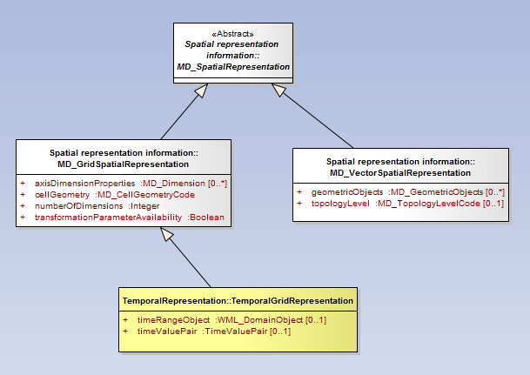
TemporalGridRepresentation to identify time-series objects
ISO 19115-1
defined within WaterML2P1

Slide 13
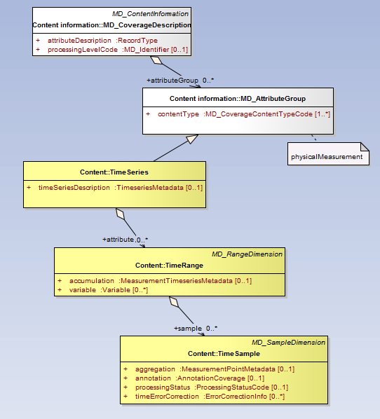
contentInfo to describe time series and time series points
ISO 19115-1
Metadata defined in WaterML2P1

Slide 14
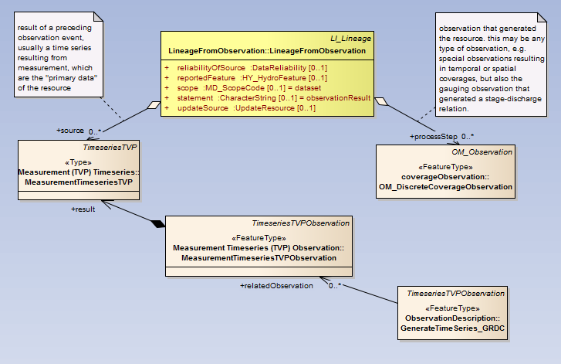
LineageFromObservation relates observation results
ISO 19115-1
ISO 19156 / WML2P1

Slide 15
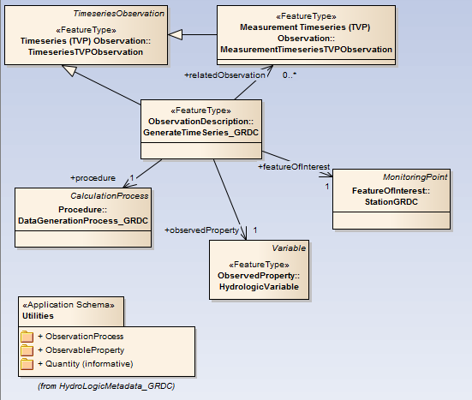
Observation description (application-specific)
WaterML2P1

Slide 16
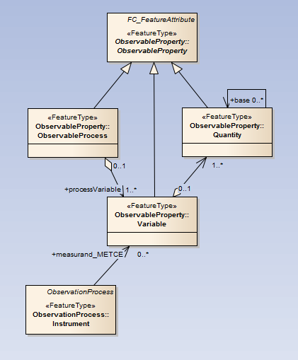
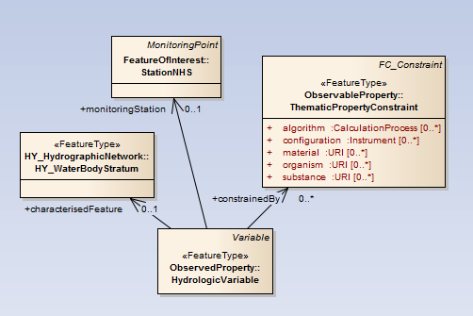
HydrologicVariable – application-specific concept
WaterML2P1

Slide 17
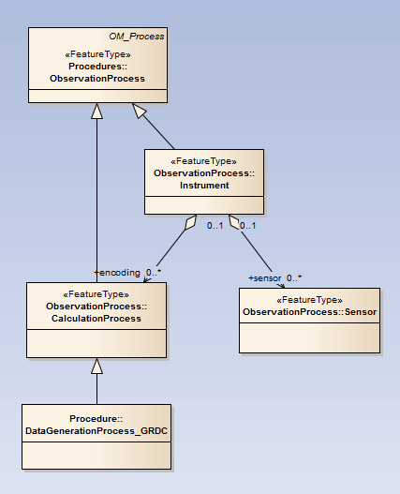
DataGenerationProcess – application-specific concept
WaterML2P1

Slide 18
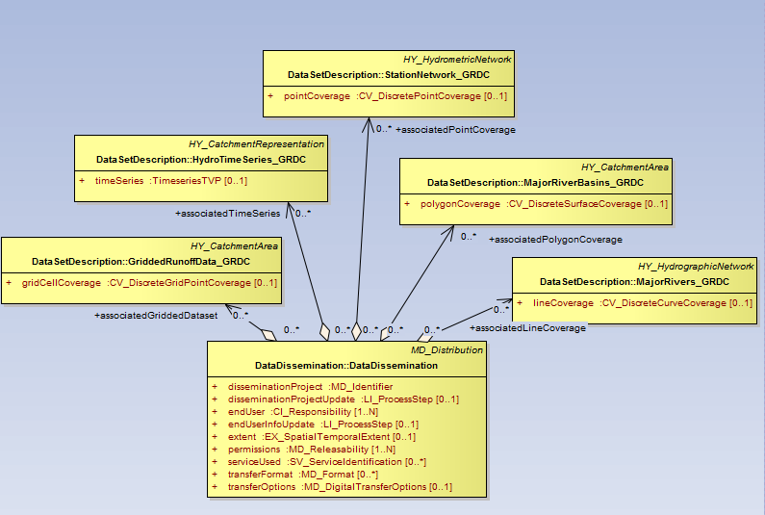
DataDissemination relates the data provided via service
HY_Features
Attributes as required by the GRDC in data collection projects on regional or global scale

Slide 19
Next steps
Oct/Nov 2013
  “Hydrologic Information – Metadata Concept” (GRDC Report)
  WMO-CHy Discussion Forum (eForum)
  Contribution (conceptual level) to WIS / WIGOS Metadata
Dec 2013
  mapping to the metadata structures currently in use at GRDC
  test implementation for the new GRDC data catalogue (depending on resources)
  Thank you !

