Slide 1
Open source solutions for federated hydrologic information systems
86th OGC Technical Committee
Frascati, Italy
Silvano Pecora
23 September 2013
Copyright © 2013 Open Geospatial Consortium

Slide 2
Hydrologic monitoring in Italy

Slide 3
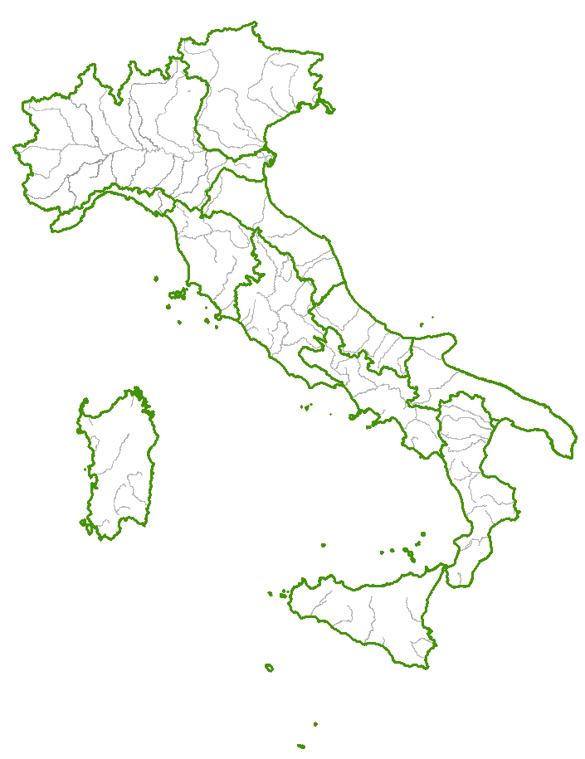
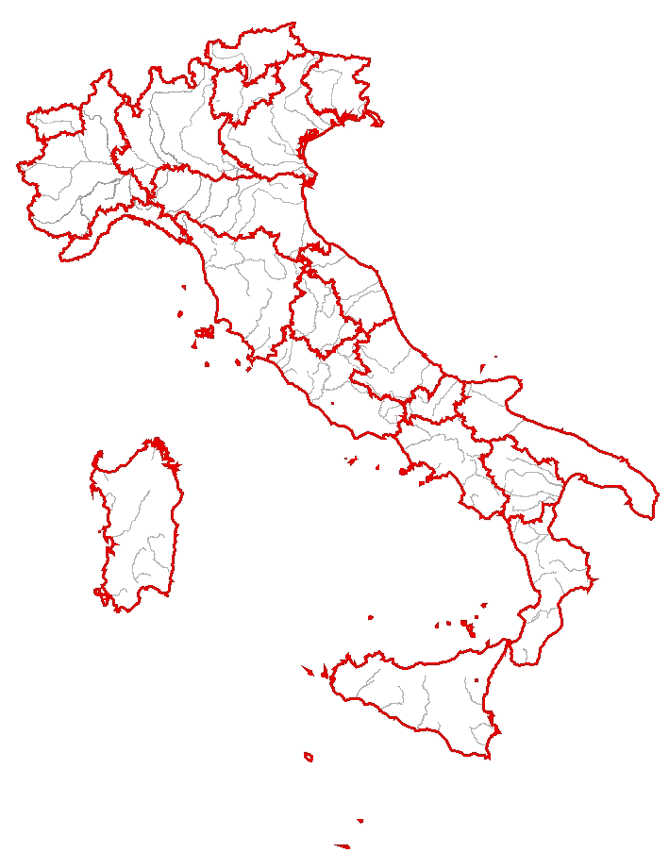
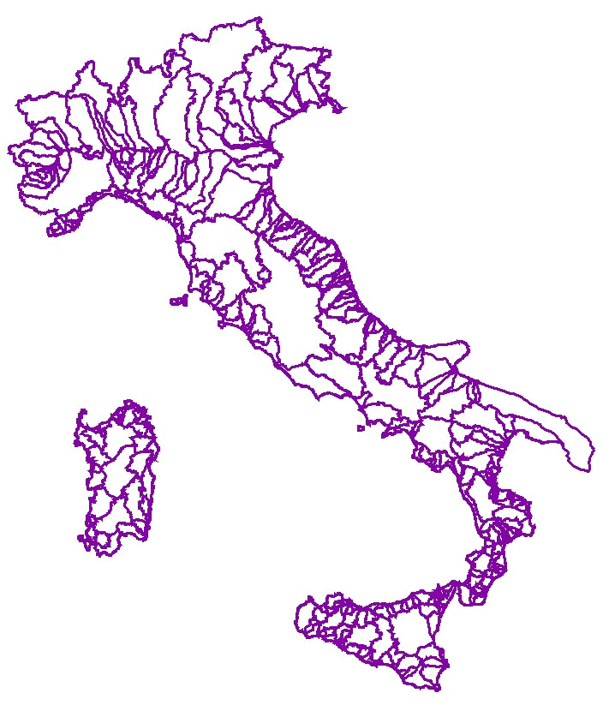
HYDROGRAPHIC COMPARTMENT | REGIONAL BOUNDARIES | BASIN LIMITS (>200kmq)

Slide 4
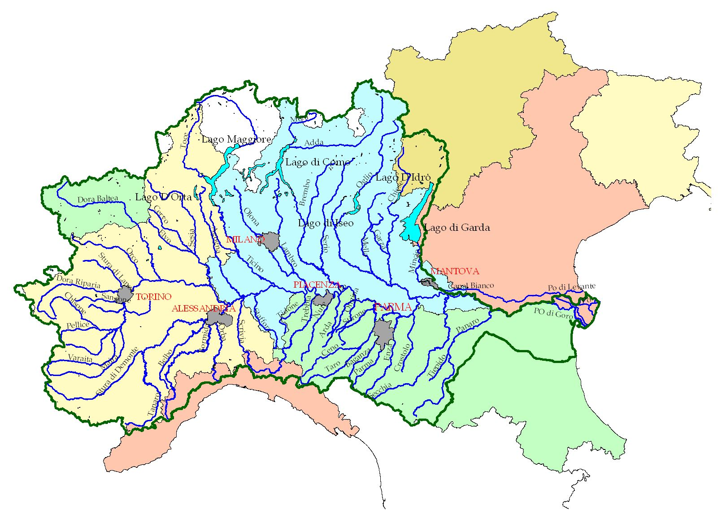
Hydrographic limits
Catchment Area 70.090 km²
Main river length 652 km
Minimum daily discharge at Pontelagoscuro 168 m³/s (in 2006)
Maximum discharge at Pontelagoscuro 12.300 m³/s (in 2000)
Mean annual discharge at Pontelagoscuro 1.510 m³/s
Basin average quote 740 m a.s.l.
Delta area 380 km²

Slide 5
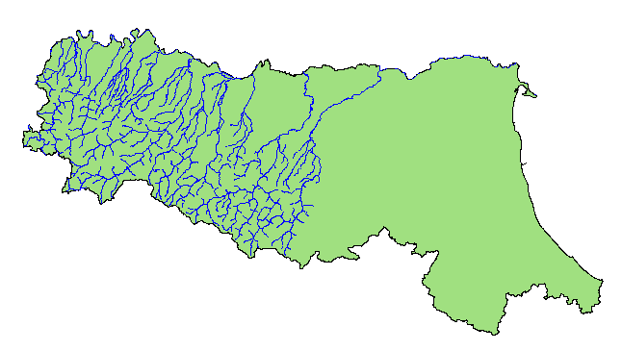
Administrative limits

Slide 6
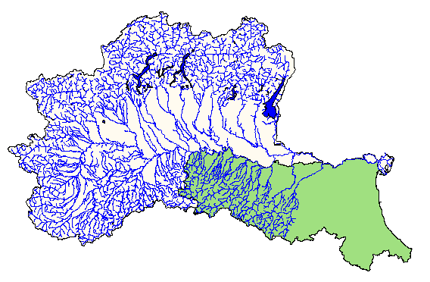

Slide 7
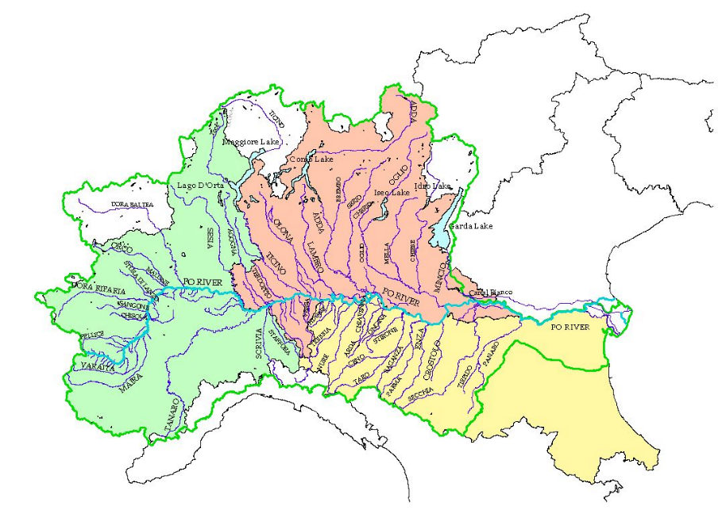
A national and interregional agreement among public administrations
Italian Department of Civil Protection
Po river basin Authority
Interregional Agency for the Po river basin
Emilia-Romagna Region
Lombardia Region
Piemonte Region
Valle d’Aosta Region
Veneto Region

Slide 8
Hydrologic monitoring in
Emilia-Romagna

Slide 9
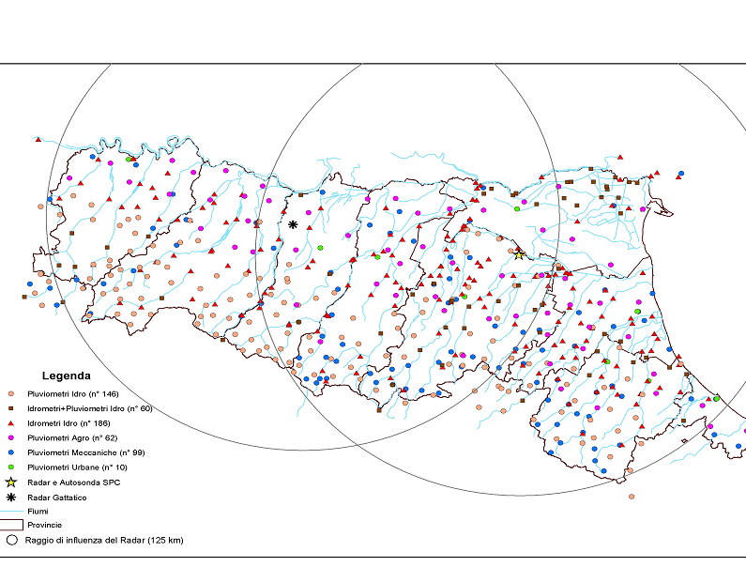
MONITORING NETWORK IN EMILIA-ROMAGNA REGION

Slide 10
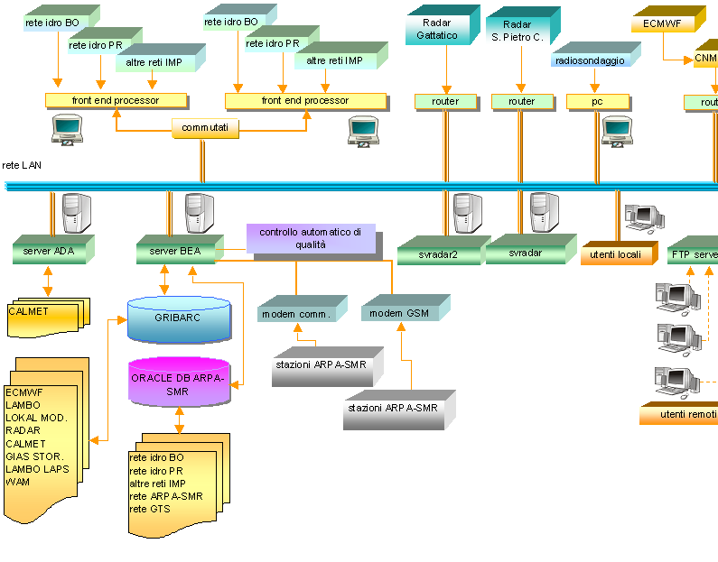
DATA FLOW IN RIRER

Slide 11
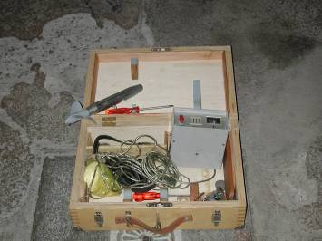
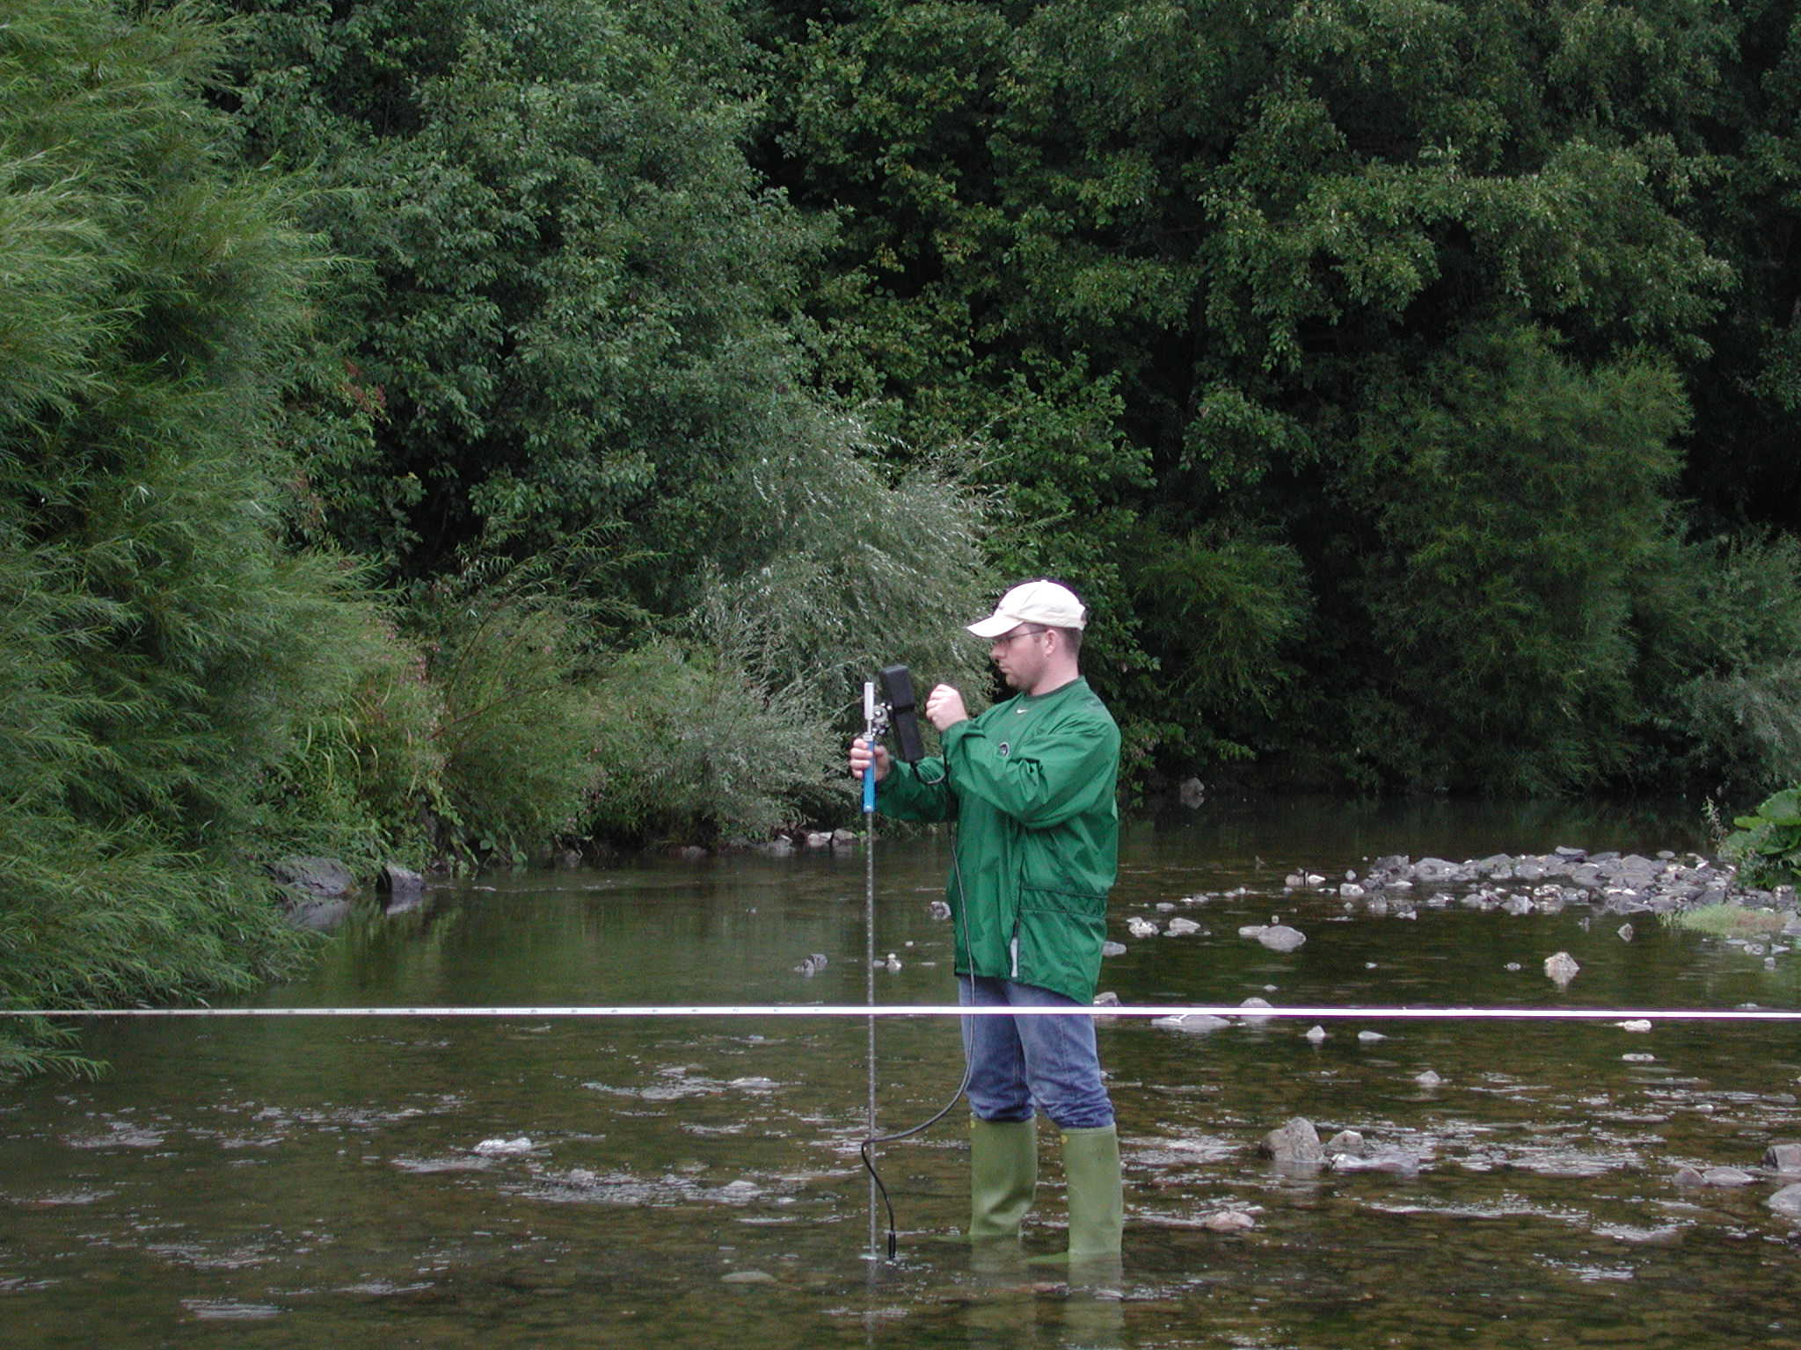
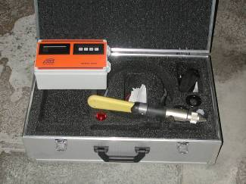
DISCHARGE MEASUREMENTS

Slide 12
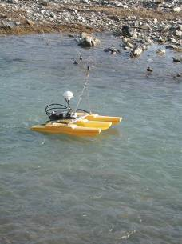
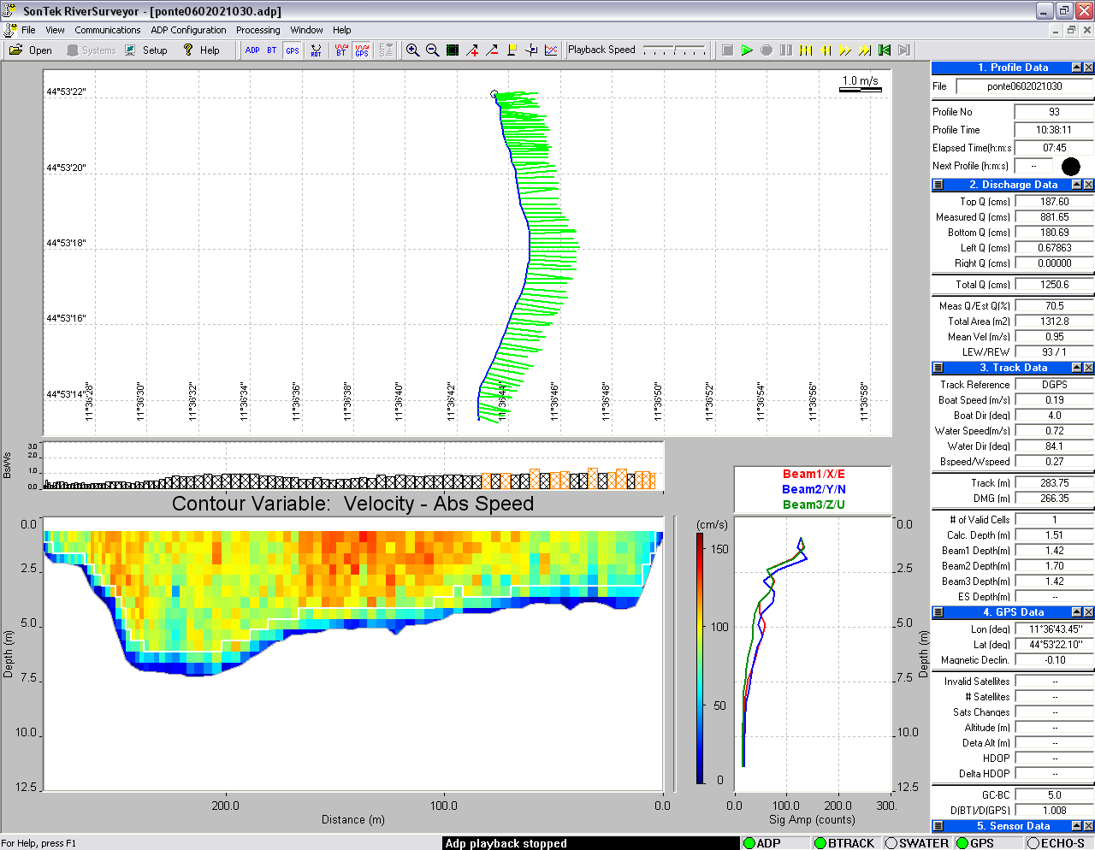
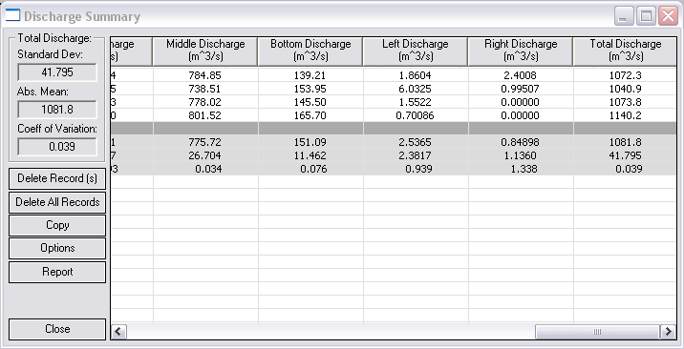
DISCHARGE MEASUREMENTS

Slide 13
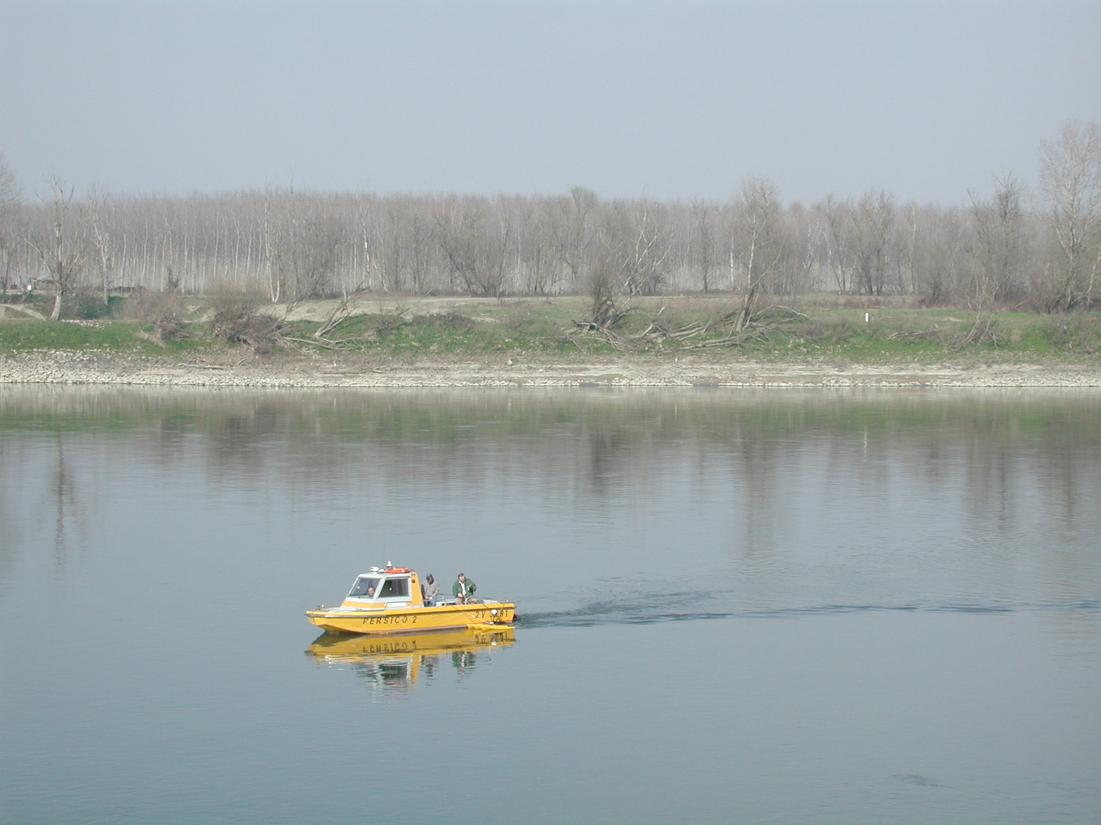
DISCHARGE MEASUREMENTS

Slide 14
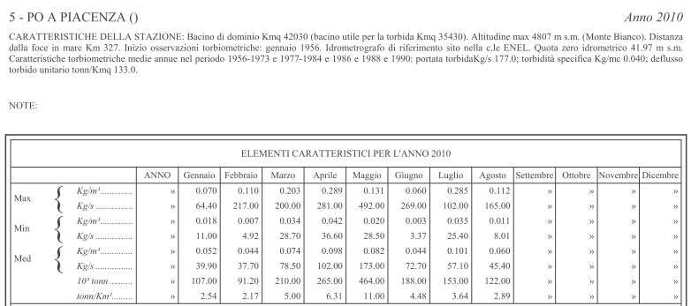
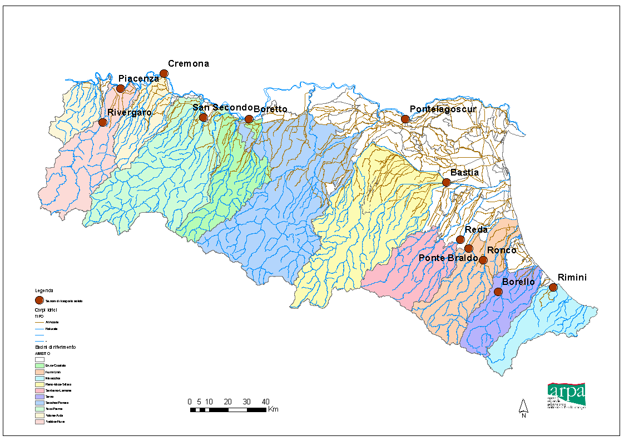
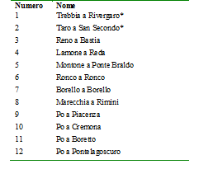
Suspended sediment transport monitoring

Slide 15
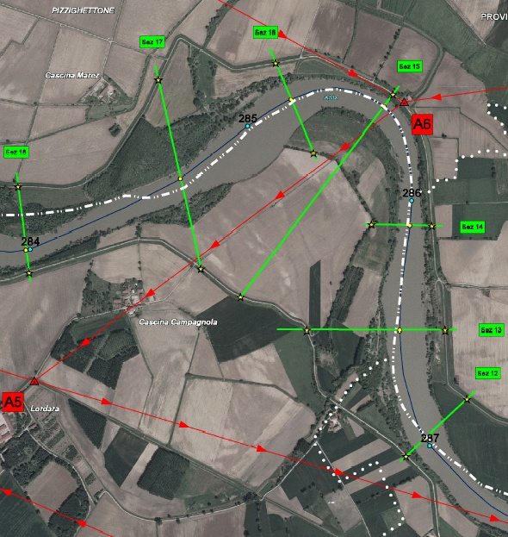
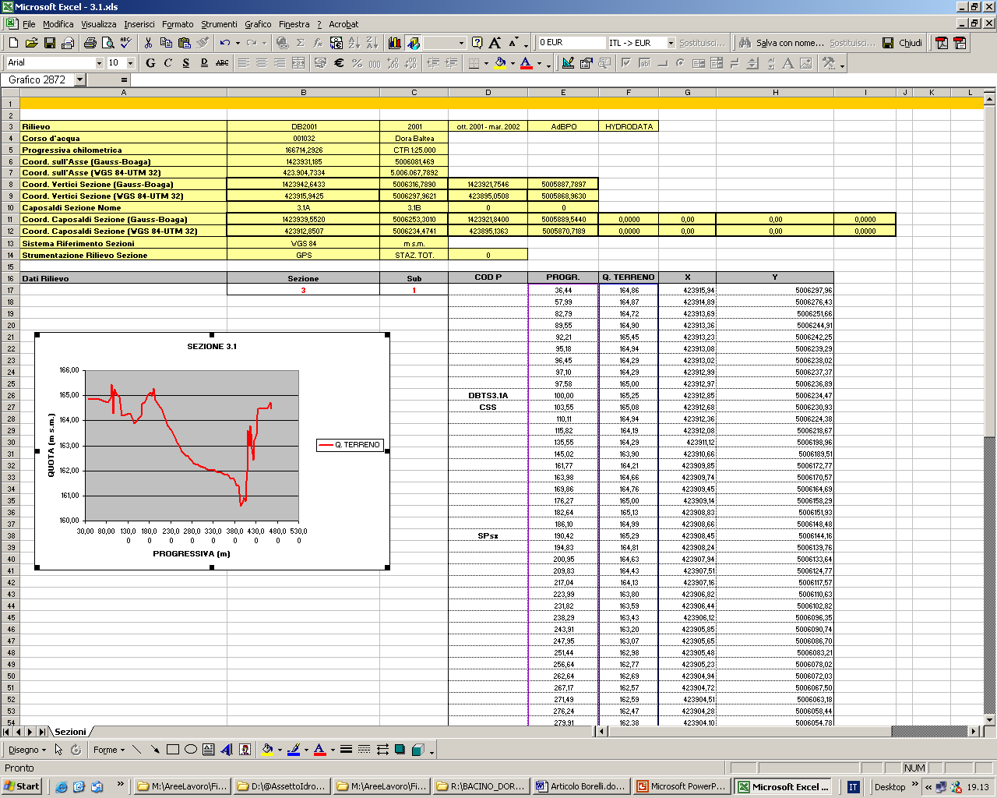
TOPOGRAPHICAL SURVEYS

Slide 16
CROSS-SECTION DATABASE
Survey 1
Import
Modelling
Survey 2
Import
CAD
Db
Excel
Text
Plots
Survey n
Import
Routine / Macro
User

Slide 17
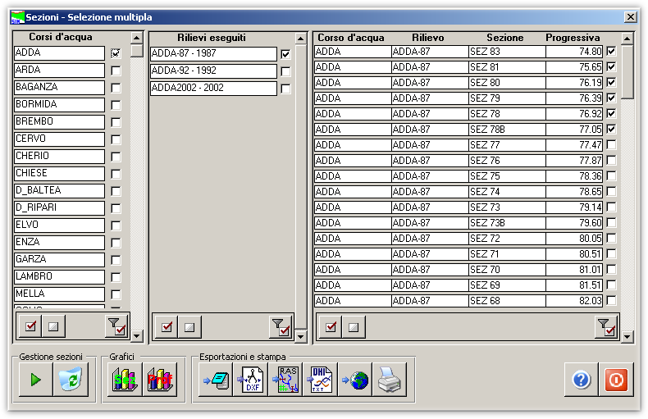
CROSS-SECTION BROWSER
1
2

Slide 18
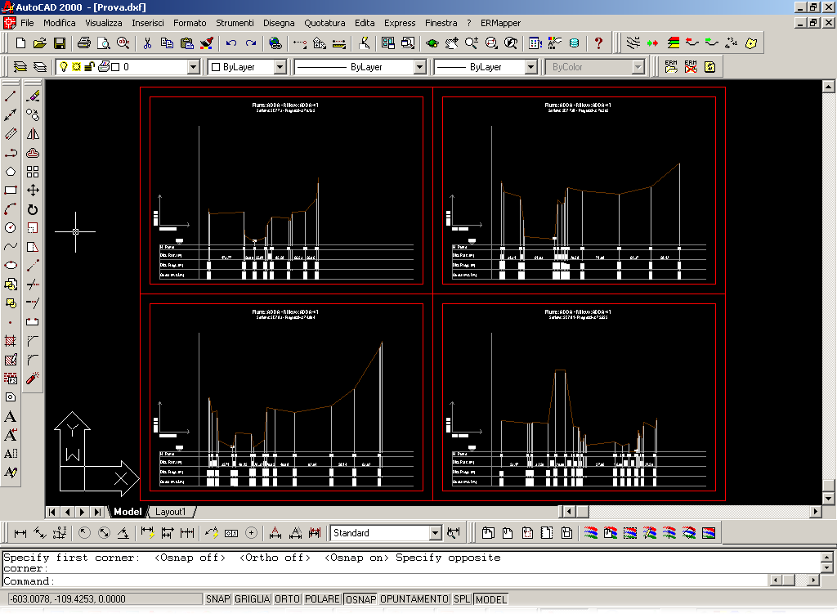
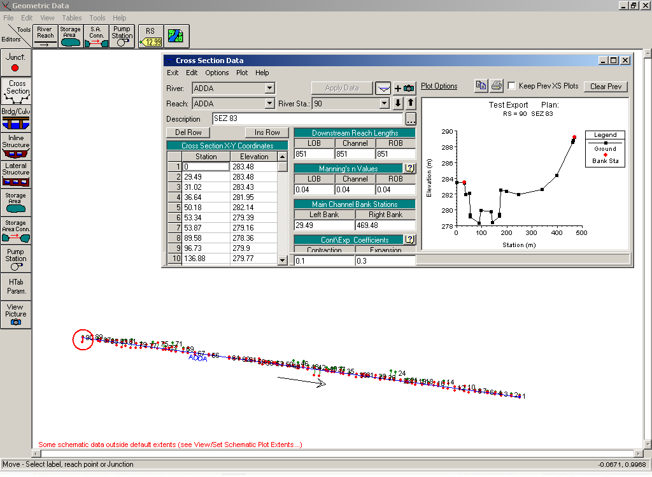
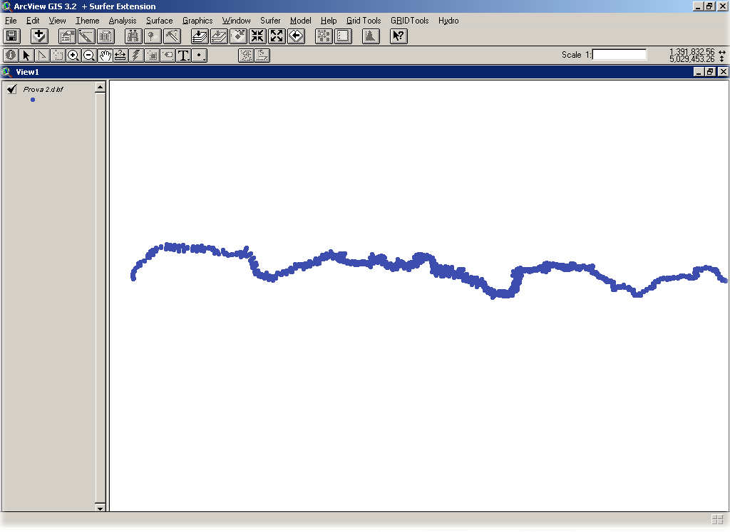
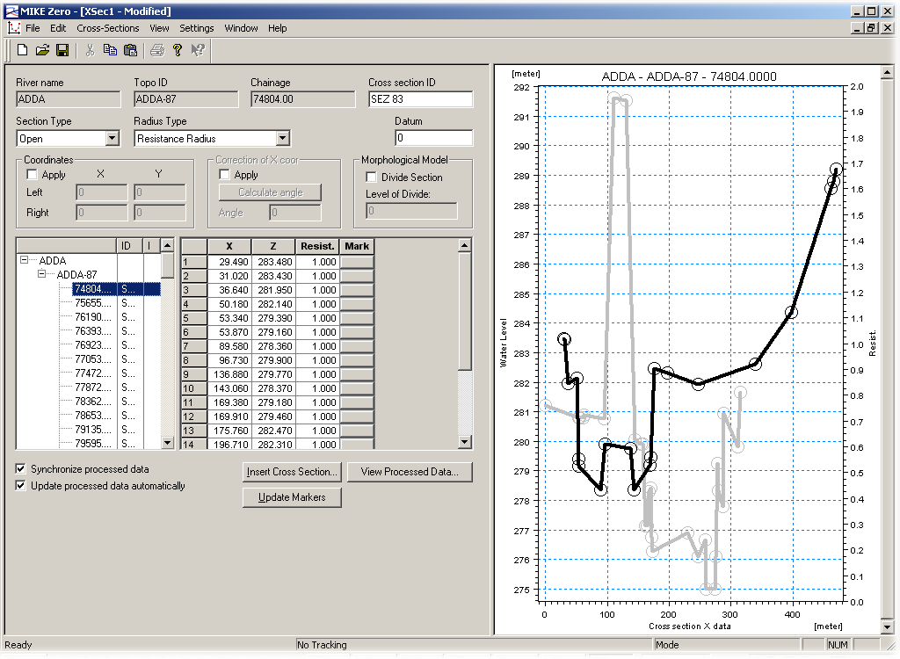
EXPORT EXAMPLES
CAD
HEC-RAS
GIS
MIKE11

Slide 19
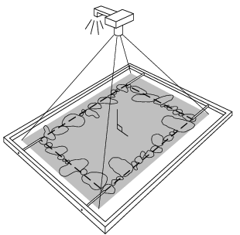
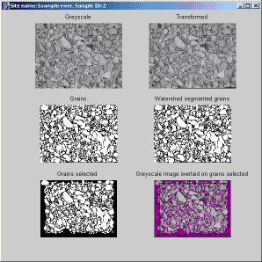
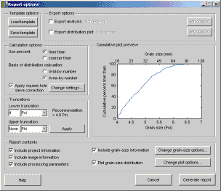
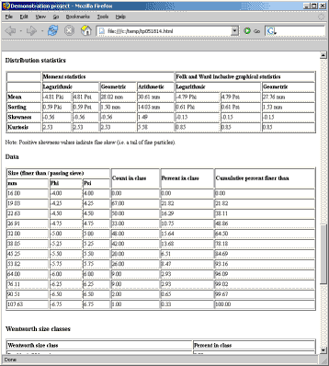
DIGITAL GRAVELOMETER

Slide 20
Water data dissemination

Slide 21
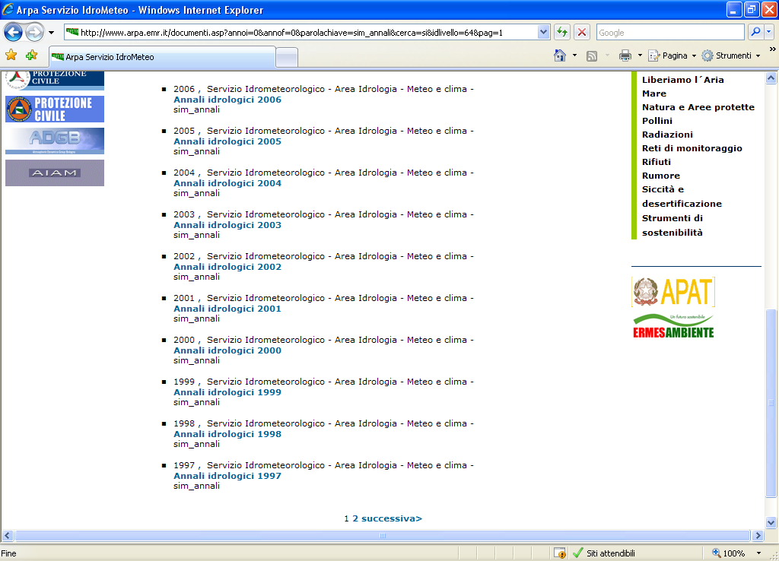
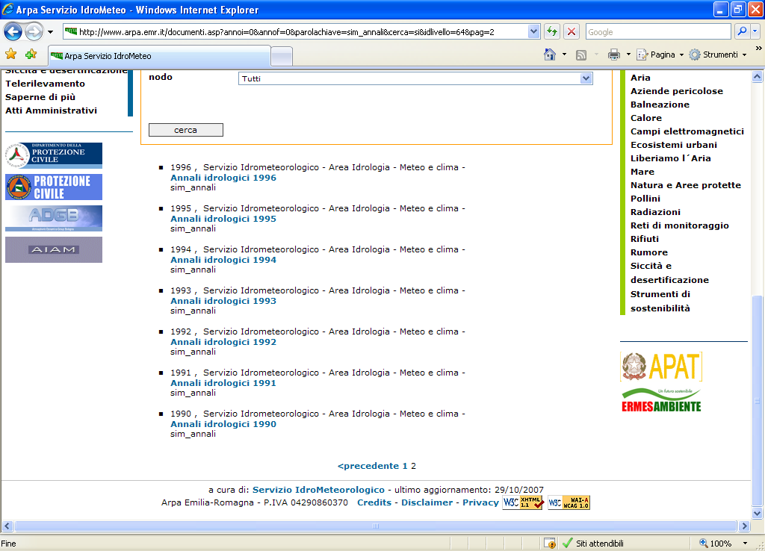
THE HYDROLOGICAL YEARBOOKS
Part I Yearbooks published from 1913 to 2013
Part I Yearbooks published from 1913 to 2013

Slide 22
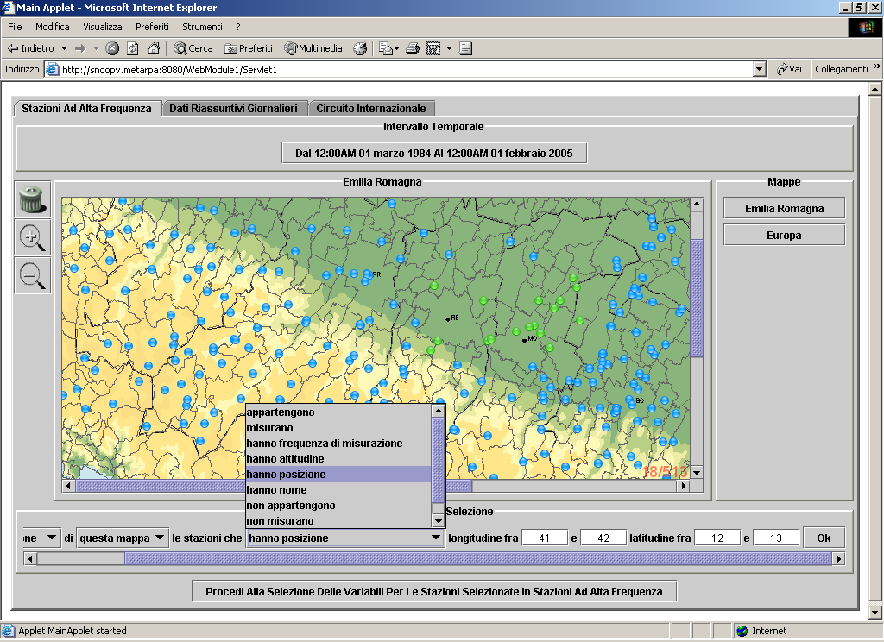
WATER DATA DISSEMINATION

Slide 23
CUAHSI architecture in Italy

Slide 24
Services-Oriented Architecture
HIS Central
Service registration
Catalog harvest
Search
HydroServer
Data access
HydroDesktop

Slide 25
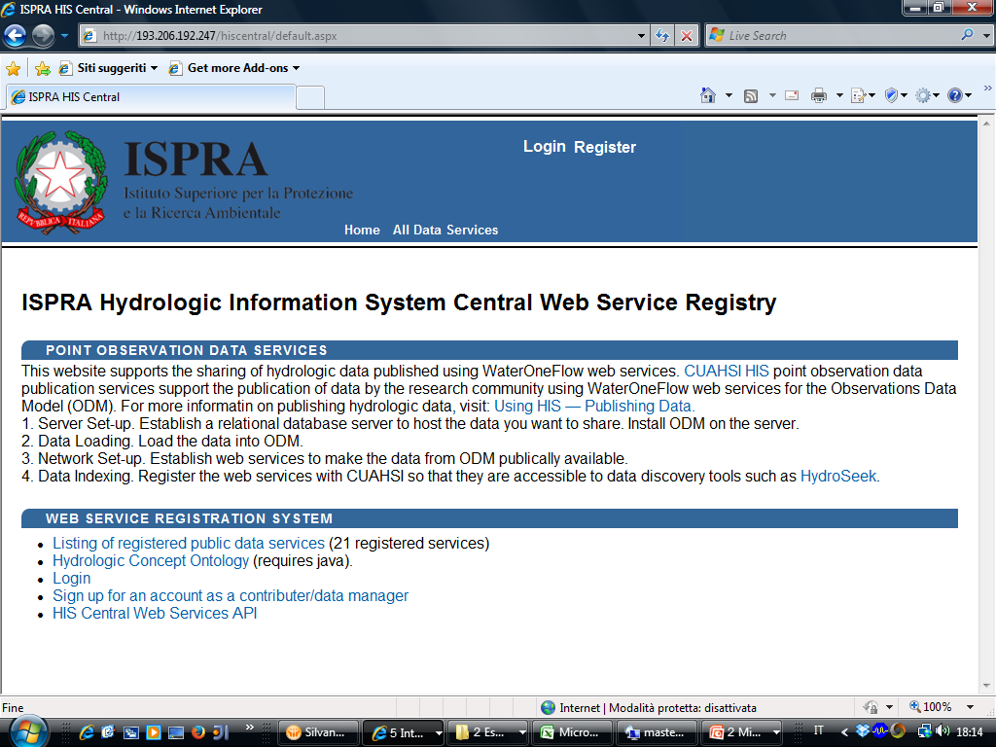
http://193.206.192.247/hiscentral/

Slide 26
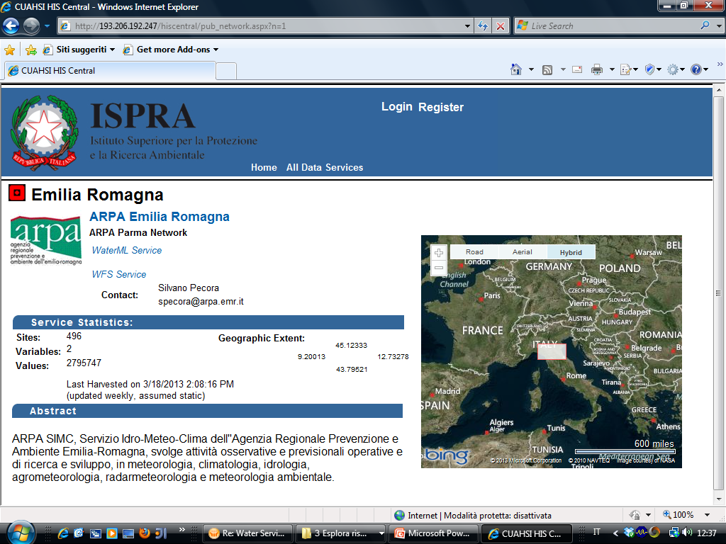

Slide 27
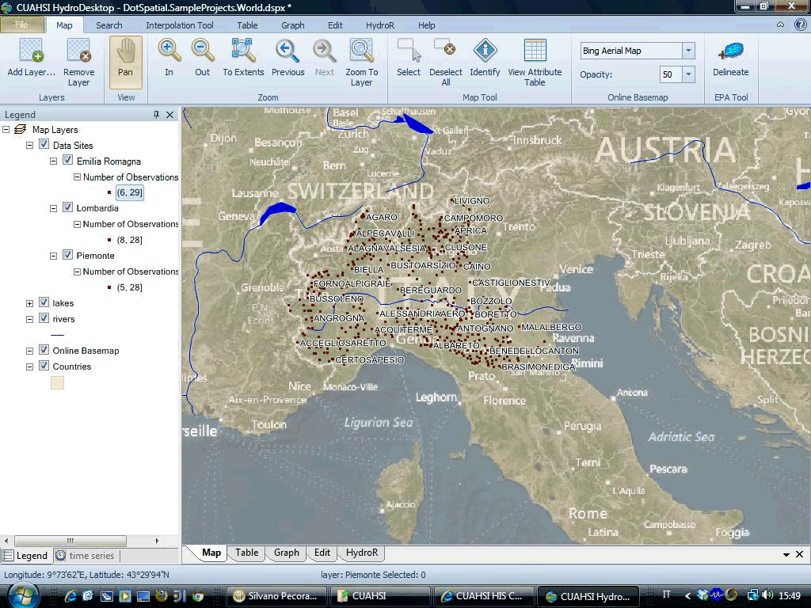

Slide 28
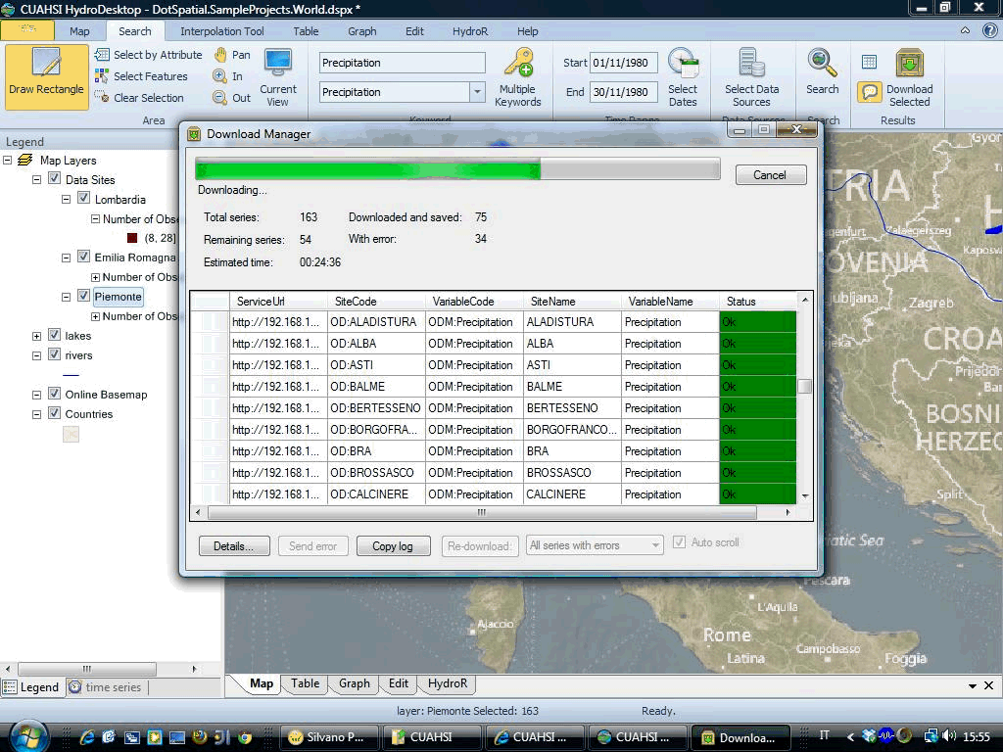

Slide 29
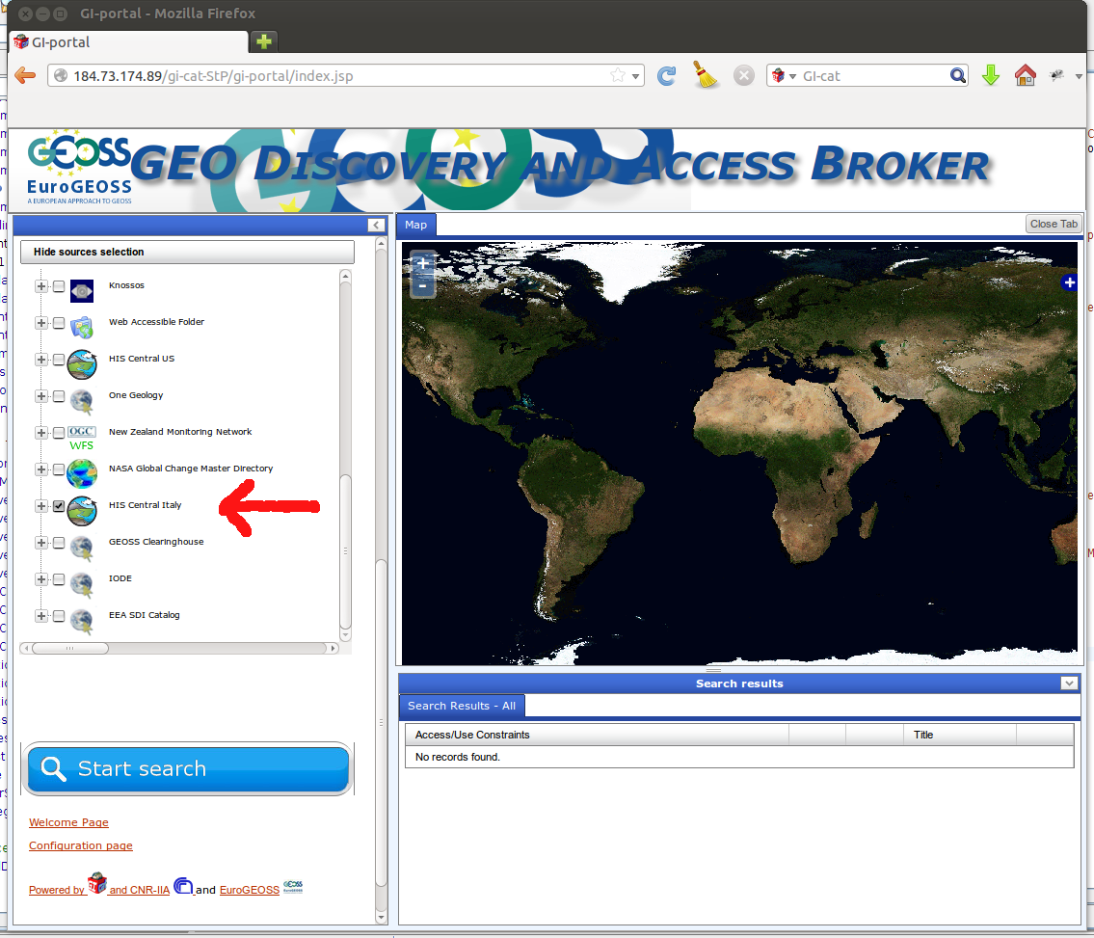
http://essi-lab.eu/do/view/GIcat/HYDROGuide

Slide 30
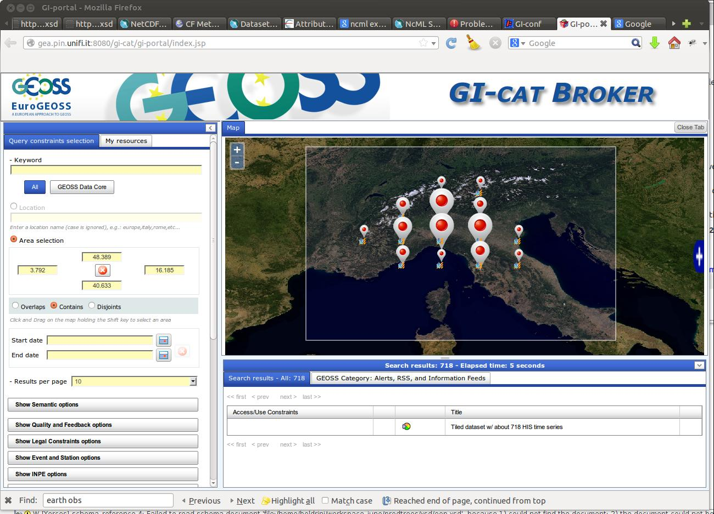

Slide 31
Open source solutions in HIS

Slide 32




Multi-platform architecture

Slide 33
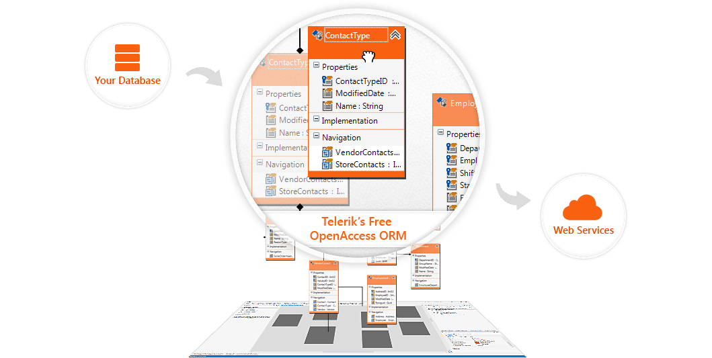
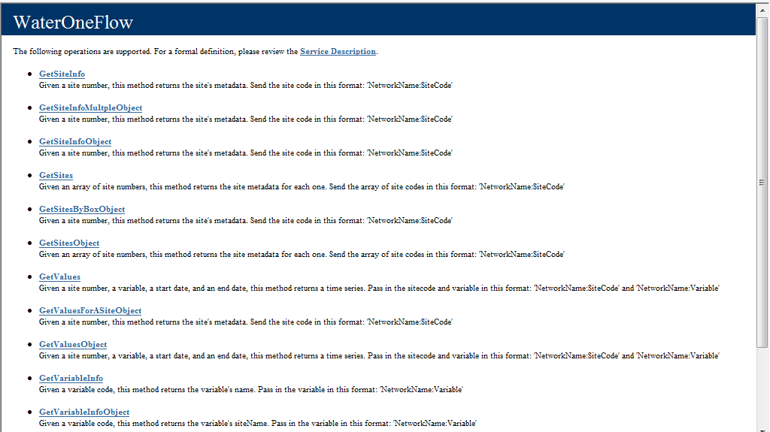

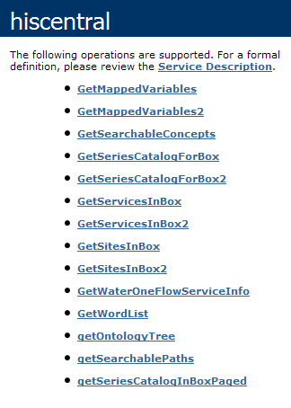
Multi-database architecture

Slide 34



Multi-GIS architecture… in progress…

Slide 35
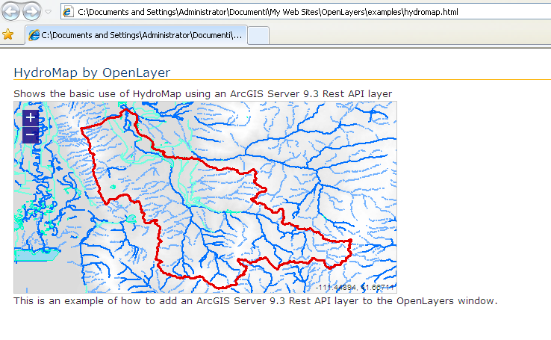
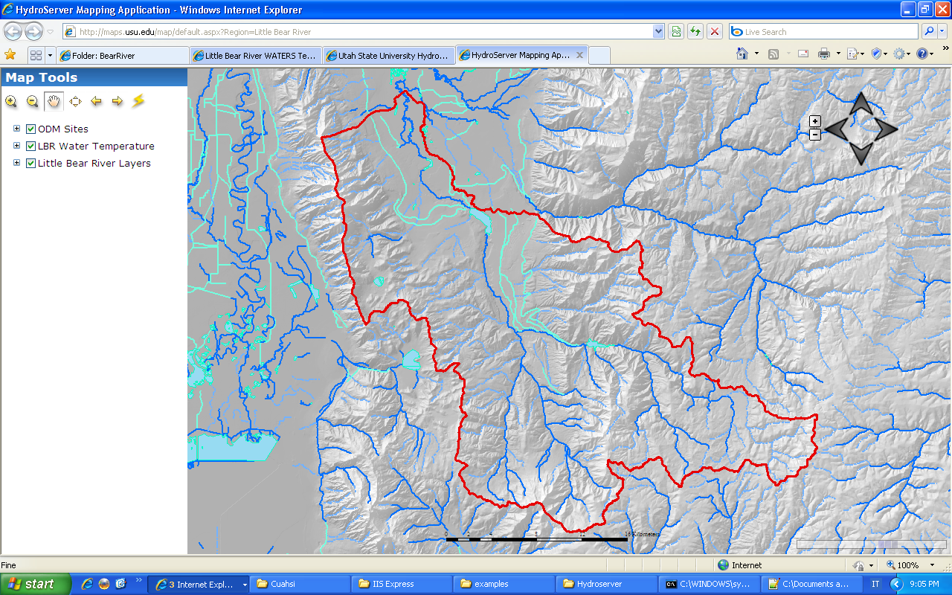
HYDROMAP

Slide 36

THANKS FOR YOUR ATTENTION
Copyright © 2013 Open Geospatial Consortium

