Slide 1
Outcomes Quebec Workshop
86th OGC Technical Committee
Frascati, Italy
Uli Looser
23 September 2013
Copyright © 2013 Open Geospatial Consortium

Slide 2
Summary and Actions
RiverML
Harmonisation Paper on current implementations and use cases
RiverML Version 0.1 prototype deferred pending harmonisation paper
RiverML IE to follow
Outreach to stakeholders (agencies, developers, engineers)
GWIE2
Scoping completed (99%)
Conceptual modelling to begin

Slide 3
Summary and Actions
WML2 Part 2 (Ratings, gaugings and cross sections )
IE Planning well underway (US; AU; GB; CA; DE)
Draft Schema
Engineering report
Standard development (2014/15)
Harmonising RiverML and HY_Features
SOS2
Compare CHISP SOS Profile and SOS2 for use with WaterML2.0 – Publish best practice paper
Acceptance of getDataAvailability as official OGC extension to SOS2
SOS2 Profile: Best practice paper in 2014
Intermediate profile document to be circulated

Slide 4
Summary and Actions
HY_Features
Review with respect to RiverML and WML2P2
Review with respect to Groundwater
Revise discussion paper for Frascati OGC/TC
Possible testing of HY_Features in N-America through OGC/OWS-10 CCI
Others
CUAHSI survey to support the harmonisation paper for RiverML
  Define Survey goals
  Draft survey
  Target CUAHSI Conf. 18-19 July 2013

Slide 5
WaterML2 Suite (Idea to be pursue?)
Part 1 Time series
Part 2 Ratings, Gaugings and Sections
Part 3 River channel and floodplain geometry
Part 4 Water Quality?
Part 5 ??
HY_Features
GWML2

Slide 6
Upcoming OGC/TC Meeting(s)
02 – 06 December 2013, Mumbai, India
24 – 28 March, Washington DC area, USA (Tentative)
09 – 13 June, Geneva, Switzerland (Tentative)
15 – 19 September, Toronto, Canada (Tentative)
01 – 05 December, Tokyo, Japan (Tentative)
Next HydroDWG Workshop: yes!, when?, where?
Seattle, Microsoft Research; Date?
Vancouver, (Whistler); Date?
CUNY New York back to back with the 11th International Conference on Hydroinformatics, 17-21 August 2014
Karlsruhe, back to back with: IWRM Conference, 19 – 20 Nov. 2014

Slide 7
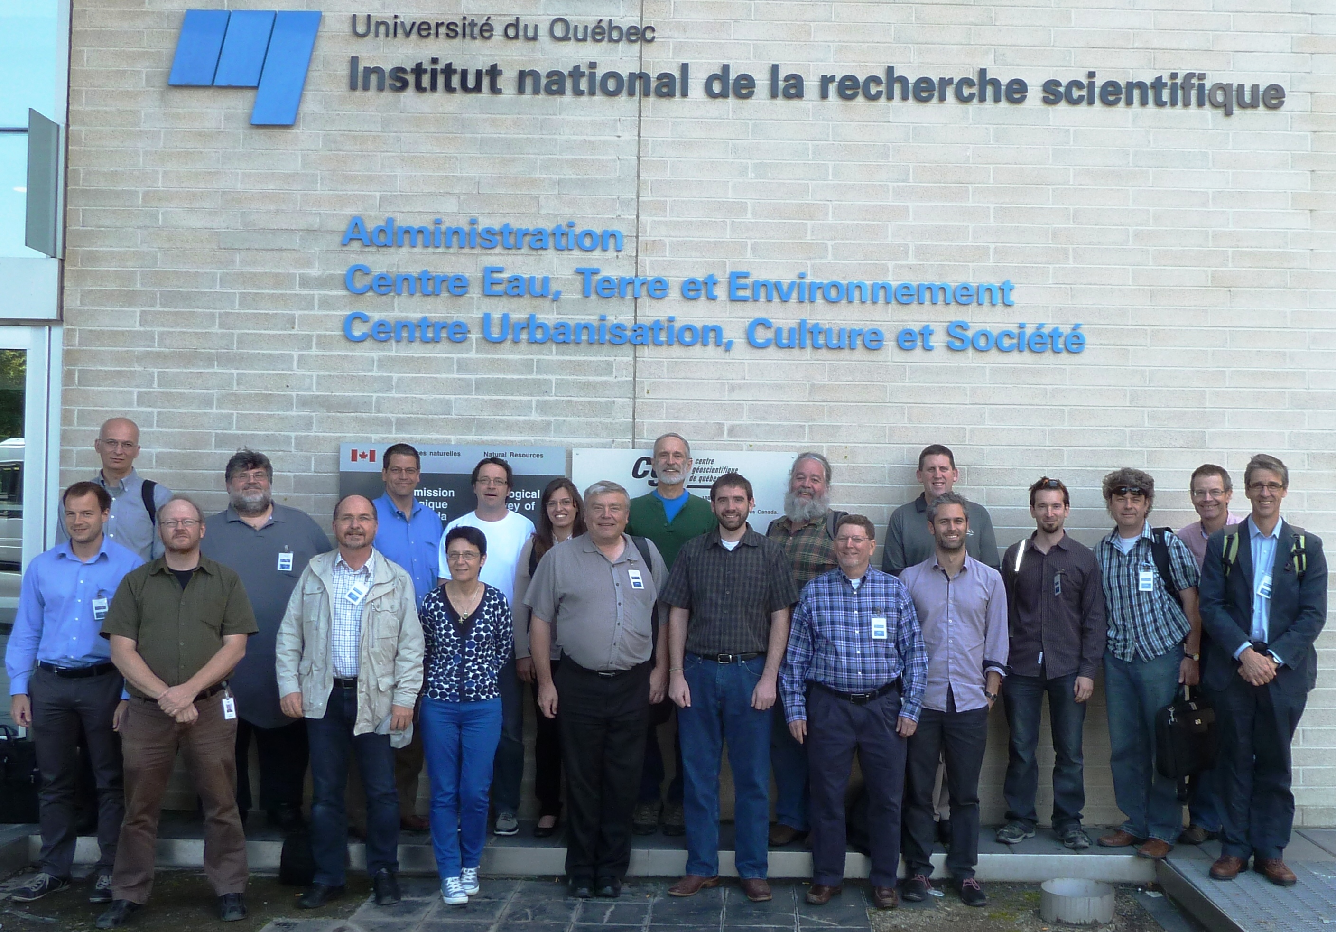
Thanks to the hosts of the HDWG Workshop
INRS-ETE &
Geological Survey of Canada (Québec division)

