Slide 1
WaterML2.0: Part 1: Survey of usage by hydrological organisations and system vendors
86th OGC Technical Committee
Frascati, Italy
Tony Boston
23 September 2013
Copyright © 2013 Open Geospatial Consortium

Slide 2
Agenda
WMO Commission for Hydrology (CHy)
  CHy-14 Resolution 7/1
WMO CHy - Data Operations and Management
  WaterML 2.0 Survey
    Target Audience
    Key questions
  Survey results
  Identified projects
Next steps
Copyright © 2013 Open Geospatial Consortium

Slide 3
WMO Commission for Hydrology - 14
Resolution 7/1:
Commence a process, including testing, that could see the potential adoption of the WaterML 2.0 as a WMO standard for information exchange managed by WMO (supported by the WMO/OGC MOU) and to register this standard as a joint WMO/ISO standard;
Copyright © 2013 Open Geospatial Consortium

Slide 4
CHy Data Operations and Management
  WaterML 2.0 Survey – Target audience
    National Hydrological Services (NHSs)
    Regional Hydrological Services
    System vendors
    Research organisations
Copyright © 2013 Open Geospatial Consortium

Slide 5
CHy Data Operations and Management
  WaterML 2.0 Survey – Key questions
    Does your organisation have database(s) or system(s) for storing hydrological data?
    Does your organisation or system support the exchange of hydrological observations data?
    Data transfer formats supported?
    OGC web services supported?
    Obstacles to use of WaterML 2.0 for hydrological data exchange?
    Type of hydrological information exchanged?
    Future plans?
    Interest in working with WMO CHy on WaterML 2.0 data exchange pilots
Copyright © 2013 Open Geospatial Consortium

Slide 6
Survey responses
29 responses to date (one duplicate responder)
  2-17 September 2013
Organisations represented
  1 Global Data Centre
  5 National Hydrological Services
  7 Regional Hydrological Services
  11 research organisations
  5 system vendors
Copyright © 2013 Open Geospatial Consortium

Slide 7
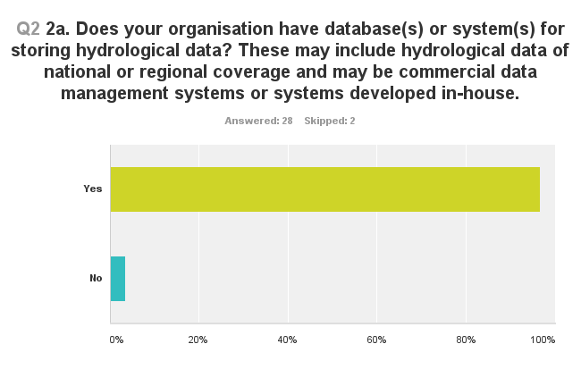
Survey results
Copyright © 2013 Open Geospatial Consortium

Slide 8
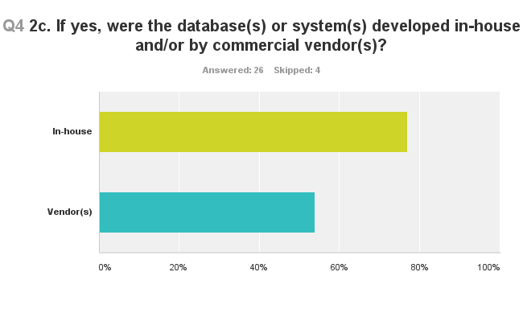
Survey results
Copyright © 2013 Open Geospatial Consortium

Slide 9
Systems
Kisters: Wiski, Hydstra
Aquatic Informatics: Aquarius
Deltares: FEWS
Hilltop Systems Limited: Datatamer
Fraunhofer Institute of Optronics, System Technologies and Image Exploitation: WaterFrame®
ESRI ArcHydro
Oracle
SQL Server
CUAHSI: HIS
Copyright © 2013 Open Geospatial Consortium

Slide 10
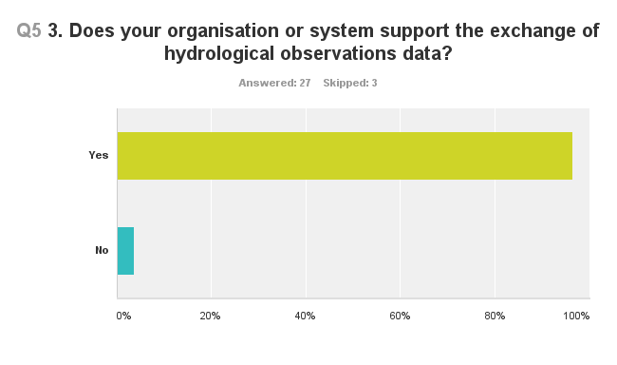
Survey results
Copyright © 2013 Open Geospatial Consortium

Slide 11
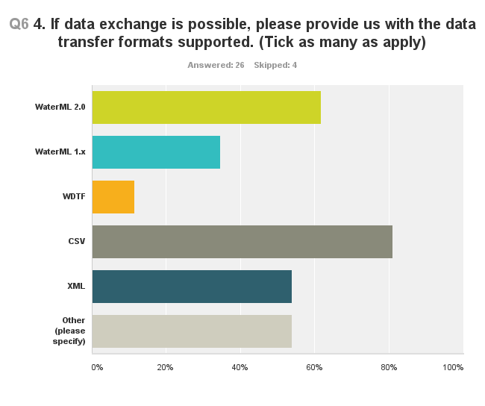
Survey results
Copyright © 2013 Open Geospatial Consortium
Notes:
Other:
1 txt
2 GWML, GeoSciML
3 ISO 19139
4 PI-xml and 45 other files formats, mostly CSV
5 netCDF, WMS, WFS, CSV, WCS
6 html
7 JSON
8 text file
9 Custom Hilltop binary format
10 zrxp, specific txt files
11 Database Export and Import
12 GRIB, NetCDF, BUFR
13 Various bespoke formats agreed historically between suppliers
14 excel

Slide 12
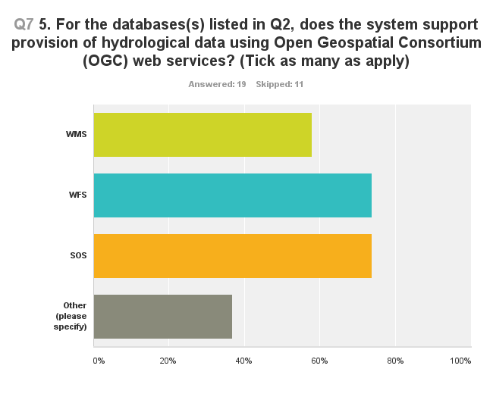
Survey results
Copyright © 2013 Open Geospatial Consortium
Notes:
Other:
1 No
2 HIS HydroServer
3 netCDF, WCS, CSW
4 CUAHSI WaterML Web Services
5 SOS and WFS are coming. Currently we have our own web service format.
6 WaterOneFlow
7 Please note: not all apply to all datasets

Slide 13
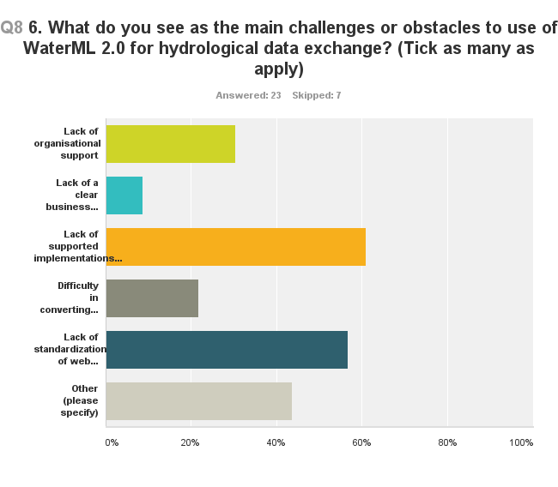
Survey results
Copyright © 2013 Open Geospatial Consortium
Notes:
□ Lack of organisational support
□ Lack of a clear business case/return on investment
□ Lack of supported implementations (libraries or complete systems)
□ Difficulty in converting from existing database(s) and exchange formats to WaterML 2.0
□ Lack of standardization of web service interfaces for WaterML 2.0
Other:
1 Lack of resources
2 Lack of enough training
3 technical literacy of data providers / speed of OGC to response to REST
4 complexity and performance
5 no clear reference implementation
6 WaterML2 is best for continuous time series data. There is still a need for discrete observations.
7 None; clear documentation supporting the standard; venders just need to start developing.
8 The main challenge is to ensure people don't create "dialects" of the language.
9 no legal obligation
10 Storage/size overhead in expressing data though WaterML

Slide 14
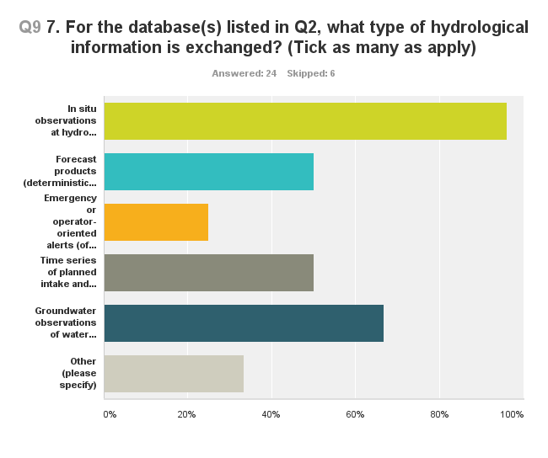
Survey results
Copyright © 2013 Open Geospatial Consortium
Notes:
□ In situ observations at hydro (gauges, reservoirs) or meteo stations
□ Forecast products (deterministic timeseries, ensembles) at forecast points
□ Emergency or operator-oriented alerts (of threshold exceedance) and reports
□ Time series of planned intake and release/discharge
□ Groundwater observations of water level within wells
Other:
1 Water Quality, monitoring point metatdata, observations related metadata
2 groundwater and geological features such as aquifers, geological units, well logs, etc.
3 Gridded information at a point such as precipitation, runoff , soil moisture
4 water quality laboratory samples
5 GOES Tx/Rx
6 water quality and ecological data
7 gaugungs, ratings
8 Master data of sensors and procedures

Slide 15
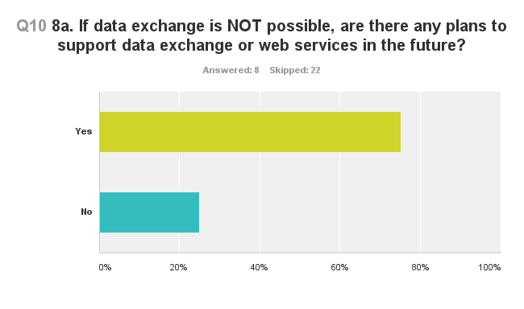
Survey results
Copyright © 2013 Open Geospatial Consortium

Slide 16
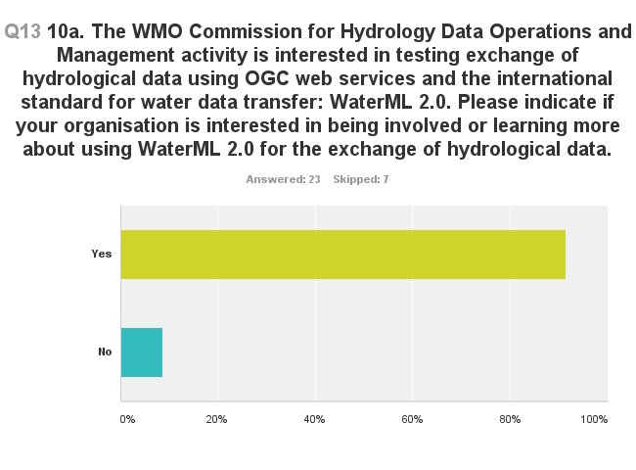
Survey results
Copyright © 2013 Open Geospatial Consortium

Slide 17
Projects using WaterML 2.0
WMO: GRDC, EU: BfG: GEOWOW: Wiski+KIWIS, 52North
Australia: BoM: Water Information Program: Wiski+KIWIS and SISS (GeoNetwork+Postgres+GeoServer+52North...)
Canada: National Groundwater Data Exchange System
Spain: Automatic Hydrologic System
France: BRLI: Water Information System
USA: OGC IEs tested WaterML 2.0
UK: CEH: National River Flow Archive
GEOSS: Discovery catalogues and data provision using OGC services. GEOSS AIP-6 Water Data Services:
  Italy: CUAHSI HIS
  New Zealand: Hilltop
Copyright © 2013 Open Geospatial Consortium
Notes:
+ EU INSPIRE water related directives in future

Slide 18
Projects not using WaterML 2.0
Deltares: FEWS – No demand for WaterML 2.0 as yet
Copyright © 2013 Open Geospatial Consortium

Slide 19
Next steps
Register WaterML 2.0 services in WIS
Publish guidance material on WaterML 2.0
  Software/system support
    Open source
    Commercial
  Implementation guidelines
    Example implementations
    Tutorials
    How to guides
WMO regional workshops
  Knowledge transfer to WMO member countries
  WaterML 2.0 pilot projects
Other suggestions welcome!
Copyright © 2013 Open Geospatial Consortium

Slide 20
Thank you
Tony Boston
Bureau of Meteorology
t.boston@bom.gov.au
Copyright © 2013 Open Geospatial Consortium

