Slide 1
Ratings, gaugings and cross-sections (WML2 part 2) Interoperability Experiment
86th OGC Technical Committee
Frascati, Italy
Simon Cox, Pete Taylor, Paul Sheahan
23rd September 2013
Copyright © 2013 Open Geospatial Consortium

Slide 2
WaterML2.0 part 2
An information model to support exchange of
  Rating tables and metadata
  Gauging observations
  River cross-sections (associated with development of ratings)
Makes use of WaterML2.0 part 1
Copyright © 2013 Open Geospatial Consortium

Slide 3
Summary of activities
Sub-group working within the HydroDWG
Face to face workshops:
  Reading, UK. June 2012
  Quebec, Canada. June 2013
Public discussion paperWaterML2.0 – part 2: ratings, gaugings and sections
Now starting an Interoperability Experiment to test implementations
Copyright © 2013 Open Geospatial Consortium

Slide 4
IE Objectives
Progress development and test the WaterML2.0 part 2 information model;
Test compatibility of WaterML2.0 part 2 with existing OGC services such as WFS and SOS;
Test approaches for alternate encodings to XML, such as JSON;
Copyright © 2013 Open Geospatial Consortium

Slide 5
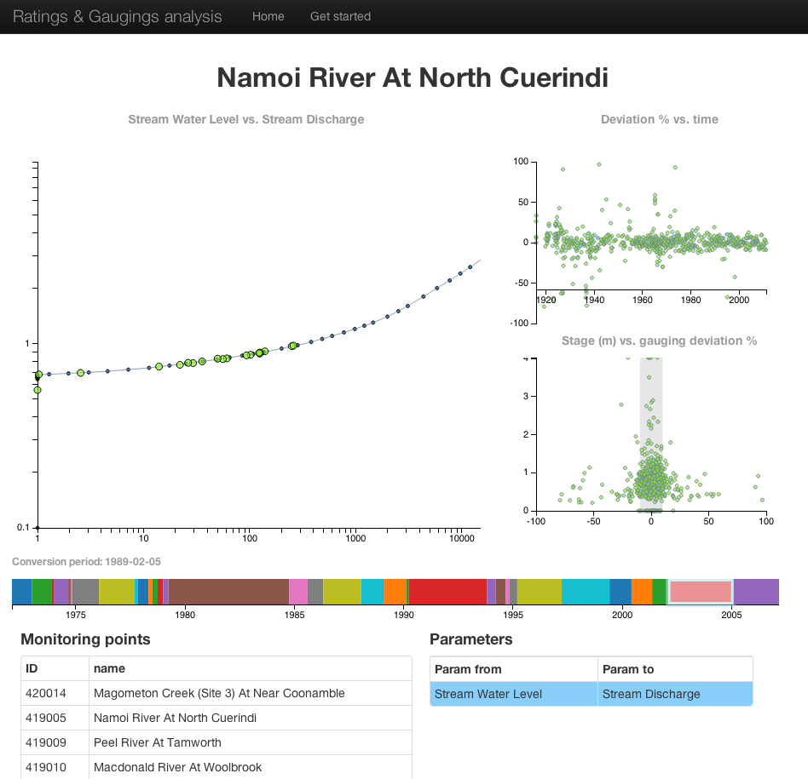
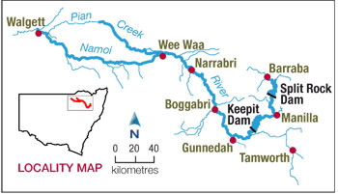
Prototype web client
Copyright © 2013 Open Geospatial Consortium

Slide 6
Standards process
Interoperability experiment
SWG formation
Standard development
Submit RFC for OAB review
Public RFC
Adoption vote
Copyright © 2013 Open Geospatial Consortium

Slide 7
Use cases
Use Case 1: Delivery of latest rating table
Use Case 2: Exposing rating tables for analysis and educational purposes
Use Case 3: Retrieval of full rating history
Copyright © 2013 Open Geospatial Consortium

Slide 8
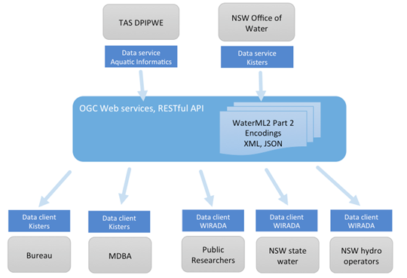
Scenario 1 - Australia
Copyright © 2013 Open Geospatial Consortium

Slide 9
Scenario 2 & 3
USGS exchanging data with National Weather Service
  Flood/flow forecasting based on USGS rating curves
UK Centre for Ecology and Hydrology
  Exposing national rating tables and gauging data
Copyright © 2013 Open Geospatial Consortium

Slide 10
Timeline
September-October 2013 – IE planning & kickoff
November 2013 – General design and agreement of schema and services
November-April 2013 – Iterative development
May 2014 – Demonstration of IE
June 2014 - Delivery of draft engineering report
Copyright © 2013 Open Geospatial Consortium

Slide 11
Deliverables
Running software
OGC Engineering Report
Demo to HydroDWG meeting in 2014
Need to develop metrics/criteria for success of the IE:
  Validated information models
  Clients that work across services
  Performance metrics?
  Others..
Copyright © 2013 Open Geospatial Consortium

Slide 12
Some open questions
We are considering a REST-based web service
  Also looking at WFS and/or SOS
We are considering a JSON encoding and XML
What is the HydroDWG’s guidance/needs in this area?
Should we adapt our information models to fit WFS and/or SOS, or look at services that more closely match the domain? (are rating tables features?)
Copyright © 2013 Open Geospatial Consortium

Slide 13
Domain-level architectural guidance
We have ‘11-013r6 - Water Information Services Concept Development Study’
We need discussion in terms of ‘recommended architecture’ for hydro (is it the same as OGC?)
For example, architectural goals/current design for:
  USGS
  Bureau of Meteorology
  CUAHSI
Do they look the same?
Copyright © 2013 Open Geospatial Consortium

Slide 14
Standardisation targets
The information model (UML) will be the first standardisation target
Most likely XML and/or JSON
But if we only use one or the other (XML/JSON) in an IE, can we claim a specific encoding has been tested?
We at least need a reference implementation that encodes both
Copyright © 2013 Open Geospatial Consortium

Slide 15








Participants
Copyright © 2013 Open Geospatial Consortium

