Slide 1
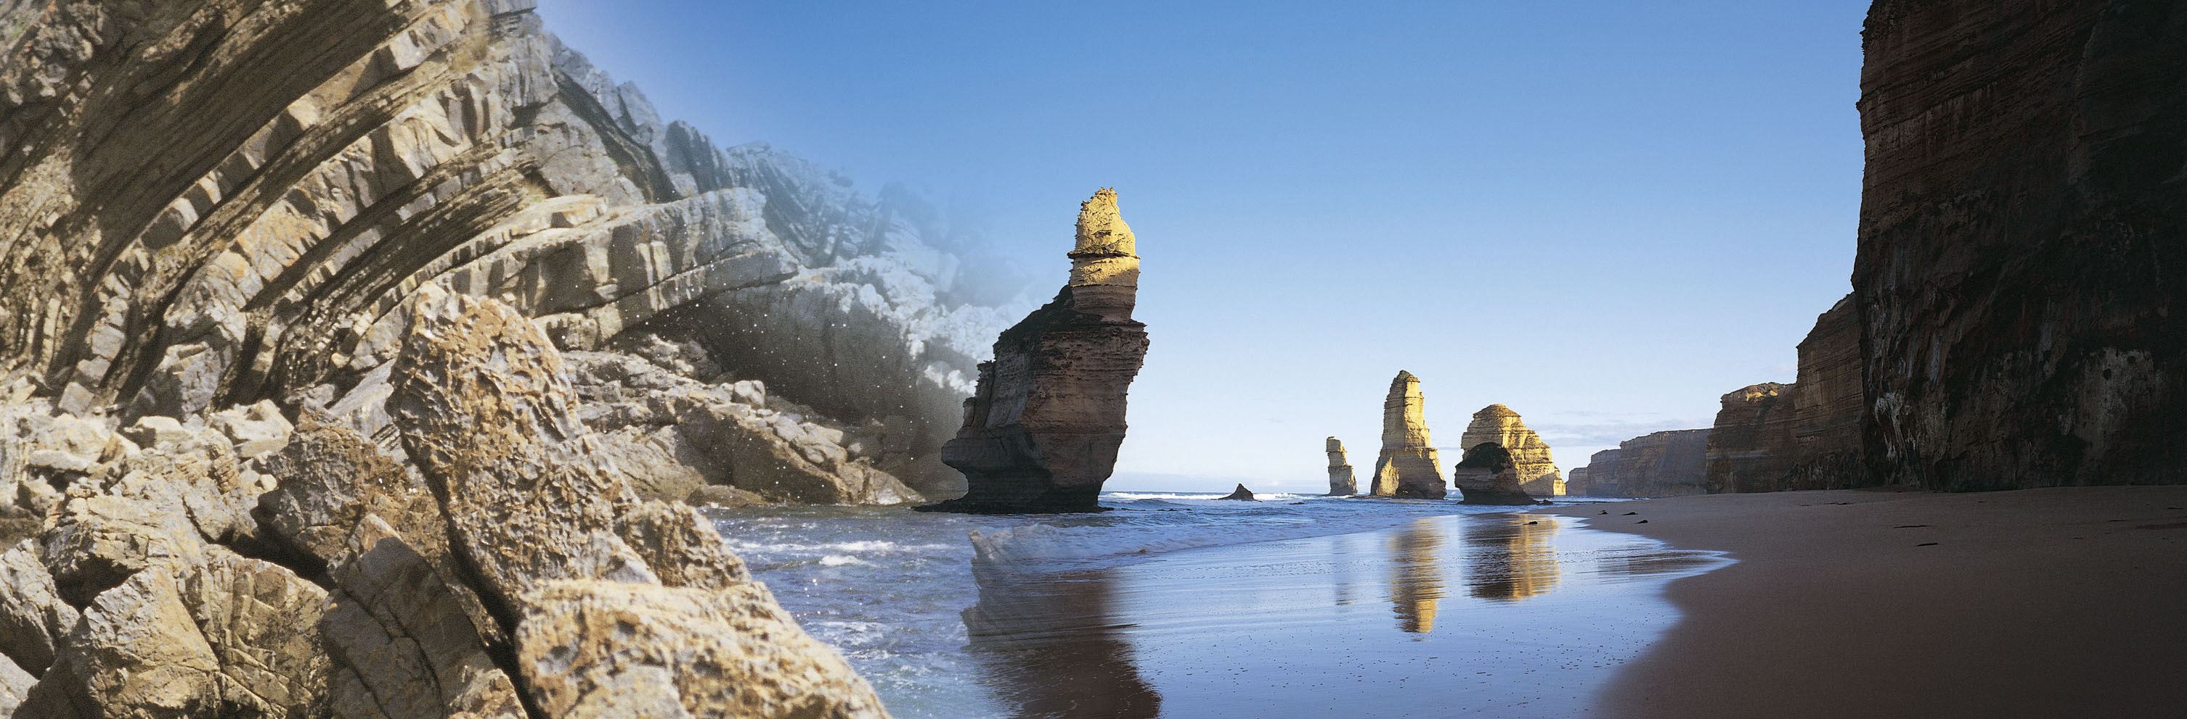
Water Quality data transfer
WaterML 2.0 – part 3 ?
Simon Cox
Land and Water
Notes:
I have successfully remained peripheral to most of the OneGeology activity, so most of what I’ll cover comes from various presentations by Ian Jackson, the Executive Secretary of OneGeology.
I’ll also aim to touch on GeoSciML, something I am much more familiar with.

Slide 2
Summary
Use of OMXML standard for encoding single measurements
Use of WaterML 2.0 – Part 1 (WML2) for water quality time-series data
observed property to be taken from water quality ontologies
units appropriate to the property
feature of interest is a water feature.
Documentation consistent with OGC and ISO requirements
explicit, testable requirements
related to an explicit target artefact or service.
Schematron validation of conformance classes
Simons, B.A and Cox, S.J.D., (2013) Water Quality exchange standard for Bioregional Assessments.
Water for a Healthy Country Flagship Report series ISSN: 1835-095X.

Slide 3
Water Quality package dependencies

Slide 4
WQ classes as sub-types of O&M and WaterML 2
«FeatureType»
+
parameter :NamedValue [0..*]
observation::OM_Observation
+
phenomenonTime :TM_Object
+
resultQuality :DQ_Element [0..*]
+
resultTime :TM_Instant
+
validTime :TM_Period [0..1]
constraints
{observedProperty shall be a phenomenon associated with the feature of interest}
Phenomenon
{procedure shall be suitable for observedProperty}
{result type shall be suitable for observedProperty}
1
{a parameter.name shall not appear more than once}
«metaclass»
+observedProperty
General Feature Model::
GF_PropertyType
{root}
«FeatureType»
«FeatureType»
coverageObservation::
measurement::
OM_DiscreteCoverageObservation
OM_Measurement
«metaclass»
WQ_Observation::
WQ_PropertyType
«FeatureType»
Range
Timeseries Observation::
«FeatureType»
TimeseriesObservation
WQ_Measurement::
WQ_Measurement
+result
«FeatureType»
Units of Measure::Measure
{root}
Timeseries (TVP) Observation::
+
value :Number
TimeseriesTVPObservation
+
convert(UnitOfMeasure*) :Measure
Legend
«FeatureType»
O&M Classes
WQ_MeasurementTimeSeriesTVPObservation::
+result
WaterML 2 Classes
WQ_MeasurementTimeSeriesTVPObservation
Timeseries
Water Quality Classes
«FeatureType»
Interleaved (TVP) Timeseries::
TimeseriesTVP
«Type»
TimeValuePair
+element
+collection
«Type»
Measurement (TVP) Timeseries::
0..*
CoverageFunction
0..*
Measurement (TVP) Timeseries::
MeasureTimeValuePair
MeasurementTimeseriesTVP
+
value :Measure
«FeatureType»
WQ_MeasurementTimeseriesTVP::
WQ_MeasurementTimeSeriesTVP

Slide 5
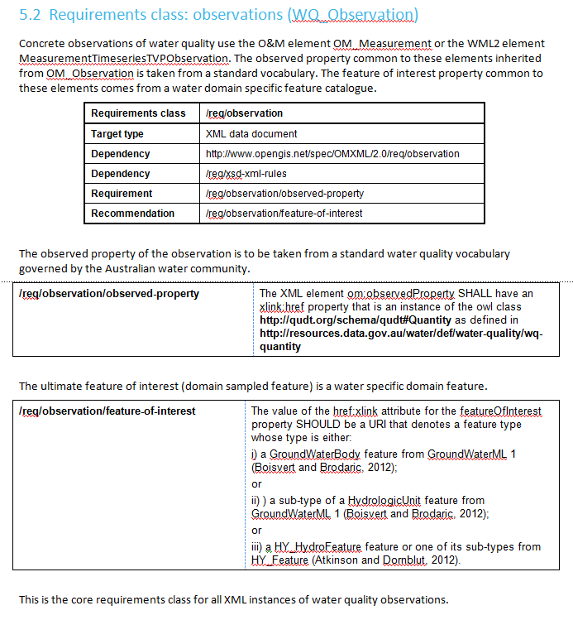
Requirements Classes (option 1)

Slide 6
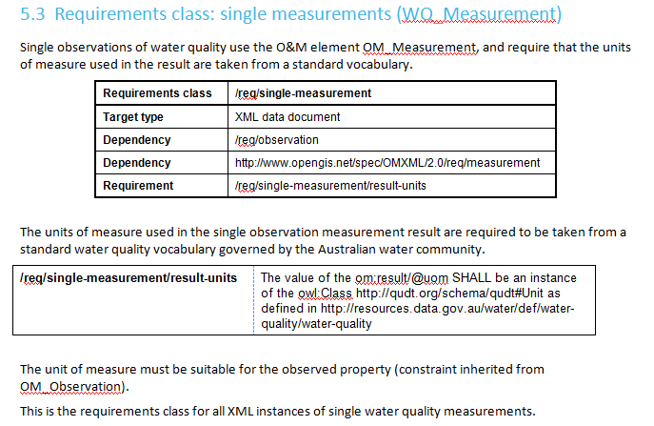
Requirements Classes (option 2)

Slide 7
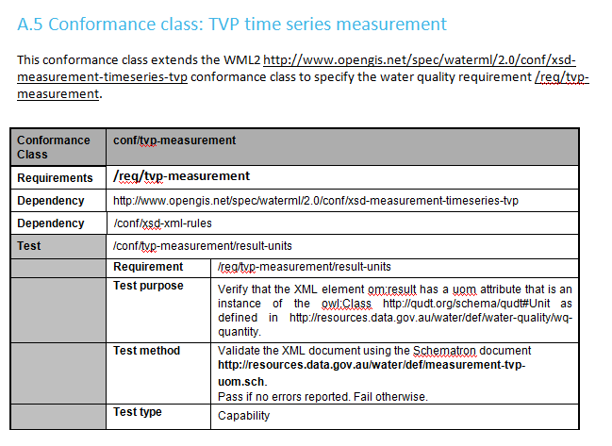
Conformance Classes

Slide 8
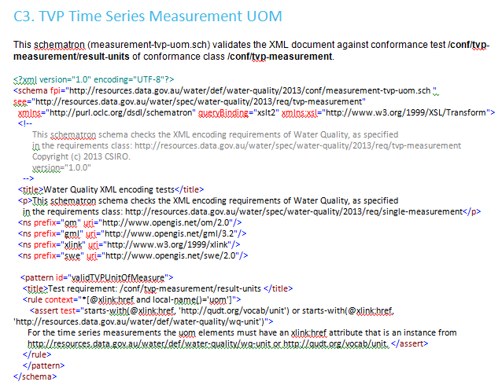
Schematron

Slide 9
Water Quality observable property vocabulary
Observable property model as a formal ontology based on
OGC O&M v1.0 (Cox, 2007)
QUDT v1.1 (Hodgson and Keller, 2011)
Content from various Australian and international projects
Analytes linked to Chemical Entities of Biological Interest (ChEBI) ontology
Simons, B.A, Yu, J. and Cox, S.J.D., (2013) Water Quality vocabularies for the Bioregional Assessment Framework.
Water for a Healthy Country Flagship Report series ISSN: 1835-095X

Slide 10
Water Quality observable property vocabulary
Simon Cox
Land and Water
Notes:
I have successfully remained peripheral to most of the OneGeology activity, so most of what I’ll cover comes from various presentations by Ian Jackson, the Executive Secretary of OneGeology.
I’ll also aim to touch on GeoSciML, something I am much more familiar with.

Slide 11
Water Quality observable property vocabulary
Observable property model as a formal ontology based on
OGC O&M v1.0 (Cox, 2007)
QUDT v1.1 (Hodgson and Keller, 2011)
Content from various Australian and international projects
Analytes linked to Chemical Entities of Biological Interest (ChEBI) ontology
Simons, B.A, Yu, J. and Cox, S.J.D., (2013) Water Quality vocabularies for the Bioregional Assessment Framework.
Water for a Healthy Country Flagship Report series ISSN: 1835-095X

Slide 12
Healthy Headwaters Terms
cas_rn number | Number of tests | Units_used | ANGDTS Code | ANGDTS Description | WDTF Parameter | chemical name | ADWG name | IUPAC name | Group |  | Comments
EC | 267621 | us/cm (256639), ms/cm (10948), mg/L (25) | EC | ease at which conduction current can be caused to flow through material in microSiemens/centimetre | ElectricalConductivityAt25C_uScm | Electrical Conductivity |  |  | Conductivity |  | us/cs and ms/cm could all be MicroSiemens/cm, but temperature of measurement not recorded
PH | 104367 | pH units | pH | negative logarithm of hydrogen ion concentration in ph units | WaterpH_pH | pH | pH |  | pH, alkalinity, acidity
16887-00-6 | 90358 | mg/L (90357), mg/kg (1) | 16887-00-6 | concentration of chloride as Cl in milligrams/litre |  | Chloride |  | Chloride | Chloride | Anion | Halide
TDS | 89918 | mg/L | TDS | the portion of total solids that passes through filter and deemed to have been dissolved in sample in milligrams/litre |  | Total Dissolved Solids | Total Dissolved Solids |  | Salinity |  | Silica + Total Anions + Total Cations
TOTALALKALINITY | 89142 | mg/L | ALKT | concentration in milligrams/litre CaCO3 of titratable bases using a methyl-orange endpoint of about pH 4.3 |  | Total Alkalinity (as CaCO3) |  |  | pH, alkalinity, acidity
HARDNESS_CACO3 | 88044 | mg/L | HARD | the ability of water to precipitate soap and is sum of calcium and magnesium concentrations as milligrams/litre CaCO3 |  | Hardness (as CaCO3) | Hardness (as calcium carbonate) |  | Hardness (as calcium carbonate)
TDI | 87949 | mg/L |  |  |  | Total Dissolved Ions |  |  | Salinity |  | Total Anions + Total Cations
SAR | 80643 | Ratio | SAR | ratio of sodium to magnesium and calcium and used to assess risk of excess sodium in irrigation water |  | Sodium Adsorption Ratio |  |  | Salinity |  | SAR = [Na⁺] / {([Ca²⁺] + [Mg²⁺]) / 2}^{1/2}
3812-32-6 | 72329 | mg/L (72328), %MOL (1) | ALKC | alkalinity ascribed to carbonate in milligrams/litre CO3 |  | Carbonate Alkalinity (as CaCO3) |  | Carbonate | pH, alkalinity, acidity
NITRATE | 68072 | mg/L (68071), mg/kg (1) | 14797-55-8 | concentration of nitrate as N in milligrams/litre |  | Nitrate | Nitrate and Nitrite |  | Nitrate and Nitrite | Anion
7439-89-6 | 53215 | mg/L (53074), mg/kg (1), ug/L (140) | 7439-89-6 | concentration of iron as Fe in milligrams/litre |  | Iron |  | Iron | Metal | Cation | Transition metal

Slide 13
O&M V1 Annex C (cut-down version)

Slide 14
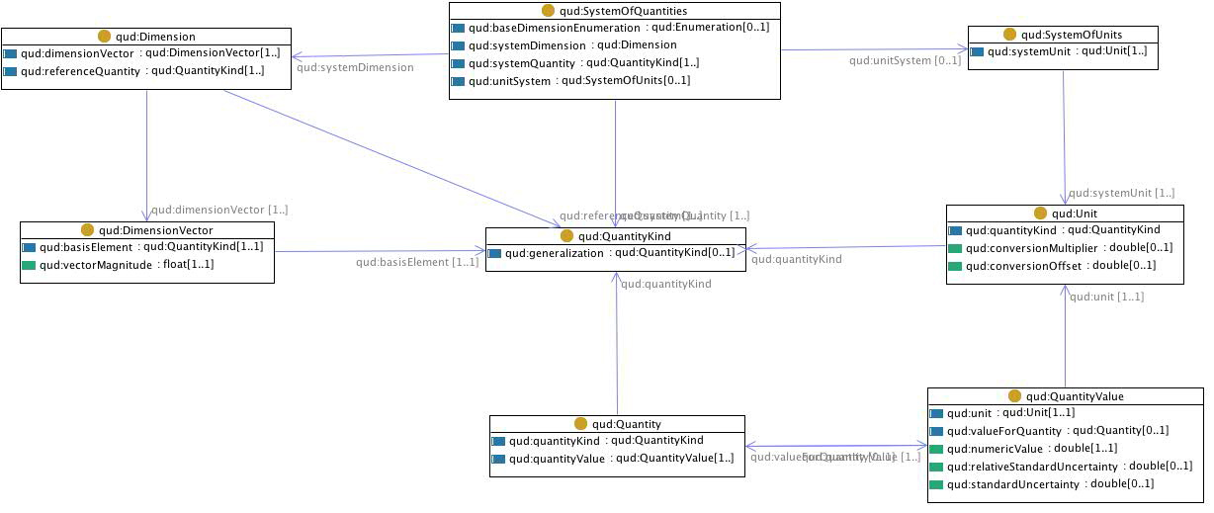
QUDT - QuantityKind, Unit, Quantity, QuantityValue, SystemOfUnits and SystemOfQuantities OWL classes
http://www.qudt.org/

Slide 15
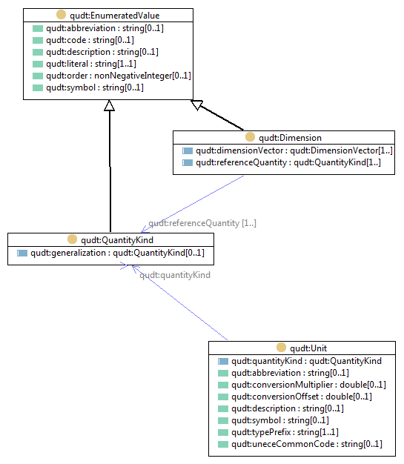
QUDT Core model

Slide 16
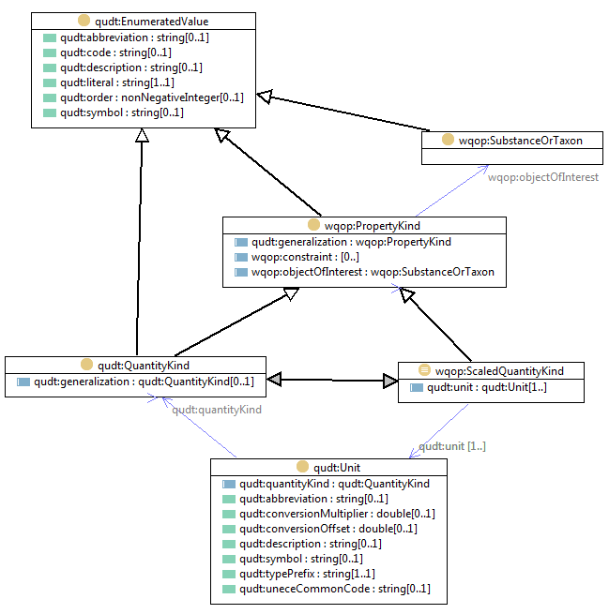
WQ extension to QUDT

Slide 17
Relationship between Water Quality (green), QUDT Unit (blue) and QUDT QuantityKind (tan) classes.

Slide 18
WQ dissolved Nitrogen concentration example

Slide 19
QUDT & WQ instances (Nitrogen and pH)

Slide 20
Associated dissolved nitrogen objects
qudt:unit
qudt:unit

Slide 21
Namespace:
wqo = [domain]/water/water-quality/wq-object
WQ imports
Namespace:
wq-chebi = [domain]/water/water-quality/wq-chebi_skos_mapping/
Subset of
IdentifiedObject
Concepts:
IdentifiedObject (wqo)
wq-objects.ttl
Namespace:
chebi-skos = [domain]/water/
water-quality/chebi-skos/
Namespace:
wq =[domain]/water/water-quality/wq/
wq-chebi_skos_
mapping.ttl
imports
into
imports
into
imports
into
imports into
imports
into
chebi_skos.ttl
water-quality.ttl
wq_obs_prop.ttl
imports
into
imports
into
Concepts:
ObservedProperty (wqq)
wq-unit.ttl
Namespaces:
wqi=[domain]/water/water-quality/wq-observed-property/wqo-instance/
wqq= =[domain]/water/water-quality/wq-observed-property/
wq-quantity-kind.ttl
Namespace:
wqu =[domain]/water/water-quality/wq-unit/
Namespace:
wqk=[domain]/water/water-quality/wq-quantity-kind/

Slide 22
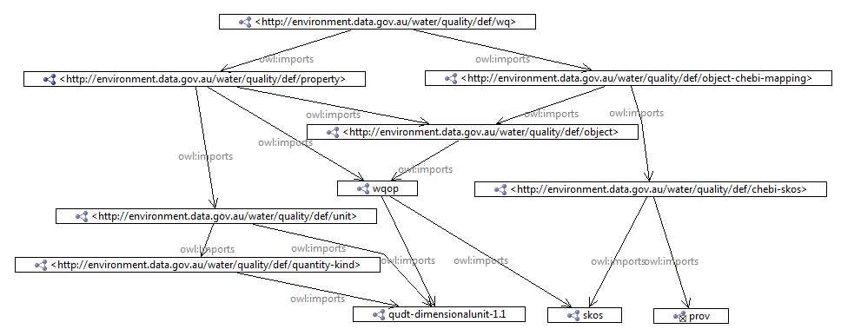
WQ Imports

Slide 23
QUDT ‘cleaning’ process
Add rdfs:subClassOf = skos:Concept
for qudt:QuantityKind, and qudt:Unit
Add rdfs:subPropertyOf
skos:semanticRelation for:
qudt:quantityKind and qudt:unit
Add Unit (wqu)
instances
remove skos:sematicRelation
properties
water-quality.ttl
imports
into
imports
into
qudt-owl-clean.ttl
wq-unit.ttl
qudt-skos.ttl
imports
into
QUDT Concepts used:
qudt:Unit
qudt:QuantityKind
qudt_owl.ttl
imports
into
imports
into
wq_obs_prop.ttl
imports
into
Removes semantic content resulting from links to dbpedia
export skos:semanticRelation
properties
Add water quality
ObservedProperty (wqi),
Add wqp:objectOfInterest property
wq-quantity_kind.ttl
qudt-dbpedia-annotations.rdf
qudt-skos-properties.rdf
Add QuantityKind (wqk)
instances
convert skos:semanticRelation
properties to rdfs:seeAlso properties

Slide 24
ChEBI to SKOS process
manually create
owl:equivalentClass
statements
transforms
wq-owl.ttl
imports
into
chebi.owl
imports
into
skos:Concept
to owl:Class
wq-objects.ttl
wq_owl-chebi-
mapping.ttl
transforms
owl:equivalentClass
to skos:exactMatch
transform owl:Class
to skos:Concept
Add prov:hadPrimarySource
Subset of
IdentifiedObjects
imports
into
imports
into
imports
into
wq-chebi_skos_
mapping.ttl
chebi_skos.ttl
wq_obs_prop.ttl

Slide 25
Water Quality observable property vocabulary
Observable property model as a formal ontology based on
OGC O&M v1.0 (Cox, 2007)
QUDT v1.1 (Hodgson and Keller, 2011)
Specifies the relationships between
measurable water quality properties
measurement types
permissible units-of-measure
Content from
Healthy Headwaters,
Australian National Groundwater Data Transfer Standard
CUAHSI Hydrologic Information System terms;
Analytes linked to Chemical Entities of Biological Interest (ChEBI) ontology
Units of measure linked to QUDT v1.1
Simons, B.A, Yu, J. and Cox, S.J.D., (2013) Water Quality vocabularies for the Bioregional Assessment Framework.
Water for a Healthy Country Flagship Report series ISSN: 1835-095X

Slide 26
Thank you
Environmental Information Systems
Simon Cox
t +61 3 9252 6342
e simon.cox@csiro.au
w www.csiro.au/science/Environmental-Information-Systems
Land and Water

